Slide 1
SWBAT identify ways in which oil spills affect birds. Do Now: What is the difference between quantitative and qualitative data? Give an example of a lab from this year where you recorded each type of data.
ES Unit 11 5/17/16
Lesson 3

Slide 2
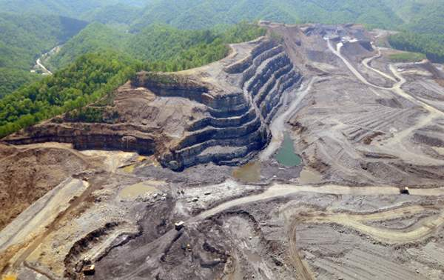
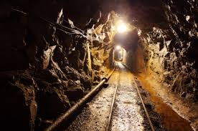
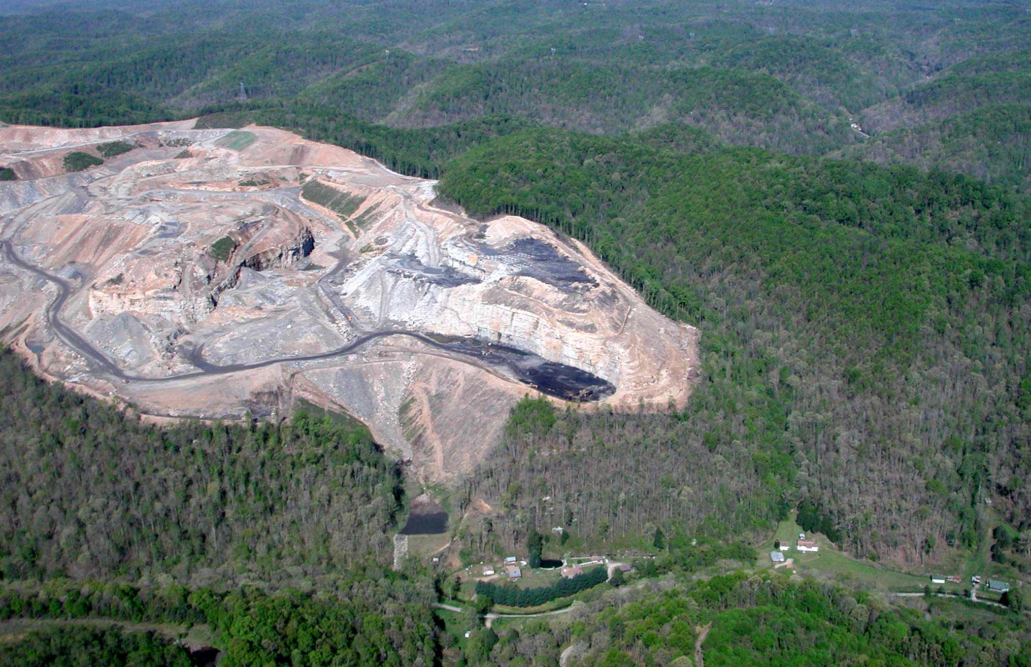
Coal Mining Homework

Slide 3
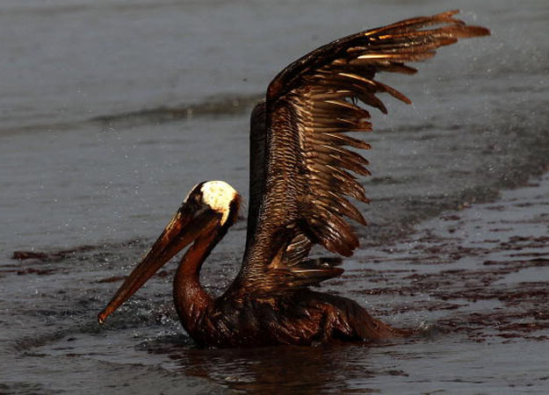
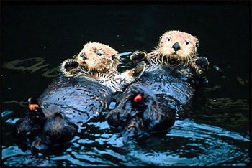
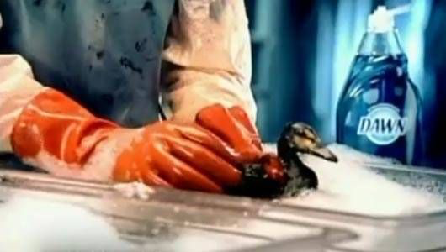
No Water Off a Duck’s Back

Slide 4
Lab
Person closest to the aisle grab a cup of dish soap
Person closest to the countertop grab a cup of oil and a cup of water
One person each to pass out:
Feathers
Toothbrush
Paper towel
Always set the feather on TOP of the paper towel!

Slide 5
Clean Up
Throw all paper towels in the garbage
Wipe off tooth brush
Place all cups on the back on the countertop where you found them

