Slide 1
SWBAT identify the advantages and disadvantages of coal and natural gas. Do Now: What are the three types of fossil fuels? Why are they considered nonrenewable sources of energy?
ES Unit 11 5/16/16
Lesson 2

Slide 2
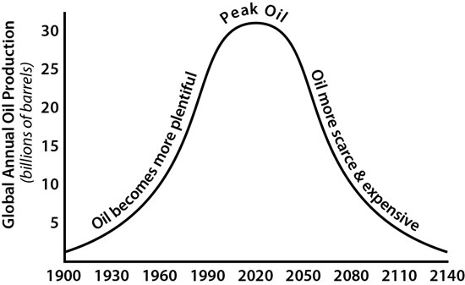
Peak Oil
The point at which half of all the world’s supply of oil has been extracted
Oil use will have to decline

Slide 3
Agenda
Lecture
Reading
Video (if time)

Slide 4
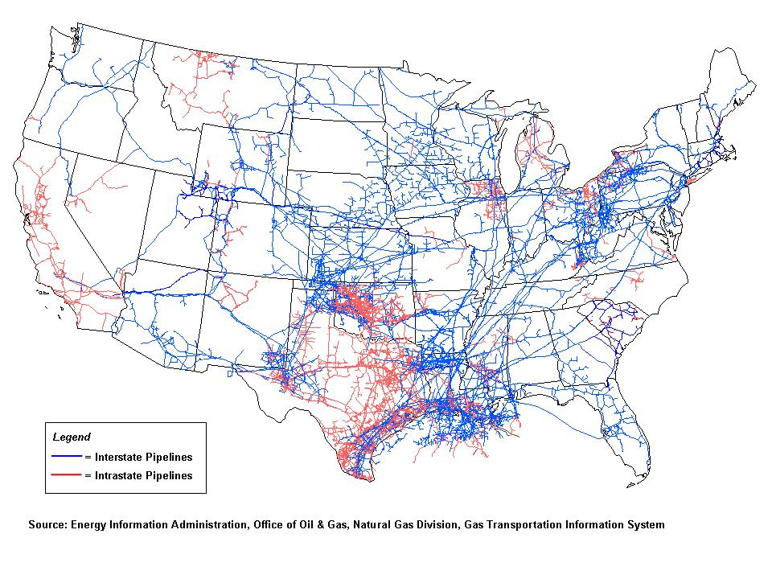
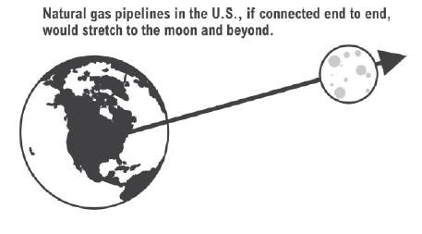
Natural Gas in the U.S.
Produced in 32 states
Scientists estimate we have enough natural gas to last us about 100 years.

Slide 5
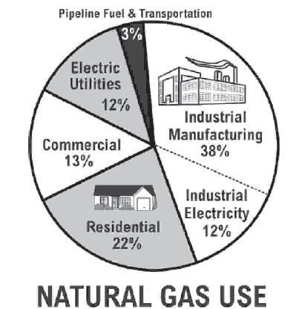
Natural Gas Use
Largest user: Industrial manufacturing burns natural gas for heat to make goods.

Slide 6
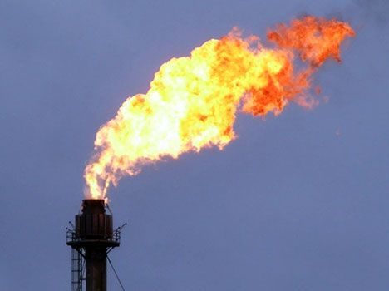
Impact on the Environment
Pros: Natural gas is the cleanest burning fossil fuel
Releases less CO₂, Ash, and Sulfur than coal and oil.
Cons: Methane can be emitted into the air from leaks.

Slide 7
Stop and Think
Do you think the pros of natural gas outweigh the cons in terms of affect on the environment? Why or why not?

Slide 8
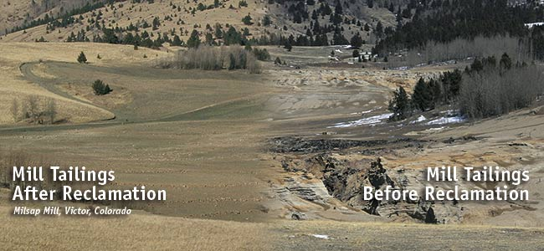
Coal Vocab:
Mine Reclamation: the process of restoring land that has been mined to a natural or economically usable state.

Slide 9
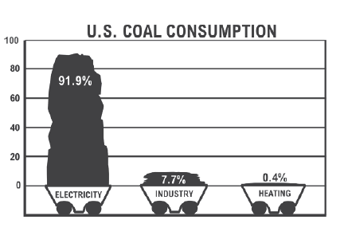
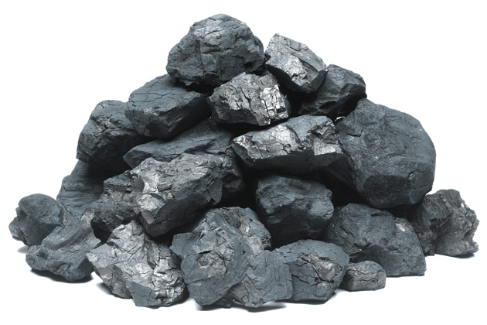
Coal
Top coal users:
China
U.S.
India
92% of coal consumed in the U.S. goes to producing electricity.

Slide 10
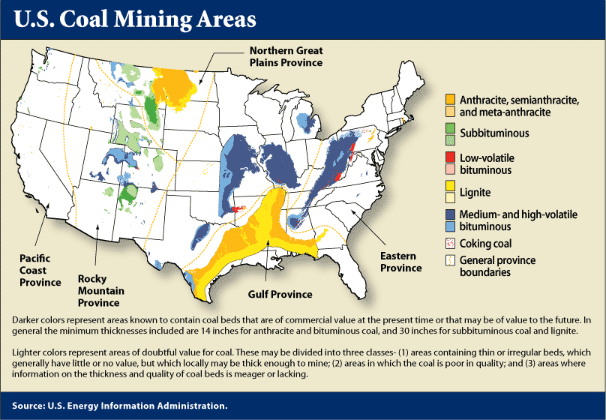

Slide 11
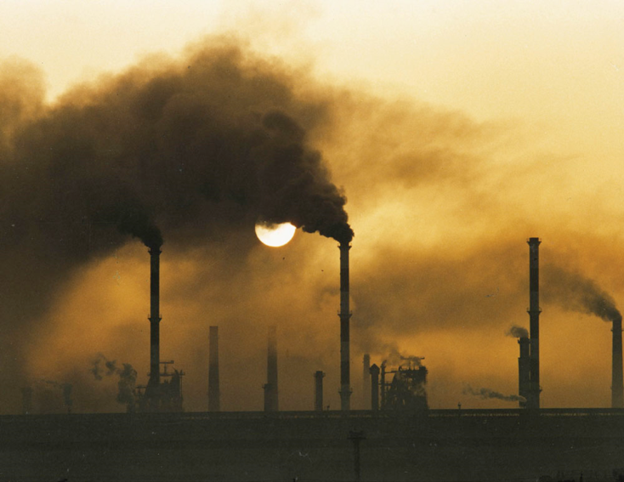
Coal is plentiful but dirty
Environmental costs of burning coal:
Sulfur released as SO₂
Large amounts of soot
CO₂
Small amounts of mercury and radioactive material

Slide 12
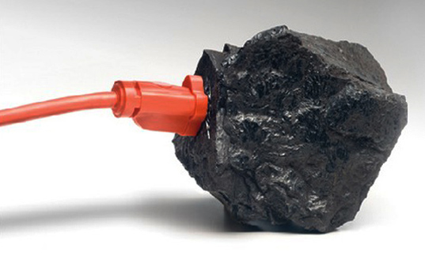
Coal Advantages
Large supplies in many countries
High net energy yield
Low cost when environmental costs are not included

Slide 13
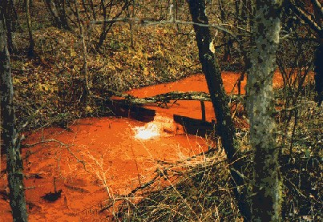
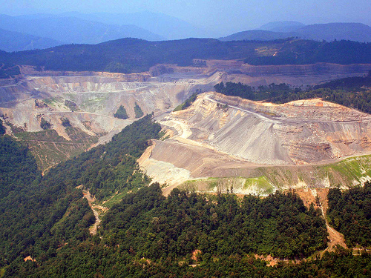
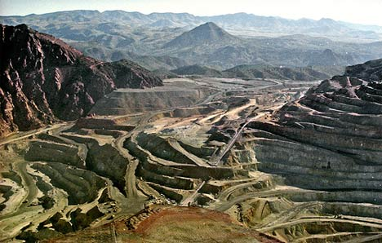
Disadvantages of Coal
Land disturbance and water pollution
Emissions harm human health
Emits large amounts of CO₂

Slide 14
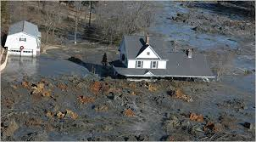
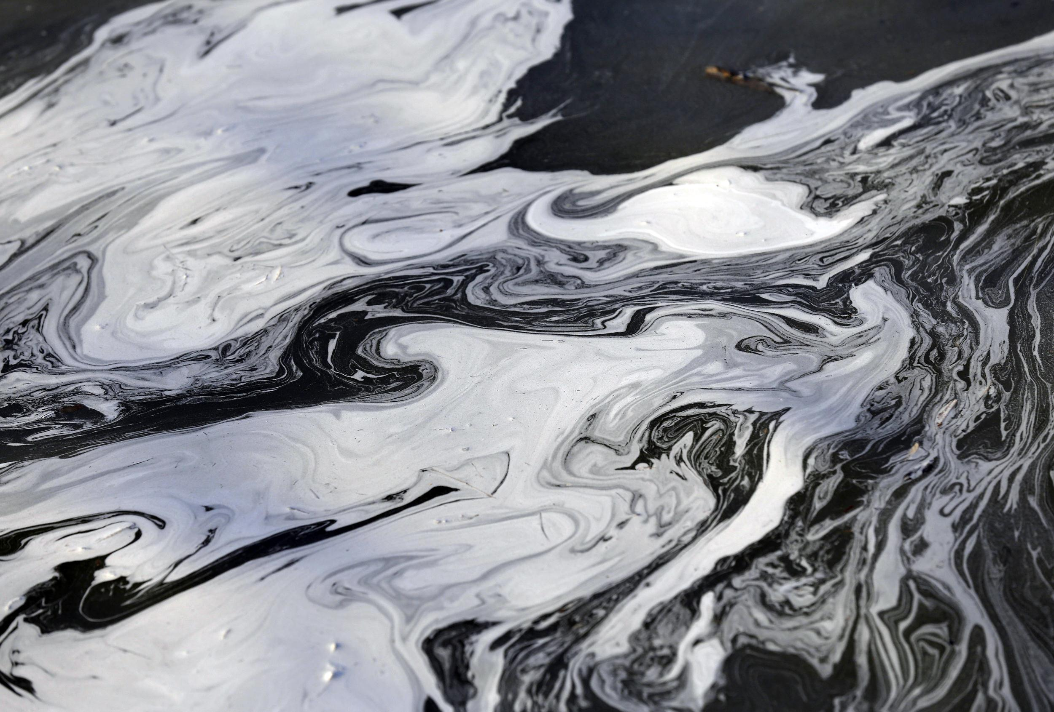
Case Study: The Problem of Coal Ash
Highly toxic
Arsenic, cadmium, chromium, lead, mercury
Most is buried or put in ponds
This contaminates ground water
Should be classified as hazardous waste

Slide 15
Video:
https://e360.yale.edu/digest/mountaintop_removal_coal_mining_has_slowed_significantly_data_show/4478/

Slide 16
Let’s Review!

