Slide 1
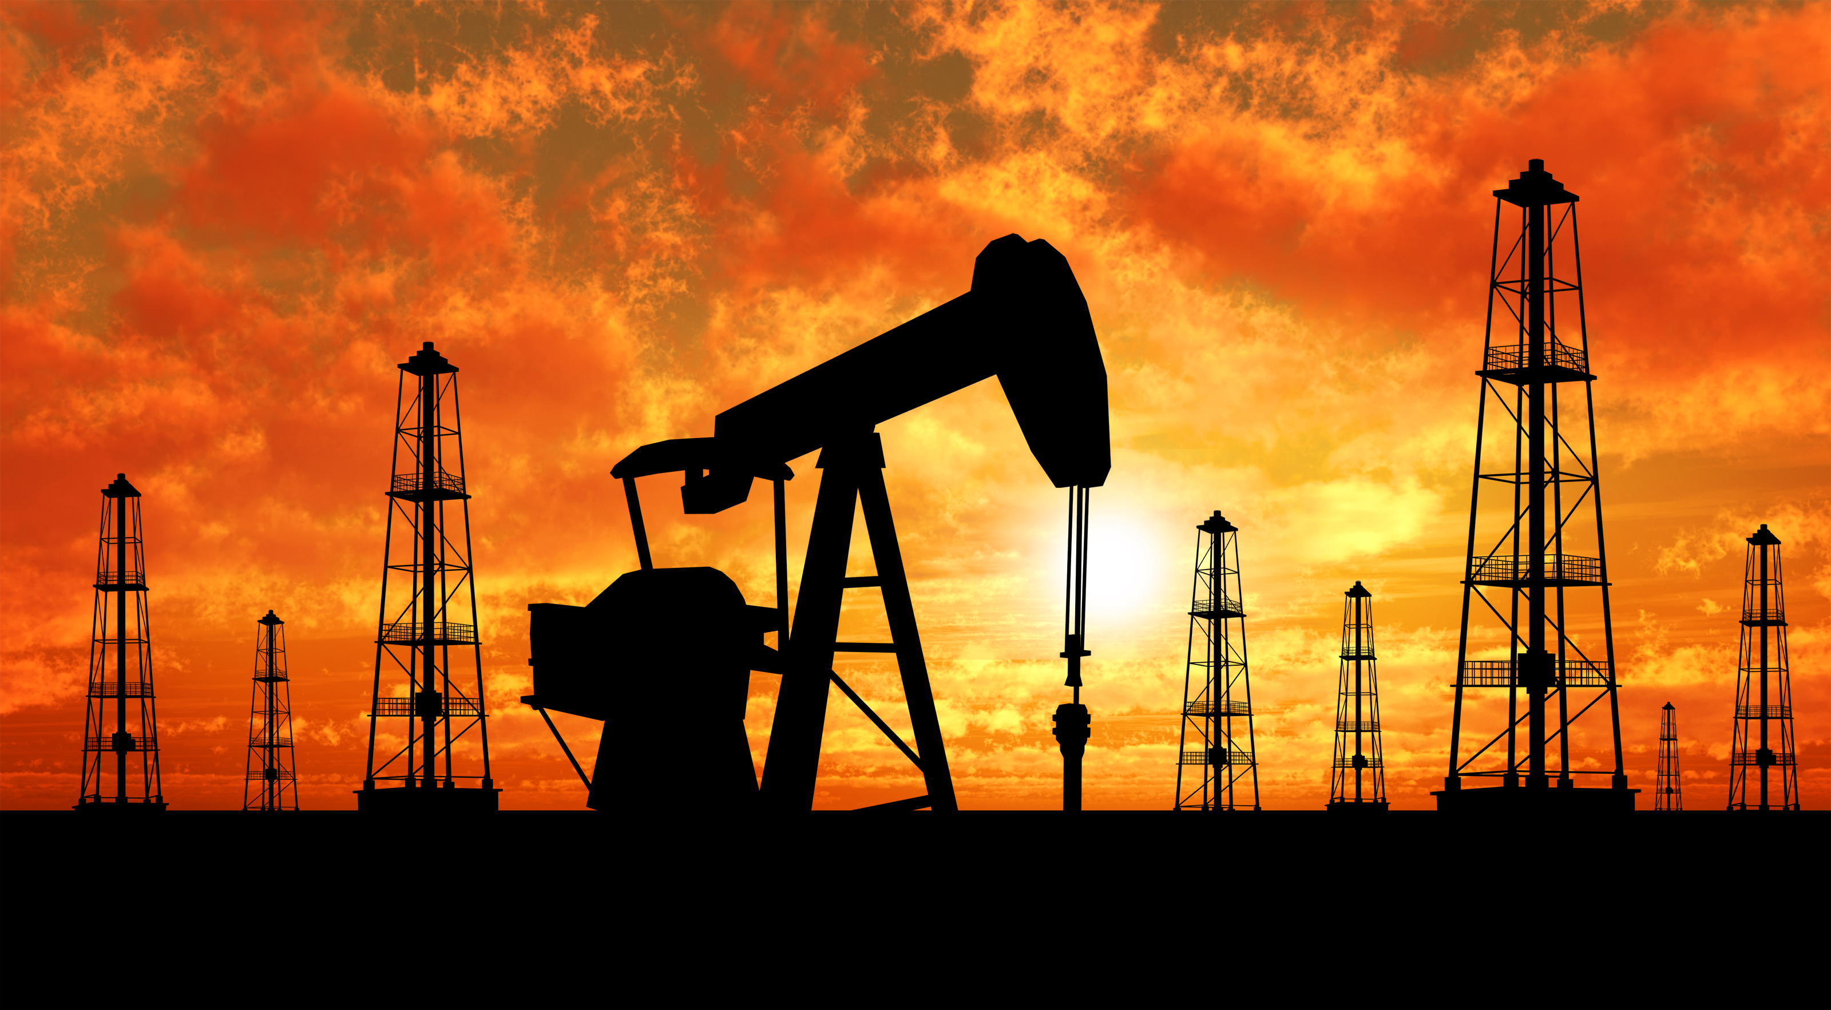
SWBAT identify the advantages and disadvantages of using oil as an energy source. Do Now: Know Want to Know
ES Unit 11 5/13/16
Lesson 1

Slide 2
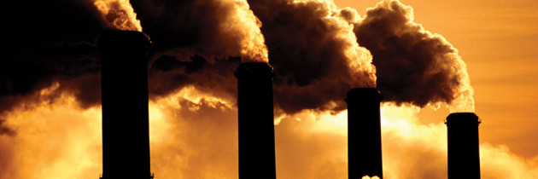
Unit 11: Energy
Fossil Fuels
Nuclear energy
Renewable energy
~2 weeks
Why is energy important?
How are fossil fuels contributing to the increase of greenhouse gases in the atmosphere?
Could alternative energy sources replace fossil fuels?

Slide 3
Agenda
Lecture
Video
Reading
Exit Ticket

Slide 4
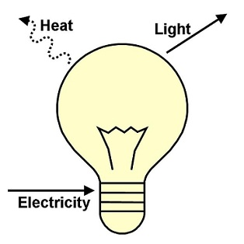
Energy
1st law of thermodynamics: Energy can neither be created nor destroyed.
2nd law of thermodynamics: Energy tends to go from a more usable (higher quality) to a less usable (lower quality) form.

Slide 5
Fossil Fuels
Forms of stored solar energy: oil, natural gas, coal
Plants convert solar energy to chemical energy
Provide 90% of energy consumed worldwide

Slide 6
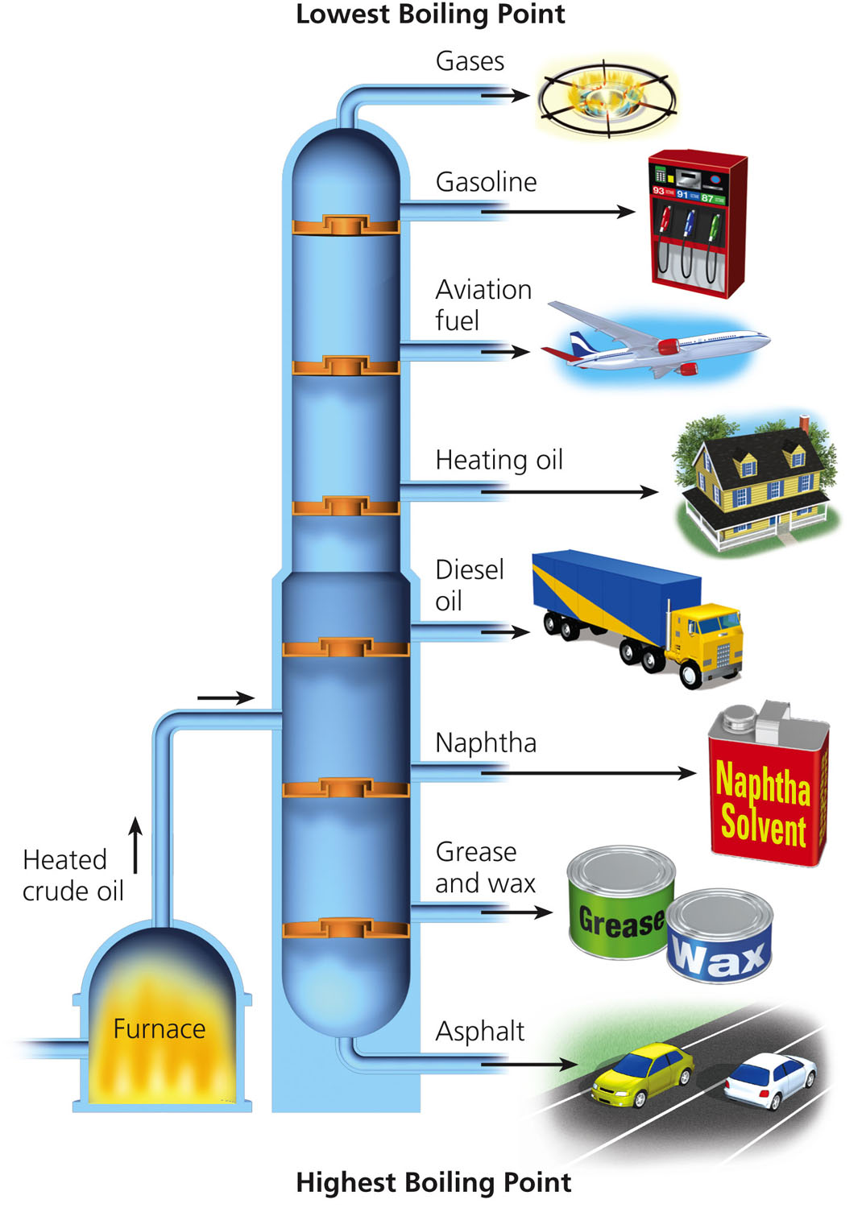
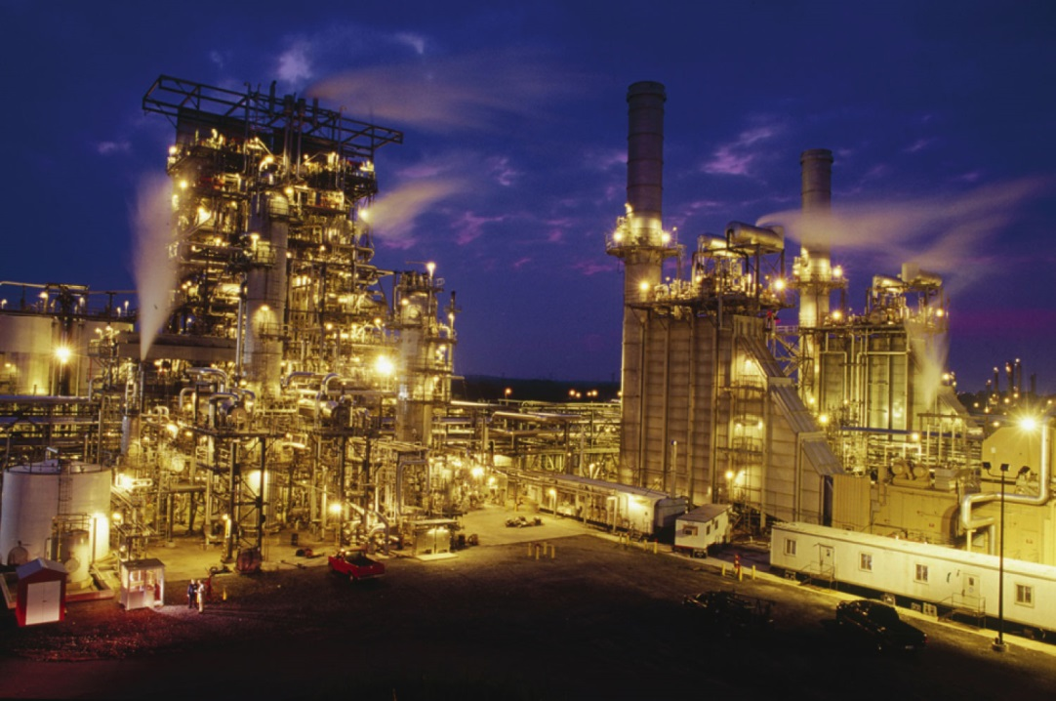
Refining Crude Oil

Slide 7
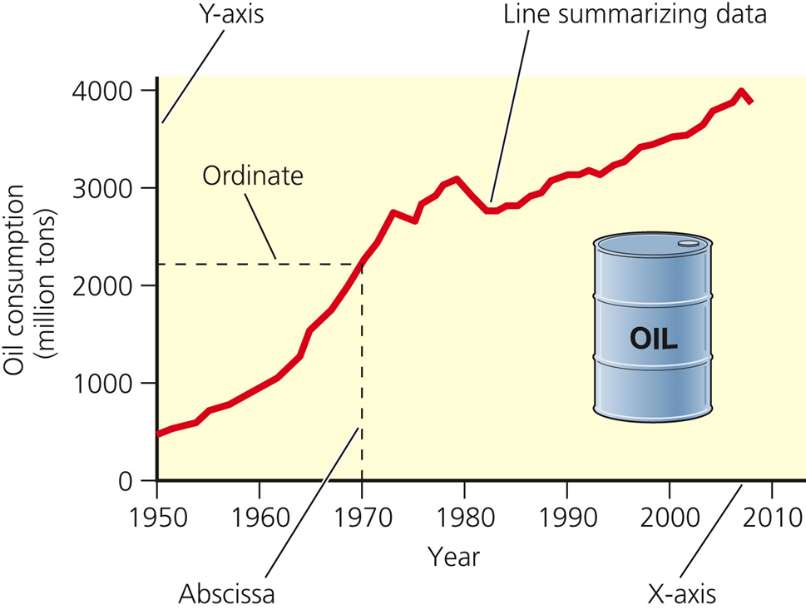
How long will supplies last?
1.6 trillion barrels of conventional oil
80% depleted between 2050 and 2100

Slide 8
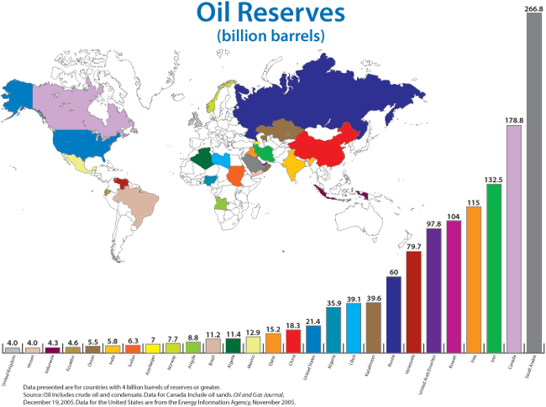

Slide 9
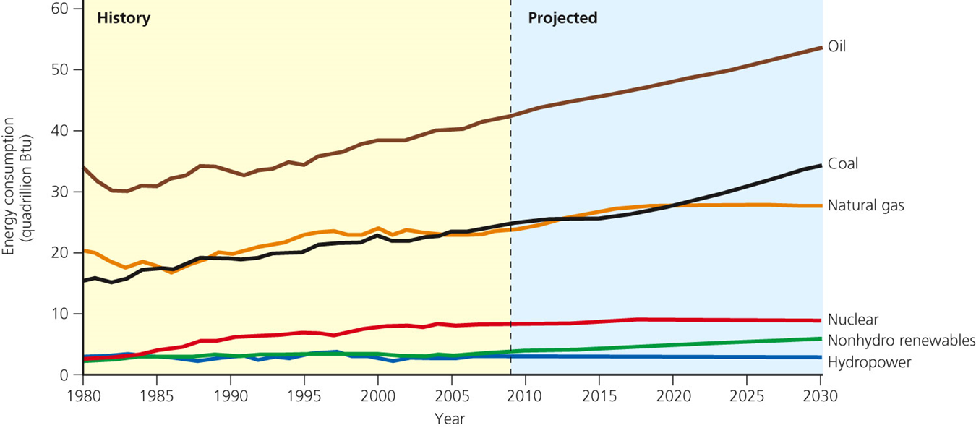
U.S. oil consumption
Have 1.5% of the world’s oil reserves
Use 23% of the world’s total

Slide 10
Advantages of Oil
Plentiful supply
High net energy yield
Easy to distribute and transport
Easier to extract from the ground than coal

Slide 11
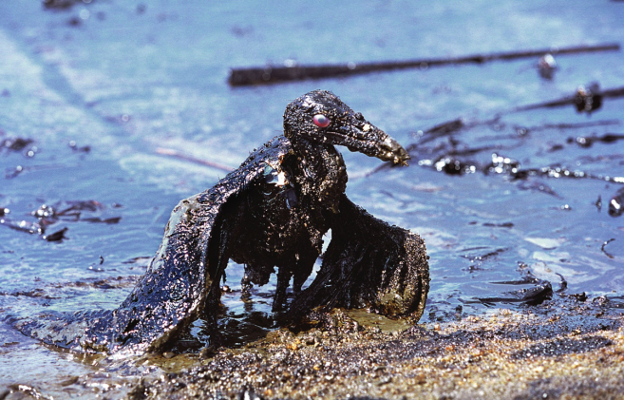
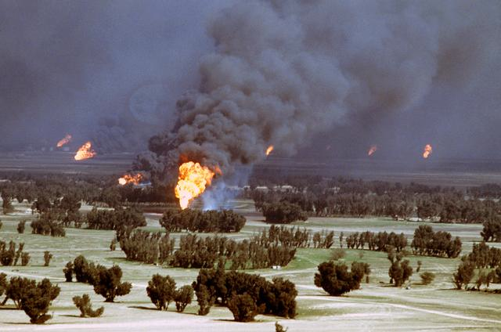
Disadvantages of Oil
Water pollution from oil spills and leaks
Releases CO₂ and other pollutants when burned
Oil supplies can be interrupted with international conflicts

Slide 12
Video
https://vimeo.com/22655744

Slide 13
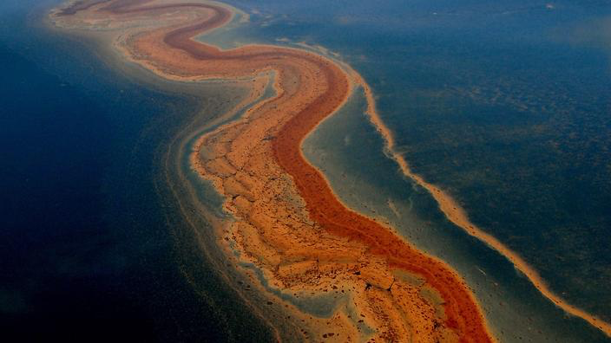
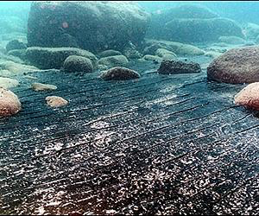
B.P. Oil Spill

Slide 14
Exit Ticket
Do the advantages of oil outweigh the disadvantages? Why or why not?

