Slide 1
SWBAT identify and describe the effects of the major types of chemical toxins. Do Now: Do you believe the U.S. has a culture of consumption (using and buying of goods) contributes to the amount of waste we produce or do you think it’s our wealth as a nation? Why?
ES Unit 10 5/10/16
Lesson 8

Slide 2
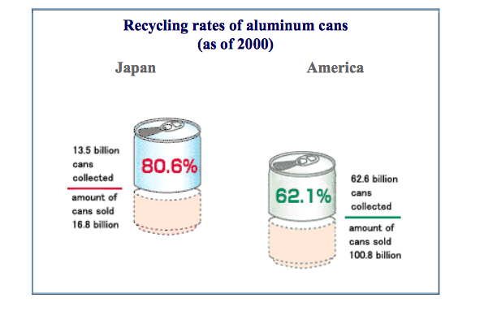
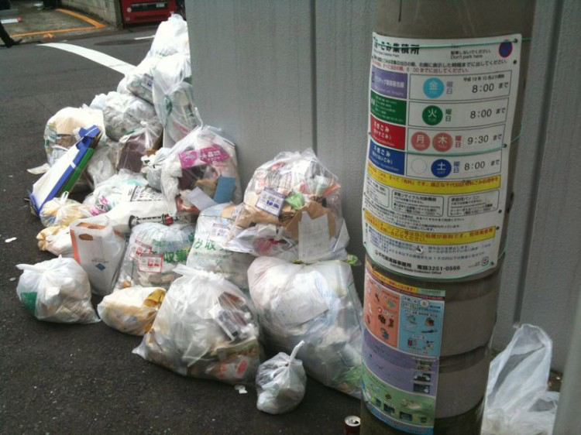
Case Study: Trash Use in Japan

Slide 3
Announcements!
Friday is the last day to turn in any late reusing trash projects!!
Agenda:
Webquest
Video

Slide 4
Toxicology Webquest
Use ipads to find answers to the questions!
Write down the sources you used!

Slide 5
Homework
Research an eco-friendly brand of make up and write one paragraph explaining what kind of makeup they sell, the approximate cost and why it is better than conventional makeup.
Complete any late work for this unit!

