Slide 1
SWBAT understand the threat of toxic pollutants to human health by studying the Love Canal case. Do Now: In your own words, what is environmental justice?
ES Unit 10 5/9/16
Lesson 7

Slide 2
Agenda
Reading
Video
Exit Ticket/Wrap up

Slide 3
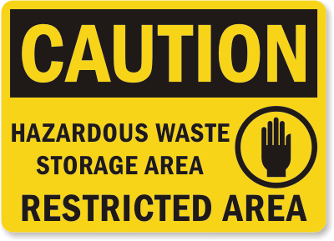
Hazardous Waste
Waste that is dangerous or potentially harmful to our health or the environment.
Examples of Hazardous Waste:
Pesticides (ant and roach killer)
Paints
Car battery acid
Acetone (nail polish remover)
Hair coloring
Bleach

Slide 4
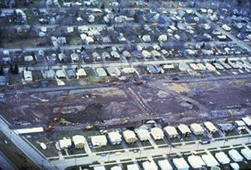
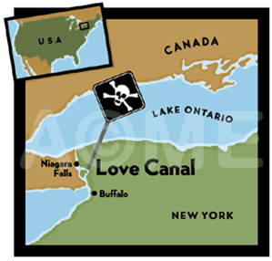
Love Canal

Slide 5
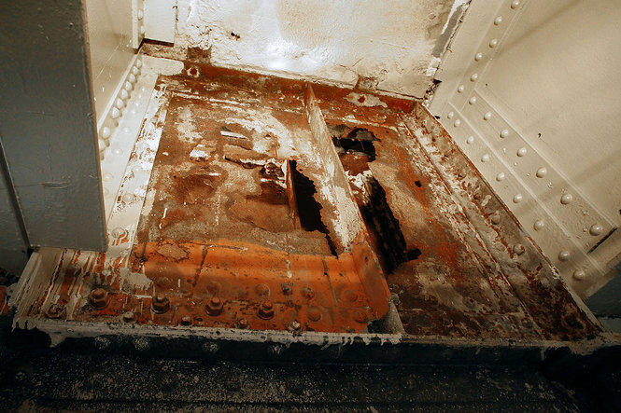

Slide 6
Love Canal Video
http://www.nytimes.com/video/us/100000002566509/love-canal-a-legacy-of-doubt.html

Slide 7
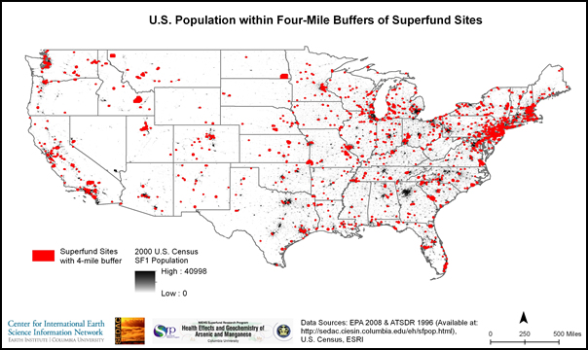
Superfund Sites
Superfund site: An uncontrolled or abandoned place where hazardous waste is located.

Slide 8
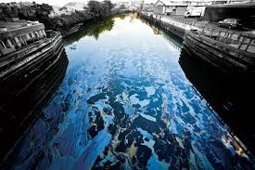
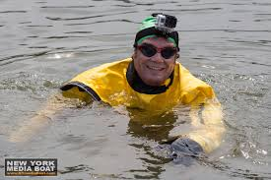
Superfund Sites in New York
Gowanus Canal in Brooklyn

Slide 9
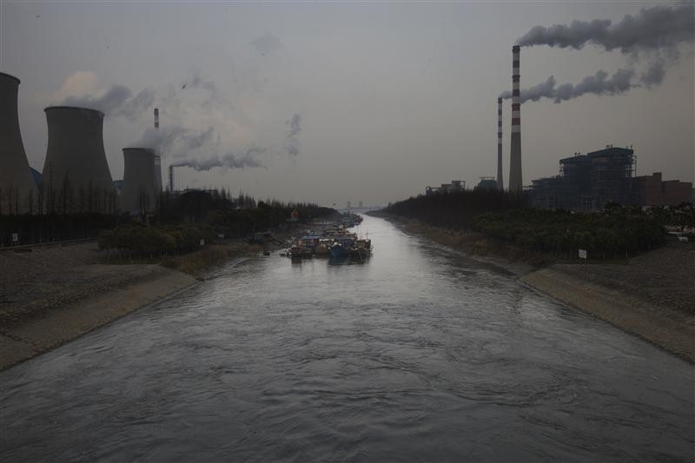
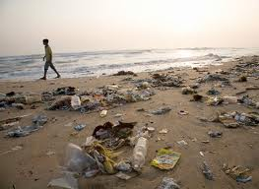
Critical Thinking
How do you think superfund sites relates to the concept of tragedy of the commons?

Slide 10
Exit Ticket
Describe the Love Canal tragedy in your own words

