Slide 1
SWBAT define and analyze examples of environmental justice. Do Now: What are two environmental benefits of recycling? What is one way we could encourage people to recycle more?
ES Unit 10 5/6/16
Lesson 6

Slide 2
Agenda
Jigsaw Reading
Discussion

Slide 3
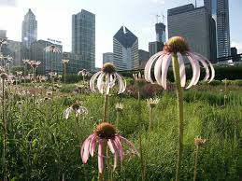
Environmental Justice
The concept that all people – regardless of their race, color, nation or income – are able to enjoy equally high levels of environmental protection.

Slide 4
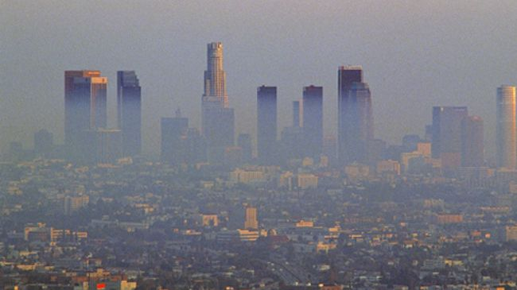
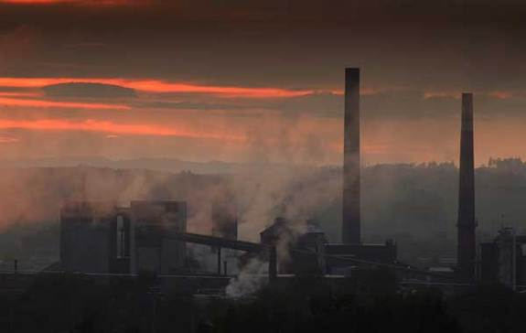
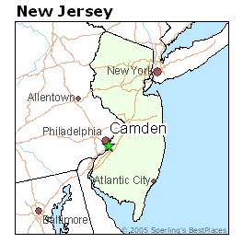
Environmental Justice Jigsaw

Slide 5
Environmental Justice Jigsaw
Expert Groups:
Read the article and answer the questions
Check your answers to the questions with members at your group
Jigsaw Groups:
Teach your fellow members about your article
Take notes on your group member’s articles
Collaborate with group members to answer the questions

Slide 6
Discussion:
Why do you think factories, landfills, and wastewater treatment plants are more commonly located in low income communities?
What role do you think the government should have to ensure that environmental justice occurs?

Slide 7
Environmental Justice
Can you think of any environmental justice examples in you’ve seen in New York?

Slide 8
Homework
Do your reusing project!

