Slide 1
SWBAT identify ways in which recycling reduces the amount of garbage produced. Do Now: On a daily basis, how often do you recycle? Which item do you recycle the most (i.e. bottles, paper)?
ES Unit 10 5/5/16
Lesson 5

Slide 2
Agenda
Mini-lecture
Videos
Pass Back Unit 9 Exams
Trash re-using project

Slide 3
Recycling Quiz!
Skip Question #9

Slide 4
Why Recycle?
Trash avoids landfills
Saves resources
Saves energy
Creates Jobs

Slide 5
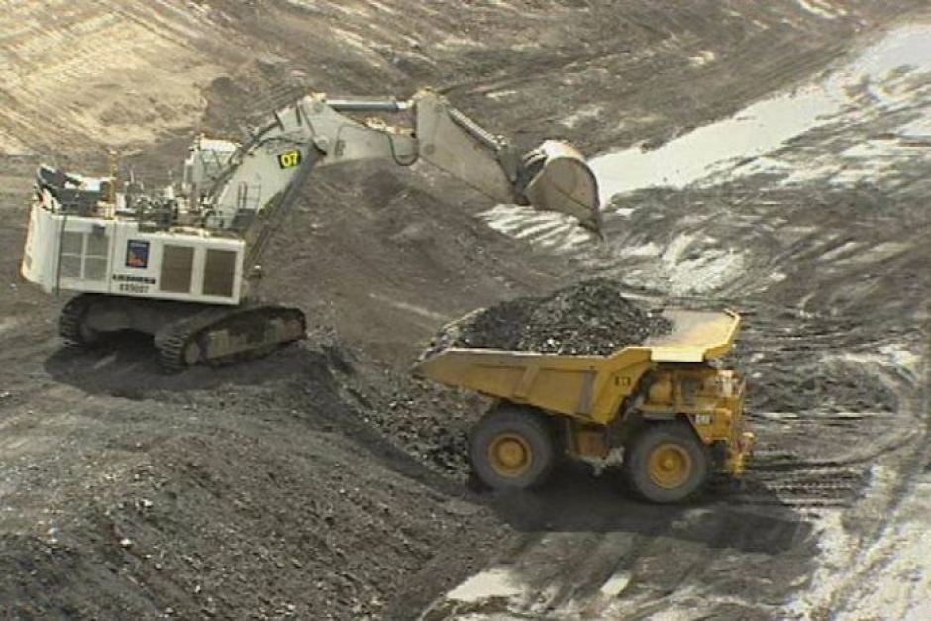
Why Recycle?
Prevents Pollution
Avoids environmental damage:
Mine for minerals
Drill for petroleum
Cut down trees

Slide 6
Turn and Talk
With your group, make a list of everything you know that is recyclable and everything that you know isn’t

Slide 7
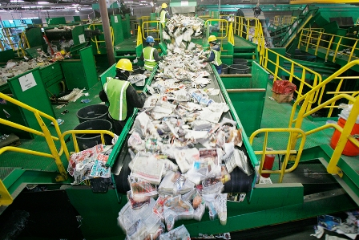
What is recyclable?
Paper
Newspaper, magazines
White and colored paper
Paper bags
Wrapping paper
Paper cups (must be clean)
Cardboard

Slide 8
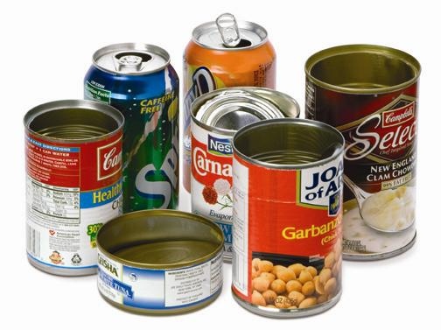
What is recyclable?
Metal
Metal cans
Aluminum foil (without food!)
Glass
Bottles and jars

Slide 9
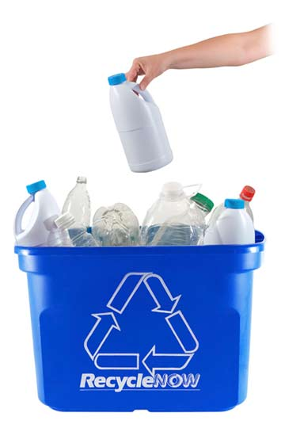
What is recyclable?
Plastic
Bottles and jars
Rigid food containers (yogurt and hummus containers)

Slide 10
True or False?
You can recycle plastic with food in it

Slide 11
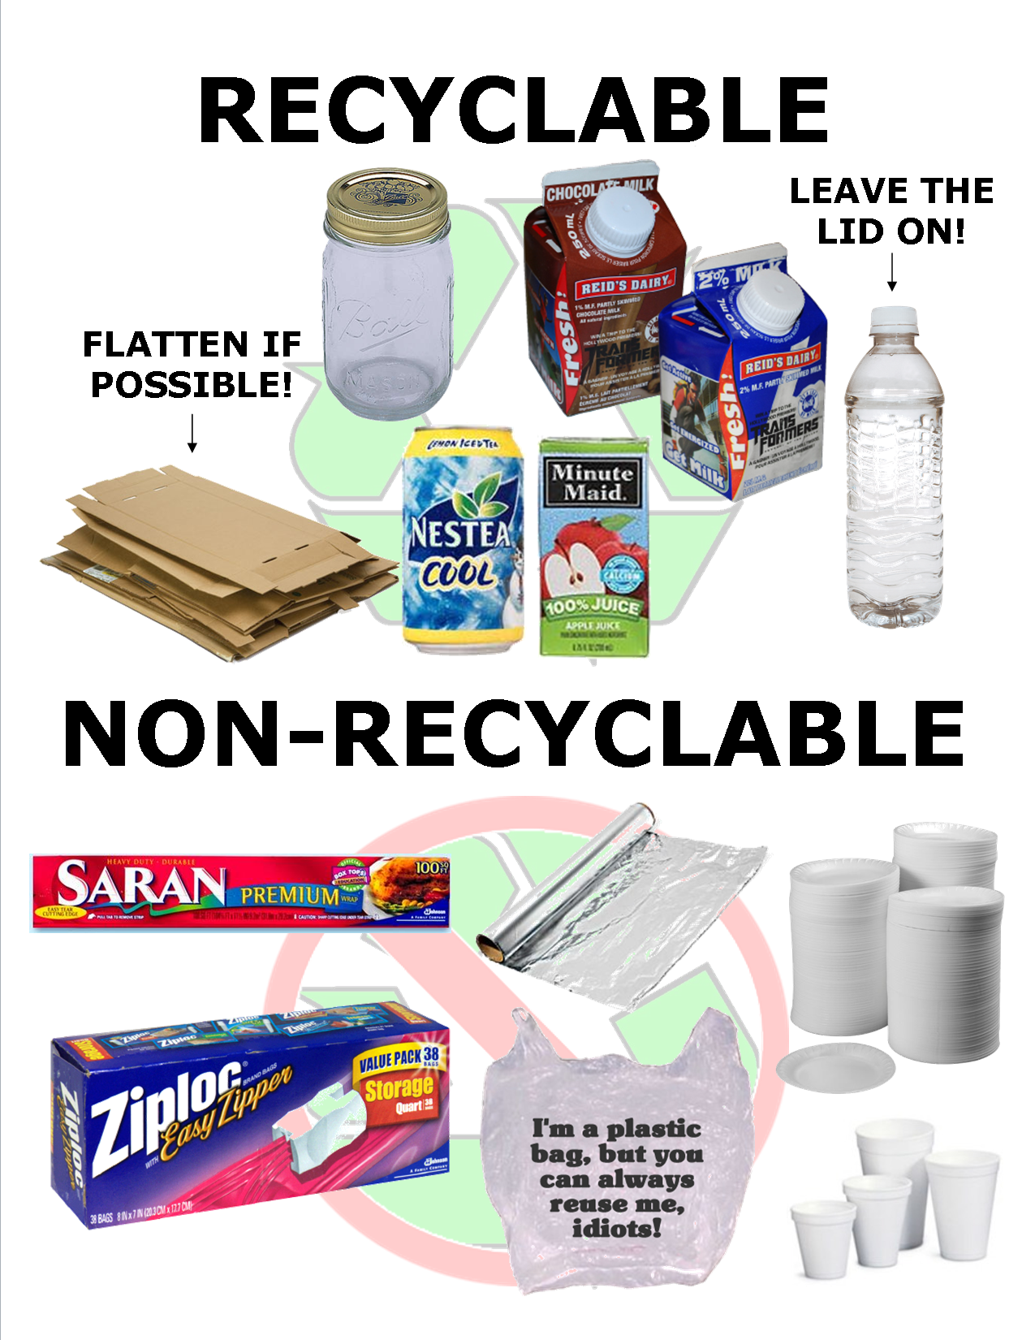
What is NOT recyclable?
Plastic bags
Sponges
Diapers
Napkins/paper towels
Styrofoam
Paper soiled with plastic or food

Slide 12
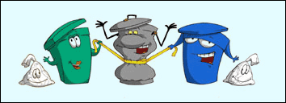
Recycling and NYC
NYC residents recycle 17% of total waste
Only HALF of what we could be recycling

Slide 13
Inside a Recycling Plant

Slide 14
Japan Trash Video
Do you think the same “zero-waste” program could work in the U.S.? Could it become the norm? why or why not?
What sort of incentives do you think we would need to offer people in order to implement this in the U.S.?

Slide 15
Unit 9 Exam Notes
CO₂ is not a part of smog
NO_{x}, SO₂, CO are!!
Acid rain doesn’t cause Eutrophication

