Slide 1
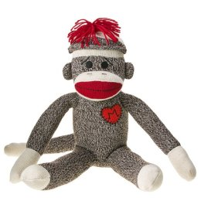
SWBAT identify how trash items can be reused. Do Now: Is there anything that you would consider to be trash that you reuse regularly?
ES Unit 10 5/4/16
Lesson 4

Slide 2
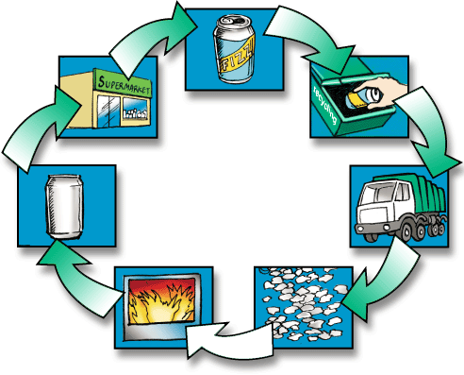
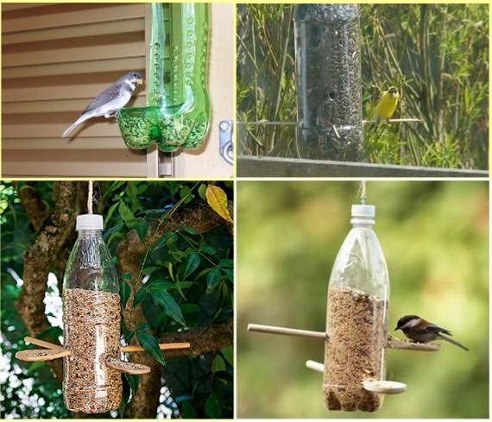
Reuse vs. Recycle
Recycle: processing used materials (waste) into new products.
Reuse: Product is put to another use.

Slide 3
Reuse vs. Recycle
Which is better? Why?

Slide 4
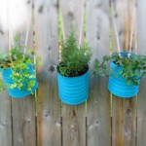
How can we reuse?
Glass bottle
Cloth Napkins
Soup can

Slide 5
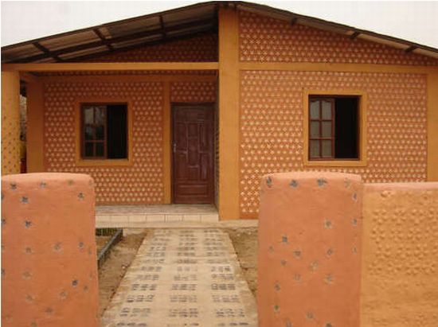
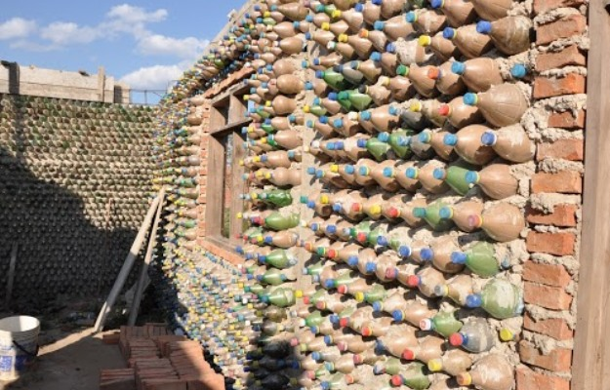
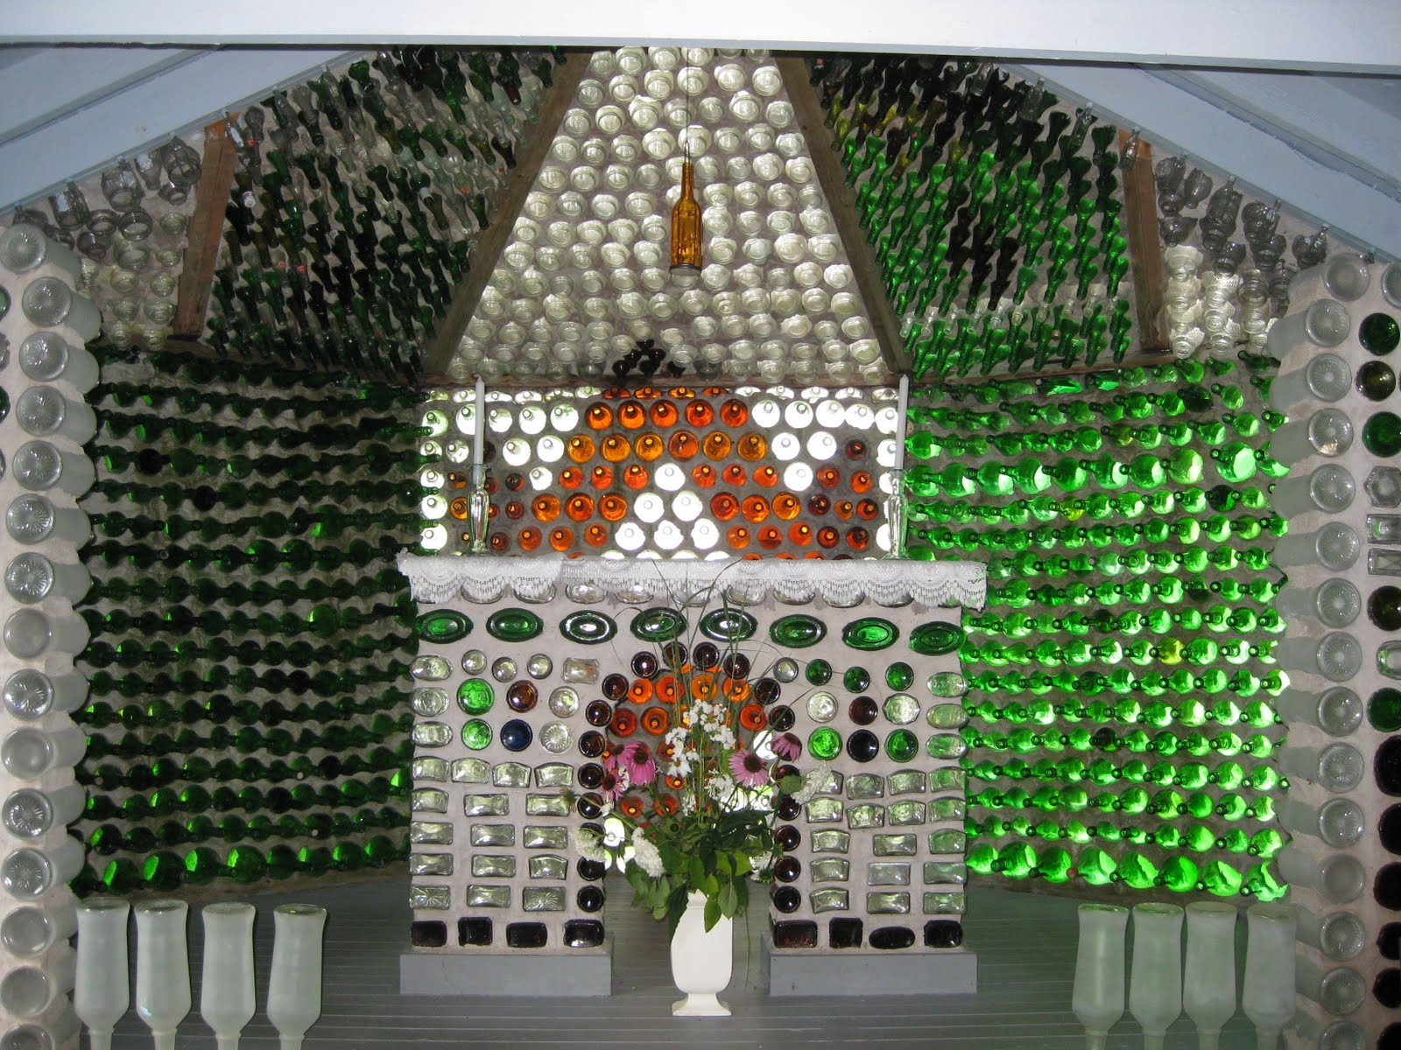
Bottle Houses

Slide 6
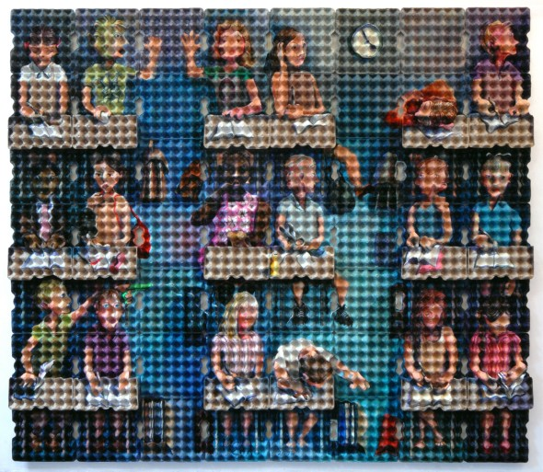
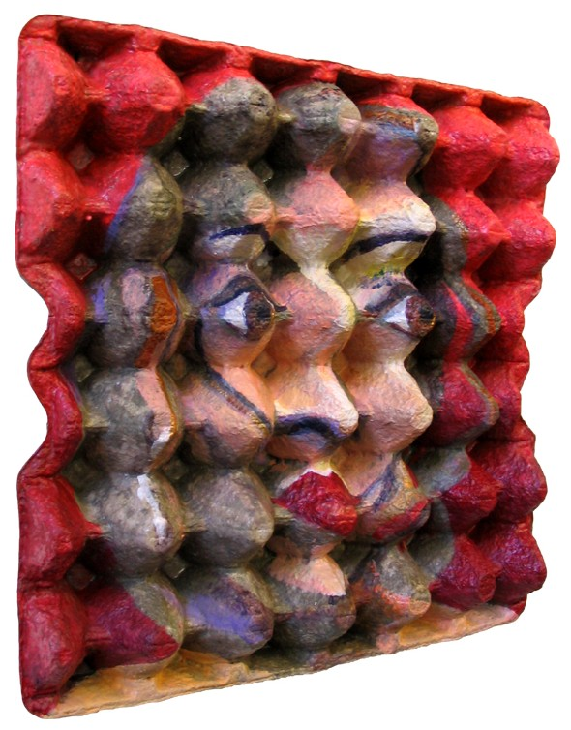
Reusing for Art

Slide 7
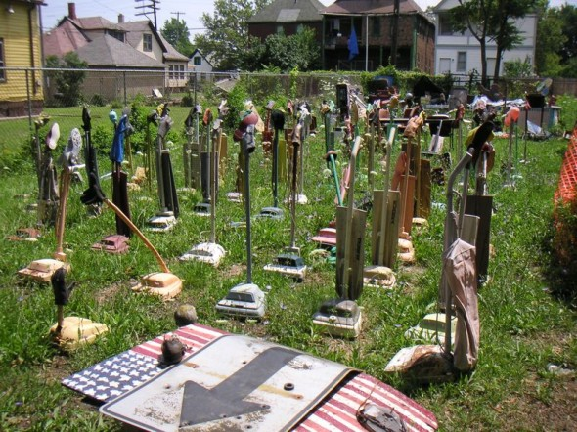
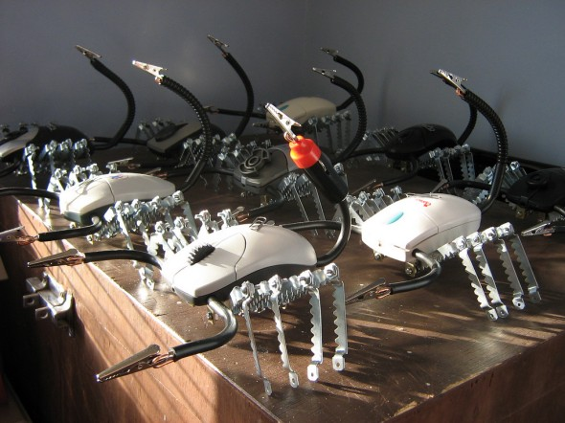
Reusing for Art

Slide 8
Recycled Art
http://minnesota.cbslocal.com/2011/10/16/finding-minnesota-recycled-art-featured-in-new-exhibit/

Slide 9
Stop and Jot
Why do we feel the need to constantly buy new things when our trash can be reused in so many different ways?

