Slide 1
SWBAT identify ways in which material waste is disposed. Do Now: What is planned obsolescence? How does it contribute to a throw away society?
ES Unit 10 5/2/16 Lesson 2

Slide 2
Agenda
Homework Share Out
Lecture
Reading
Video/Discussion
Pass Back lab reports

Slide 3
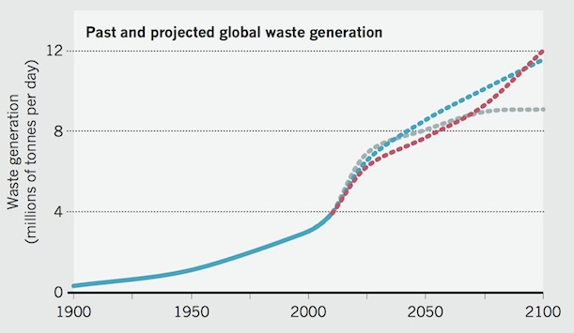
Waste Generation

Slide 4
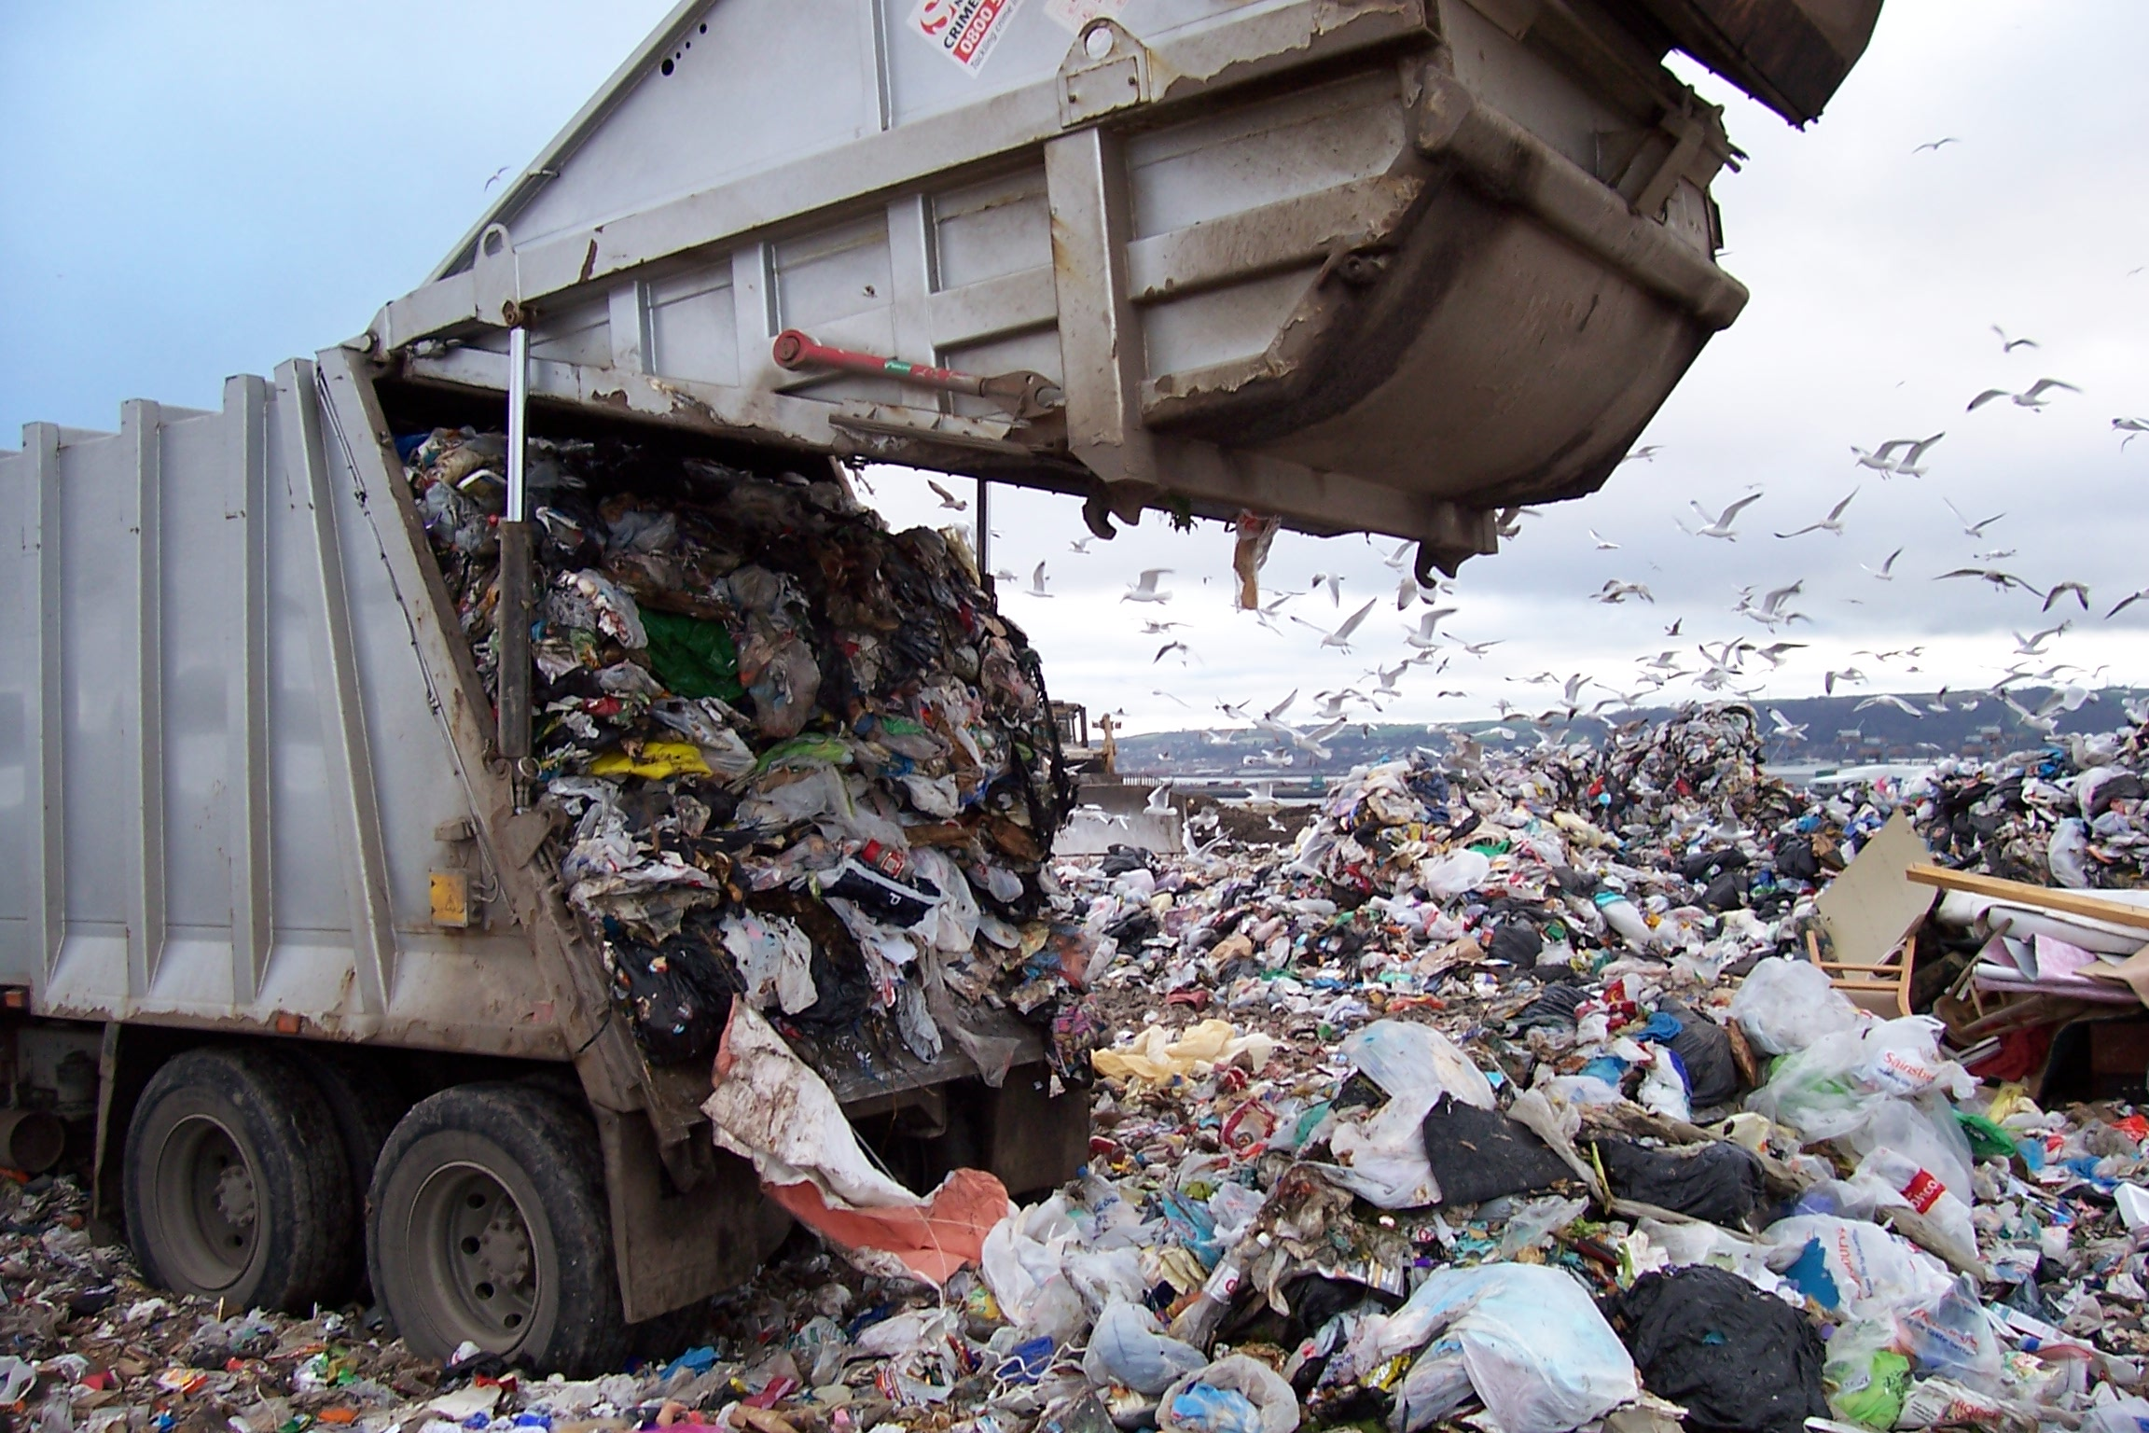
Where does our trash go?

Slide 5
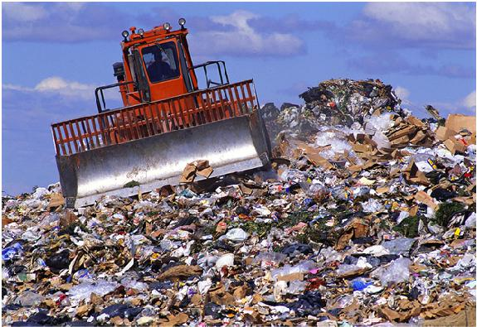
Landfills
Dispose of waste by burying
Over 3,000 active landfills in the U.S.
Problems:
Many are full
Waste can contaminate ground water

Slide 6
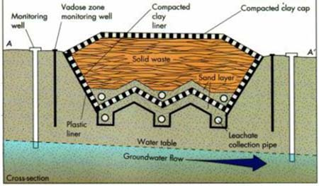
Sanitary Landfills

Slide 7
Sanitary Landfills
Disadvantages
Expensive to build
Methane is produced during decomposition
Advantages:
Methane can be burned to generate energy
Holds waste with little contamination of the surrounding environment

Slide 8
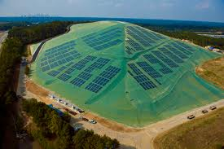
Solar Panel Landfills

Slide 9
Staten Island Landfill: Fresh Kills

Slide 10
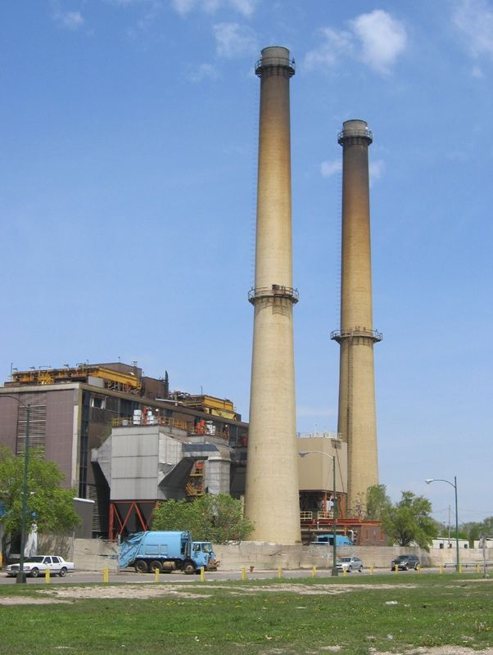
Incinerators
Burning trash
Pros:
Reduce solid mass of trash by 80 to 85%
Cons:
Releases toxins into the air
Can create toxic ash

Slide 11
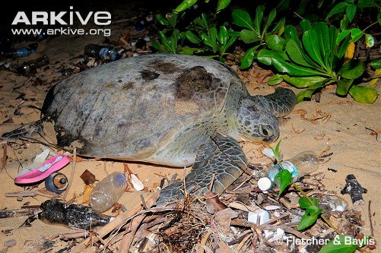
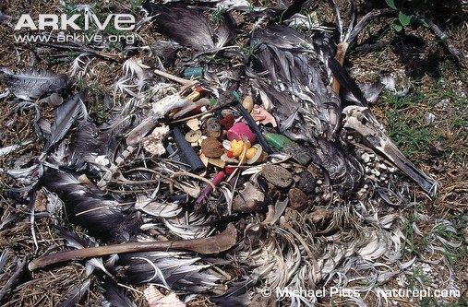
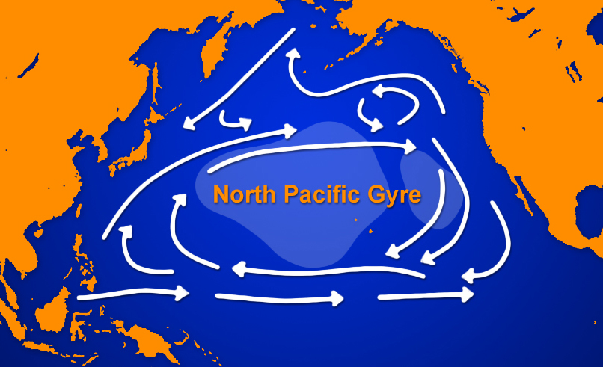
The Great Pacific Garbage Patch
Waste is trapped by rotating ocean currents
Covers an area twice the size of France

Slide 12
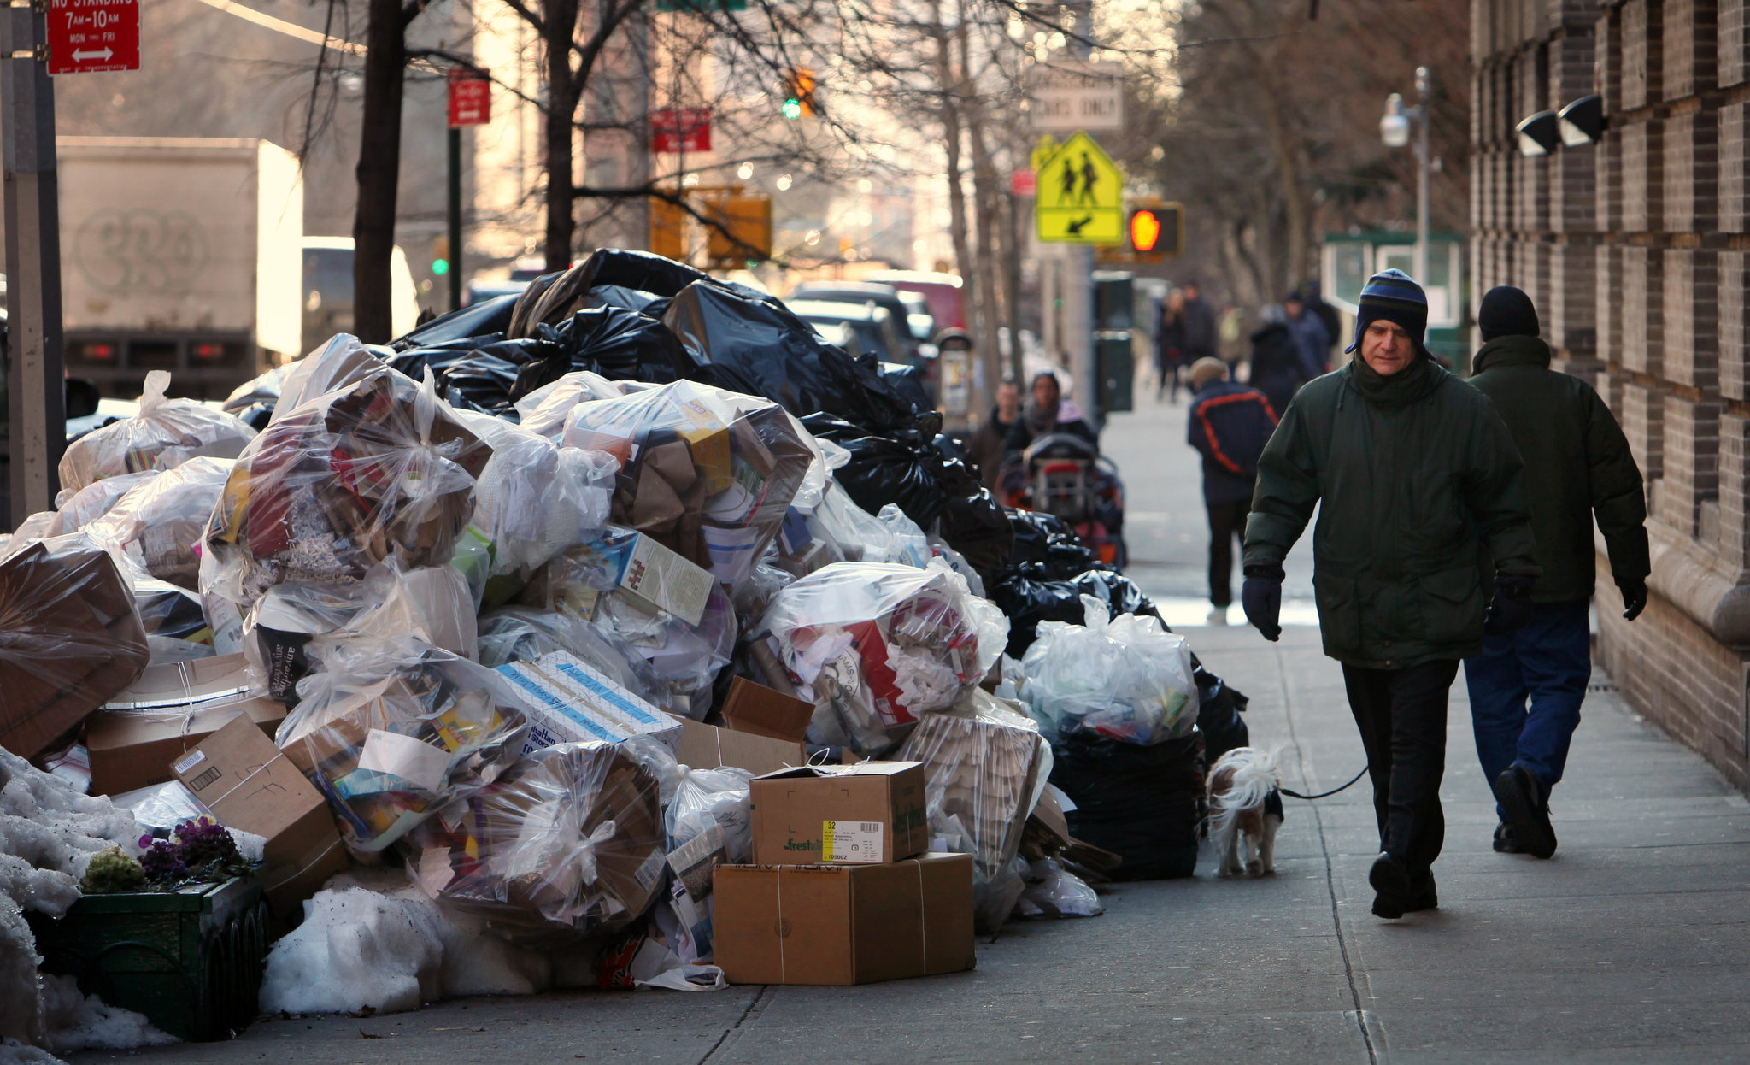
Trash in New York
NYC produces 12,000 tons of trash every day
Sent to New Jersey, Pennsylvania, South Carolina, and Virginia
Goes to incinerators or landfills
Cost: over 1 million a day

Slide 13
Turn and talk
Why do you think people are oblivious (not aware) as to where their trash goes?

Slide 14
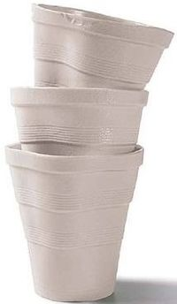
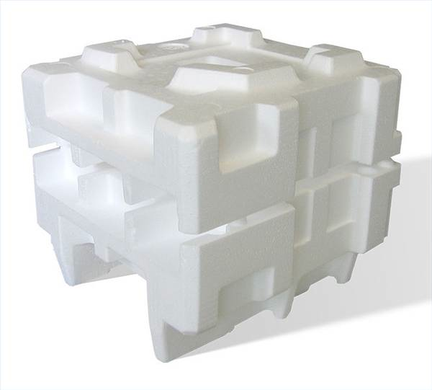
New York City ban on Styrofoam
Polystyrene: Polymer found in plastic

Slide 15
Use Less Packaging
http://disappearingpackage.com/

Slide 16
Lab Report Notes
Glows:
Great job with data representation
Great job with experimental design
Grows:
Always cite ALL outside research you include
Remember to compare your data to your control
Refer to numbers in your results summary section

Slide 17
Homework
Research San Francisco's “Zero Waste” Policy
Keep collecting your trash ☺

