Slide 1
SWBAT identify solutions for large amounts of solid waste. Do Now: List everything that you have thrown away today. How much trash do you think the average American produces on a daily basis (in pounds)?
ES Unit 10 4/22/16
Lesson 1

Slide 2
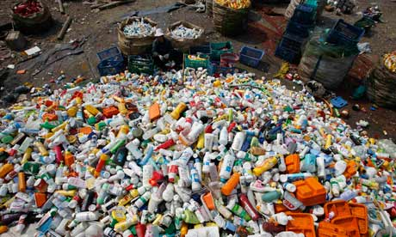
Unit 10: Waste and Human Health
~ 2 weeks
Reusing Project
EQs:
How does our culture embrace a throw-away society?
Where does our trash go?
How can we reuse trash?
How does our way of life affect our health?

Slide 3
Trash Quiz
Take 5 minutes to grade the quiz
Switch with someone at your table
Grade your partner’s quiz
Winner gets core cash!

Slide 4
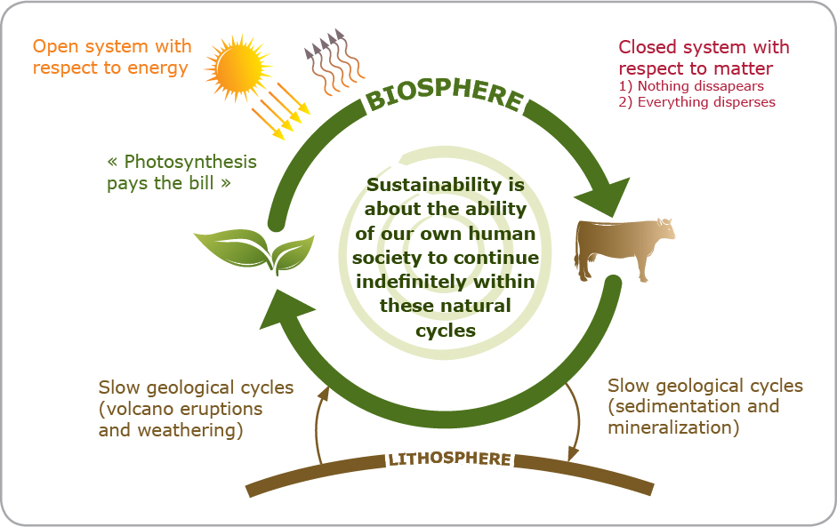
Waste
Waste in nature is reused
Human waste (garbage) is not reused.

Slide 5
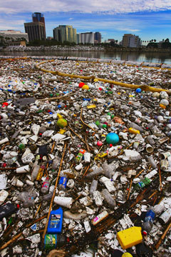
Trash
Every year the U.S. generates 230 million tons of trash
4.6 pounds of trash per person PER DAY
Less than 25% is recycled

Slide 6
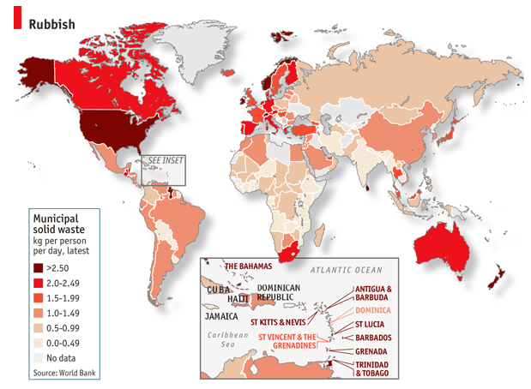

Slide 7
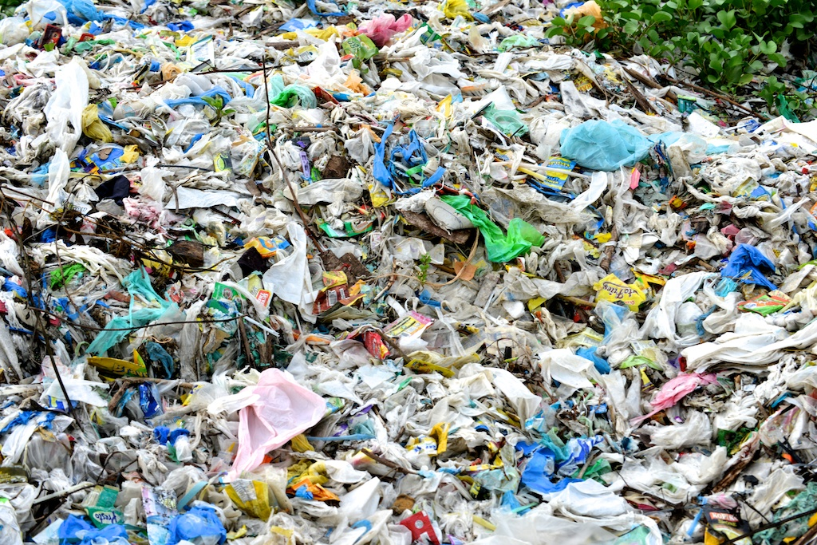
Plastic Bags
1 million plastic bags are used every minute in the U.S.
China uses 3 billion plastic bags every minute
It takes 20 to 1000 years to degrade in the environment

Slide 8
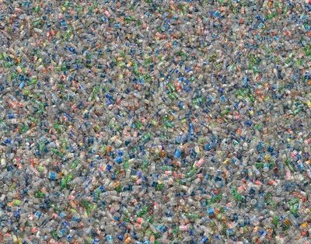
Plastic Bottles
1500 plastic water bottles are consumed every second in the U.S.
50 billion bottles bought each year
80% end up in landfills
17 million barrels of oil are used in producing plastic bottles each year.

Slide 9
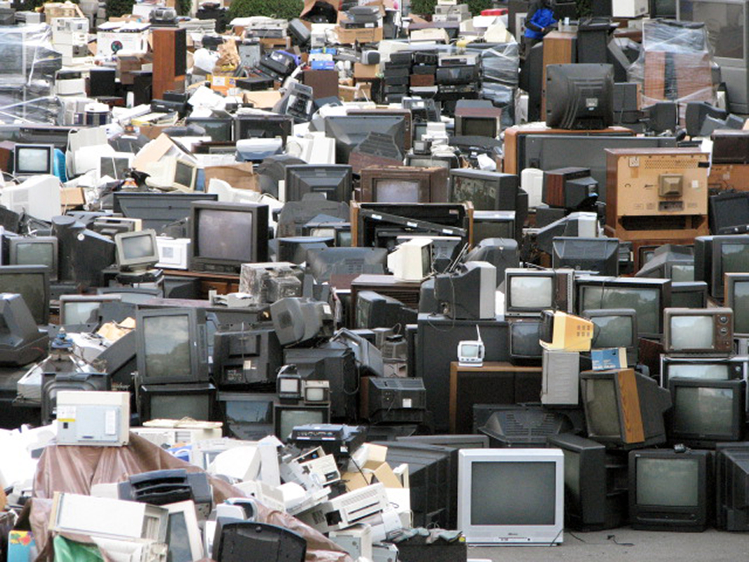
Electronic Waste
2.37 million tons are discarded every year
25% of TVs and computers recycled
8% of cell phones recycled
May contain lead, nickel, cadmium and mercury→ detrimental to human health and environment

Slide 10
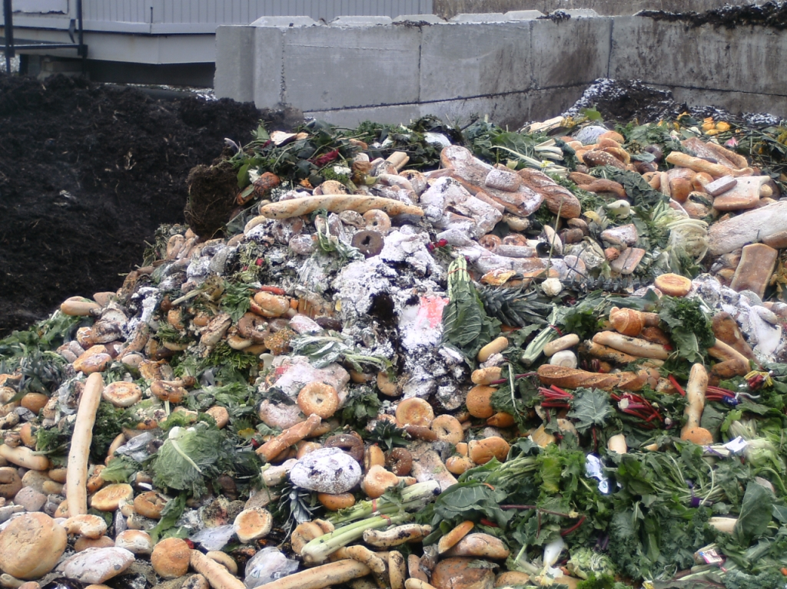
Food Waste
In 2012, there was 36 million tons of food waste
Only 5% composted
Rots in landfills and becomes source of methane

Slide 11
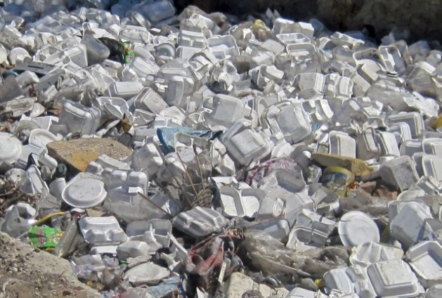
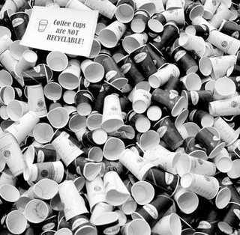
Other Trash
Coffee Cups
14 billion paper coffee cups are thrown away every year
Styrofoam
1 million years to decompose

Slide 12
Solutions
Compost
Use re-usable bags, water bottles and coffee mugs
Recycle!
Try not to buy Styrofoam

Slide 13
Picturing Excess
http://blog.ted.com/chris_jordan/
http://www.chrisjordan.com/gallery/rtn2/#insatiable

Slide 14
Trash Homework
Collect your trash over Spring Break
Wrappers, bottles, plastic bags
Don’t collect food waste or any waste with bodily fluids!

