Slide 1
ES Unit 1 9/17/15 Lesson #6
SWBAT apply the scientific method by performing a lab.
Do Now: Bassma wants to test a new drug, livelonger, to see if it will lower blood pressure. Independent variable:
Dependent variable:
Control:
Constants:

Slide 2
Reminder
Scientific Method Quiz on Monday!

Slide 3
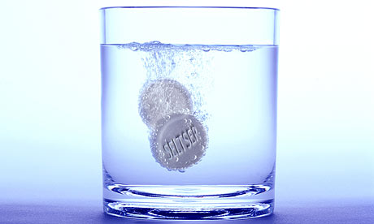
Experimental Design
Independent variable: Type of water
Dependent variable: Time it takes for alka-seltzer to dissolve
Constants: amount of water, amount of alka-seltzer tablet
Testable question: How does the type of water affect the time it takes for alka-slezter to dissolve?

Slide 4
Safety
Be careful of the hot plate!!

Slide 5
Lab Roles
Timer
Recorder
Someone who monitors alka-seltzer

Slide 6
Clean Up
Pick up all your trash!!!
When you are finished collecting your data, go back to your seat and make a graph of your data.

Slide 7
Yesterday’s Exit ticket
Hannah has two fish tanks which both contain goldfish. She notices that the goldfish in tank 1 are orange while the goldfish in tank 2 are yellow. When she measured the chlorine levels in both fish tanks, she observed that the chlorine levels for tank 1 were much higher than those for tank 2.
Independent variable: level of chlorine
Dependent variable: color of fish
Testable question: How does the level or chlorine affect the color of fish
Notes:
Answer: How does the level of chlorine affect the color of the fish?

Slide 8
Tips for the quiz on Monday!
Review the Simpsons and the Scientific method worksheet
Testable Question:
How does independent variable affect dependent variable?
Format for hypothesis:
If independent variable ____________ then dependent variable ____________ because_________________.

