Slide 1
SWBAT represent data in bar and line graphs. Do Now: Humera wants to test whether Tide or Shout is more effective in removing stains from clothing. Find the: Independent variable Dependent variable Testable Question Control
ES Unit 1
Lesson 5 9/17/15

Slide 2
Announcement
Scientific method quiz on Monday!

Slide 3
Turn and Talk
Share out your experimental design homework from last night

Slide 4
Agenda
Graphing
Exit ticket

Slide 5
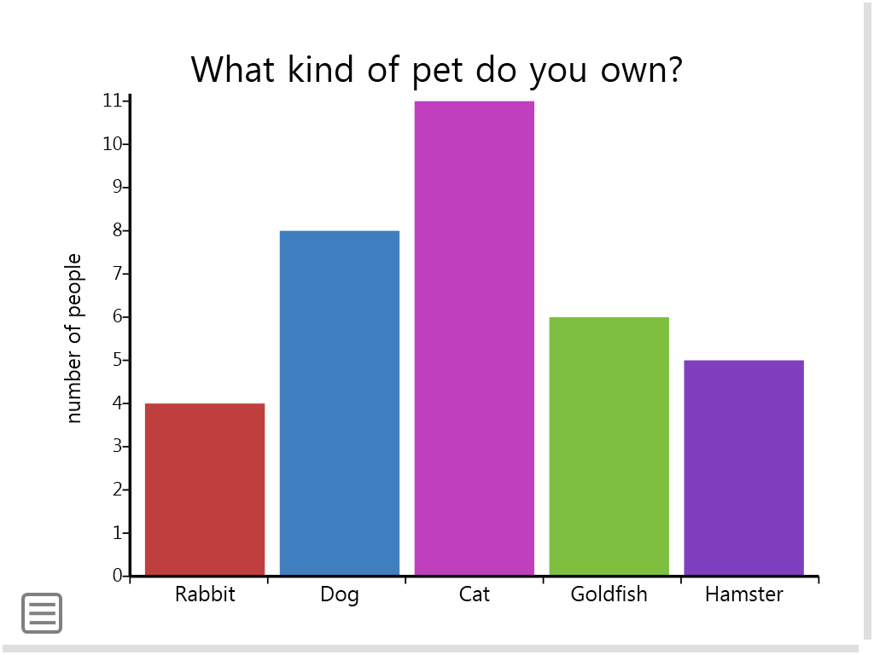
Bar Graphs
Useful for comparing facts

Slide 6
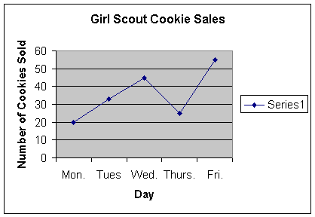
Line Graph
Useful for comparing changes over the same period of time

Slide 7
Homework
Simpsons and the scientific method:
Testable Question
Hypothesis
Control

Slide 8
Exit ticket
Hannah has two fish tanks which both contain goldfish. He notices that the goldfish in his tank 1 are orange while the goldfish in his tank 2 are yellow. When the measured the chlorine levels in both fish tanks, he observed that the chlorine levels for tank 1 were much higher than those for tank 2.
Independent variable:
Dependent variable:
Testable question:
Notes:
Answer: How does the level of chlorine affect the color of the fish?

