Slide 1
ES Unit 1 Lesson 3 9/16/15
SWBAT design an experiment
Do Now: Aisha wants to design an experiment to test the effect of exposure to light on the rate of growth of tomato plants.
Identify:
Independent variable
Dependent variable
Testable Question
Hypothesis

Slide 2
Agenda
Definitions and Examples
Independent Practice
Homework/Exit ticket

Slide 3
Components of Experimental Design
Hypothesis
Independent variable
Dependent variable
Control group
Strategize
What materials will you need?
What is the duration?
How will you collect your data?

Slide 4
Definitions
Experimental group: Group that is affected by the independent variable
Control Group: A group that is separated from the experiment that cannot be affected by the independent variable.

Slide 5
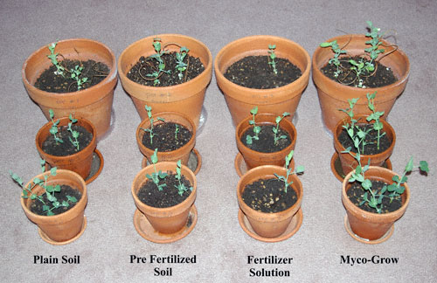
Definition
Constant (controlled variable): A variable that stays the same throughout the experiment.

Slide 6
Example: Control group
Testable question: How does weight at the nose of a paper airplane affect the duration of its flight?
Control group: Paper airplanes without any weight on the nose
Constant: Type of paper, different structures of paper airplanes

Slide 7
Example: Control group
How does exposure to UV rays affect the rate of skin cancer?
Control group: Organism that isn’t exposed to any UV rays
Constant: Where the organisms is exposed to UV rays

Slide 8
Experimental Design
Describe the process in which you design the experiment.
Consider if it is practical.
Be creative!

Slide 9
Experimental Design
What is my independent and dependent variable?
What are my constants?
How am I going to manipulate (change) the independent variable?
How often will I measure the dependent variable?
How will I show my results?

Slide 10
Testable Questions
#1 How does Rogaine affect hair growth?
#2 How does the hormone estrogen affect the milk yield of dairy cows?
#3 How does the pesticide COMBAT affect the population of cockroaches in your house?
#4 How does the amount of peanut butter in dog food affect the rate at which it will be eaten by a dog?

Slide 11
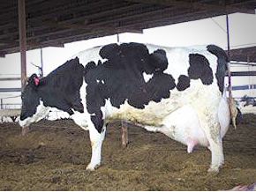
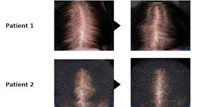

Slide 12
Homework
Design an experiment for one of the scenarios in your observations and testable questions worksheet.
Include:
How long would your experiment last?
What variables would you hold constant?
What materials would you need?

Slide 13
Exit ticket
Hannah has two fish tanks which both contain goldfish. He notices that the goldfish in his tank 1 are orange while the goldfish in his tank 2 are yellow. When the measured the chlorine levels in both fish tanks, he observed that the chlorine levels for tank 1 were much higher than those for tank 2.
Independent variable:
Dependent variable:
Testable question:
Notes:
Answer: How does the level of chlorine affect the color of the fish?

