Slide 1
9/10/11 Unit 1 Lesson 1 SWBAT make observations SWBAT distinguish between independent and dependent variables.
Do Now:
List 3 reasons why it is important to conduct experiments in science.

Slide 2
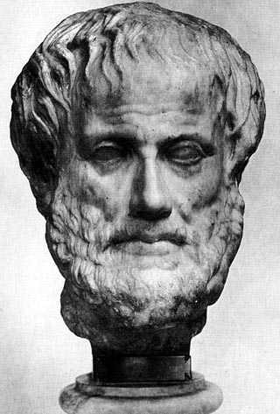
Why is the scientific method important?

Slide 3
Scientific Method
Make observations and develop a question about the observations.
Develop a tentative answer to the question- a hypothesis.
Design an experiment
Collect data
Interpret the data
Draw a conclusion
Compare the conclusion with the hypothesis
Revise and repeat!
Notes:
This is what we will focus on today.

Slide 4
Agenda
Mini-lecture: Observations and IV/DV
Guided practice
Independent Practice
Exit ticket/homework

Slide 5
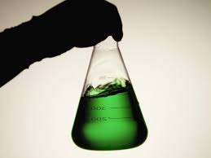
Observations
Observations are made using any of the 5 senses:
touch
sight
sound
taste
smell

Slide 6
Definitions
Independent Variable:
The variable that is being manipulated or controlled in the experiment.
Notes:
This is the variable that you as a scientist intend to control

Slide 7
Definitions
Dependent Variable:
The variable that responds to the independent variable.
Notes:
This is the variable that you can’t control in the experiment that you are measuring.

Slide 8
Example
Testable question: How does temperature affect the length of time it takes for mold to grow on bread?
Independent variable: temperature
Dependent variable: length of time for mold to grow

Slide 9
Example
TQ: How does fertilizer affect the height of the plant?
Independent variable: fertilizer
Dependent variable: height of the plant

Slide 10
Example
TQ: How does temperature affect the rate of growth of bacteria?
Independent variable: Temperature
Dependent variable: Rate of growth of bacteria

Slide 11
Observation: In New York City, parks that have fewer trash cans have more litter on the ground.
Independent variable: Trash cans
Dependent variable: Litter on the ground

Slide 12
Example
Hypothesis: If there is a higher rate of UV exposure, then there will be a higher rate of skin cancer.
Independent variable: UV exposure
Dependent variable: rate of skin cancer

Slide 13
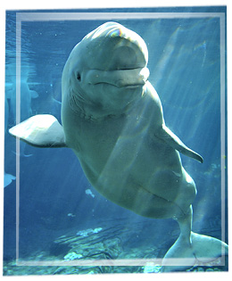
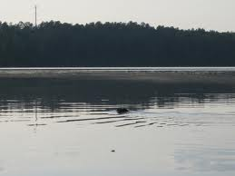
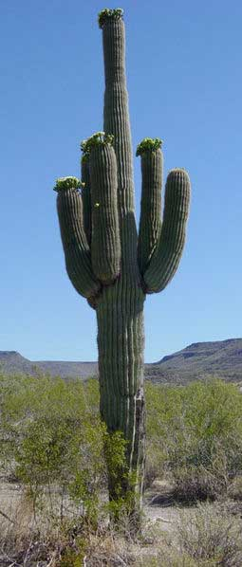
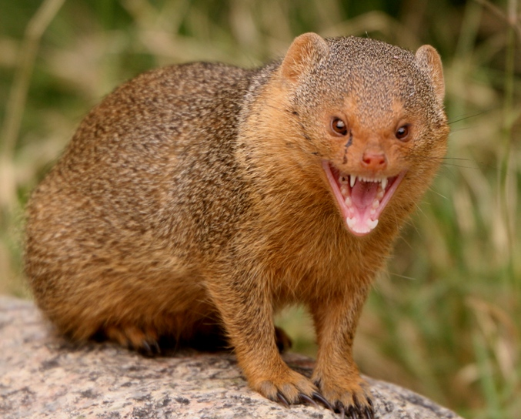
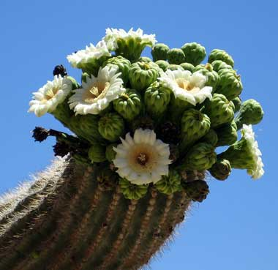

Slide 14
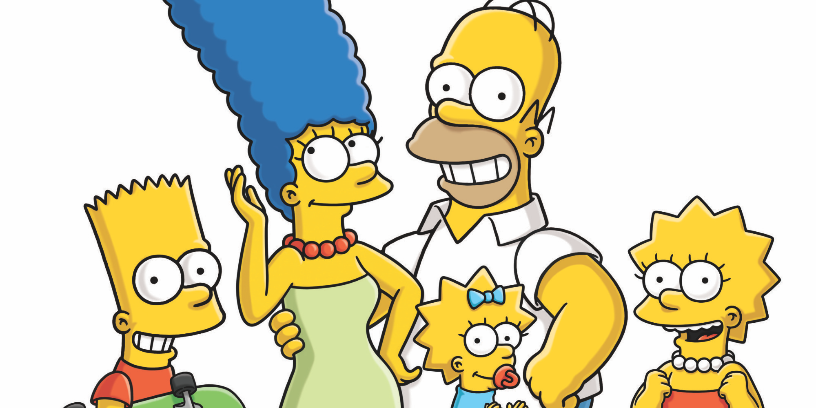

Slide 15
Homework
Only find IV and DV! Don’t do the hypothesis!

Slide 16
Exit ticket
You are a biologist studying the habitat of turtles in a local pond. You notice that there is a greater amount of turtles in areas of the pond that have high levels of saturated oxygen.
Independent variable
Dependent variable

