Slide 1
Unit 1 lesson 2 9/8/14 Objective: SWBAT write testable questions and hypotheses.
Do Now:
Think of a science experiment you have done in a previous class. What was your testable question and hypothesis?

Slide 2
Agenda
Definitions
Practice problems
Independent practice
Exit Ticket

Slide 3
Reminder!
You MUST have school supplies (binder +composition notebook) by Wed. Sept. 16th
Who can’t see the board??

Slide 4
Testable Questions
A testable question is a question that can be answered by designing an experiment.
Format: How does independent variable affect dependent variable?
Notes:
The next step after making observations is forming testable questions. A testable question is a question that can be answered by designing an experiment. Testable questions must have the format how does variable 1 affect variable 2. I’m sure you’re all heard of variables before but just to remind you, a variable is a factor that can be controlled and changed in an experiment.

Slide 5
Example:
Observation: The amount of CO₂ is rising and global temperatures are rising.
Independent variable: amount of CO2
Dependent variable: global temperatures
TQ: How does the amount of CO₂ in the atmosphere affect global temperatures?
Notes:
Let’s look at an example. Right now on our planet we’re observing that CO₂- carbon dioxide levels- are rising global temperatures are also rising. So one testable question would be how does the amount of CO₂ in the atmosphere affect global temperatures.

Slide 6
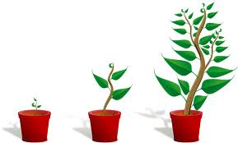
Example
Observation: Plants that have fertilizer in the soil are on average taller than plants without fertilizer.
Variables: fertilizer and height of plant
TQ: Does fertilizer make plants grow taller?
TQ: How does fertilizer affect the height of a plant?
Notes:
Let’s look at another example. Is this a testable question? No, it’s not. Why not? It doesn’t follow the format- we don’t want a question that gives us a yes or no answer. You can’t design an experiment that gives you a yes or no answer. For example, you might have one plant that grows a lot, and another plant that hardly grows at all. We want a question that allows us to give an explanation, not just a yes or no answer. We can change this question to how does fertilizer affect the height of a plant, which is a testable question.

Slide 7
Hypothesis
An explanation for an observation that can be tested.
Key points:
Gives the purpose of the research
Follows the format: if independent variable _________then dependent variable _____________ because _____________.
Notes:
A hypothesis is an explanation for an observation that can be tested. Another way to define it is an educated guess for some phenomenom that is unexplained.

Slide 8
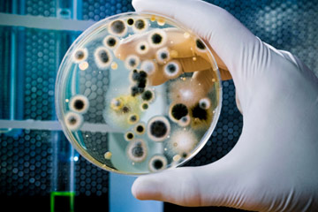
Example: bacterial growth
How is bacterial growth affected by temperature?
Observation: Bacteria grows more rapidly at higher temperatures
Hypothesis: If the temperature increases, then the rate at which bacteria grows will increase because bacteria grows more rapidly at higher temperature
Notes:
Has anyone ever done an experiment where they grow bacteria?
Usually they like warm, moist environments.

Slide 9
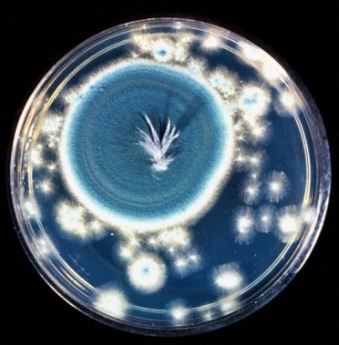
Why are hypotheses important?
They can be tested
They can be disproved
They lead to further experimentation!
Notes:
Say you conducted an experiment where and you expected to pull out a petri dish that looks like this. Instead, you pulled out a petri dish that looks like this. This is not bacteria- it is a mold, Penicillium notatum, or commonly known as penicillin. That’s what happened to Alexander Fleming who pulled out a petri dish one day and instead of seeing bacteria, he saw this mold growing. So that spurred him to discover the first antibiotics.

Slide 10
Friday’s Exit Ticket
You are a biologist studying the habitat of turtles in a local pond. You notice that there is a greater amount of turtles in areas of the pond that have high levels of saturated oxygen.
Independent variable: high level of saturated oxygen
Dependent variable: amount of turtles

Slide 11
Homework
Complete testable questions and hypothesis for The Scientific method: Guided Notes.
Complete Hypothesis and testable questions for back page of Independent versus Dependent Variable Worksheet

Slide 12
Exit ticket
Aaron has two fish tanks which both contain goldfish. He notices that the goldfish in tank 1 are orange while the goldfish in tank 2 are yellow. When the measured the chlorine levels in both fish tanks, he observed that the chlorine levels for tank 1were much higher than those for tank 2.
Independent variable
Dependent variable
Testable question:
Hypothesis:
Notes:
Answer: How does the level of chlorine affect the color of the fish?

