Slide 1
Welcome to Environmental Science
May S.
Shaba A.
Memona B.
Khadija B.
Arooj F.
Rahat F.
Momina D.
Heaven W.
Carolina R.
Aysha N.
Maida W.
Aisha S.
Zanea L.
Hamial I.
Bassma T.
Maria S.
Rabia S.
Sabina S.
Mahaa T.
Sanajan P.
Kiara S.
Samavia I.
Sharmin S.
Aurielle B.
Sana S.
Saryna R.
Aisha F.
Naomi L.
29. Ramay R.
31. Hifza S.
32. Melanie A.

Slide 2
Welcome to Environmental Science
Imama A.
Alison A.
Orooba A.
Shume A.
Dhekra A.
Stephanie A.
Fatima C.
Karen F.
Nadia G.
Amna H.
Salehah K.
Efuru K.
Vanessa L.
Hannah M.
Iqra M.
Anam M.
Aisha N.
Cynthia P.
Anisa K.
Jannatul S.
Huma S.
Ruba T.
Keyshla M.
Humera A.
Zahra R.
Arzu B.
Anum Z.
Blanca G.
Arwa R.
Brianna G.
31. Suma K.
32. Nekiyah C.
33. Mubeen S.

Slide 3
Welcome to Environmental Science
Aamna A.
Entidhar A.
Arseleena A.
Aisha A.
Rabia B.
Janet C.
Habiba F.
Janet V.
Ysabelle F.
Nyelah G.
12. Mirian G.
13. Aphrodite L.
14. Nancy M.
15. Sonia R.
16. Anam R.
17. Liliana R.
18. Teniyah R.
19. Kaila T.
20. Tasmina R.
21. Sevdije
22. Tamia Y.
23. Kanis F.
24. Natalie R.
25. Beatrice F.
26. Amen S.
27. Marylyn G.
28. Starr E.
29. Fatima J.
30. Fabliha A.
31. Princess W.
32. Maryam J.

Slide 4
Agenda
Class Rules and Procedures
Student surveys
What is environmental science?
Mini-experiment

Slide 5
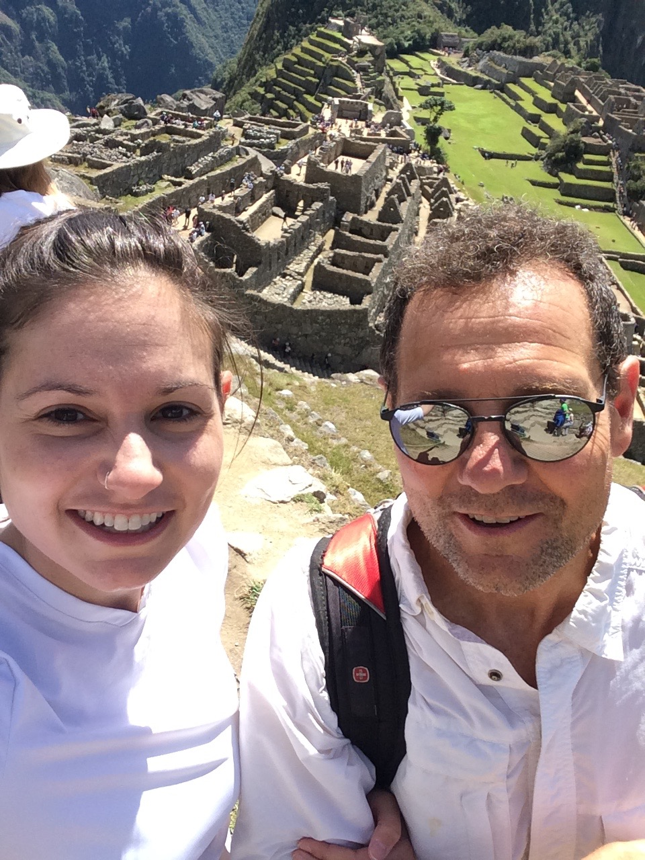
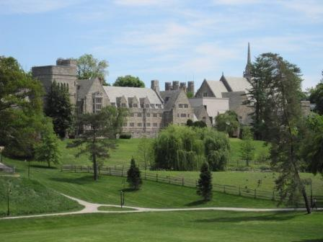
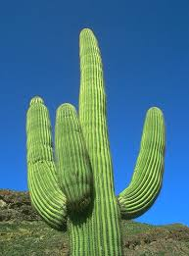
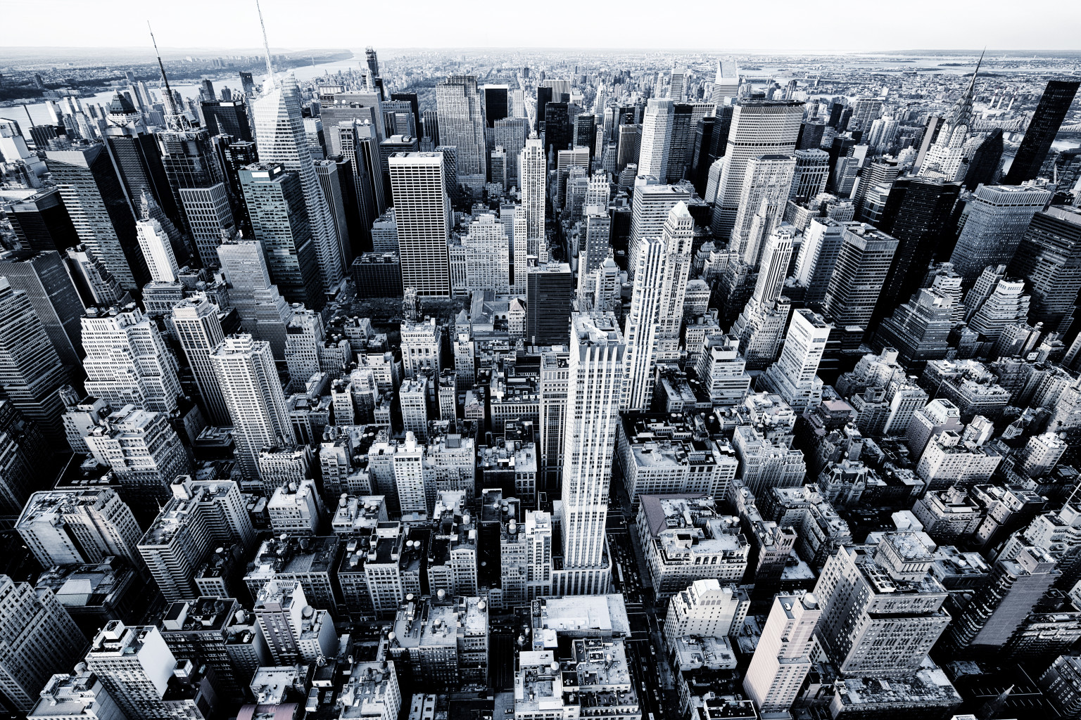
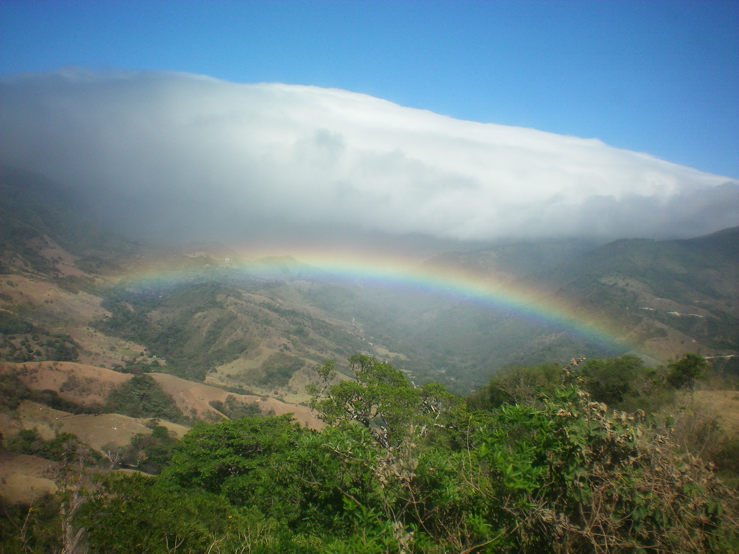
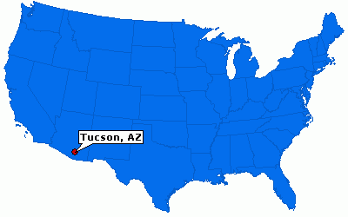
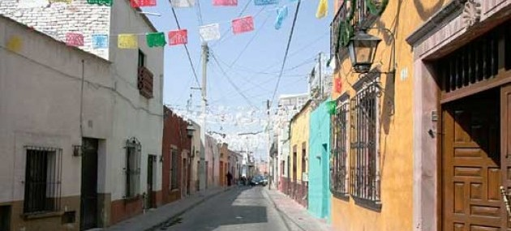
About Ms. McDaniel

Slide 6
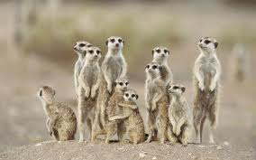
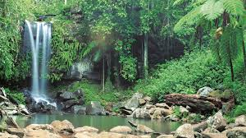
What is environmental science?
Environmental science studies how life on earth can be sustained.

Slide 7
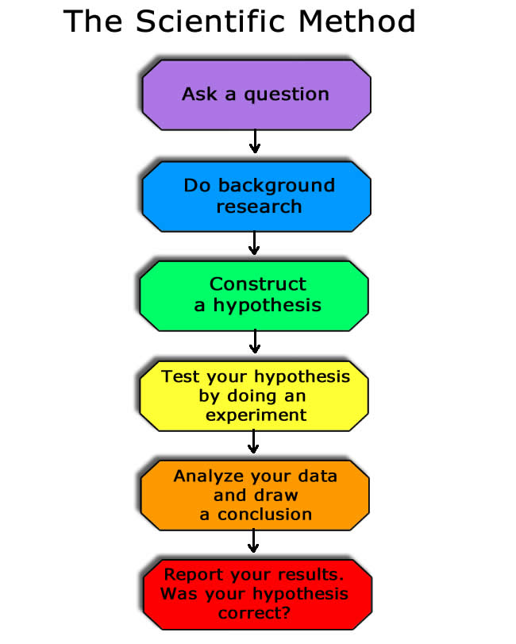
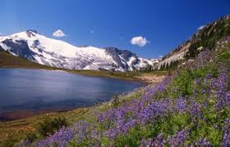
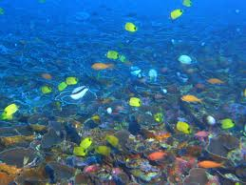
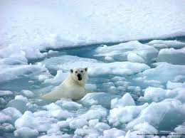
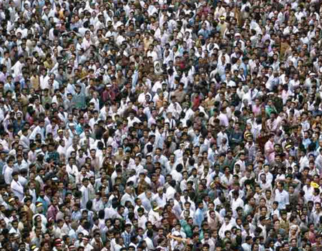
What will we be learning this year?
Unit 1
The Scientific Methods
Unit 2
The four spheres
Unit 3
Ecology
Unit 4
Biodiversity and Conservation
Unit 5
Climate Change
Unit 6
More Humans, More Problems

Slide 8
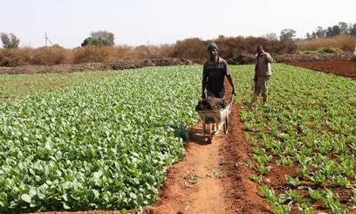
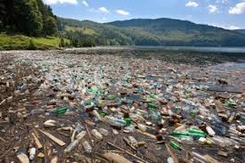
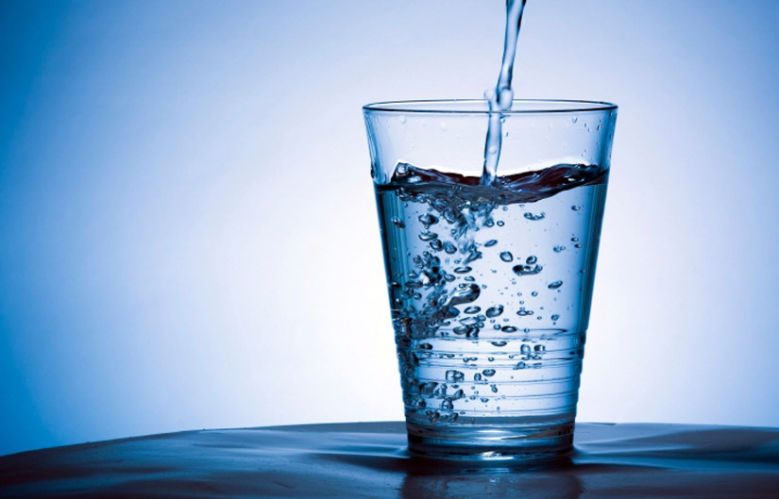
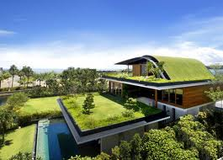
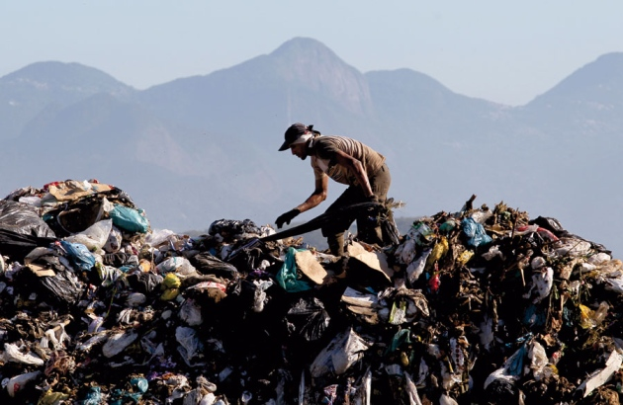
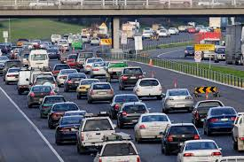
What will we be learning this year?
Unit 9
Pollution
Unit 7
Land and Food
Unit 8
Water Use
Unit 10
Waste and Human Health
Unit 11
Energy
Unit 12
Environmental Design

Slide 9
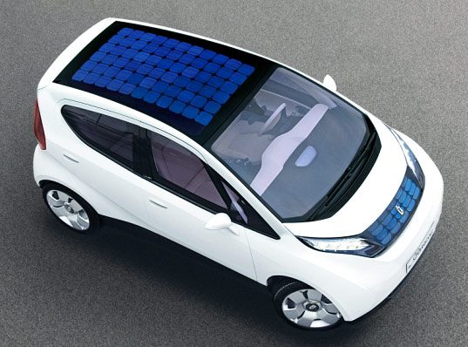
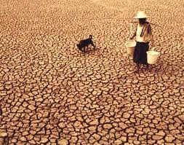
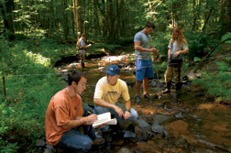
Why should I care?

Slide 10
Turn and Talk
3 things you know about Environmental Science
3 things you want to know

Slide 11
Experiment Time!
Clean up: person closest to the aisle dumps milk/food dye in the bucket

