Slide 1
2011 Japan Tsunami
By: Cynthia Crichlow

Slide 2
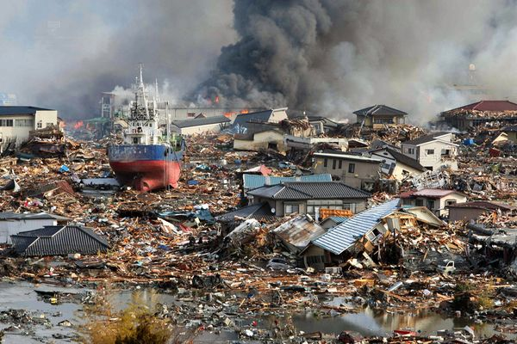
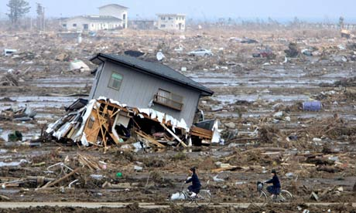
What Happened?
Eastern Japan
On March 11th, 2011 at around 2:46pm an 9.0 earthquake led to a tsunami with 30ft waves
Caused the destruction of coastal areas in Japan.
Caused the death of almost 16,000 people (as of October 2015)
5 tons of debris was washed away most of it sank, only 30% floated (1.5 million tons) “non radioactive”

Slide 3
How?
Japan lays between two boundaries (Pacific and North American Plate). The pacific plate contains a layer of clay on it which was slipping under the North American plate while the plates went into the trench. The clay trapped water which made it extremely slippery and when the Pacific plate moved toward the trench it caused such a huge slip.
There was no friction(brake) because of the clay lying in between the plates
The fault (boundary between the two tectonic plates) in the trench slipped by 164 feet!
Lead to an earthquake of 9.0 magnitude which then led to a tsunami

Slide 4
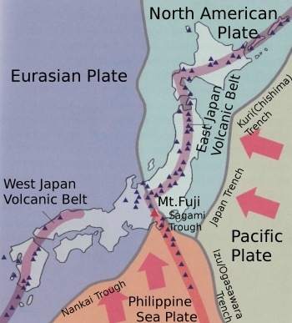

Slide 5
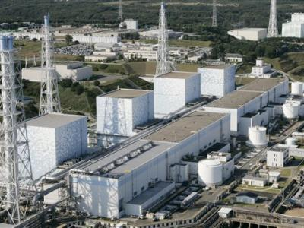
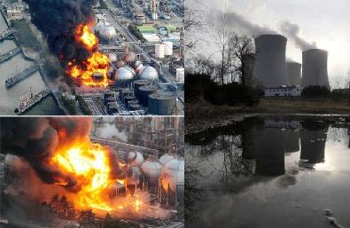
Nuclear Reactors
Earthquake disabled the nuclear reactors power which halted the cooling process of the reactors
All three reactors melted within 3 days
Radiation from Japan can be detected 90 miles away from California
People living near radiation areas have increased risk of thyroid cancer
Boys exposed as infants are more likely to develop leukemia

Slide 6
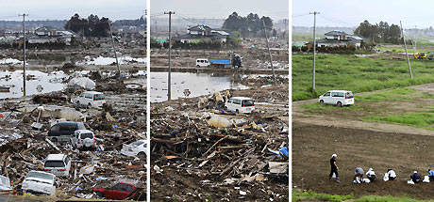
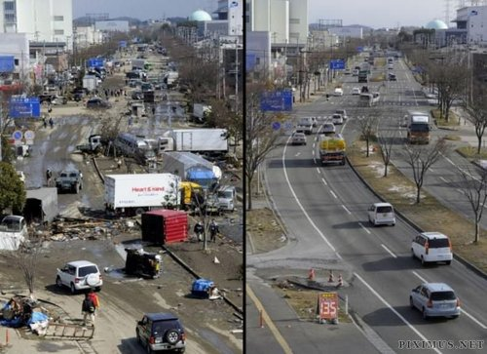
Economic Concerns
Damage was about 16-25 trillion yen
home, road, factories and other infrastructures
Nuclear reactors kept parts of Japan powered, it cost a lot to fix the nuclear reactors lost
Damage to businesses caused many to shut down decreasing government revenue from taxes
Government has been forced to use many back up emergency funds ($180 Billion dollars)
Which apparently has been misspent. A large sum of money was put into reviving the economy
Japan cared more about the economy then its citizens

Slide 7
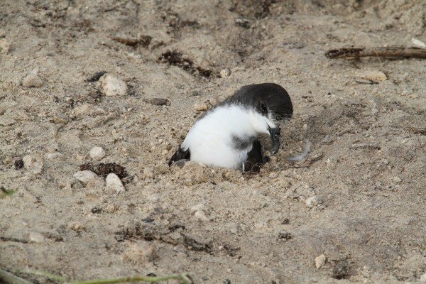
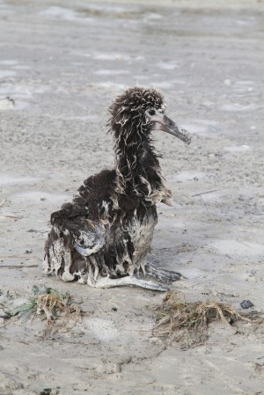
Environmental Concerns
Bonin petrels were buried alive by the debris numbers are unknown due to nesting sites in the sand
Thousands of fish washed onto shore
110,000 Laysans were killed during the tsunami
Rare species found short-tailed albatross chick was found and returned from her nest, in which she was 100 ft from, but it’s eggs have not been found nor the chicks that should have hatched from it.
Caused displacement on many sea bird nests

Slide 8
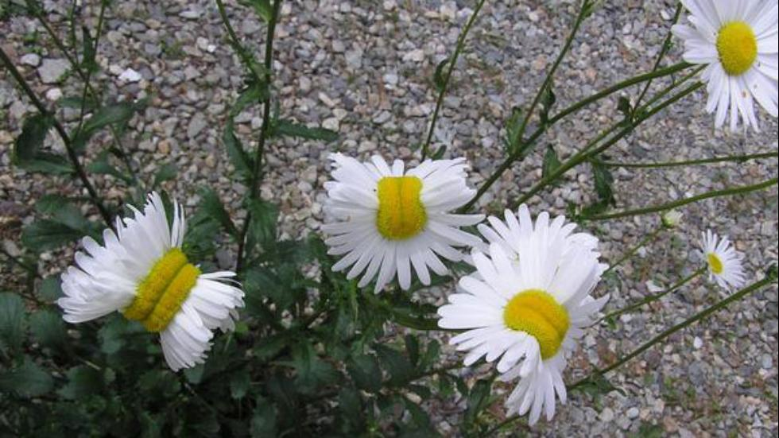
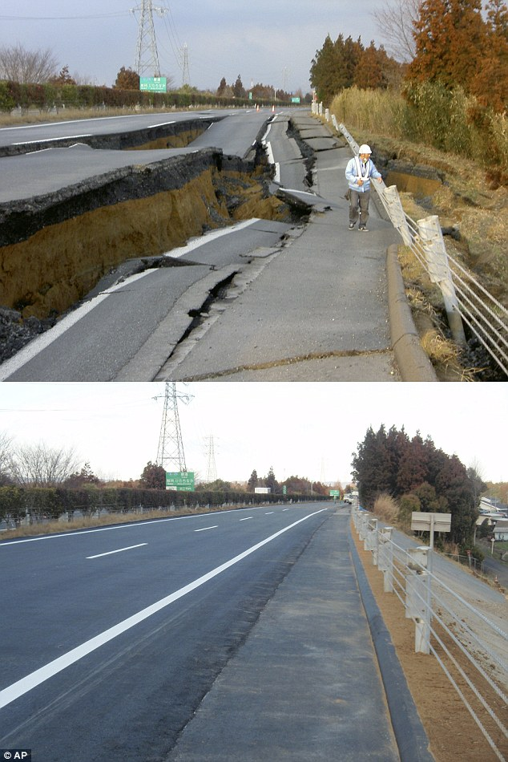
Environment Continued
Earthquake had caused land to slip (large crack)
70% of debris from tsunami sank to the bottom of the ocean
Large amount of salt water caused plant loss
Nuclear reactor melting caused land to be inhabitable til today.
Mutations on flowers at Fukushima
Hawaiian Islands are receiving lost nests from sea birds

Slide 9
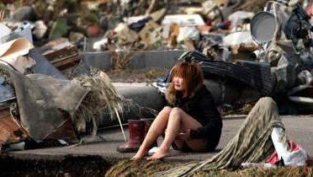
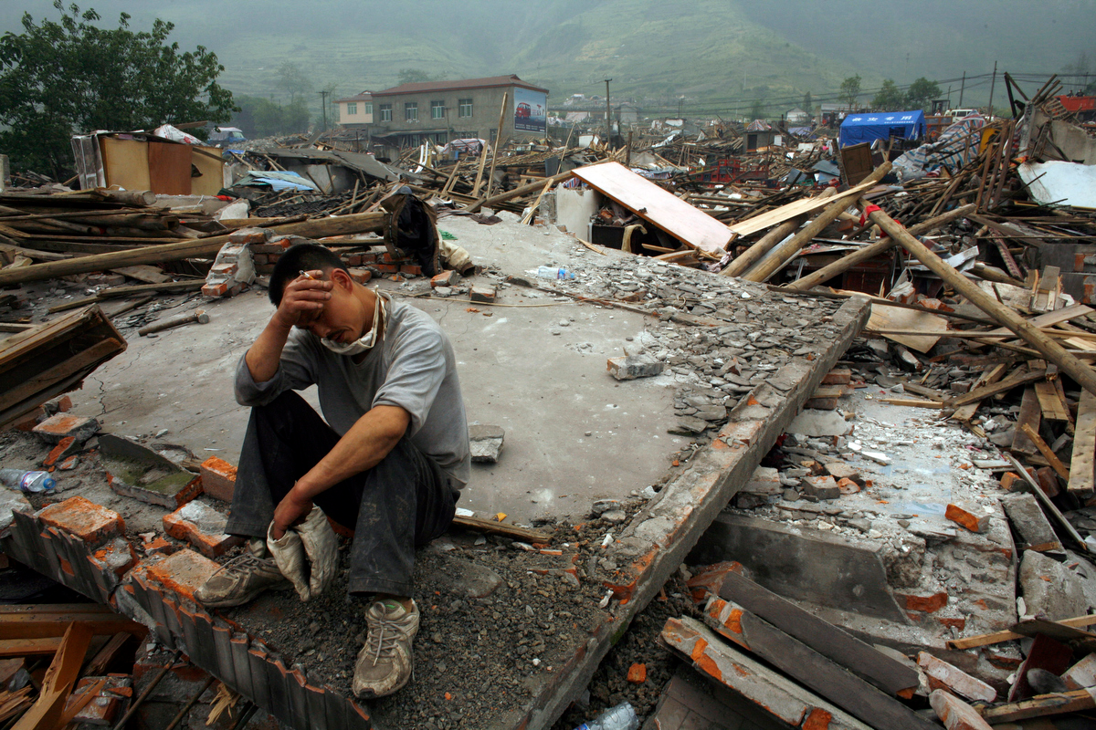
Social
Around 163,000 were forced to move into shelters.
Of the people who still had a home, at least 170,000 were left without water
Approximately 46,000 buildings were destroyed
Radiation sickness is said to not have affected anyone
100,000 extra people were placed into shelters because of reactors
Government does not want to take any chances with radiation although they are declining that there is harmful radiation
Thousands to this day are sheltered

Slide 10
Bibliography
http://dailycaller.com/2015/08/21/the-daily-caller-proudly-presents-the-dumbest-college-courses-for-2015/
http://www.cnn.com/2013/07/17/world/asia/japan-earthquake---tsunami-fast-facts/
http://www.independent.co.uk/news/world/asia/the-explosive-truth-behind-fukushimas-meltdown-2338819.html
http://www.telegraph.co.uk/news/worldnews/asia/japan/8431209/Japan-earthquake-and-tsunami-list-of-impacts-of-disaster.html
http://www.world-nuclear.org/info/safety-and-security/safety-of-plants/fukushima-accident/
http://www.bbc.com/news/world-asia-20150364
http://wamc.org/post/ecological-impacts-japanese-tsunami#stream/0
http://earthsky.org/earth/the-march-2011-tsunami-toll-on-wildlife-at-the-midway-atoll

