Slide 1
Under The Sea Corp.
Agent Sinkler & Agent Neville
Funded by Atlantis Solutions

Slide 2
Your Weather Forecast
Agent Sinkler found me the perfect spot where the temperature was cozy!
Coral Reefs are generally only found in tropical and subtropical waters.
They can not tolerate temperatures below 18° Celsius (64° Fahrenheit).
Growing optimally in water temperatures between 23°–29°Celsius (73° and 84° Fahrenheit), yet some can tolerate temperatures as high as 104° Fahrenheit (40° Celsius) for short amounts of time.

Slide 3
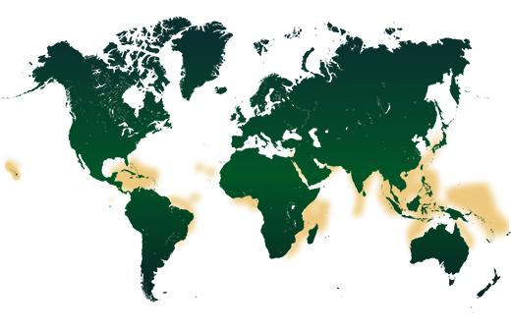
It’s All About Location
Reefs are located near the Tropics of Capricorn and Cancer, in the Indian and Pacific Ocean, the Caribbean and Red Sea, and the Persian Gulf. Corals are generally found farther than the equator where warm currents are able to flow out of the tropics.
Fun Fact:
Worldwide, coral reefs cover an estimated 110,000 square miles (284,300 square kilometers).

Slide 4
How Reefs Are Made
This stuff doesn’t happen overnight.
Coral reefs are built by these coral polyps as they secrete layers of calcium carbonate beneath their bodies. The corals that build reefs are known as “hard” or “reef-building” corals.
The coral polyps that help build the reef survive by forming a symbiotic relationship with algae called zooxanthellae. The polyps offer the algae shelter while the zooxanthellae create energy that the corals use as food. Reefs are also made by all the organisms in the area which help it thrive.
Coral spawning: all at once and usually one night a year, the coral eject trillions of eggs and sperm into the surrounding water. Allowing eggs and sperm to fertilize which helps the coral reefs grow.

Slide 5
How Do Coral Reefs Survive?
Sunlight: Corals need sunlight in order to grow. Corals depend on the zooxanthellae (algae) that grow inside of them for oxygen and other necessities, they rarely develop in water deeper than 165 feet (50 meters).
Clear and Clean water: Corals need clear water in order to let sunlight shine through; they can’t survive properly in cloudy water. Sediment and plankton can cloud water, not allowing photosynthesis to happen and this can lead to death of the reef. Corals are sensitive to pollution and sediments. Sediment can create cloudy water and be deposited on corals, blocking out the sun and harming the polyps. Wastewater discharged into the ocean near the reef can contain too many nutrients that cause seaweeds to overgrow the reef.
Warm water temperature: Reef-building corals require warm water conditions to survive. Depending on its region, coral reefs can withstand various temperature fluctuations. However, corals generally live in water temperatures of 68–90° F or 20–32° C.
Saltwater: Corals NEED saltwater to survive and require a certain balance in the salt to water ratio. This is why corals don’t live in areas where rivers drain fresh water into the ocean (“estuaries”).

Slide 6
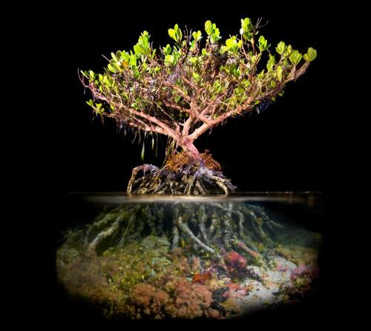
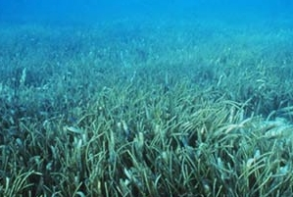
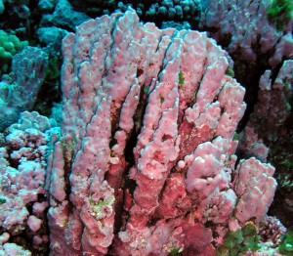
Plants of the Coral Reefs
Mangrove Forests
Seagrass
Red Algae (type of seaweed)

Slide 7
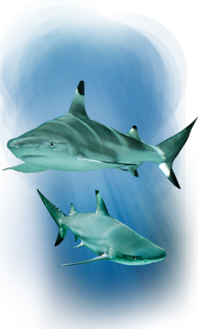
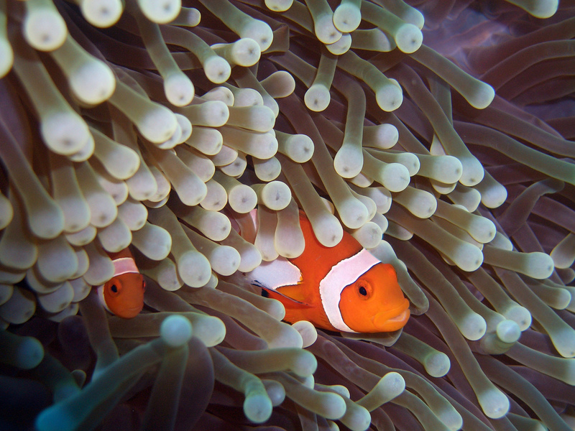
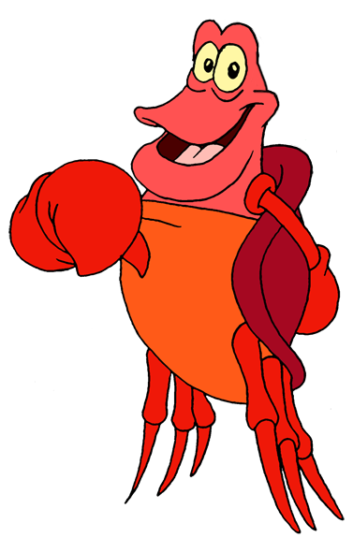
Who Will Be Your Neighbor?
Don’t forget me! Crabs too!
The coral reef biome is so vast that it is actually home to 25% of marine species.
Clownfish
Sea Turtles
Black Tip Reef Shark

Slide 8
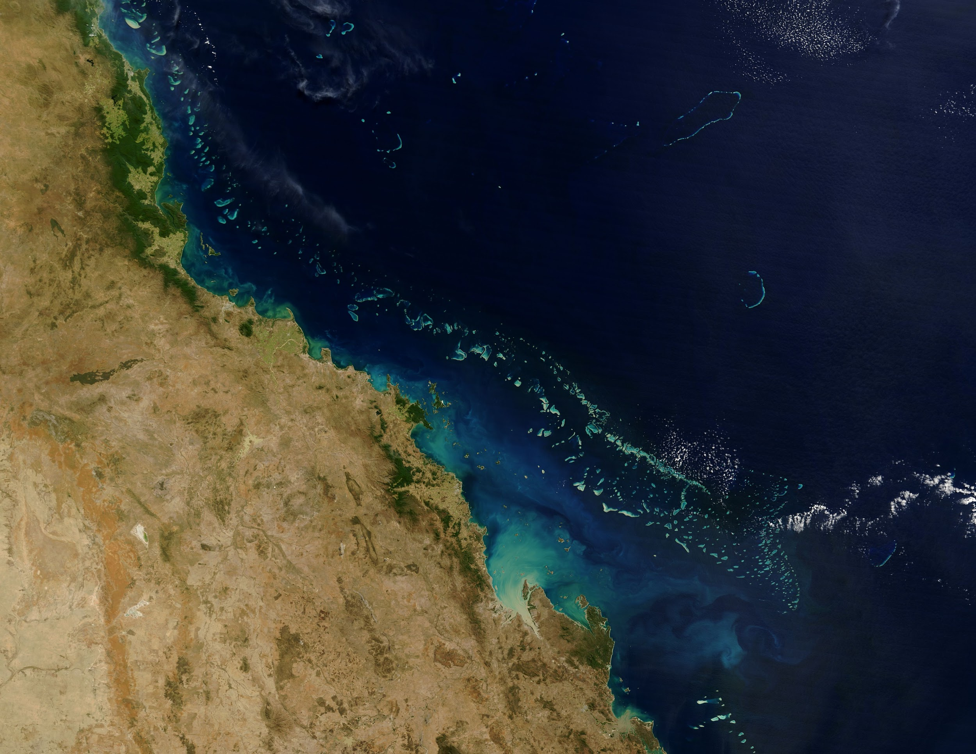
What infamous Coral Reef can be seen from space?

Slide 9
Oh No! Global Warming!
If you want us to stick around you might want to change your ways!!
Coral Reefs are a very sensitive biome. Equilibrium in this ecosystem is key to it’s survival.
But with the waters warming, oxygen is decreasing in the waters. This is causing what is known as coral bleaching.
The heat is also killing the algae that lives on the coral and that will inturn kill the coral.
Coral reefs lack genetic diversity which allows them to die off faster.

Slide 11
Fun Facts!
Corals are also predators; they extend their tentacles at night and capture tiny organisms that are floating by with stinging cells called nematocysts. The captured prey is then moved into the mouths and digested in their stomachs.
Some of the ancestors of these reefs were formed over 240 million years ago.
Coral Reefs are able to reproduce asexually and sexually.
There are 4 types of Coral Reefs:Fringing Reefs, Barrier Reefs, Atolls, and Bank/ Platform Reefs.
Polyps are actually translucent and get their color from other organisms.
Scientists have found that parts of the reefs can be harvested in order to treat illnesses and cancer.
Coral reefs can usually start from old ships that have sunk. Sometimes, the navy will sink ships in order to help coral reefs.

Slide 12
Brought to You With the Help Of...
http://oceanservice.noaa.gov/facts/coralwaters.html
http://coral.org/coral-reefs-101/coral-reef-ecology/geography/
http://coralreef.noaa.gov/aboutcorals/coral101/polypcolony/
http://wwf.panda.org/about_our_earth/aboutcc/problems/impacts/coral_reefs/
http://oceanservice.noaa.gov/facts/coral_species.html
https://www.visitsealife.com/arizona/explore-our-creatures/default/blacktipreefshark/
http://www.conserve-energy-future.com/top-25-coral-reef-facts.php

Slide 13
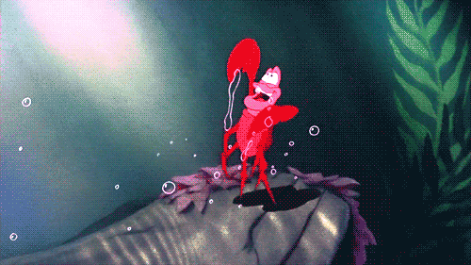
And Don’t Forget!
TAKE IT FROM ME!
Under the sea! Under the sea! Down there is wetter, down their is better!

