Slide 1
California Drought
by;Mekhrangiz Khashimova

Slide 2
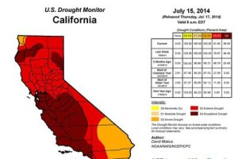
What and Where is the issue?
California, U.S (Especially Southern Central Valley).
Due to low precipitation in 2011-2012 California State have declared drought and since it has worsening

Slide 3
Environmental Impacts
Drought is causing massive wildfires
According to California Department of Forestry and Fire Protection in 2014 there was 3,400 wildfires
Drought is causing evacuation of fish
Due to little mountain run off bodies of water are getting warm in which fish cannot live in

Slide 4
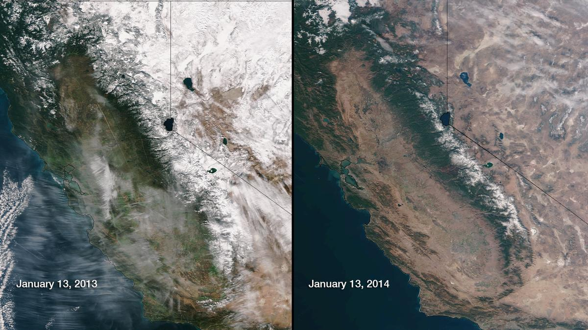
Mountain Snow

Slide 5
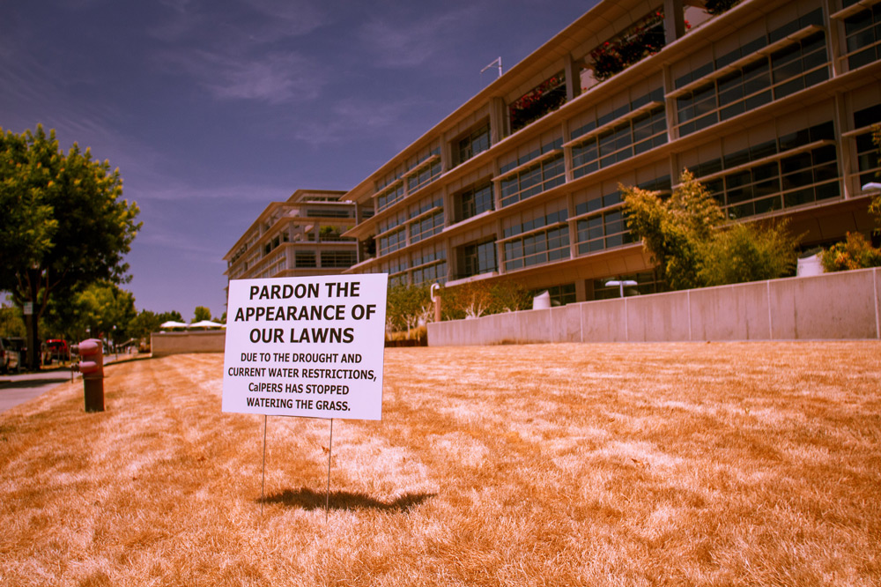
Social Concern
Quality of Life
Have worsened
No water for shower, laundry & dishes
$500 fine on watering lawns, sidewalks and for wasting water
Human Health
Hygiene concerns
Psychological issues

Slide 6
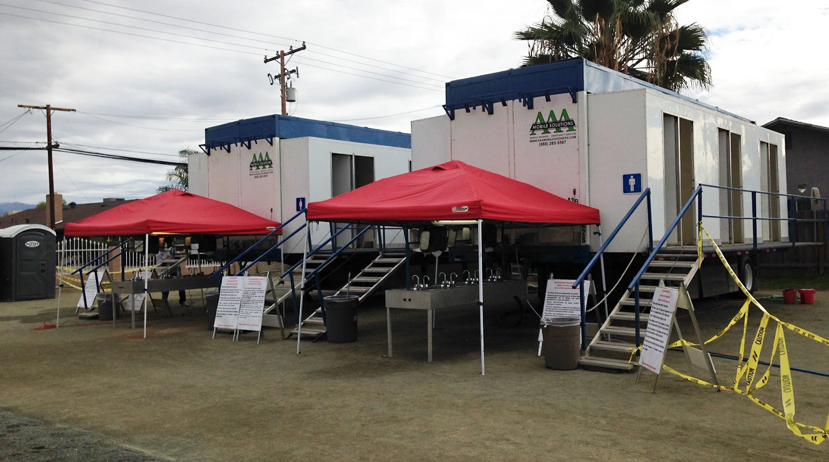
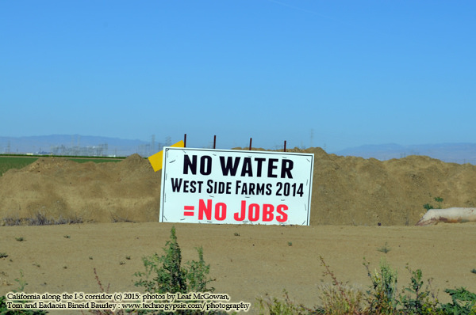

Slide 7
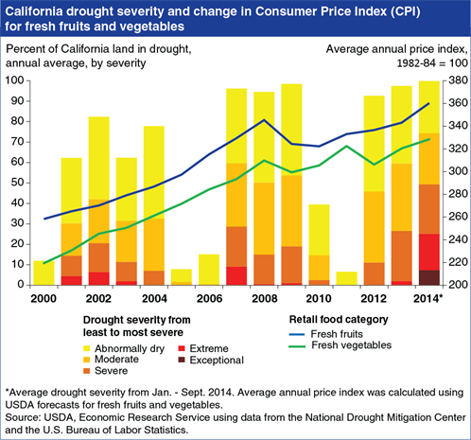
Economic Effects
Will cost California about $2.7 billion for 2015 (increase $.5 billion since 2014)
21,000 people have lost jobs just this year in 2015, (10,100 are farmers)
542,000 acres of land are fallow
$856 million direct crop revenue loss ( 1.8 billions agricultural costs)
$350 dairy and in livestock revenue loss
Increase in prices of fruits, vegetables and nuts

Slide 8
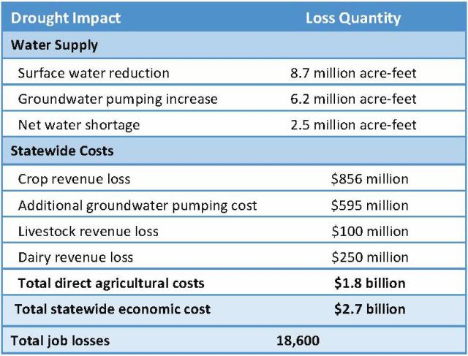

Slide 9
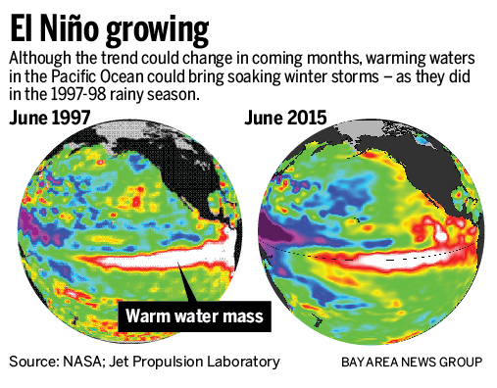
Can the drought end?
Yes! Only if El Nino occurs
Warm water in the Pacific Ocean will bring rainy winter
Now it’s forming a weak and moderate el nino in the ocean
California needs a very strong El Nino to recover
Chance of happening 80%

Slide 10
So what is government doing?
Governor Edmund Brown Jr. introduced the 25 % statewide mandatory water reductions
Set regulations and fines ($500) on using water thoughtlessly
Desalinations Plant
Through Reverse Osmosis the salty ocean water becomes a drinkable water
This desalination project costs $1 Billion dollars

Slide 11
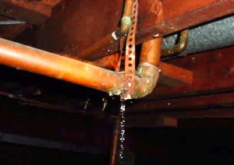
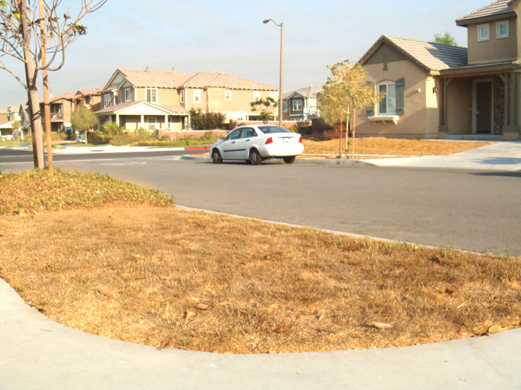
Ways to save water.
Get the leaking pipes fixed
Change showerheads
Reduce the amount of shower time
Use dishwashers properly (fill out)
Don’t hose down or water your lawn

Slide 12
Bibliography
http://gizmodo.com/the-reservoir-that-made-the-world-pay-attention-to-cali-1742917839
https://www.google.com/search?q=California+Drought&safe=strict&espv=2&biw=1309&bih=726&source=lnms&tbm=isch&sa=X&ved=0CAcQ_AUoAmoVChMIrcXc7LqayQIVw1w-Ch18oQQM#imgrc=nkCS7FySOb9ogM%3A
http://www.sacbee.com/news/state/california/water-and-drought/article31396805.html
http://www.latimes.com/local/lanow/la-me-ln-fish-hatcheries-evacuated-20140617-story.html
http://www.cbsnews.com/news/california-folsom-lake-reaches-historic-low-during-record-drought/
http://www.latimes.com/local/weather/la-me-ln-as-huhttp://www.ppic.org/main/publication_quick.asp?i=1141
ge-el-nino-brews-california-fights-to-keep-drought-mentality-20151116-story.html
http://www.cbsnews.com/pictures/californias-drought/4/
http://www.cadrought.com/
http://www.standard.net/Business/2015/06/03/Drought-Takes-2-7-Billion-Toll-on-California-Agriculture
https://www.revealnews.org/article/why-the-california-drought-affects-everyone/
http://www.standard.net/Business/2015/06/03/Drought-Takes-2-7-Billion-Toll-on-California-Agriculture

