Slide 1
IS THIS BIOME FOR YOU?
by Attia Azam

Slide 2
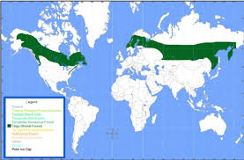
Location
Canada
Europe
Russia
Finland
Sweden

Slide 3
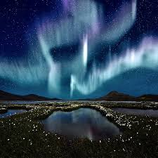
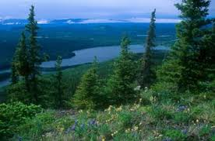
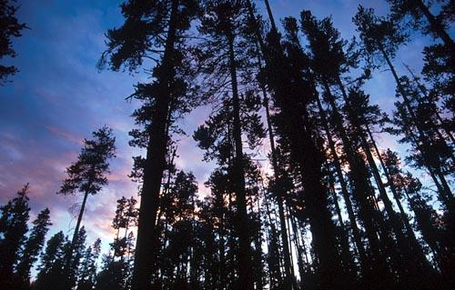
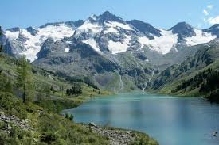
Scenery

Slide 4
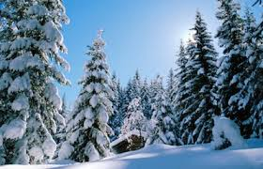
Temperature
anywhere from -5 to +5 celsius
23-43 degrees Fahrenheit
Perception is in form of snow
20cm-200cm
7-78 inches of snow
Short summers = long winters

Slide 5
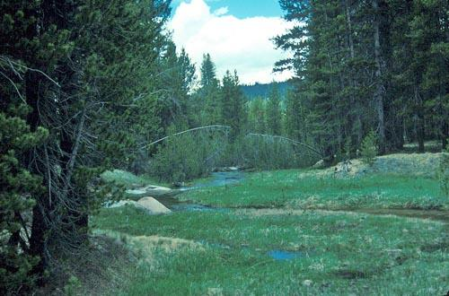
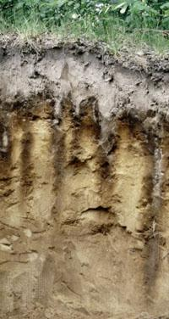
soil
Short growing season
Soil is spodosol- grey and ashy
Acidic

Slide 6
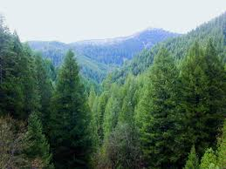
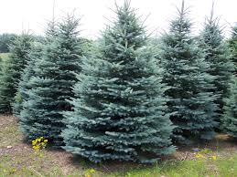
Vegetation
Coniferous trees
Evergreen spruce
Pine tree

Slide 7
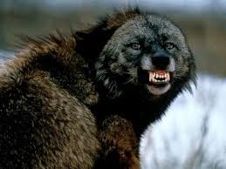
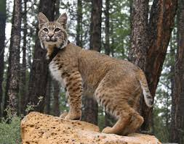
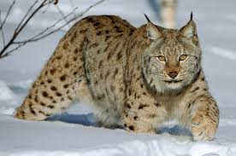
Animals
Lynx
Wolverine
Bobcat

Slide 8
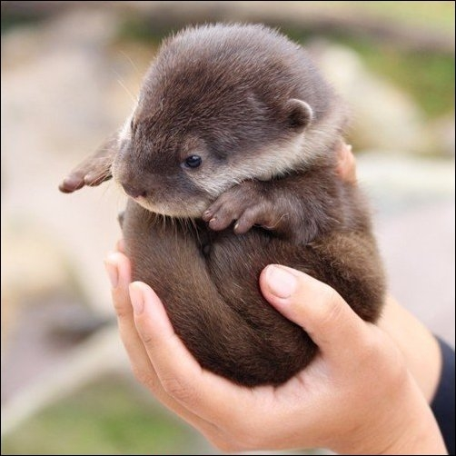
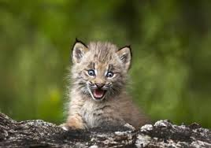
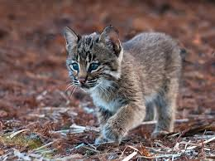

Slide 9
Effect of Climate Change
Emissions of CO2 and other greenhouse gasses warming the planet will cause
Warmer weather year round
Carbon sponges
Loss in habitat = decline of species grizzly,wolverine,caribou

Slide 10
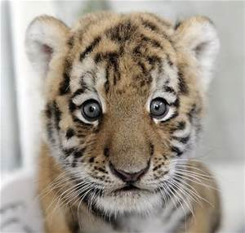
Facts
The greek god of north wind was Boreas
Has 300 bird species in the summer time but only 30 during winter
Only 12% is protected around the globe
Home to the Siberian tiger
The Aurora Borealis named after a goddess named Aurora and the greek god of the north wind Boreas
Means “dancing of the spirits”

Slide 11
sources
http://www.marietta.edu/~biol/biomes/boreal.htm
https://php.radford.edu/~swoodwar/biomes/?page_id=92
http://www.treehugger.com/natural-sciences/30-fascinating-facts-about-the-boreal-forest.html
http://forestecology.cfans.umn.edu/Research/B4WARMED/

