Slide 1
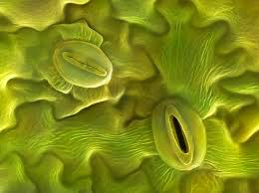
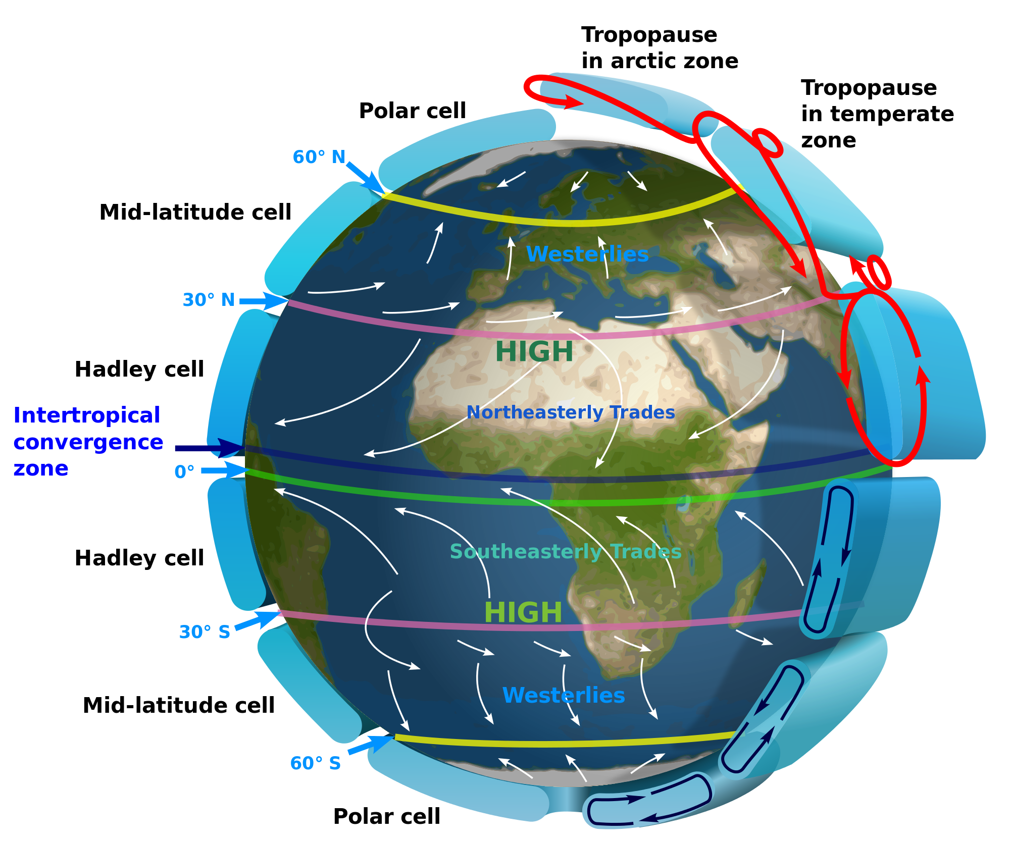
SWBAT design a lab that tests soil salinization. SWBAT evaluate students responses to an experimental design FRQ.
APES 1/29/16

Slide 2
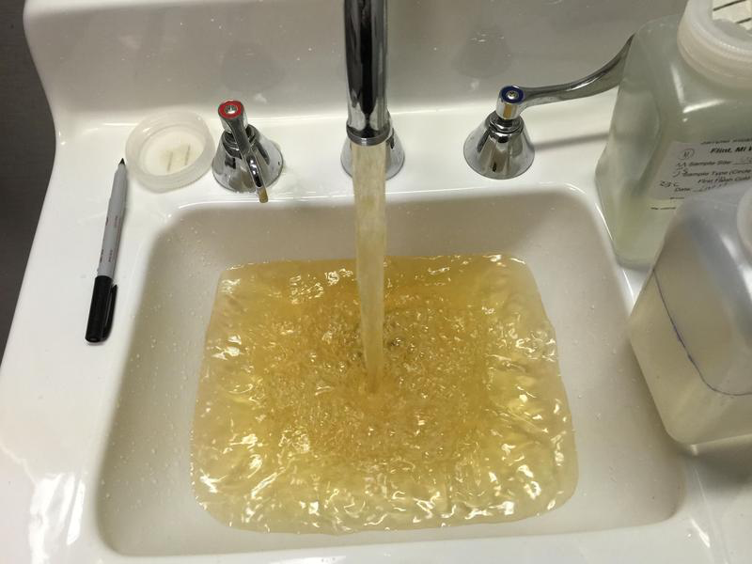
Homework Share Out
Share out your reaction of the Flint Water Crisis

Slide 3
Agenda
Experimental Design FRQ
Design Salinization Lab
Math FRQ

Slide 4
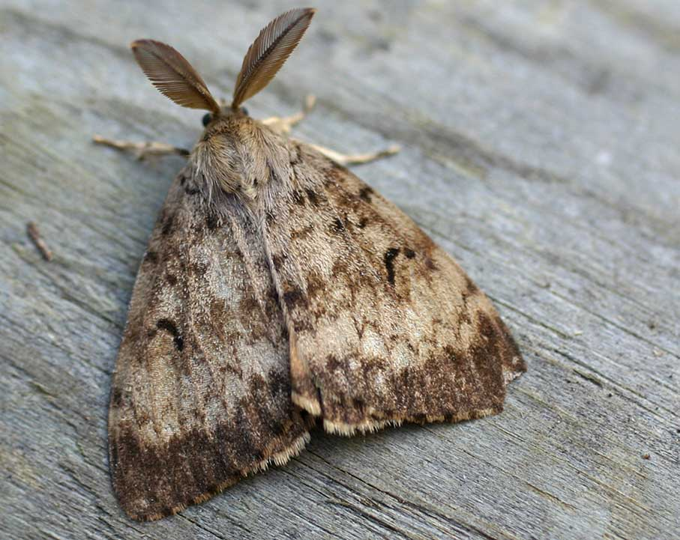
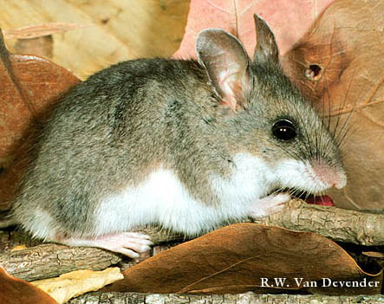
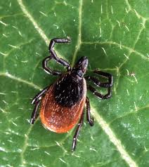
Gypsy Moth and Deer Tick FRQ

Slide 5
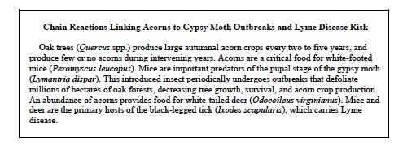
Gypsy Moth and Deer FRQ
Make a food web of the organisms interacting in the following FRQ:

Slide 6
Gypsy Moth and Deer Tick
Hypothesis: The independent variable makes a difference
Null hypothesis: the independent variable does NOT make a difference
Used because it is easy to disprove
Example:
If there is increased acidity, then there will be more weathering of rocks
Acidity has no effect on the weathering of rocks

Slide 7
Gypsy Moth and Deer Tick
Read over the rubric for part B
Read the first sample
Score for hypothesis
Which type of experiment is it: experimental or observational?
Score for control
Score for elaboration
Repeat for the second sample
Don’t grade part C!

Slide 8
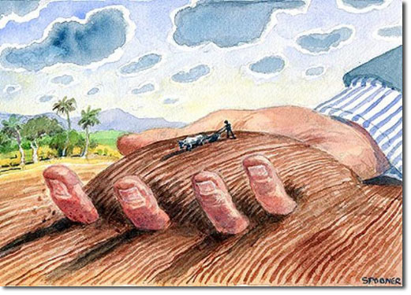
Unit 8: Land and Food
~ 2 weeks
Soil Salinization lab
EQs:
How does agriculture and our food choices impact the environment?
What role do GMOs play in feeding the world?
Current Event Presenters: Wyllana and Mahnoor

Slide 9
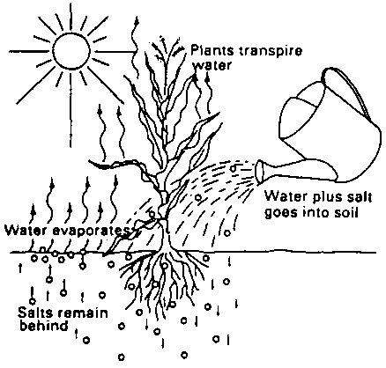
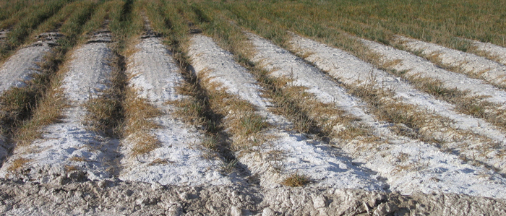
Soil Salinization

Slide 10
Lab Design
Independent variable:
Dependent variable:
Hypothesis:
STOP and check in with Ms. McDaniel!

Slide 11
Lab Design
Constants:
Control:
Materials:
Graduated cylinder
10 mL 0% salt solution
10 mL 0.5% salt solution
10 mL of 3.5% salt solution
3 ziplock bags
3 napkins
Permanent marker
30 radish seeds

Slide 12
Homework
Unit 7 FRQ rewrite

