Slide 1
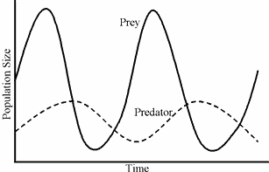
SWBAT review for a midterm.
APES 1/21/16

Slide 2
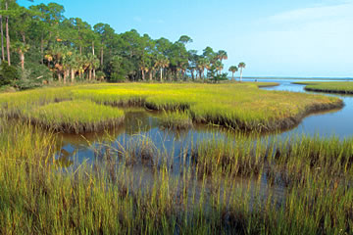
Wetlands
Why are they important?
How are humans impacting them?
Migratory birds rely on wetlands as stopovers and breeding grounds
High amount of biodiversity
Humans are draining wetlands and diverting the water for drinking water and agricultural use
Building housing developments on wetlands

Slide 3
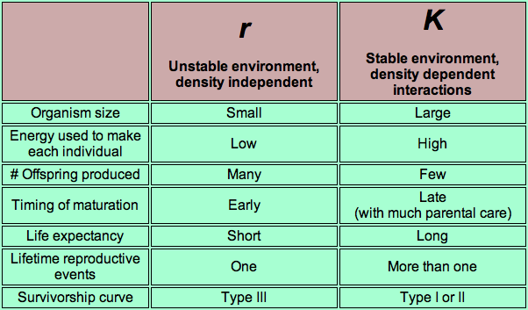
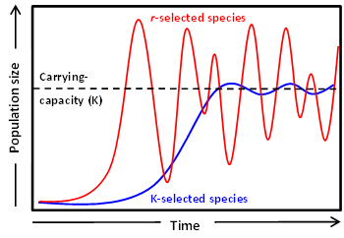
R vs. K selected species

Slide 4
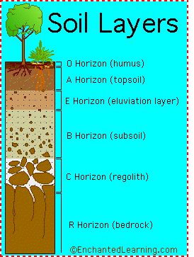
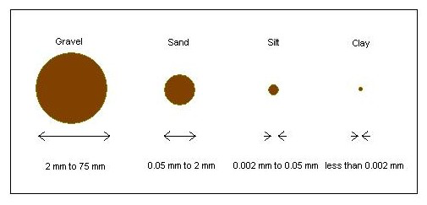
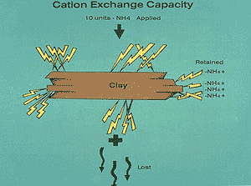
Soil

Slide 5
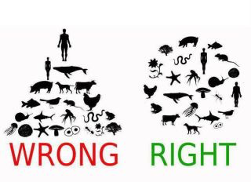
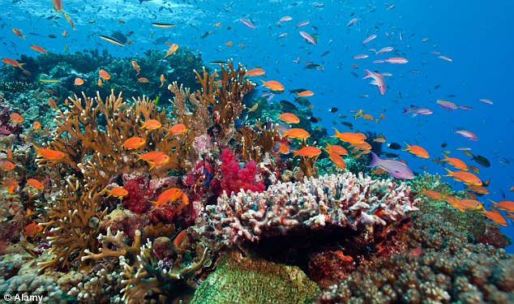
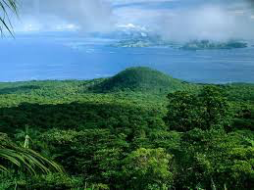
Biodiversity

Slide 6
Homework
Study for the exam!

