Slide 1
APES Unit 7 2/23/16 SWBAT understand current event issues related to land and food.

Slide 2
Reminders
All work for Unit 7 is due today!
Come up at lunch to make up the exam!

Slide 3
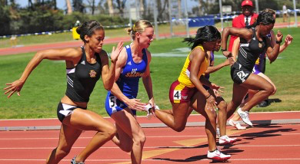
The final stretch!

Slide 4
Discussion
How can we change our food industry to make it safer for consumers?

Slide 5
Homework
Read Ch. 15 through page 415 (stop right before natural emissions)
Take detailed notes!

