Slide 1
SWBAT review global warming and math!
APES 4/21/16

Slide 2
Agenda
Carousel activity: global warming
Math
Hw/wrap up

Slide 3
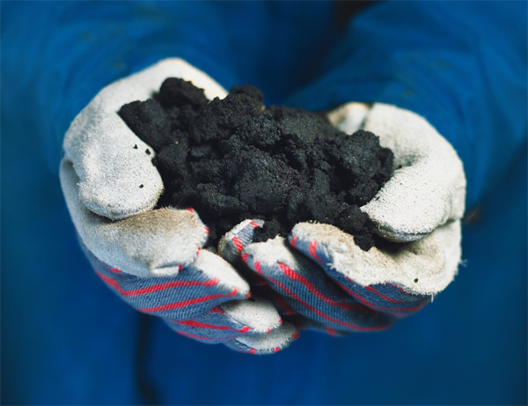
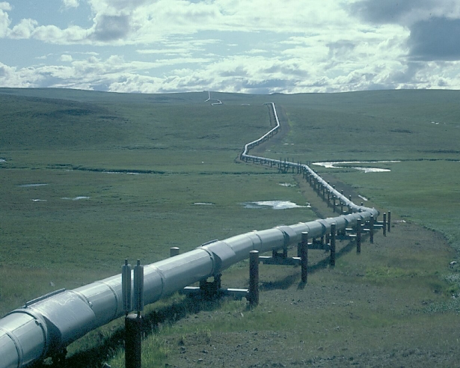
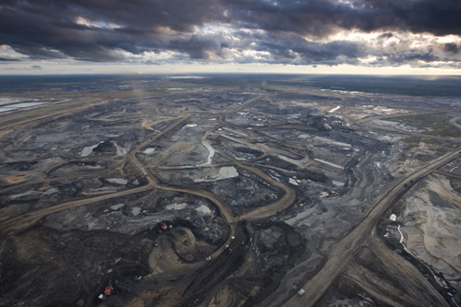
Keystone Pipeline

Slide 4
Carousel
Greenhouse Gases and the greenhouse effect
Loss of Biodiversity
Cause and effects
Protecting biodiversity
Rise in sea level
Cause and effects
Ocean acidification
Effects of Global Warming

Slide 5
Math
Same groups as before!
#1 should read 100 meters
No Calculators

Slide 6
Hw:
You only have to do 14 FRQ reflections over break
Plan in when you are going to study
Plan in when you will do FRQ reflections #10-14
2 hours each day
Ways to review:
APES in a box videos
Flashcards
Barron’s MC
Practice dry runs on your own
Bring in Barron’s flash cards tomorrow!

