Slide 1
SWBAT identify the ways humans use water and methods for water conservation.
APES Unit 4 11/13/15

Slide 2
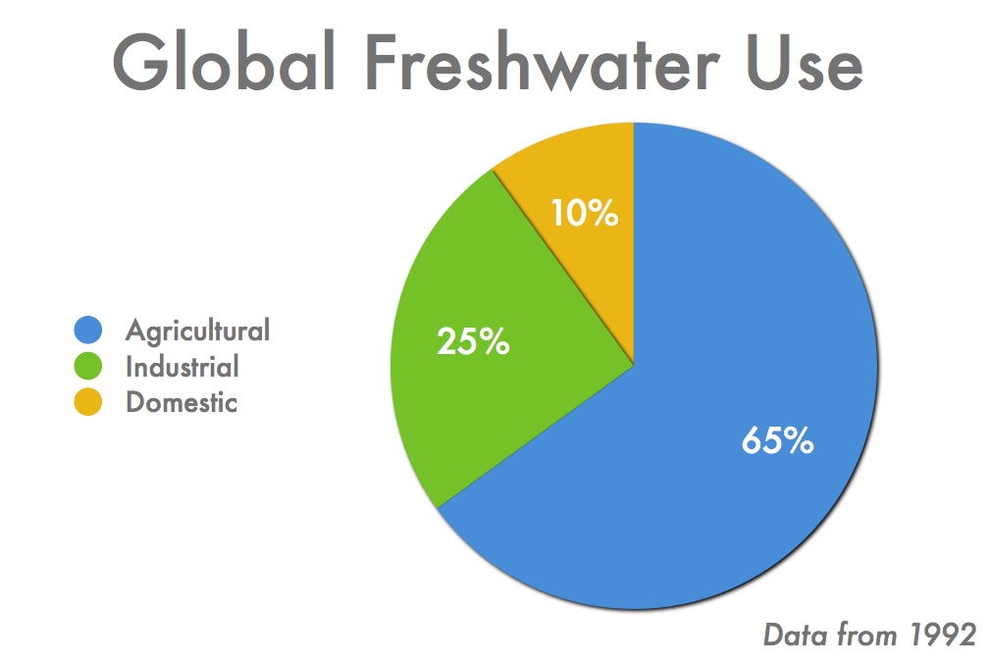
Humans and water use
Freshwater use:
70% for agriculture
20% for industry
10% for household uses

Slide 3
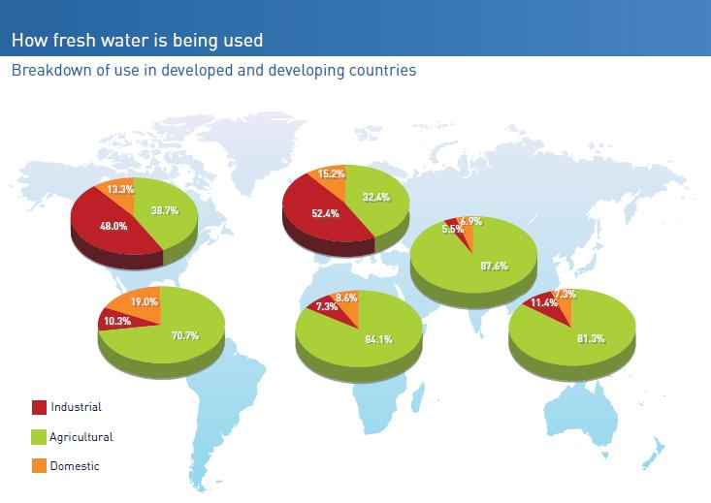

Slide 4
Agriculture
More humans → greater demand for food→ more water needed for agriculture
Livestock requires more water than crops
1 kg beef uses 11 times more water than 1 kg of wheat
Countries with the greatest amount of irrigated land:
India
China
U.S.
Pakistan

Slide 5
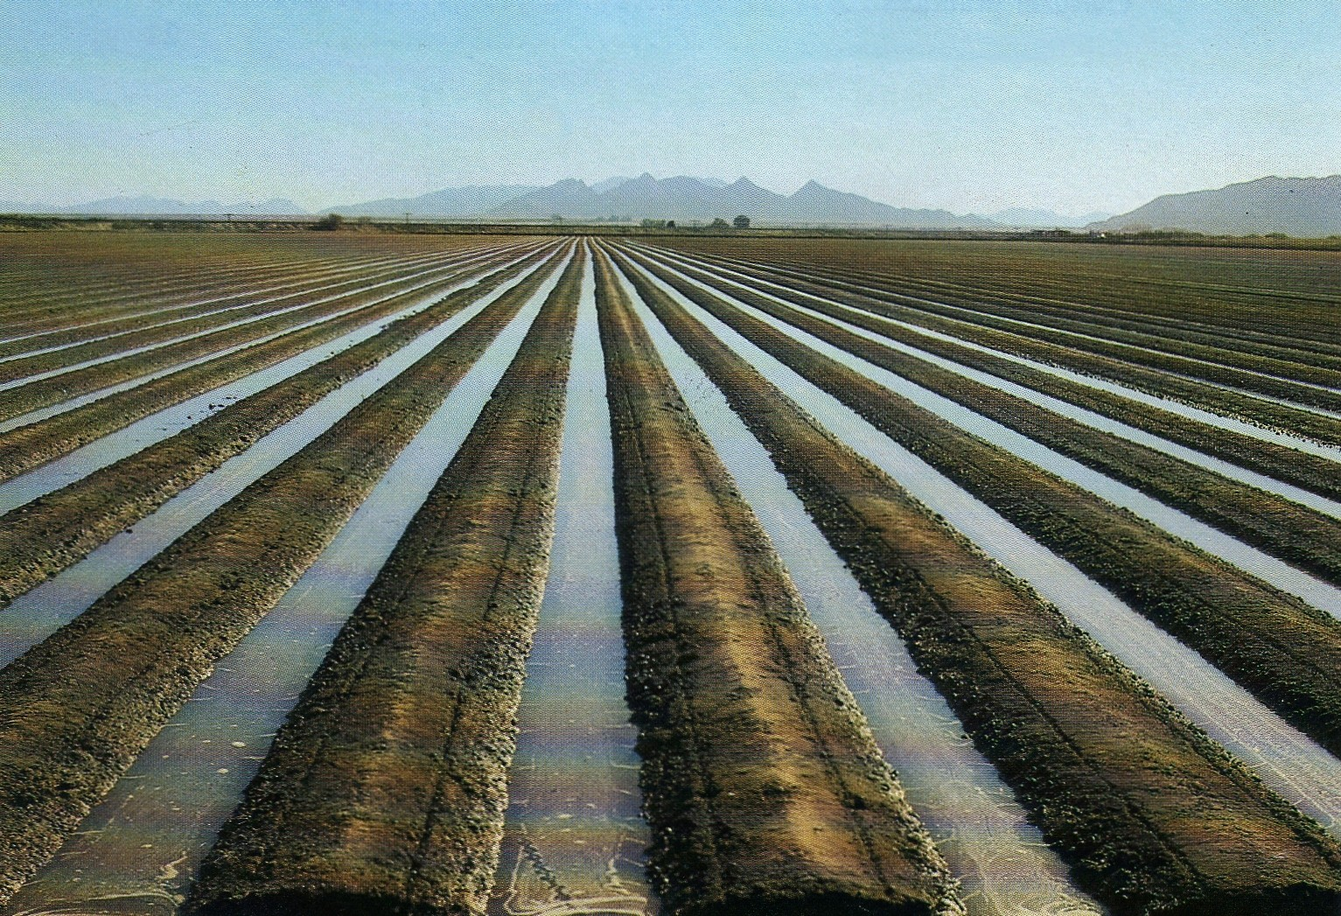
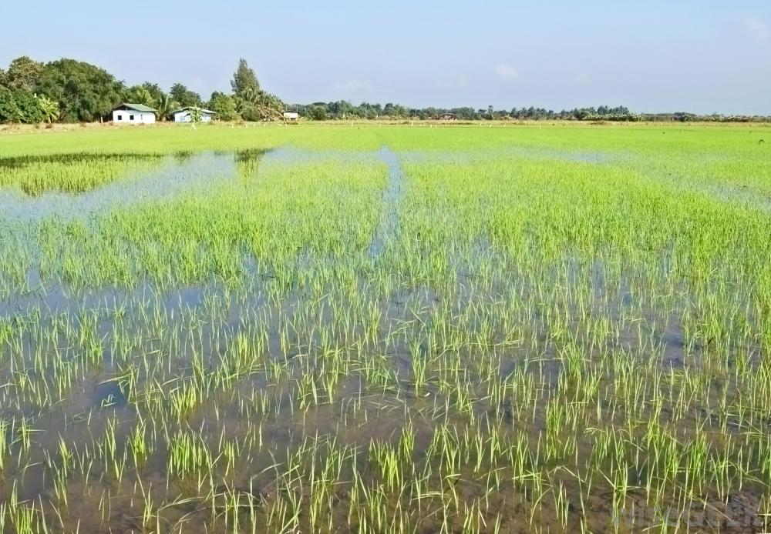
Irrigation
Furrow irrigation
Furrows (trenches) dug on either side of crops
65% efficient
Flood irrigation
Flood entire field
More disruptive to plant growth
70 to 80% efficient

Slide 6
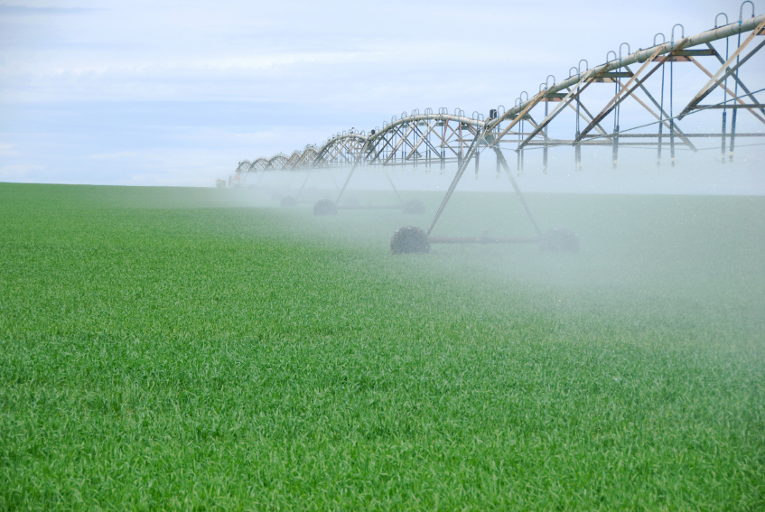
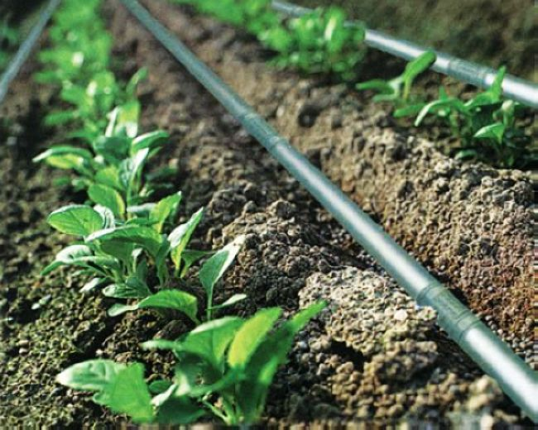
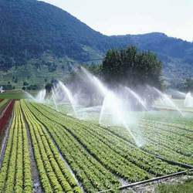
Irrigation
Spray irrigation (center-pivot systems)
Water pumped from a well to nozzles that spray over a field
More expensive
Drip irrigation (micro-irrigation)
Hose buried beneath ground
Increases efficiency (95%) and crop yields

Slide 7
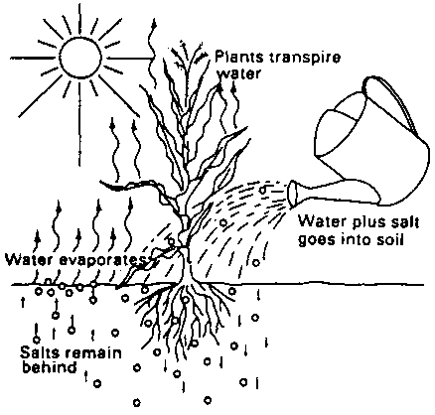
Increased soil salinity from irrigation

Slide 8
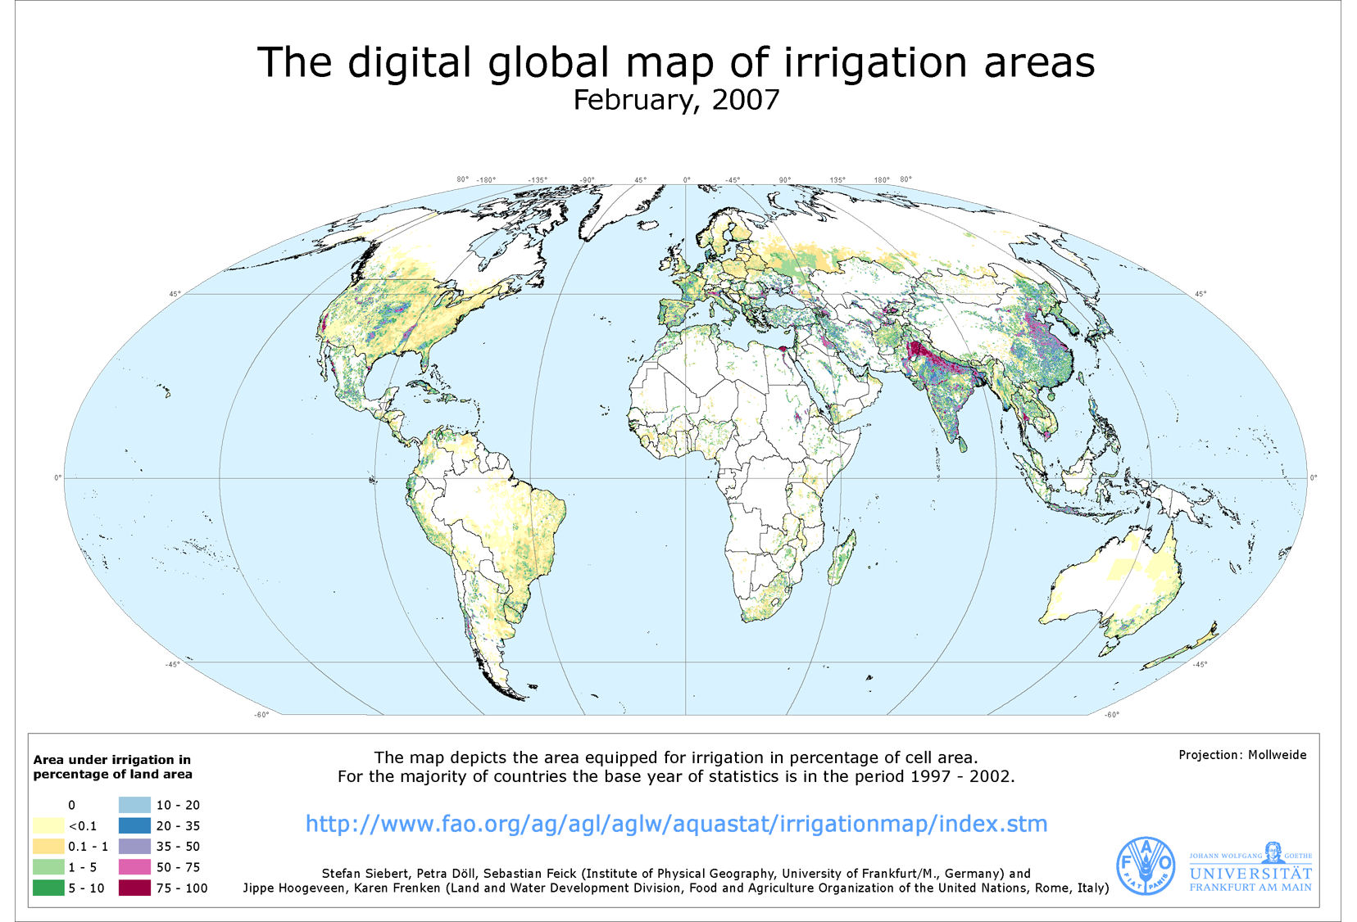
Irrigated Land

Slide 9
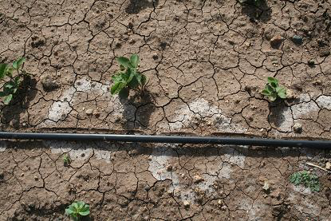
Irrigation
The most agricultural land under irrigation is found in Asia
Massive irrigation of desert areas to grow crops can lead to salts accumulating in the soil and reduced crop productivity

Slide 10
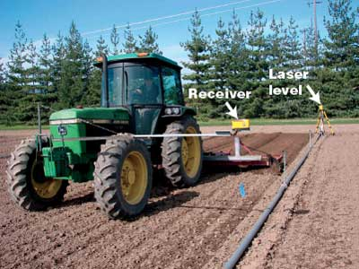
Irrigation
Ways to reduce wastewater in irrigation
Leveling fields with lasers
Lining irrigation ditches with concrete
Using polyculture
Irrigating with treated urban wastewater

Slide 11
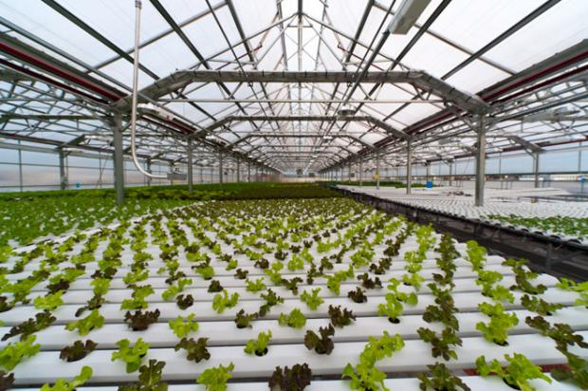
Hydroponic agriculture
Crops grown in greenhouse with no soil, only water
Advantages:
Water can be reused
Uses 95% less water
Produces more crops per hectare
Minimal need for pesticides
Disadvantage:
More expensive

Slide 12
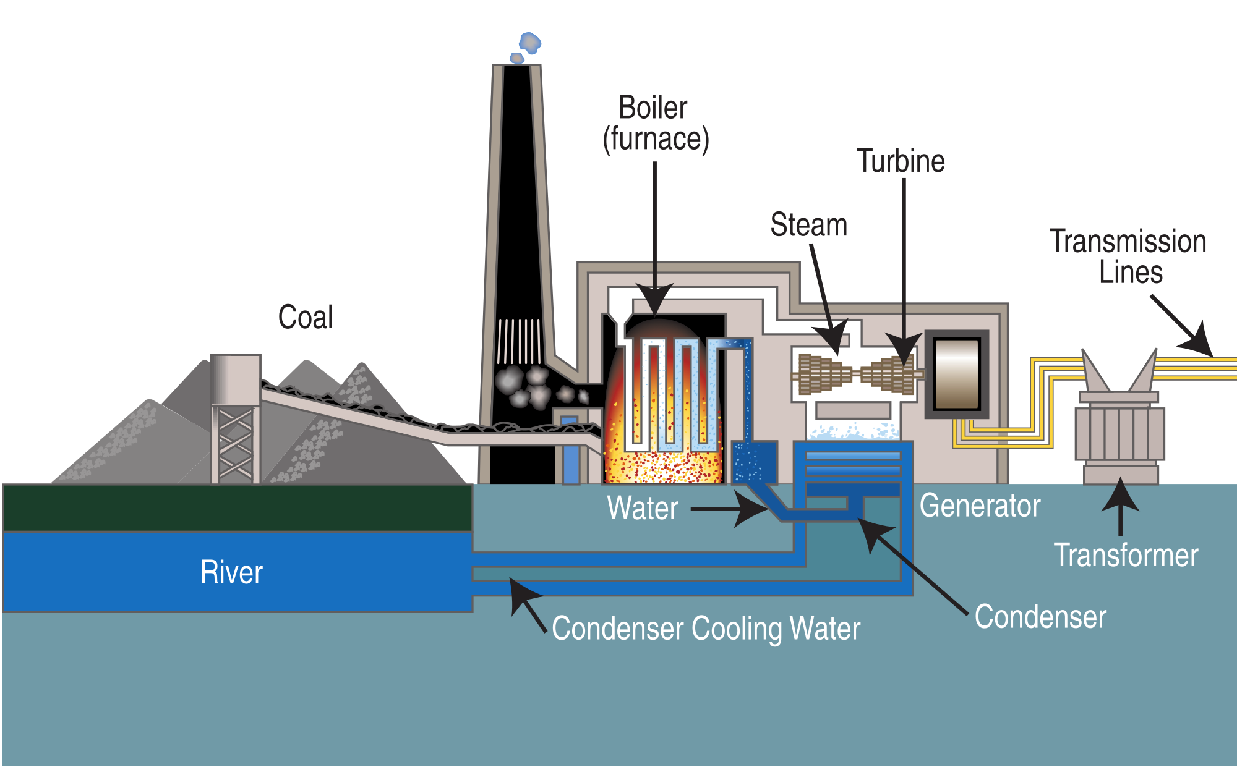
Industry
Water is used for industrial purposes
Generating electricity
Cooling machinery
Refining metals and papers

Slide 13
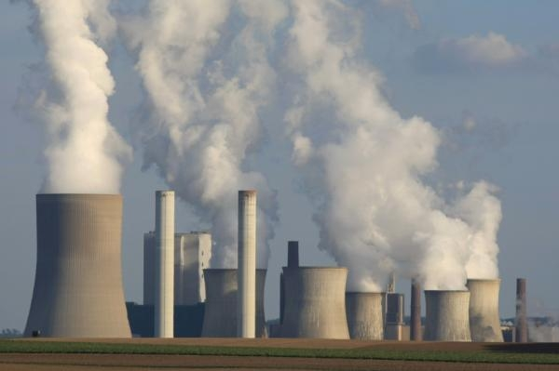
Industrial water use: Electricity
Largest use for industrial water is for cooling electrical power plants
Water used for hydroelectric dams is recycled
Thermoelectric and Nuclear power plants
Most water is not recycled back to source
Water converted to steam and used to turn turbines
Large percentage of water is lost to the atmosphere

Slide 14
Industry
Refining papers and metals require water
Copper
Aluminum
Steel
Paper

Slide 15
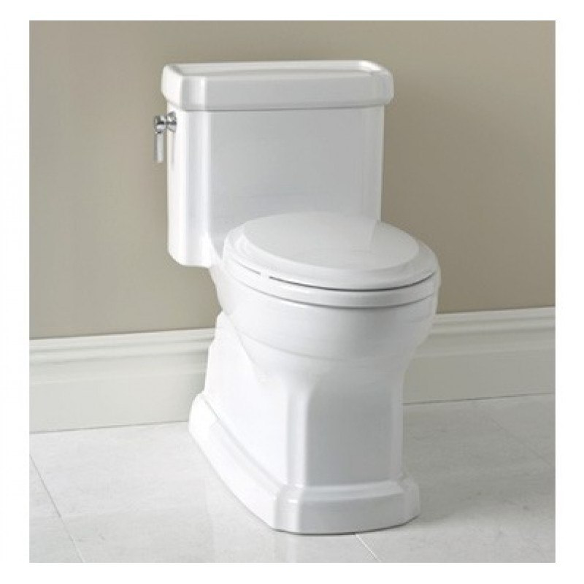
Household
10% of water in U.S. is consumed in the household
41% flushing toilets
33% for bathing
21% laundry
5% cooking and drinking

Slide 16
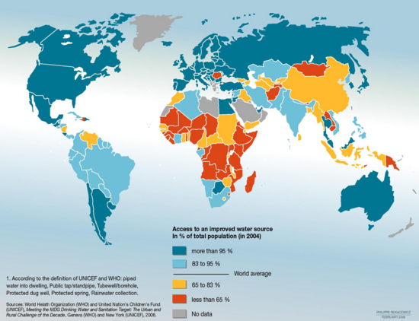
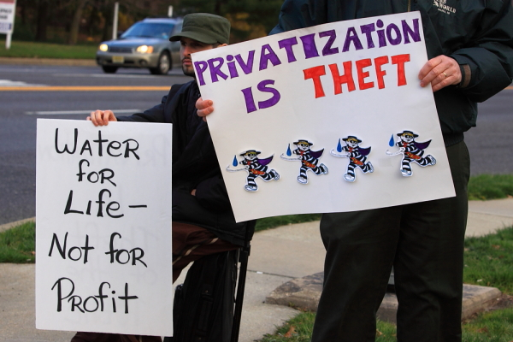
The future of water
Who owns water?
Conflicts between countries
Arab-Israeli War (1967)
Iran-Iraq War (1980)
Private vs. Public

Slide 17
Water Conservation: Agriculture
Irrigate crops with treated urban wastewater
Irrigate at night to reduce water lost to evaporation
Don’t grow water-thirsty crops in semi-arid regions
Increase government subsidies for efficient irrigation practices
Use soil moisture monitors to irrigate only when necessary
Use rainwater harvesting for smaller agriculture fields (developing countries)

Slide 18
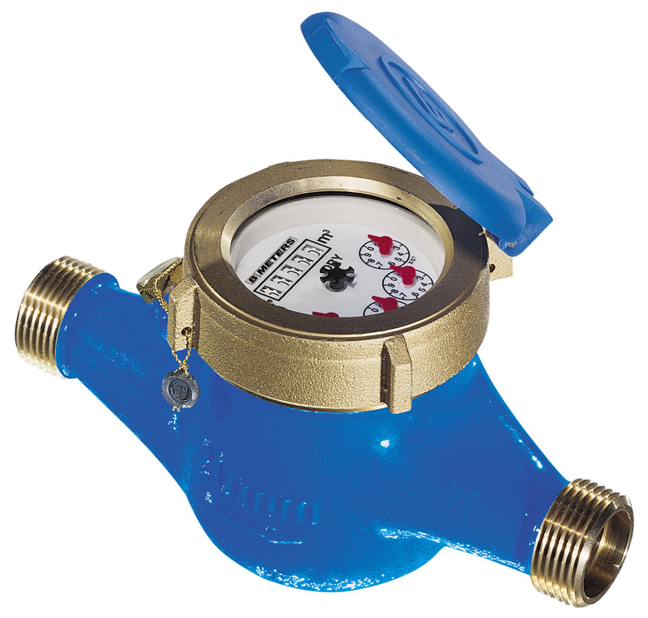
Water Conservation: Industrial and residential practices
Fix leaks in pipes and water mains (largest source of water loss for industrial and residential uses)
Increase prices for water
Require the use of water meters
Recycle water used in industrial processes
Use low-flow showerheads and low-volume toilets

Slide 19
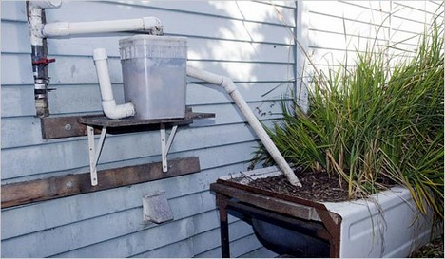
Water conservation: Grey water
Grey water systems: collects water from showers, bathtubs, dishwashers and clothes washers
Water used on lawns, to wash cars or to flush toilets

Slide 20
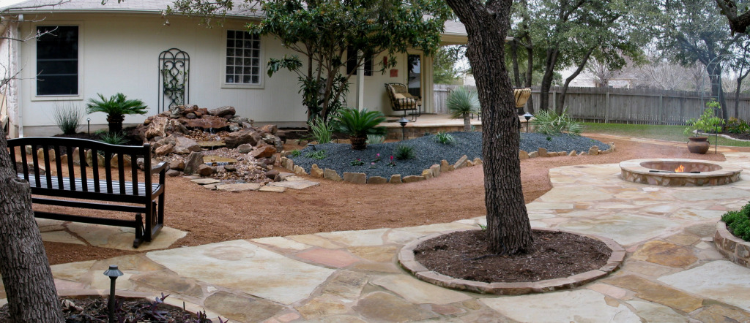
Xeriscaping
Landscaping and gardening that reduces or eliminates the need for supplemental water from irrigation.
Reduces household lawn irrigation needs

Slide 21
Check your understanding
Why is water ownership a complex issue?
What are some of the ways that humans can conserve water?
How does economic development influence water use?

Slide 22
Homework
Study for the quiz!
Read Ch. 14 through page 388

