Slide 1
Aim: How can humans alter the availability of water?
APES Unit 4 11/12/15

Slide 2
The week ahead
Chapter 9 quiz on Monday
Does anyone live near a natural source of water?
Agenda:
Lecture
Math practice!
Videos (if time)

Slide 3
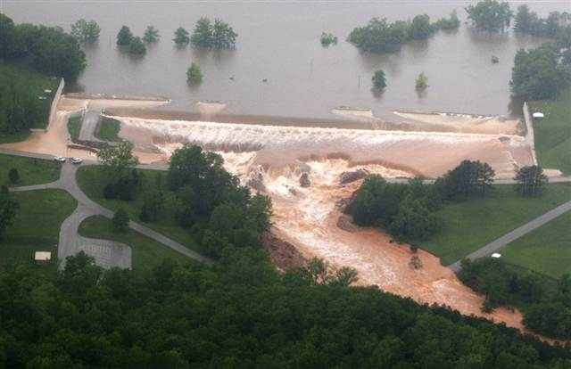
Levees
Levee: an enlarged bank built up on each side of the river.
Prevents flooding by rivers
Largest levees along the Mississippi river

Slide 4
Disadvantages of Levees
Floodwaters don’t add nutrients to plain→ less fertile soil
Sediments carried downstream and settle where the river enters the ocean
Prevent flooding at one location→ can cause flooding downstream
Developed areas may still flood

Slide 5
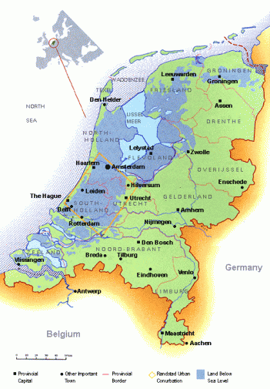
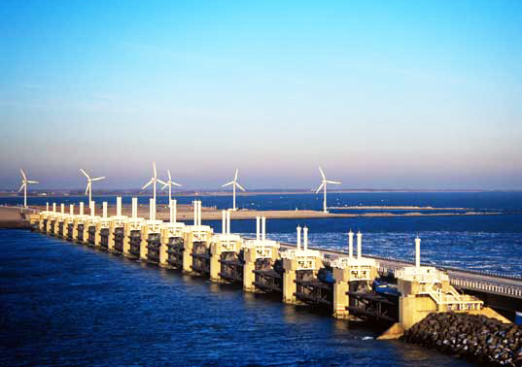
Dikes
Prevent ocean waters from flooding adjacent land
Common in Northern Europe

Slide 6
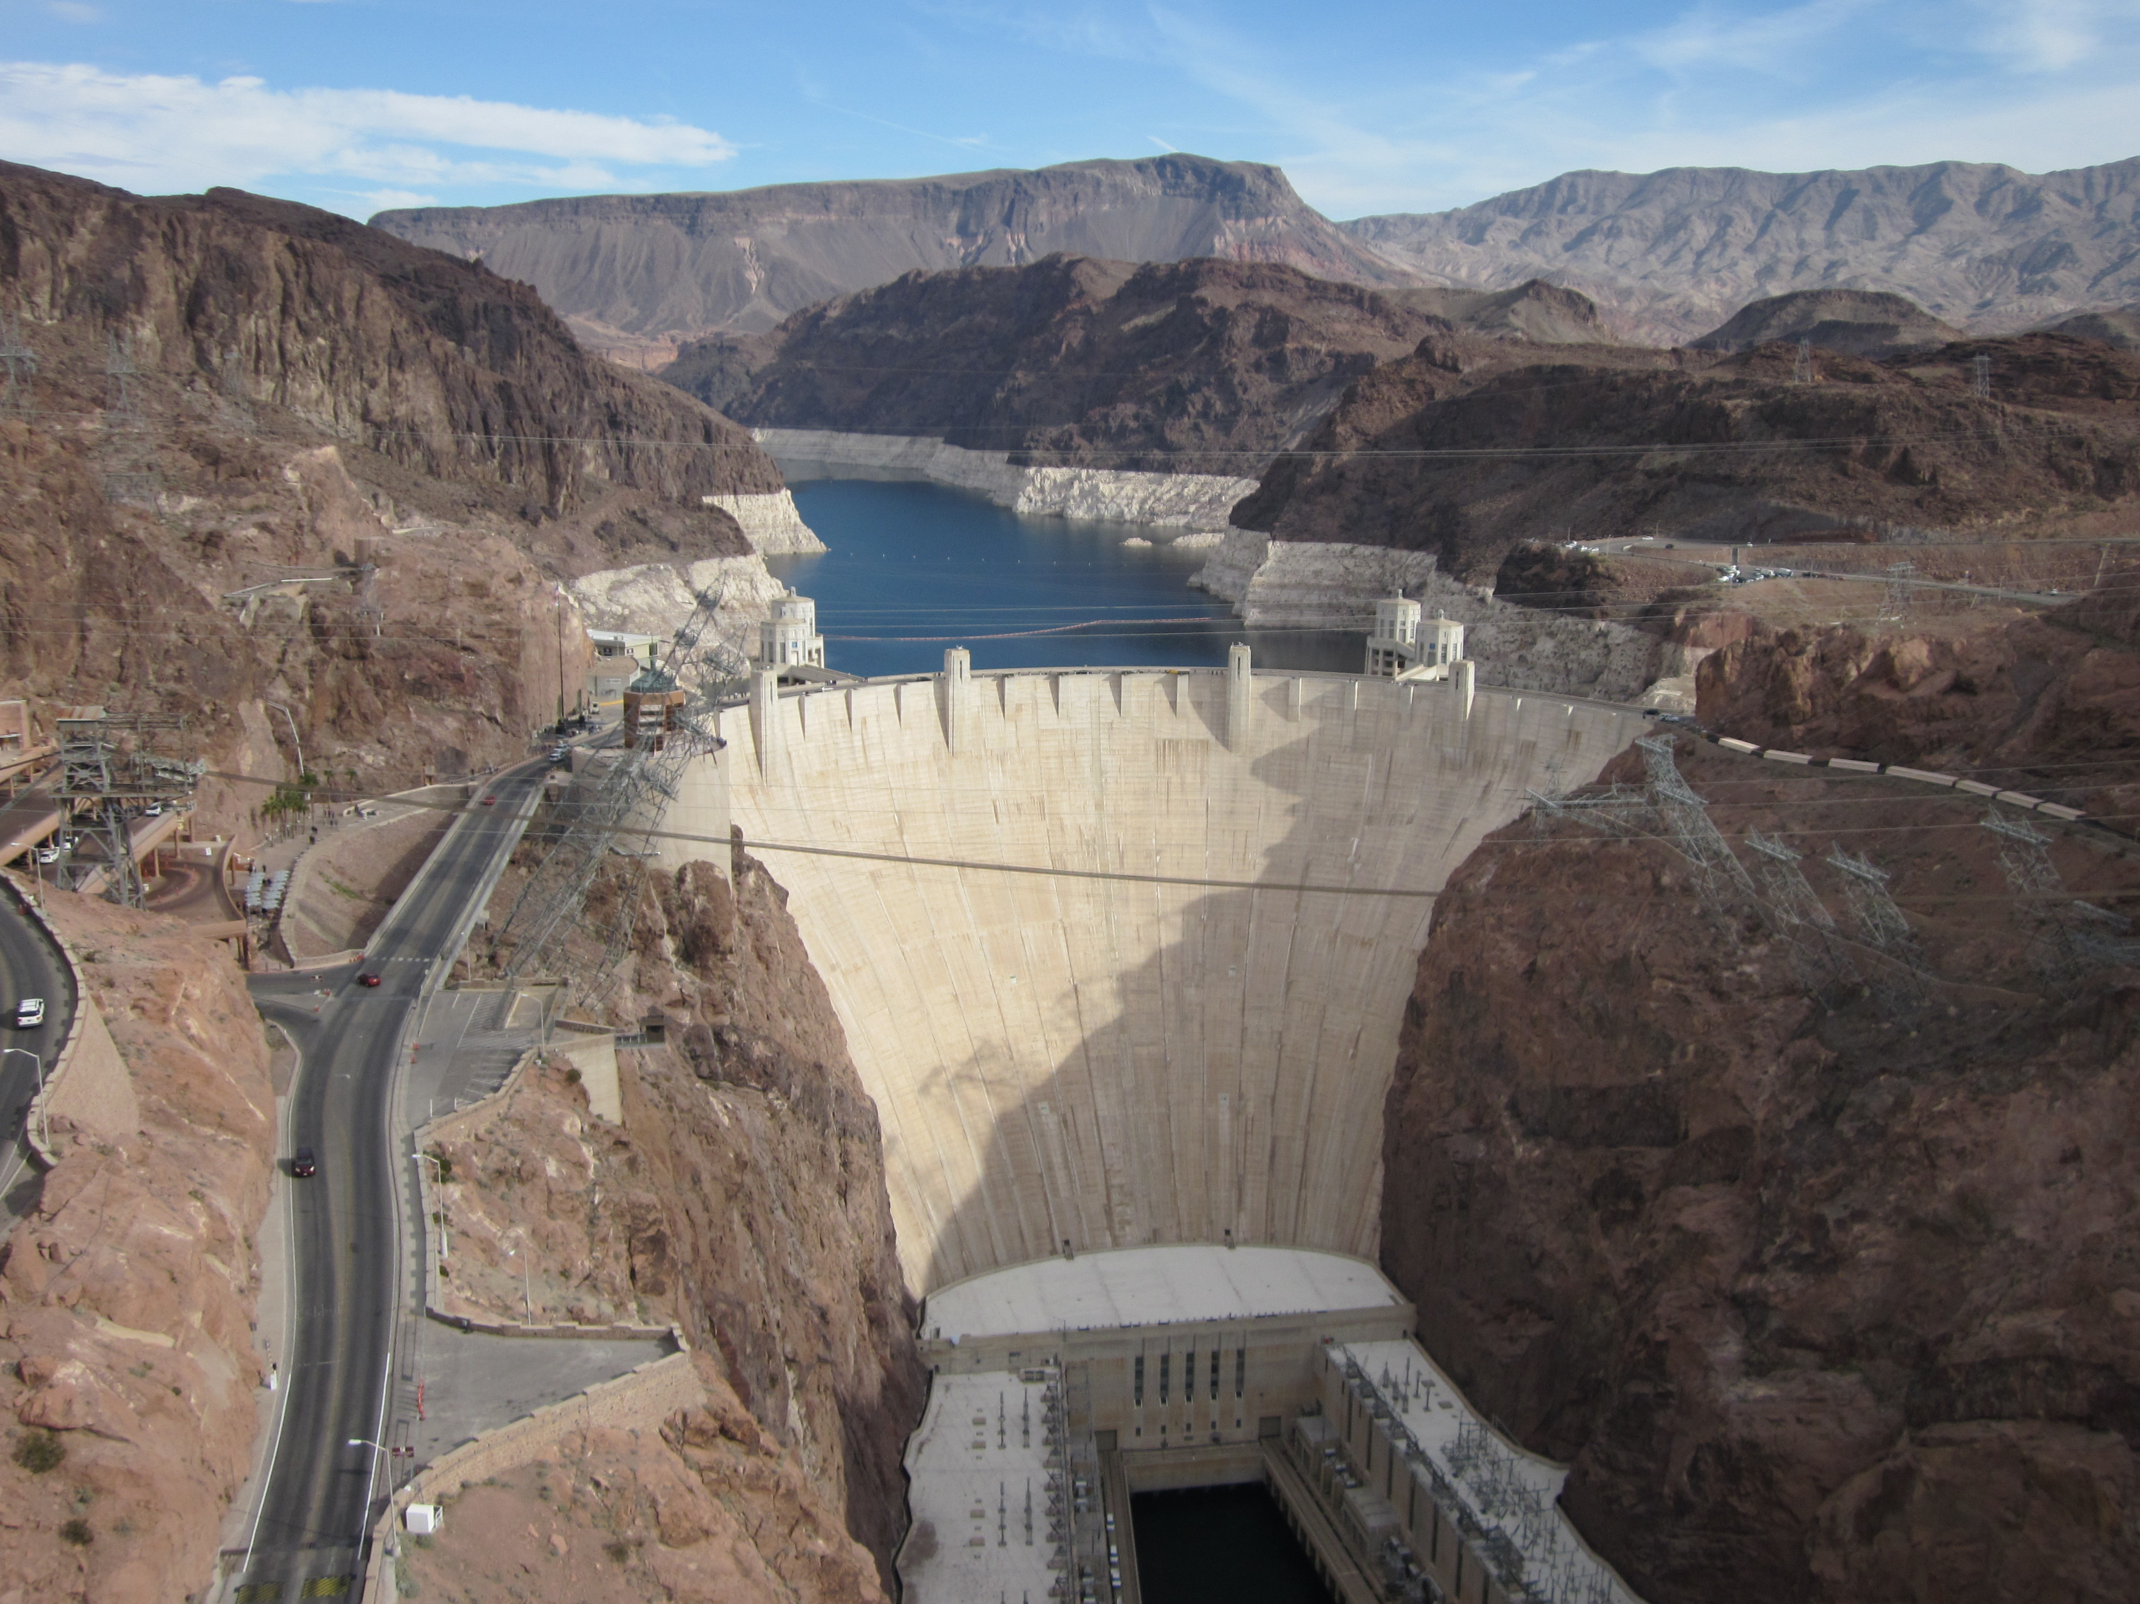
Dams
Barrier that runs across a river or stream to control the flow of water
Reservoir: body of water behind the dam where the water is stored

Slide 7
Advantages of building dams
Cheap electricity
Year round irrigation
Reduced downstream flooding
Reservoir for recreation

Slide 8
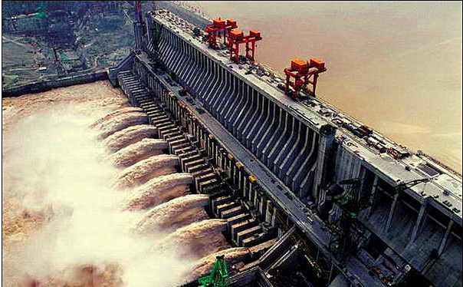
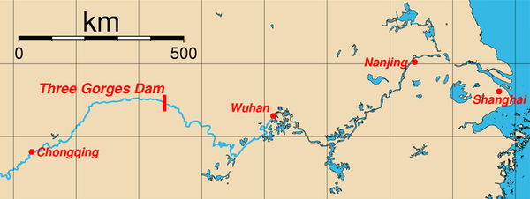
Case Study: Three Gorges Dam
World’s largest dam
Hydroelectric dam
Controls the flow of the Yangzte River in China
Disadvantage:
Flooding of large areas of farmland and homes behind the dam
1.3 million people relocated

Slide 9
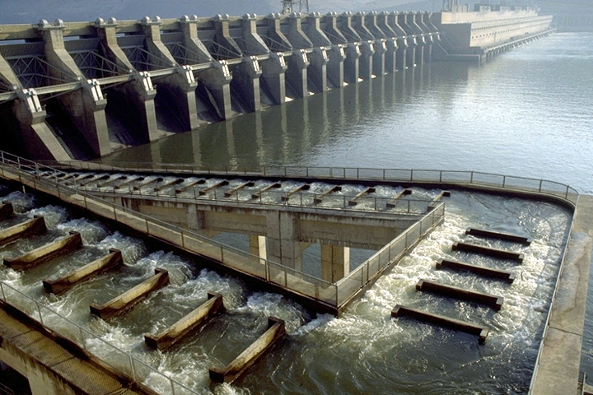
Dams
Fish ladders: permits migrating fish to swim up the ladder and reach their traditional breeding ground

Slide 10
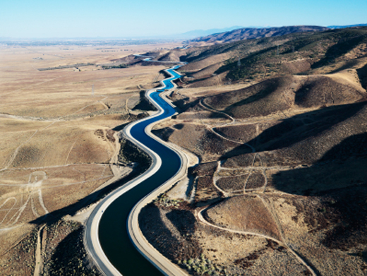
Aqueducts
Canals or ditches designed to carry water from one location to another.
Transport water from river or lake to where it is needed
Catskill aqueduct: Water from Catskill mountains to NYC
Colorado River aqueduct: Water from Colorado river to L.A.

Slide 11
Aqueducts
Advantages:
Fresh water supplied to needy regions
Disadvantages:
Expensive
Leads to habitat fragmentation
Less water in natural river

Slide 12
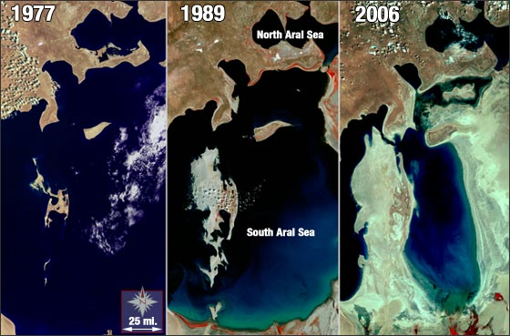
Case Study: Aral Sea
Project by Soviet Union in 1950s
Decreased freshwater input into Aral sea→
Salinity of water increased →
Destroyed local fish populations

Slide 13
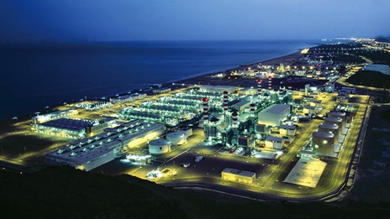
Desalination (Desalinization)
Process by which salt is removed from water
Most desalinization plants are located in the Middle East
Uncommon in the U.S. due to high value

Slide 14
Desalination Process: Distillation
Heat boils seawater→ leaves behind evaporated salt water
Steam is captured and condensed→ yields pure water
Disadvantages:
Uses lots of energy
Expensive

Slide 15
Desalination Process: Reverse Osmosis
Most common form of desalination
Water forced through semipermeable membrane at high pressure
Water passes through membrane, salt does not
Brine: remaining liquid that has a high salt concentration
Can contaminate soil and harm plants and animals
Usually dumped in ocean but not safe

Slide 16
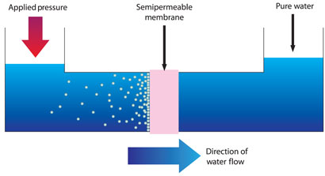
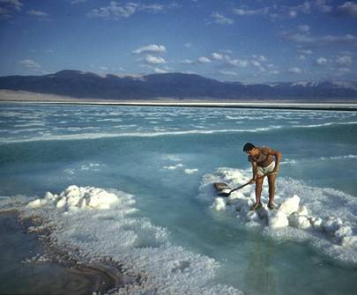
Desalination Process: Reverse Osmosis

Slide 17
Water Use: World Facts
The worldwide demand rate for water is about two times the rate of population growth
1/6 of the world’s population does not have access to clean drinking water
The U.S. per capita use of water on a daily basis is 1,500 gallons

Slide 18
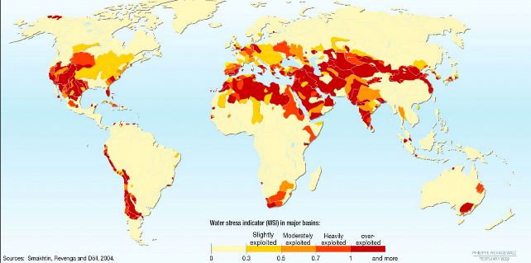
Water-stressed areas

Slide 19
Check your understanding
How do levees, dikes, dams and aqueducts differ from one another? What is the primary purpose of each?
What are the two methods of desalinization? How do they differ from one another?

Slide 20
Homework
Finish reading Chapter 9

Slide 21
Math Groups!
Group 1: Rimsha, Ramlah, Monica
Group 2: Cynthia, Wyllana, Rahila, Uzma
Group 3: Hamna, Shayna, Amrat, Mahnoor
Group 4: Attia, Wendy, Bukurie, Saliha
Group 5: Mehrangiz, Desire, Kaylah, Harmanpreet

Slide 22
Directions
Start with the ending unit!
Show ALL your work!
Ask 3 before me!
Don’t use your calculator for number 2

