Slide 1
SWBAT identify where usable water is located.
APES Unit 4 11/10/15

Slide 2
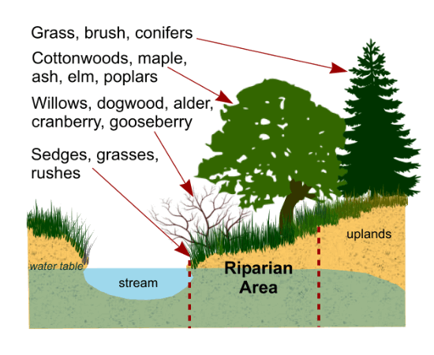
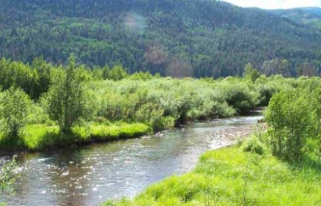
Riparian Zones
Ecosystems located along the banks of rivers, streams, or creeks.

Slide 3
Unit 4: Water!
Ch. 9 (water resources) and Ch. 14 (water pollution)
~ 2 weeks
Two labs: Water quality and Waste water treatment
EQs:
Is water the new oil?
How does pollution affect the water cycle?
What can we do to mitigate water pollution?
How can we conserve water?
Current event presenters: Shayna and Mehrangiz on Friday, Nov. 20th

Slide 4
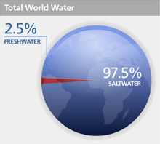
Water is abundant; freshwater is rare
70% of Earth’s surface is covered in water
97.5% is salt water
2.5% is freshwater
Most (67%) is trapped in glaciers
Of the freshwater that is not trapped in glaciers 95% is trapped in aquifers.

Slide 5
Groundwater
Aquifer: groundwater that exists within permeable layers of rock and sediment
Unconfined aquifers: porous rock covered by soil that allows water to easily flow in and out
Confined (artesian) aquifers: Aquifers surrounded by a layer of impermeable rock or clay
Replenished by surface water percolating from a distant site
Frequently tapped for wells

Slide 6
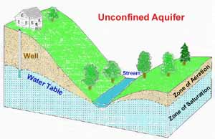
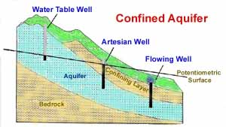
Aquifers

Slide 7
Ground water
Water table: uppermost level at which water in a given area fully saturates the rock or soil
Groundwater recharge: water seeping into an aquifer.
Occurs where there is permeable soil or rock
Springs: when water from aquifers percolates up to the ground surface

Slide 8
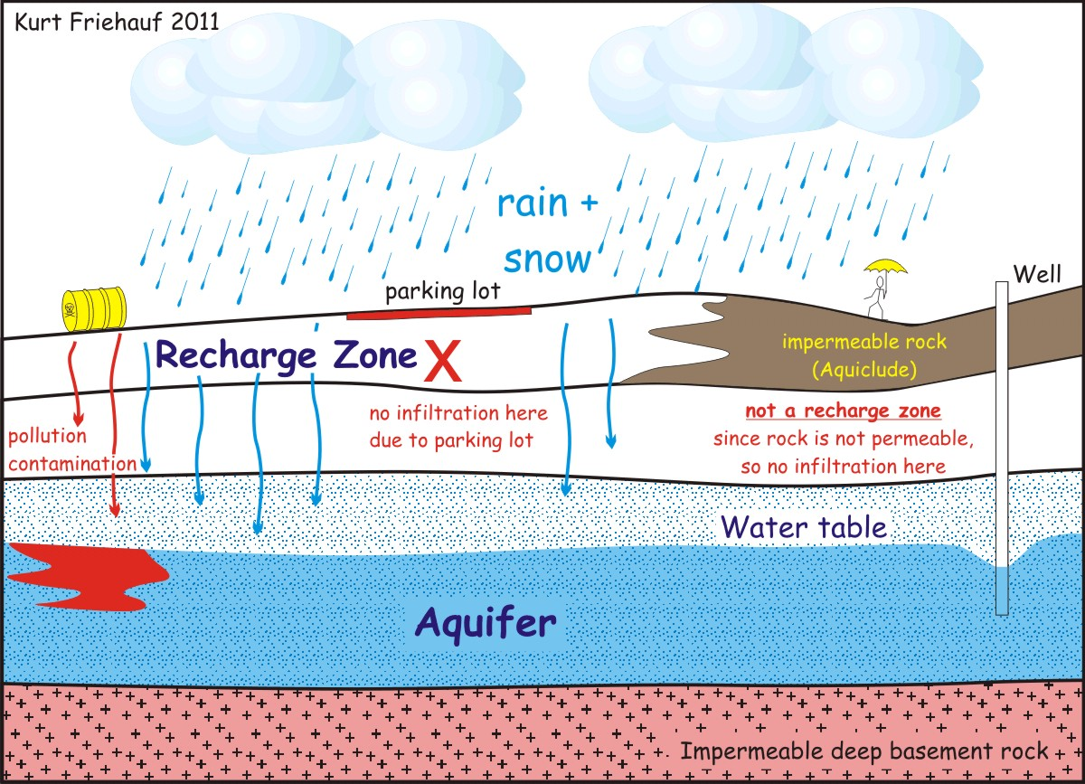

Slide 9
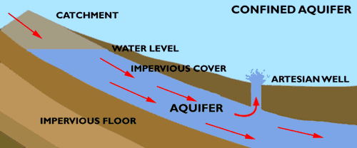
Aquifers
Confined wells take more time to be recharged → less likely to be polluted
Artesian well: when no pump is required to extract groundwater
Pressure causes water to come to the surface

Slide 10
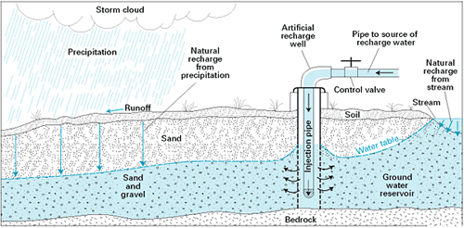
Groundwater
50% of people in the U.S. rely on groundwater for their water supply.
In order to classify groundwater as a renewable resource, the rate of infiltration must be greater than or equal to the rate of use.

Slide 11
Groundwater
Groundwater depletion is most severe in the southwest
Methods to reduce groundwater depletion:
Control population growth
Developing crop strains that need less water
Developing crop strains that are more resistant to heat
Wasting less irrigation water

Slide 12
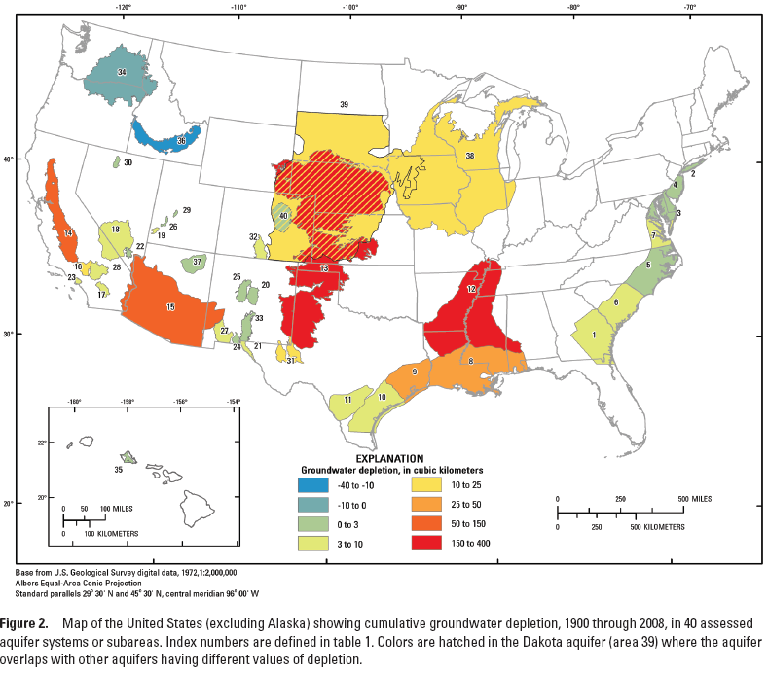

Slide 13
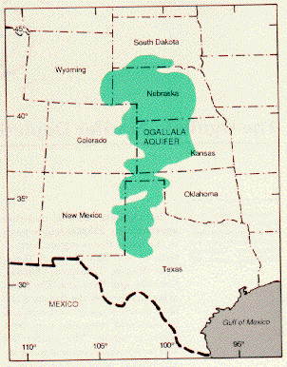
Ogallala Aquifer
Largest aquifer in the U.S.
Water levels changing due to withdrawing water for agricultural, household, and industrial uses
Result: less water for great plains

Slide 14
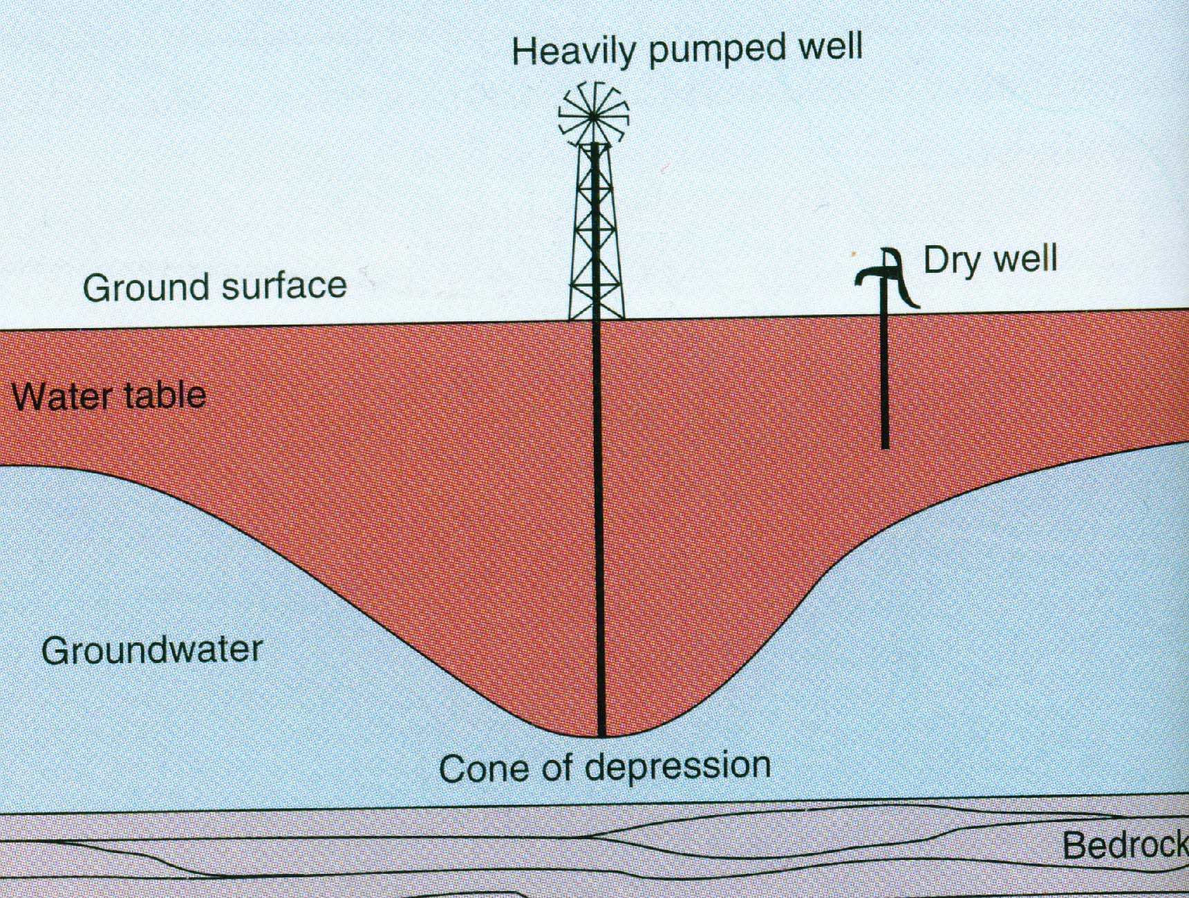
Groundwater
Cone of Depression: An area where there is no longer any groundwater due to rapid pumping of a deep well

Slide 15
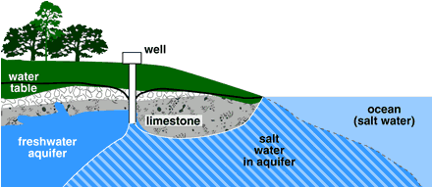
Saltwater Intrusion
Humans pump groundwater → lowers the water table→ saltwater intrudes into wells
Occurs in coastal areas

Slide 16
Surface Water
Fresh water that exists above ground
Streams, rivers, ponds, lakes, and wetlands
Worlds largest rivers:
Amazon in South America
Congo in Africa
Yangtze in China
Colorado, Nile, Yellow, and Ganges no longer reach the sea during dry season

Slide 17
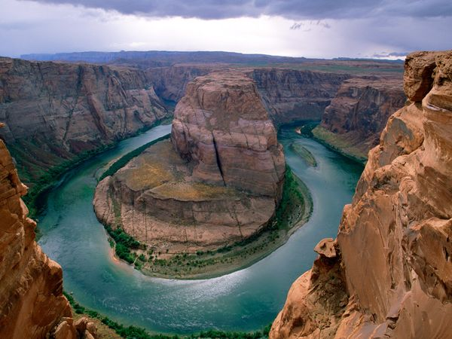
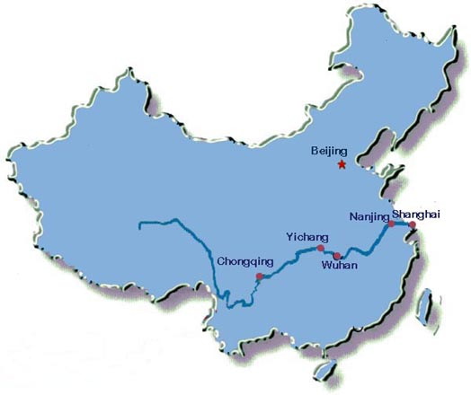
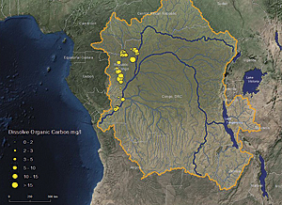

Slide 18
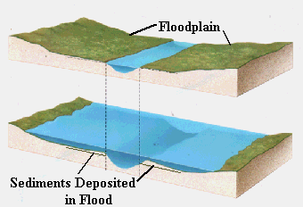
Surface Water
Floodplain: When excess water from a river spreads onto the land adjacent to the river.
Deposit nutrient-rich sediments

Slide 19
Lakes
Classified by primary productivity
Oligotrophic lakes: low amounts of nitrogen and phosphorous → low productivity
Deep
Oxygen found in high levels
Mesotrophic lakes: lakes with the a moderate amount of productivity
Eutrophic lakes: high level of productivity
Shallow
Lots of of biomass→ lots of decomposition→ low levels of oxygen

Slide 20
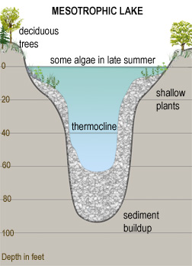
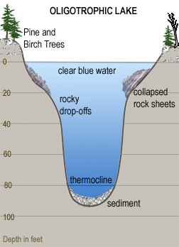
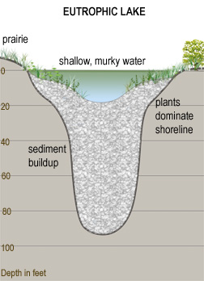
Lakes

Slide 21
Atmospheric Water
People in arid (dry) regions rely on atmospheric water
Droughts: extended period when a region receives a deficiency in its water supply
Effects:
Less water for agriculture
Hinders nutrients cycling
Dry out top soil and it will blow away

Slide 22
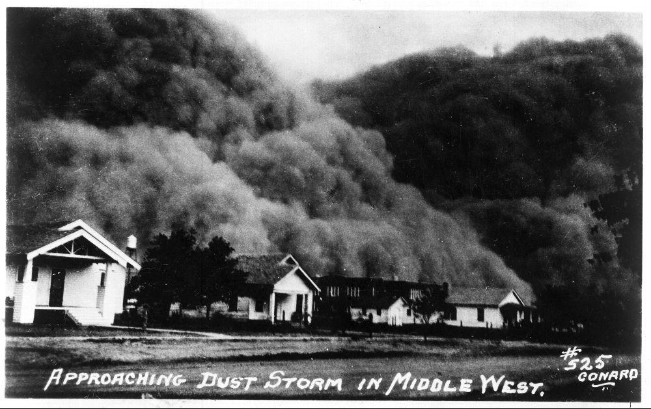
The Dust Bowl
Conversion of grasslands to wheat fields→ more soil erosion
Farming methods removed protective plant cover
Top soil (A horizon) blew away
Government passed the Soil Conservation Act

Slide 23
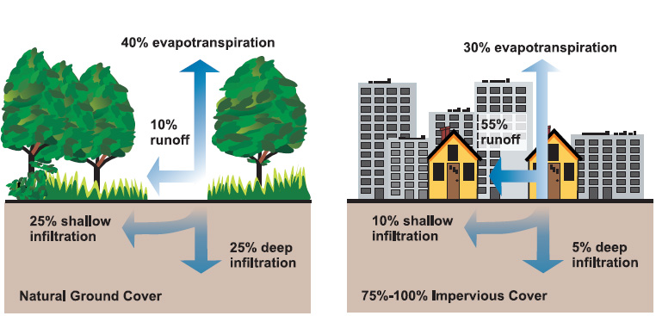
Human activities and flooding
Impermeable surfaces: areas that do not allow water penetration
Ex: pavement and concrete
Water fills streams and rivers, which causes overflow

Slide 24
Check your Understanding
What are the primary repositories of fresh water on earth? Which of these repositories is the largest?
What is the difference between a confined and an unconfined aquifer? How do their recharge rates differ?
How do human activities worsen the effects of droughts and floods?

Slide 25
Homework
Read through page 246 in Ch. 9 (if you haven’t already done so!)
Write summaries in your current events journal of Monica and Desire’s presentations

