Slide 1
SWBAT understand current event situations relating to plate tectonics.
APES Unit 5 12/14/15

Slide 2
Agenda
Current event presentations
Pass back/review exams

Slide 3
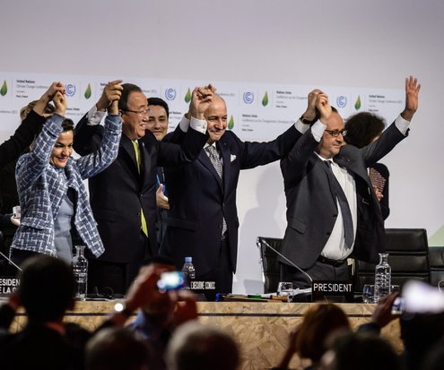
Paris Climate Accord
195 nations reached an agreement
Will take effect in 2020

Slide 4
Exam Notes
When talking about pollution, be specific and list the pollutant:
Example: CO₂, H₂SO₄, methane, etc.

Slide 5
Do Now Changes
Some will be MC and some will be open-ended questions
May randomly be collected and graded

Slide 6
Internship Opportunity
DonorsChoose internship opportunity
Practical work experience
Training in workplace communication and research techniques
Regular meetings with a staff mentor
Professional development sessions with organization leadership
Deadline: Jan. 6th
Time commitment: twice per week for a minimum of 2 hours

Slide 7
Homework
Read Ch. 7 through page 187 ( stop right before migration)
FRQ re-write due Friday!

