Slide 1
SWBAT execute an inquiry lab.
APES Unit 5 12/9/15

Slide 2
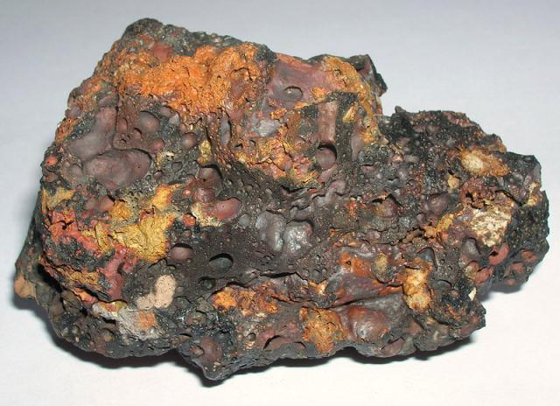
Do Now
Slag: stony waste matter separated from metals during the smelting or refining of ore.

Slide 3
Agenda:
Inquiry Lab
Review answers to mining worksheet
Pass back lab reports

Slide 4
Lab Safety
Follow the procedure for chemical weathering part 2
Wear goggles and gloves at all times!!!!
Pour all HCl waste into the HCl waste container!
If your group used NaOH, come up at lunch to weigh the rocks

Slide 5
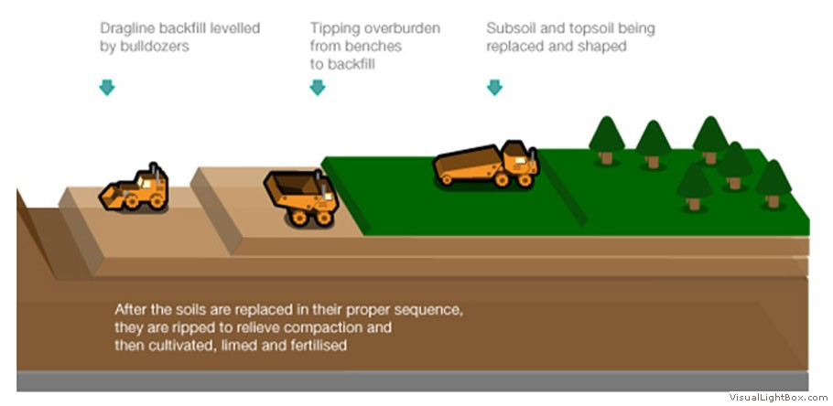
Land Reclamation

Slide 6
Lab report feedback
Use APA citations (in text and bibliography) for ALL formal writing assignments!

Slide 7
Let’s review!
Divergent plate boundaries
Convergent plate boundaries
Transform plate boundaries

Slide 8
Homework
Study for the exam!!
Soil/weathering lab will be due on Monday 12/14

