Slide 1
SWBAT identify different types of mining and identify the impact on the environment.
APES Unit 5 12/8/15

Slide 2
Agenda:
Lecture
Cookie Mining Activity!

Slide 3
Mining
Mining is the excavation of earth for the purpose of extracting ore or minerals
Nonmetallic minerals are mined to be used in their natural state– nothing is extracted from them
Ex: coal, salt, clay marble
Metallic minerals: mined for minerals and can be extracted through smelting
Ex: zinc, iron, copper, tin, manganese

Slide 4
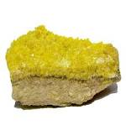
Metals
Metals: elements with properties that allow them to conduct electricity
Common constituents of metal ores include sulfur
U.S., Germany and Russia consume about 75% of the world’s most widely used metals.

Slide 5
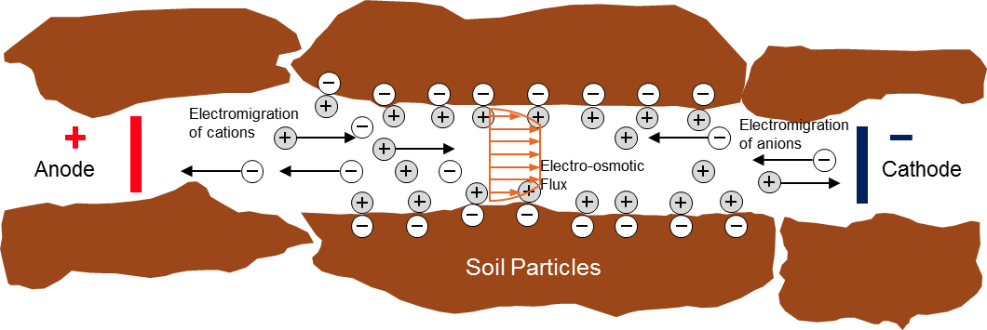
Metals
Electrokinetic separation removes metals and polar organics

Slide 6
Mining
Mineral deposit is an area in which a particular mineral is concentrated
More valuable resource→ more money and time put into mining it

Slide 7
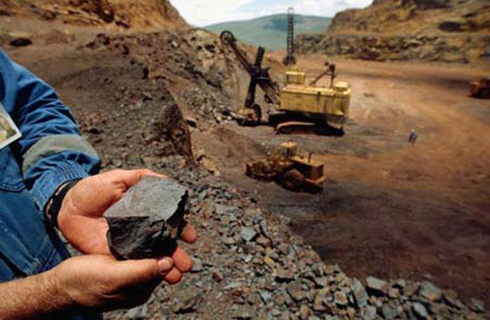
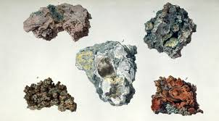
Ores
Ore mining includes all of the following processes
Extraction of ore
Development of mining
Restoration of site
Beneficiation
Separation of ore into valuable minerals
Buaxite ore→ where aluminum is commonly found

Slide 8
Ores
Smelting: extract metal from it’s ore by a process that involves heating and melting

Slide 9
Mining: Environmental Concerns
Environmental damage is done during the extraction process
Disrupts the ecosystem and harms the land
Example: deposition of iron pyrite and sulfur from coal mining→ acid mine drainage
Gangue: waste material
Mining spoils or Tailings: piles of gangue
Smelting produces liquid, solid and gaseous waste

Slide 10
Major Environmental Concerns
Mining, clearing vegetation of land and road building can lead to
Increase in runoff
Reduced infiltration that replenishes groundwater
Increased flooding
Accelerated soil erosion and landslides

Slide 11
Types of Mining
Strip mining: Strip the surface layer of soil and rock in order to expose a seam of mineral ore
Overburden: layer of rock and soil above an area of scientific interest
Tailings returned to hole created during mining

Slide 12
Strip Mining
Reclamation: process of restoring and improving land disturbed by coal mining

Slide 13
Types of mining
Open pit mining: Creating of a large pit or hole in the ground that is visible from the Earth’s surface
Example: copper mines

Slide 14
Types of Mining: Mountaintop removal
Mountaintop removal: remove entire top of a mountain with explosives
Tailings removed by machinery and deposited in lower-elevation regions, often in rivers or streams.

Slide 15
Types of mining
Placer mining: looking for metals and precious stones in river sediments.
Example: California Gold Rush
Can contaminate water with chemicals
Subsurface mining (shaft or underground mining): vertical tunnels are built to access and excavate minerals that are more than 100 m deep.
Subsurface mining is the least environmentally harmful.
Less disturbed earth and less wasted rock
BUT can result in acid mine drainage
Hazardous to miners

Slide 16
Subsurface (shaft) mining

Slide 17
Mining Legislation
Mine Restoration projects: air, land and water harmed by mining can be reclaimed
Mining Act (1872): governed prospecting and mining of minerals on publicly owned land.

Slide 18
Mining Legislation
Surface Mining Control and Reclamation Act (SMCRA, 1977): Established a program for regulating surface coal mining and reclamation activities
Reclamation of abandoned coal mines
Preservation of national parks
Restoration of actively mined areas
Conversion of former mining areas into biological habitats

Slide 19
Check your Understanding
Why are economically valuable mineral resources distributed unevenly on the planet?
Describe the various types of surface mining operations
What are the consequences of surface mining or subsurface mining?

Slide 20
Cookie Mining
Hard cookies: $7
Soft cookies: $10
Large toothpick: $5.00
Paper clip: $7.00
Everyone gets five minutes to mine!

Slide 21
Homework
Read mining article

