Slide 1
SWBAT describe how population and consumption influence the environment. Do Now: What is the IPAT equation? What does it explain? How does a country’s degree of development influence its environmental impact?
APES Unit 6 12/21/15

Slide 2
Agenda
Lecture
Discussion
Math worksheet
Reminders!
Ch. 7 quiz tomorrow!
Unit 6 Exam on Thurs. Jan 7th

Slide 3
The IPAT equation
Impact = Population x Affluence x Technology
Affluence= average resource use per person
More affluence→ Higher impact
Technology= environmental impacts of technology
Used to estimate the impact of human lifestyles on earth

Slide 4
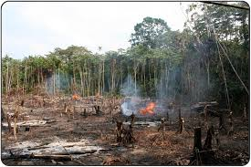
Local Impacts
Common in rural, agricultural, societies
Ex: deforestation in Brazil
Benefit: Good for local economy
Cost: Environmental degradation

Slide 5
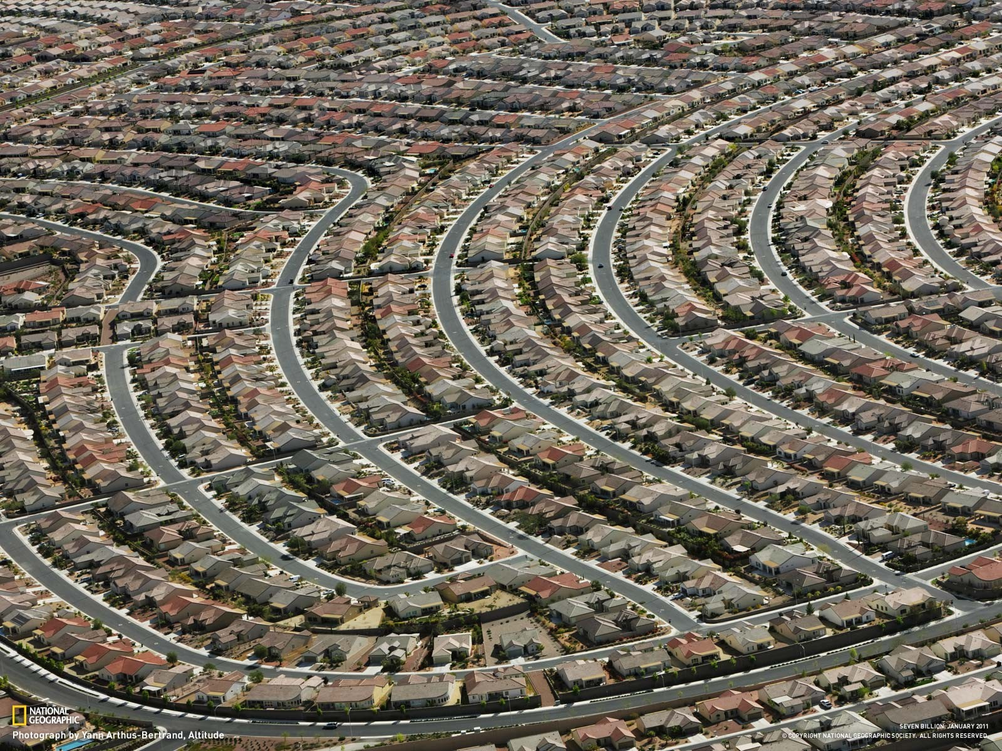
Global Impacts
Typical of affluent or urban societies
Benefits:
consume fewer local resources
Better technology (wastewater treatment plants)
Costs:
greater global impact
deplete more environmental resources

Slide 6
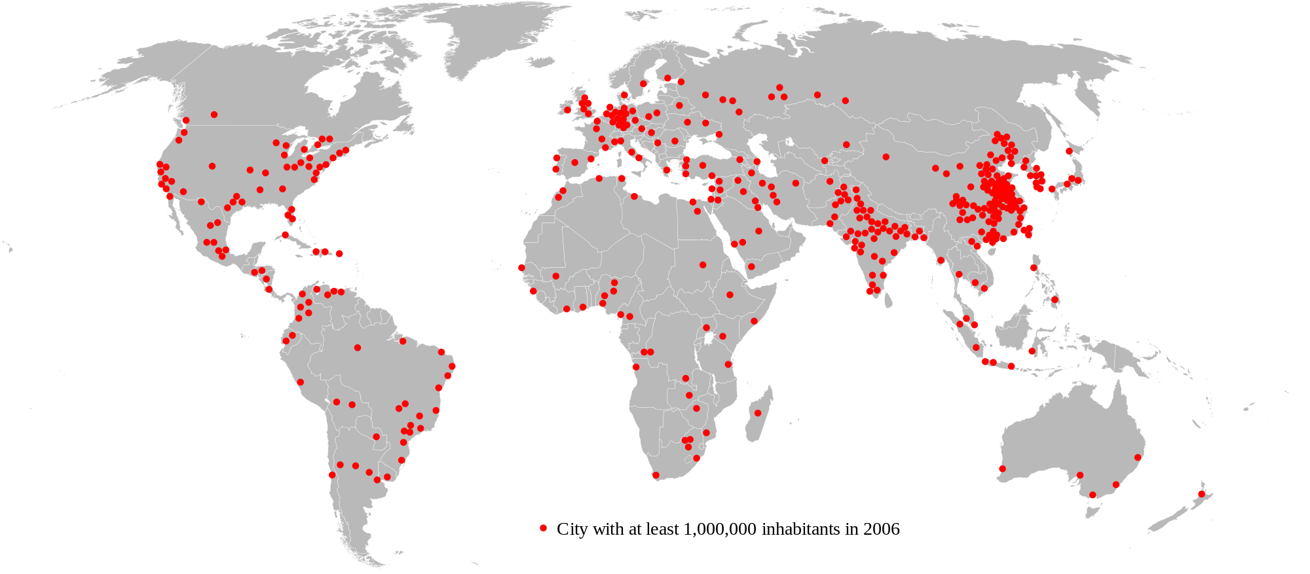
Urban Impact
Urban area: contains more than 386 people per sq. area
Half of the world’s population but consume ¾ of the world’s resources

Slide 7
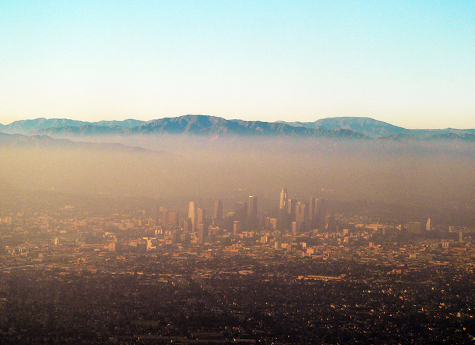
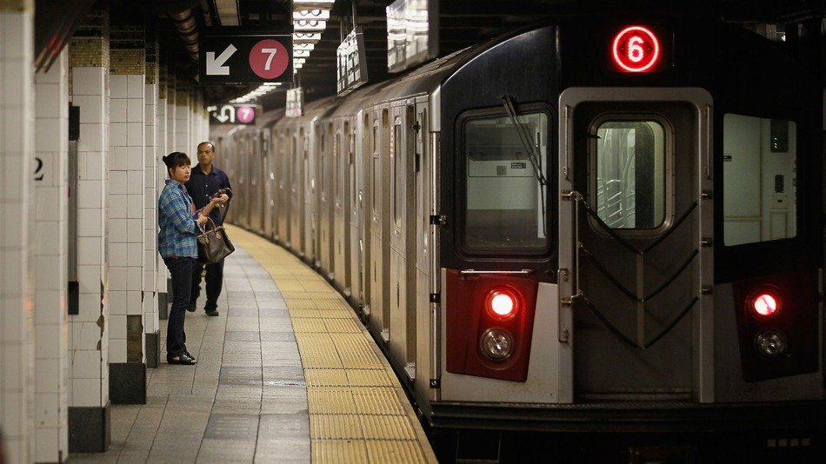
Urban Living: Developed Countries
Pro: urban areas have more public transportation and nearby services
Con: Urban areas have more solid waste, pollution and CO₂ emissions

Slide 8
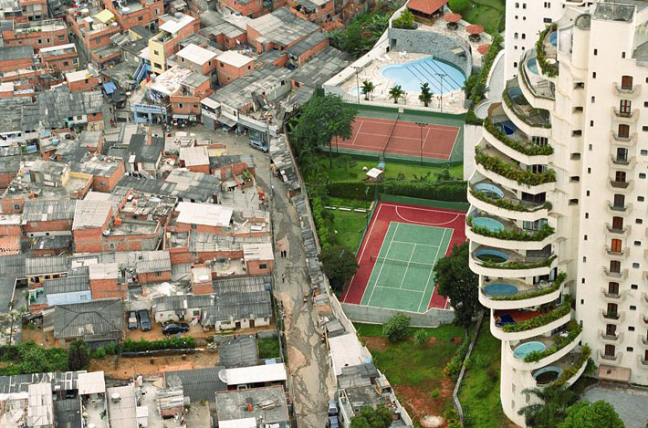
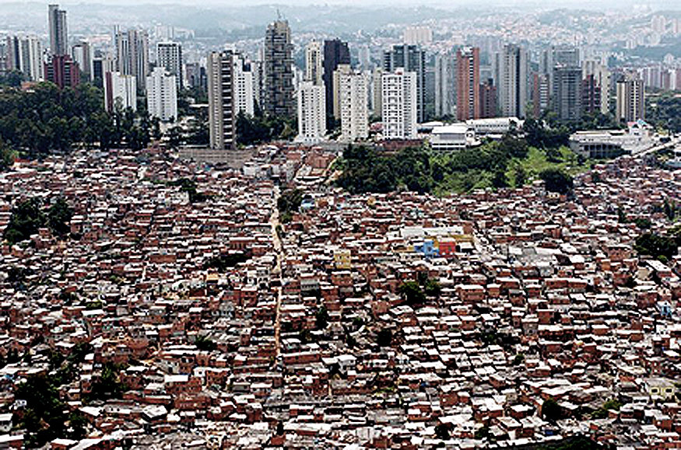
Urban Living: Developing Countries
Living conditions divided by class
Rapid urbanization→ influx of very poor
About 1 billion people live in squatter settlements

Slide 9
The Impact of Affluence
Gross Domestic Product (GDP): The value of all products and services produced in a year in that country.
Size of the economy
Economic activity:
Consumer spending
Investments
Government spending
Exports minus imports
Higher GDP→ higher pollution

Slide 10
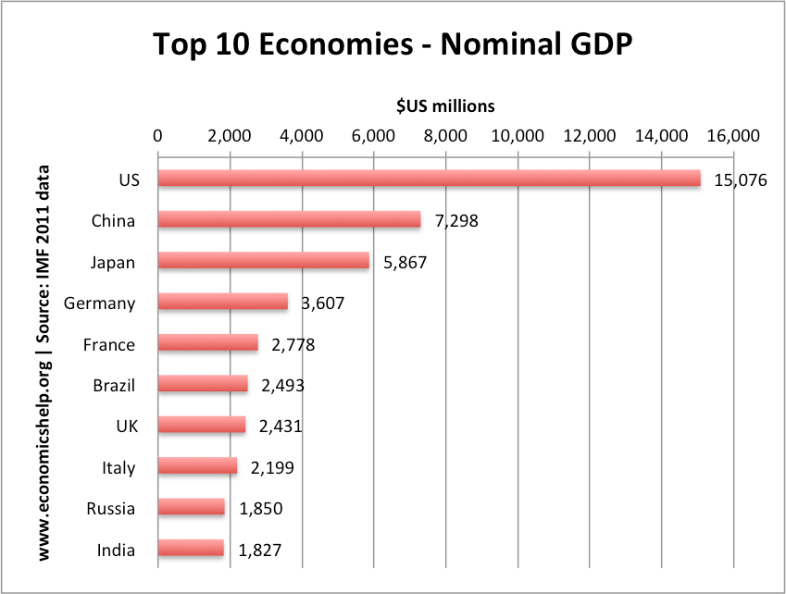
GDP

Slide 11
The Impact of Affluence
Gross national product (GNP): Value of total worth of production and services of a country on its land or foreign land
GNP and GDP are limited as measures of a nation’s well-being in that they fail to account for the depletion of natural resources

Slide 12
Millennium Ecosystem Assessment
Ecosystem sustainability threatened by human population
Altering ecosystems improves human well being for some populations and exacerbates poverty for others
Sustainable practices lead to improved standard of living for more people

Slide 13
Tiny homes!

Slide 14
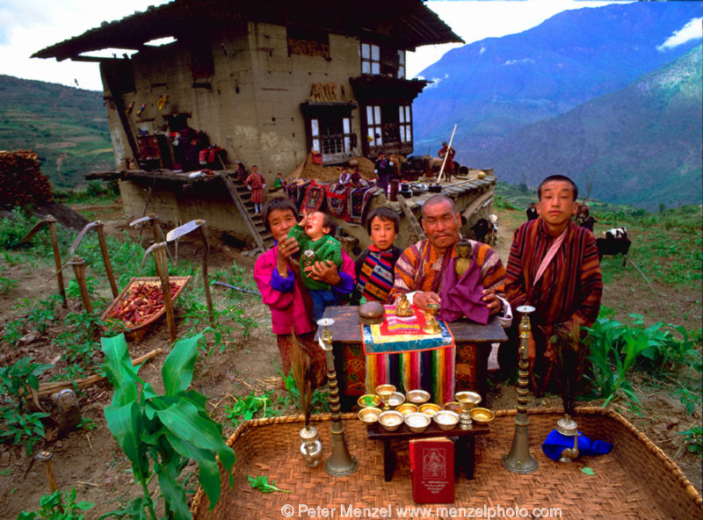
Bhutan

Slide 15
Discussion
How should we limit or slow population growth in developing countries?
How do we limit ourselves in a world of limitless consumption?
Do you believe that raising the GDP of a country is the best way to save the environment? Why or why not?

Slide 16
Math Worksheet
Work with people at your table-- Ask 3 before me!
Answer the discussion questions when you’re done!
Complete annual net increase without a calculator

Slide 17
Homework
Read Ch. 20 through page 555 (stop before economic health)

