Slide 1
SWBAT identify different stages of the demographic transition model. Do Now Question #1: None of the answer choices are correct
APES Unit 6 12/17/15

Slide 2
Agenda:
Mini-lecture
Finish Video
Power of the Pyramids Lab
Announcement: Ch. 7 Quiz on Tuesday

Slide 3
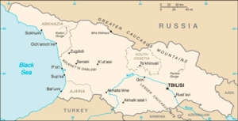
Migration
Net migration rate: (immigration-emigration)/1,000
U.S. net migration rate is 3.3 immigrants per 1,000 people.
Canada has a net migration rate of 1.6 per 1,000 people
Case study: Georgia has a low TFR + negative net migration rate→ population decreases

Slide 4
The Theory of Demographic Transition
As a country moves from a subsistence economy to industrialization and increased affluence, it undergoes a predictable shift in population growth
Predicts population changes based on birth and death rates
A population can experience zero population growth via two different means:
High birth rates + high death rates
Low birth rates + low death rates

Slide 5
The Theory of Demographic Transition
Four States (Phases):
Pre-industrial state
Transitional state
Industrial state
Postindustrial state
Demographic transition is when a population moves from the first state to the second state

Slide 6
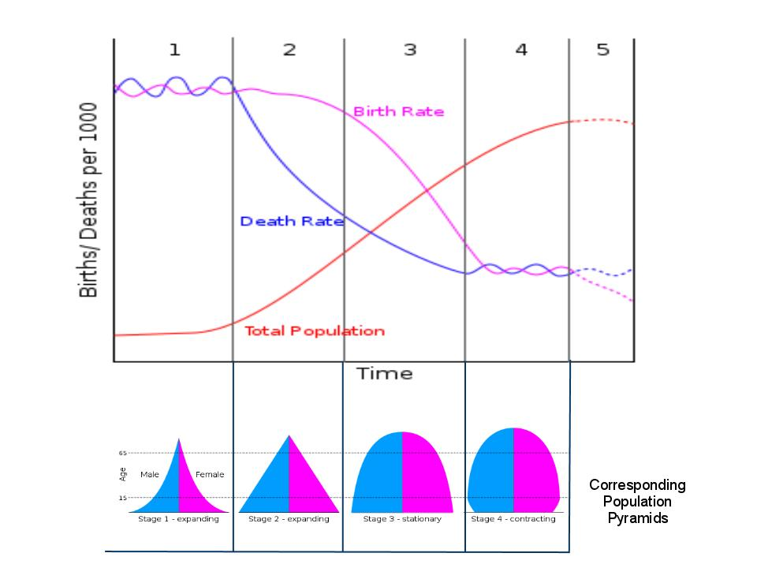
The Theory of Demographic Transition

Slide 7
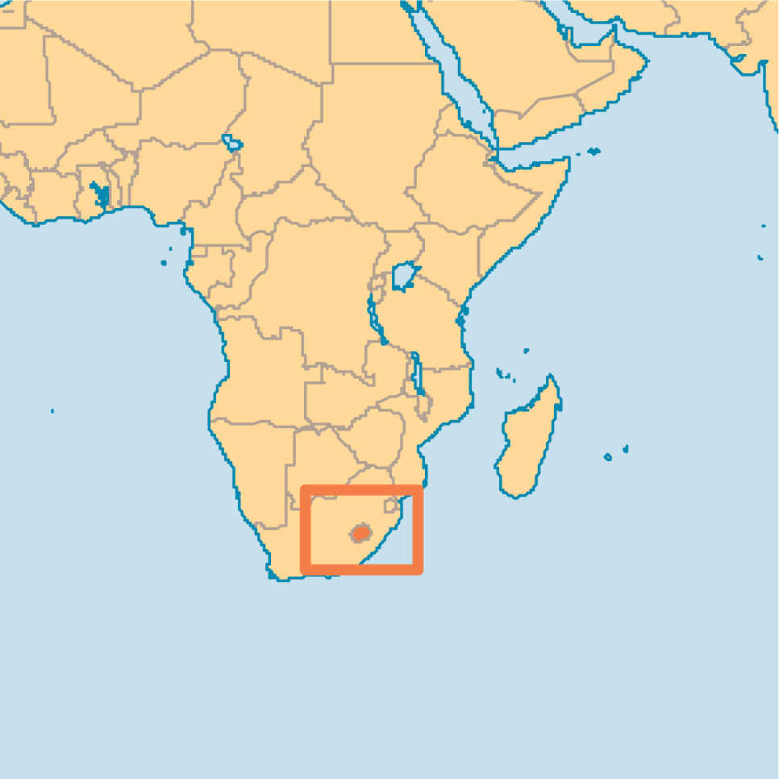
Phase 1: Pre-industrial state
Typical of countries before they modernize
Slow population growth
High birth rate
High death rate
Short life expectancy
High infant mortality rate
Caused by harsh living conditions (environmental resistance)
Disease, lack of health care, poor sanitation
No social security→ children must care for adults
Example: Lesotho
Most of human history has been spent in stage 1

Slide 8
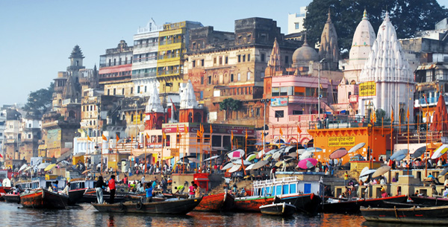
Phase 2: Transitional State
Rapid Population Growth
High birth rates
Lower death rates
Lower infant mortality rate
Causes:
Better sanitation
Increased access to food, goods, health care
Example: India

Slide 9
Phase 3: Industrial State
Stable population
Fairly high population growth rate
Birth rate drops, becomes similar to death rate
Characteristic of many developed countries
Causes:
Economy and educational systems improve
Availability of birth control
Children can be a financial burden

Slide 10
Phase 4: Postindustrial State
Population approaches and reaches a zero growth rate
Populations may drop below the zero growth rate
High level of affluence and economic development
Fewer young people and more elderly people
Fewer people in the labor force and more retired people
Examples: Japan, UK, Germany and Russia

Slide 11
Stop and think
The U.S. is currently in which phase?
The 3rd phase

Slide 12
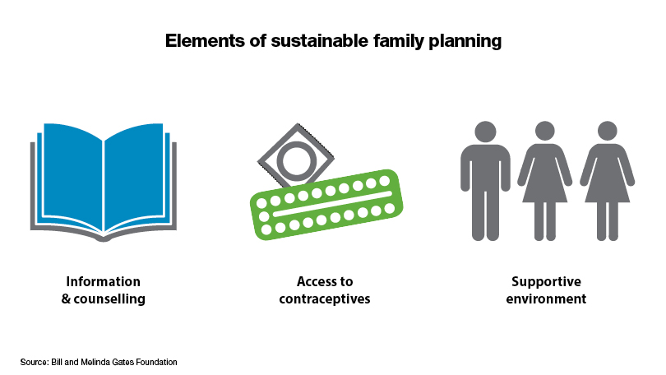
Family Planning
Regulation of the number of spacing of offspring through contraception
Higher levels of education among females→ lower birth rates
Higher age at first reproduction→ fewer children in the lifetime of a woman

Slide 13
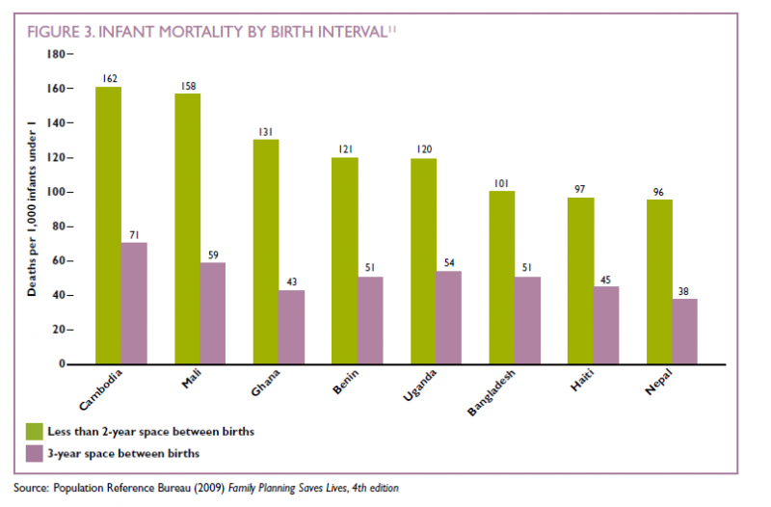
Family Planning

Slide 14
Economic Development
5.6 billion people live in developing countries
1.3 billion live in developed countries
1/5 of the human population lives in developed countries BUT they consume more than one half the world’s energy and resources
U.S. ecological footprint is equal to 22 acres

Slide 15
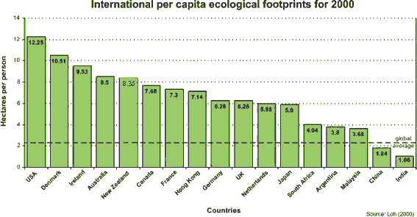
Ecological Footprint

Slide 16
Power of the Pyramid Lab
Country Options:
China
Mexico
U.S.
India
Nigeria
France

Slide 17
Homework
Finish Doubling Time Lab Questions
Find an article about human population growth and summarize it in the 3 paragraph format in your current events journal

