Slide 1
Aim: What factors drive human population growth?
APES Unit 6 12/15/15

Slide 2
Agenda
Mini-lecture
Video
Math Practice

Slide 3
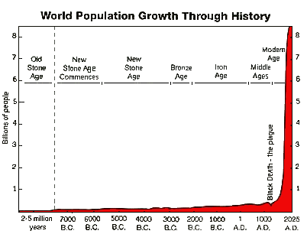
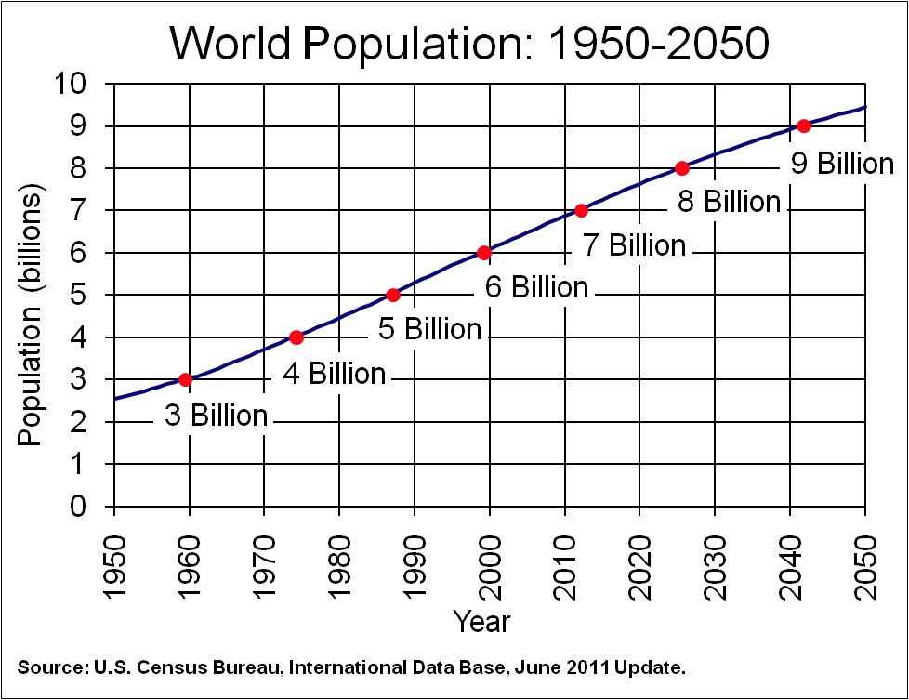
Unit 6: More Humans, More Problems

Slide 4
Unit 6: More humans, More problems
~2 weeks
Ch. 7: The Human Population
Ch. 20: Sustainability, Economics and Equity
Essential Questions:
Can human population grow indefinitely?
Will the economy be the death of the environment?
How do we limit ourselves in a world of limitless consumption?
Which has a larger impact on resources: high population growth in developing countries or the lifestyle of citizens in developed nations?
Current event presenters: Hamna and Rahila
Present on 1/6/15
Email presentation topic by Dec. 23rd

Slide 5
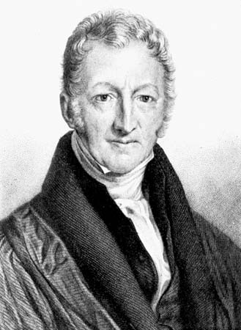
Earth’s Carrying Capacity
Thomas Malthus (1798)
Concluded that human population would exceed the food supply
Increase in human population due to industrial revolution and modern medicine

Slide 6
Changes in population size
Demography: Study of human population and human population trends
Immigration: people moving into a country
Emigration: people moving out of a country
Crude Birth Rate (CBR): number of birth per 1,000 individuals per year
Crude Death Rate (CDR): number of deaths per 1,000 individuals per year

Slide 7
Limiting Factors
Density dependent limiting factors: factors that will influence population size
Immigration
Emigration
Predation
Competition for food, water or living space
Disease
Buildup of toxic materials
Density independent limiting factors: change the populations size regardless of whether the population is large or small
Natural disasters
Human activities (dumping chemicals)

Slide 8
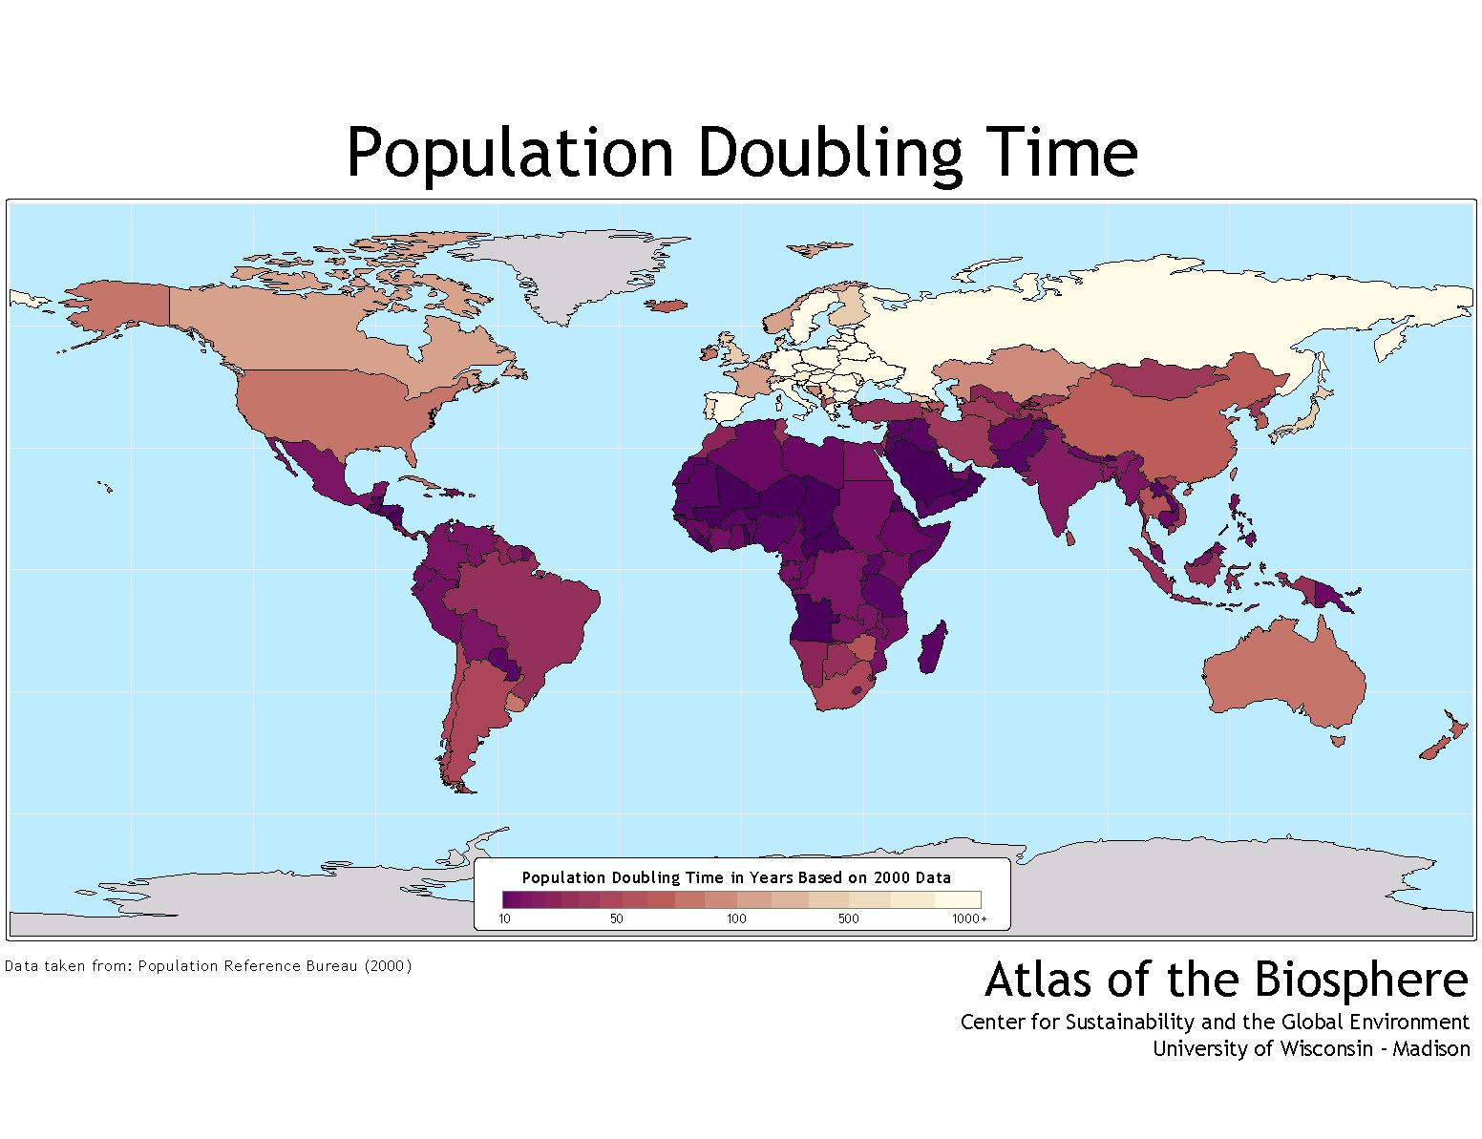
Changes in Population Size
Doubling time: the time it takes for a population to double if the population growth rate is kept constant

Slide 9
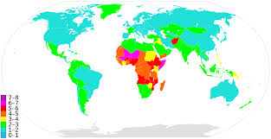
Fertility
Total Fertility Rate (TFR): the average number of children a woman will bear during her lifetime
The total fertility rate is about 2 in the U.S.
The world’s current TFR is approximately 3

Slide 10
Fertility
Replacement-level fertility: the number of children a couple must have in order to replace themselves in a given population
Need to compensate for deaths of children and existence of non-child bearing females
Can be as high as 2.5 in developing countries

Slide 11
Fertility
Factors that affect total fertility rate:
Availability of birth control
The demand for children in the labor force
The base level of education for women
The existence of public and/or private retirement systems
The population’s religious beliefs, culture and traditions
High population growth rates in developed countries are due primarily to economic factors and cultural factors

Slide 12
Factors that cause women to have fewer children
Higher education
Better prenatal care
Birth control education
Human rights protected

Slide 13
Life Expectancy
Life expectancy: average number of years that an infant is expected to live
Dependent upon particular country and particular year
Infant mortality rate: number of deaths of children under 1 year of age per 1,000 live births.
Child mortality: number of deaths of children under age 5 per 1,000 live births

Slide 14
Life Expectancy

Slide 15
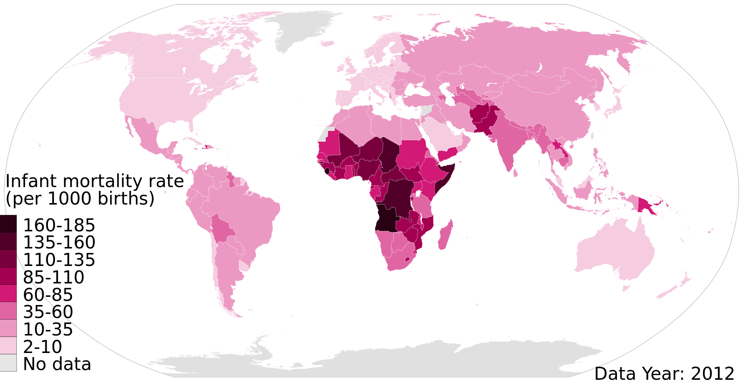
Infant Mortality

Slide 16
Infant and Child Mortality
High life expectancy + low infant mortality →
Good health care
Adequate food supply
Potable drinking water
Moderate pollution
Low life expectancy + high infant mortality →
insufficient health care
Limited food supply
Limited Potable drinking water
High pollution

Slide 17
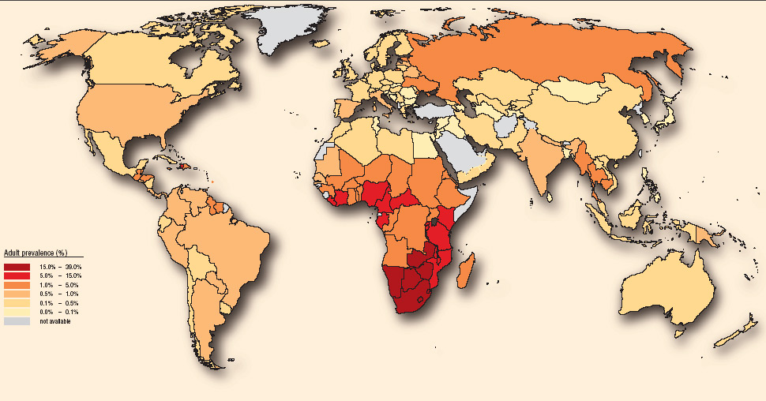
Aging and Disease
Infectious diseases: Diseases that are caused by microbes and are transmissible from one person to another
Examples: Malaria, HIV, TB, Ebola

Slide 18
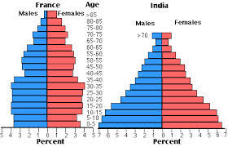
Age Structure Graphs
Age structure pyramids (age structure graphs): Used to study the number and ages of people in a population.
Pre-reproductive (age 0-14)
Reproductive (15-44)
Post-reproductive (45 and older)

Slide 19
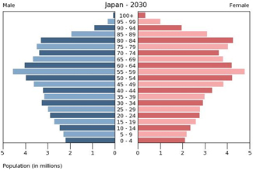
Age Structure graphs
Age structure pyramids can predict population trends:
When majority of population is in the post-reproductive category, the population size will decrease

Slide 20
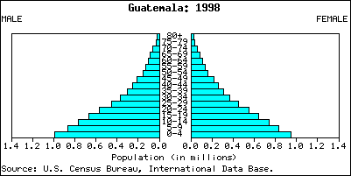
Age Structure Graphs
Population pyramid: Majority of the population in the pre-reproductive category→ population will increase in size
Characteristic of developing countries

Slide 21
Age Structure Graphs
Age structure of a population is determined by
Mortality rate: measure of the number of deaths in some population, scaled to the size of that population, per unit time.
Generation time: average age at which females give birth to her offspring
Fecundity: potential reproductive capacity of an individual or population

Slide 22
Age Structure Graphs

Slide 23
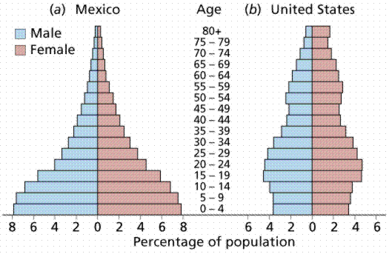
Age Structure Graphs
Population momentum: it takes time for actions that attempt to reduce births to catch up with a growing population.

Slide 24
Math Groups!
Group 1: Rimsha, Ramlah, Monica
Group 2: Cynthia, Wyllana, Rahila, Uzma
Group 3: Hamna, Shayna, Amrat, Mahnoor
Group 4: Attia, Wendy, Bukurie, Saliha
Group 5: Mehrangiz, Desire, Kaylah, Harmanpreet

Slide 25
Math Group Rules
Show ALL your work
Ask three before me!

Slide 26
Homework
Read health and longevity article (posted on website) and take notes
Research the following:
Explain two causes of the drop in TFR worldwide
Research the TFR for Kenya and the U.S.
Identify two economic or societal factors that account for the differences in TFR
Research three incentives the government can use to reduce population growth rate

