Slide 1
Aim: How do scientists determine how many species are present in a population?
APES Unit 3 10/29/15

Slide 2
Agenda
Mark and Recapture Lab
Succession Virtual Lab
Succession Lecture

Slide 3
Consider the following:
How do we know the population size of New York City?
How do we determine the number of giraffes in Kenya?

Slide 4
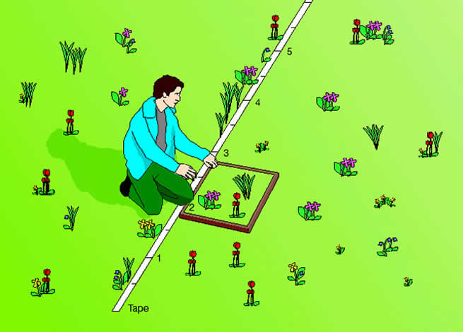
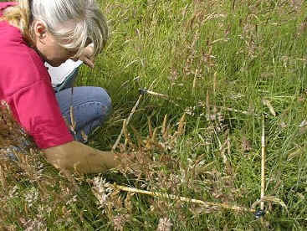
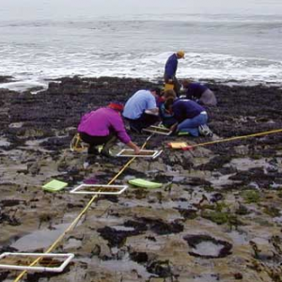
Line-transect

Slide 5
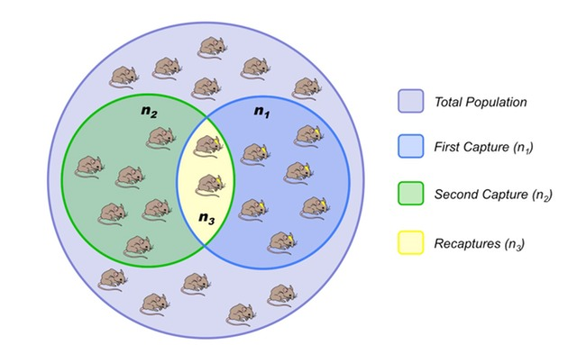
Mark and release

Slide 6
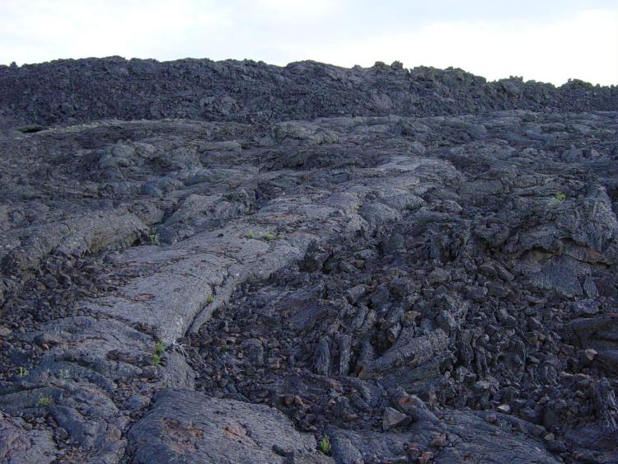
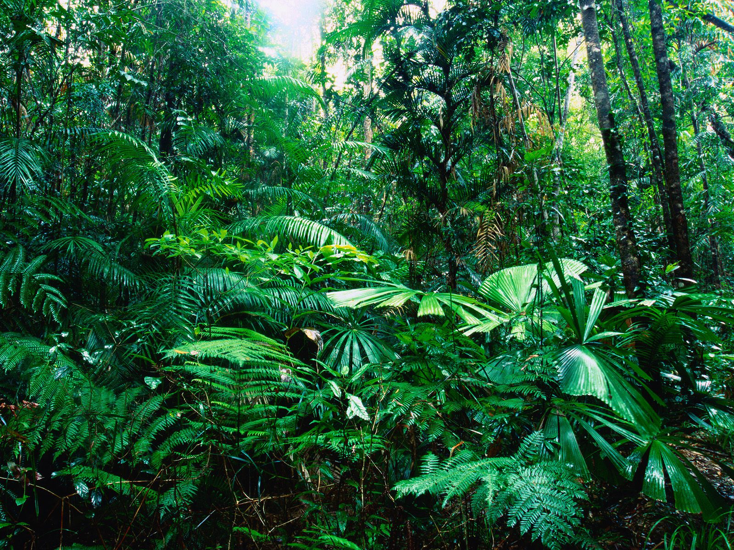
Succession
Aim: How does change naturally occur in ecosystems?

Slide 7
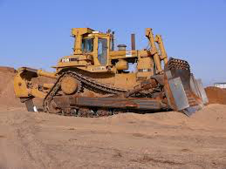
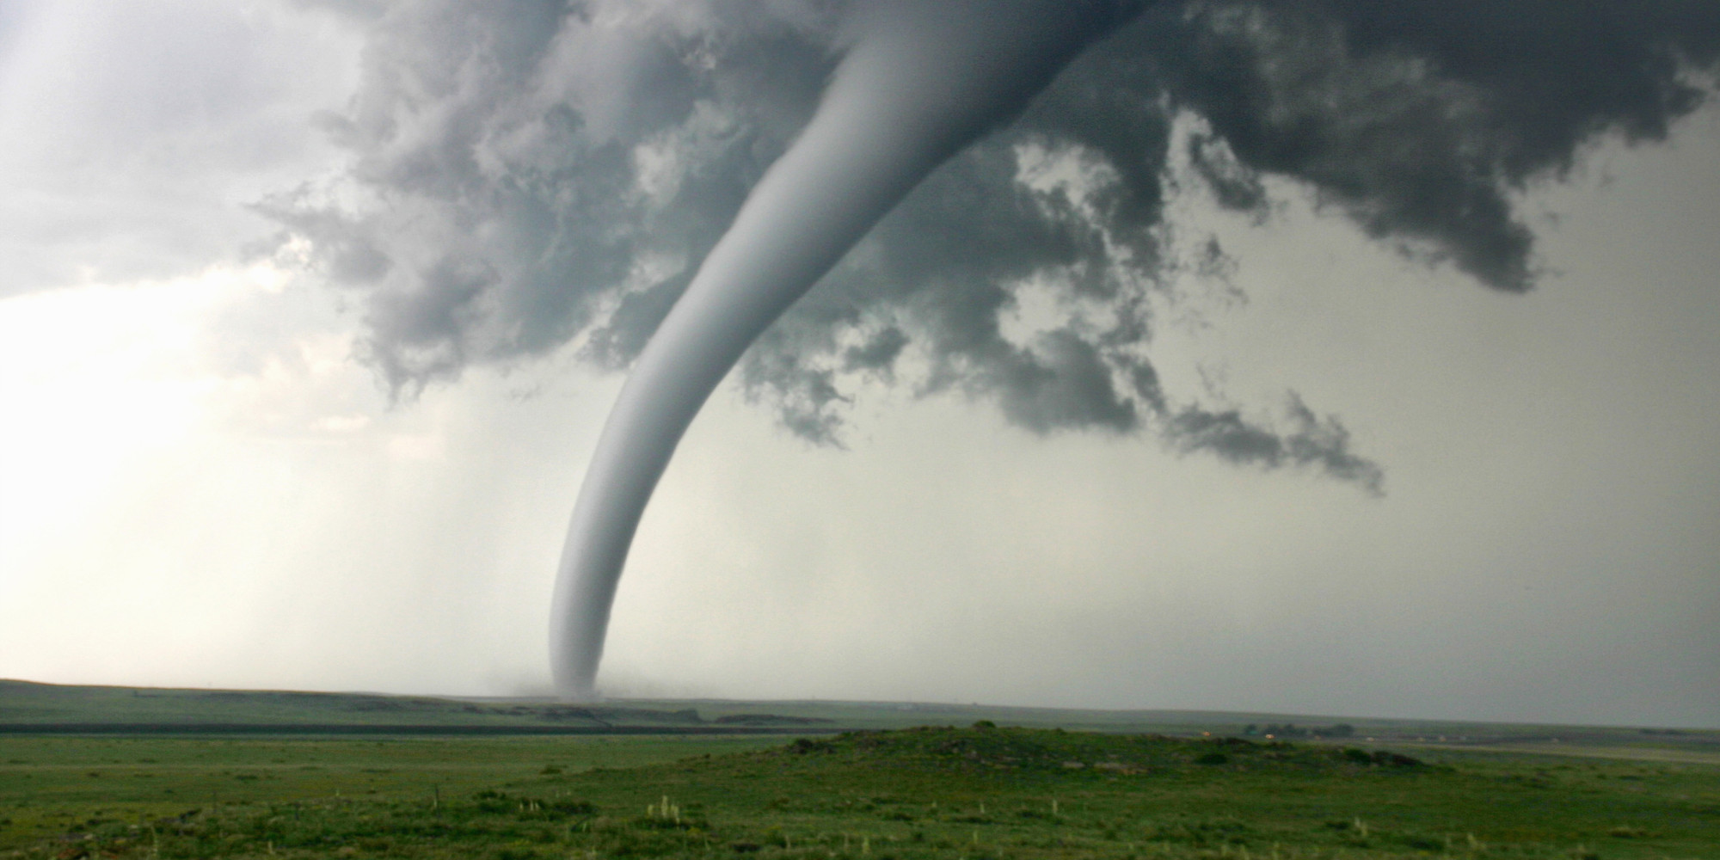
Changes in ecosystems
Ecological succession: Replacement of one group of species with another group of species.
Disturbance: an event that will instigate (start) the process of succession

Slide 8
Succession Terms
Inhibition: A particular species hinders the establishment and growth of other species
Example: plants produce species toxins that inhibit the growth of other types of plants
Tolerance: when late succession plants are not disturbed by early succession plants
Inertia: The tendency of an ecosystem to maintain its overall structure

Slide 9
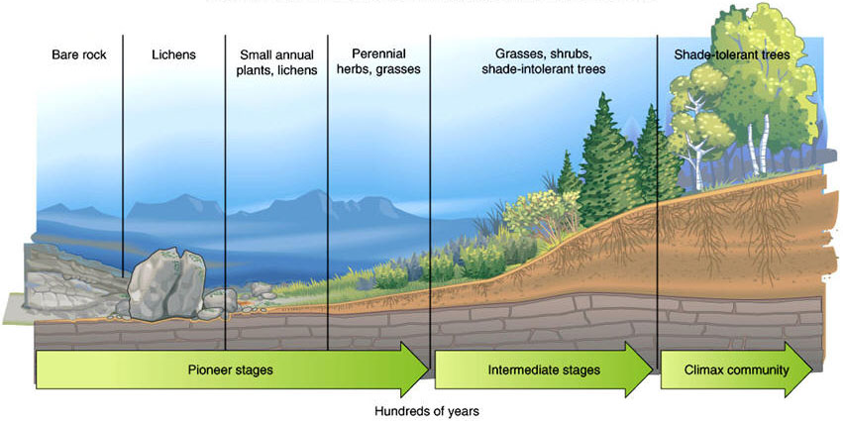
Ecological Succession
Primary succession: Ecological succession that begins in a lifeless area
Abandoned parking lot
Exposed rock after a glacier retreat
Area after volcanic eruptions

Slide 10
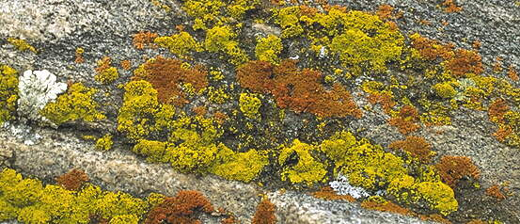
Primary Succession
First stage (pioneer stage): lichens invade, erode the rock surface and turn into soil
Pioneer species: The organisms in the first stages of succession
Make the area more habitable for other organisms

Slide 11
Secondary Succession
Ecological succession that takes place where an existing community has been cleared
The renewal of partially destroyed, disturbed, or removed organisms or environment
Soil is still there!
Events that cause secondary succession:
Fire
Tornado
Hurricane
Human impact
Abandoned agricultural fields

Slide 12
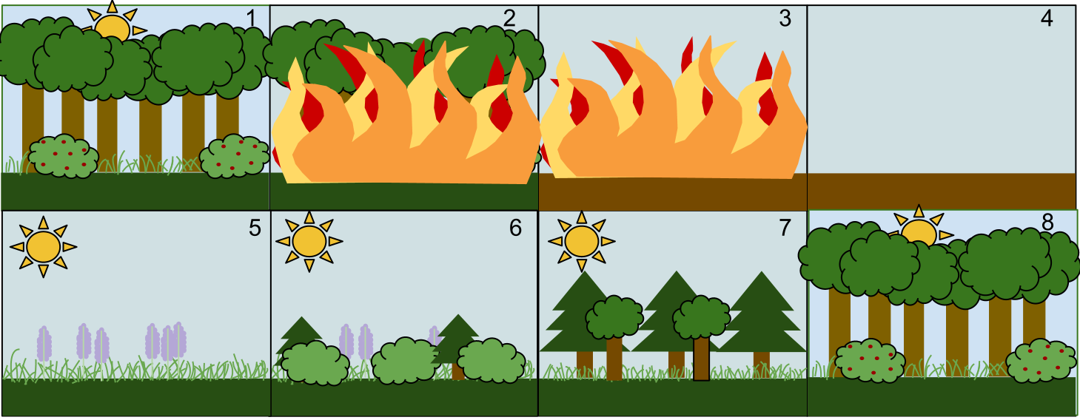
Secondary Succession

Slide 13
Stages of Succession
Early stage succession:
Plant communities have high net primary productivity
Plant communities have short life spans
Widespread seed dispersal
Long seed life spans

Slide 14
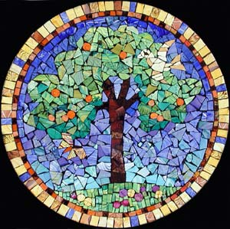
Climax Community
Final stage of succession
Dynamic balance between abiotic and biotic components of the community
Not necessarily “permanent” because the ecosystem can at any moment it can be reset to an earlier stage
There is very rarely any ecosystem that is blanketed by the climax community
Most communities consist of a mosaic of vegetation patches at different stages of succession

Slide 15
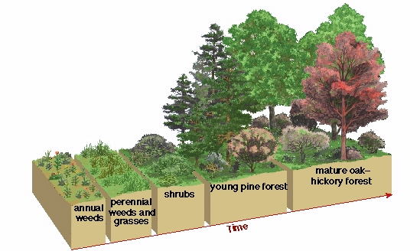
Climax Community
Characterized by:
Many different species of plants
Mixture of decomposers, producers, and consumers
Most of the organisms are specialized in their niche requirements
There is a large amount of biomass

Slide 16
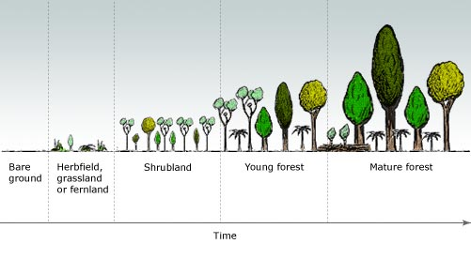
Succession rates
Rate of succession depends upon modification of the environment by one species that meets the need of another species

Slide 17
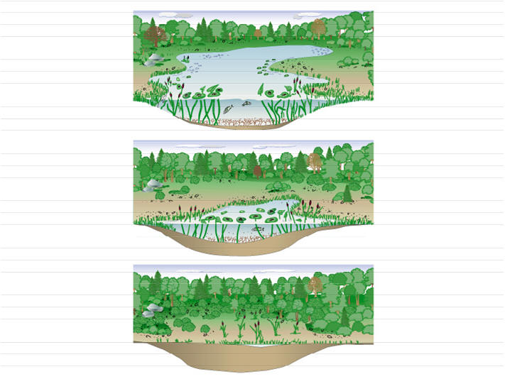
Aquatic Succession
Except for oceans, most aquatic systems are considered temporary
As soil and nutrients are added, aquatic systems become terrestrial systems
This process occurs over hundreds to thousands of years

Slide 18
Factors that influence species richness
Number and types of species present is determined by:
Colonization of the area by new species
Speciation within the area
Losses from the area by extinction

Slide 19
Factors that influence species richness
Latitude:
Farther away from the equator → less species
Time:
Longer a habitat exists→ more colonization, speciation and extinction
Size of habitat
Distance of the habitat from the source of colonizing species

Slide 20
Theory of island biogeography
Habitat size: larger habitats contain more species
Dispersing species are more likely to find larger habitats than smaller habitats
Larger habitats can support larger populations→ larger populations are less likely to go extinct
Larger habitats often contain a wider range of environmental conditions→ provide more niches

Slide 21
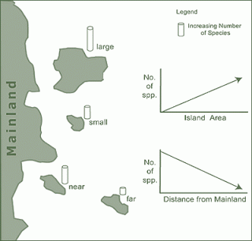
Theory of Island Biogeography
Distance
Larger distance between island and mainland→ smaller species richness

Slide 22
Homework
Finish Mark and recapture lab questions
Finish dimensional analysis through problem 13
Finish succession virtual lab

