Slide 1
SWBAT demonstrate doubling time and exponential growth through a lab.
APES Unit 6 12/16/15

Slide 2
The Power of Doubling
Toss coins at your table- don’t throw them across the room
Read through the directions carefully
Include everyone in the group

Slide 3
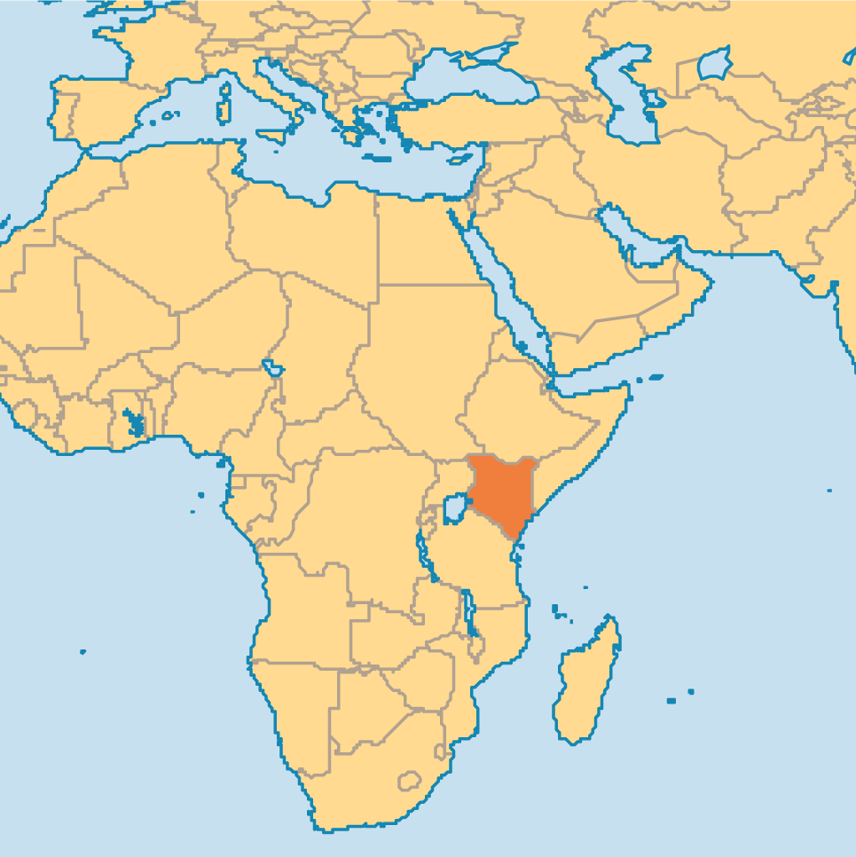
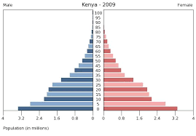
Kenya/ U.S. Research

Slide 4
Homework
Read Ch. 7 through page 192 (stop right before the IPAT equation)

