Slide 1
SWBAT understand how growth models can predict population changes.
APES Unit 3 10/27/15

Slide 2
Agenda
Lecture
Interspecific/Intraspecific competition lab
Keystone species jigsaw

Slide 3
Growth Models
Growth rate: (number of births and immigrants)- (number of deaths and emigrants)
Intrinsic growth rate (r) : maximum potential for growth under ideal conditions with unlimited resources

Slide 4
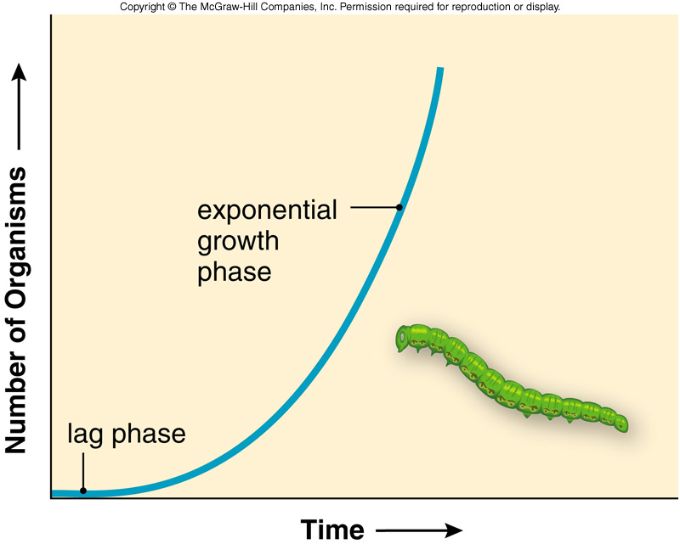
Exponential Growth Model
Exponential growth model: N_{t} = N_{o}e^{rt}
J-shaped curve
Biotic potential of most species represents a J-shaped curve
Characteristic of the human population
Shows positive feedback

Slide 5
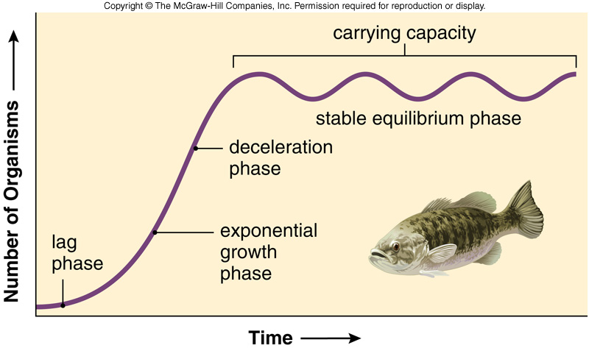
Logistic Growth Model
Growth is exponential initially, but slows as the population approaches carrying capacity
S-shaped curve

Slide 6
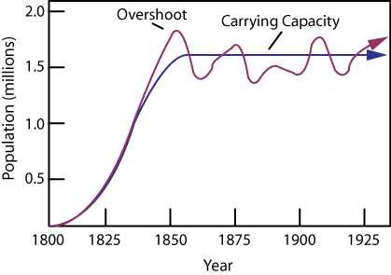
Logistic Growth Model Variations
Overshoot: Population exceeds the long term carrying capacity
Die-off: Population crash as a result of limited resources

Slide 7
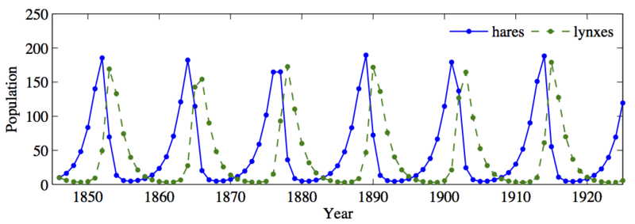
Predator/prey relationships

Slide 8
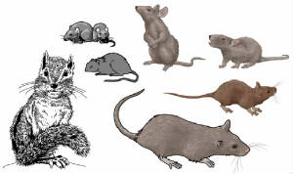
Reproductive Strategies
r-selected (r-strategist) species:
reproduce early and often in life
high capacity for reproductive growth
Go through cyclic or irregular population changes
Reproduce in abundance to overcome high death rates of unprotected young
Opportunistic species
Little or no protections of offspring
Most populations in nature
Example: bacteria, rodents

Slide 9
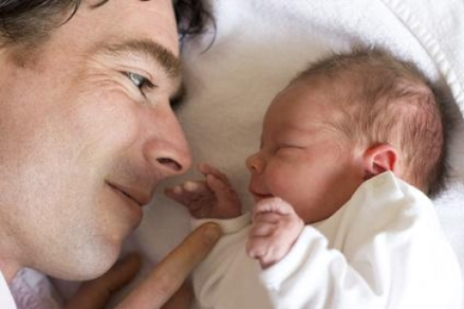
Reproductive Strategies
K-selected species (K-strategists):
Reproduce later in life
Produce fewer offspring
Thrive in competition
Slow maturation
Devote significant time to nurturing their offspring
Low juvenile mortality rates
Intraspecific competition due to density dependent limiting factors
Long life spans

Slide 10
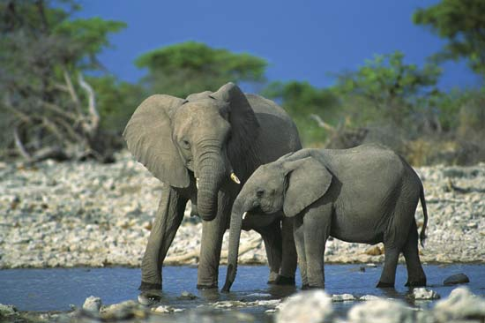
Reproductive Strategies
K-strategists are called equilibrial populations because they are able to maintain stable populations as niche specialists
The do NOT occupy generalized niches
Governed by their biotic potential

Slide 11
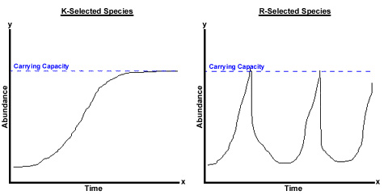

Slide 12
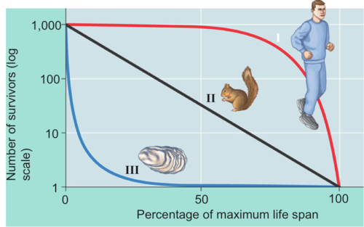
Survivorship Curves
Type I survivorship curves: k-selected species
High survival rates
Die off in large numbers with old age
Type II survivorship curves: constant decline in species throughout their lifespan
Type III survivorship curve: r-selected species
few survivors in early life
Few animals reach adulthood

Slide 13
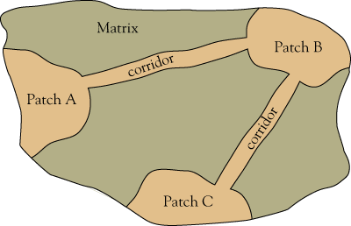
Metapopulations
A group of spatially distinct populations connected by occasional movements of populations between them
Corridor: areas of habitat that connect the metapopulations

Slide 14
Species Interactions
Determine the survival of a species:
Competition
Predation
Mutualism
Commensalism
Community ecology: the study of these interactions

Slide 15
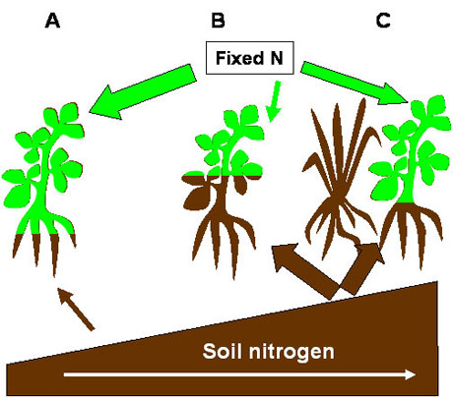
Competition
The struggle of individuals to obtain a limiting resource
Exploitative competition: Indirect competition between species through resource consumption

Slide 16
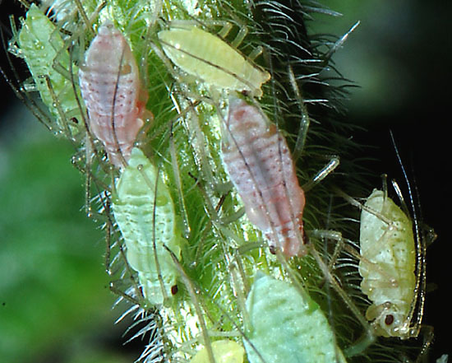
Competition
Interference competition: the process by which one species limits another’s access to some resource, regardless of its abundance
Direct competition

Slide 17
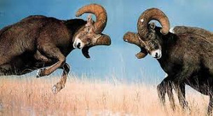
Competition
Interspecific Competition: Competition between different species
Intraspecific competition: Competition within one species

Slide 18
Predation
When one species feeds on another species
Population level predation can benefit the prey species by improving the genetic stock of the prey population.
True predators: kill their prey and consume most of what they kill
Herbivores: consume plants as prey

Slide 19
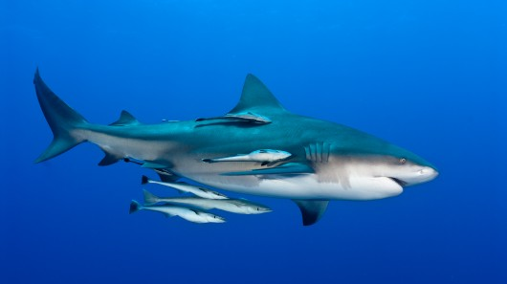
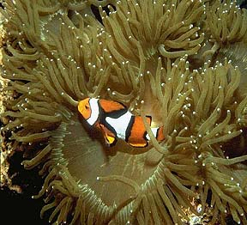
Symbiotic Relationships
Prolonged associations between two or more different organisms
Mutualism: both species benefit
Example: E.coli living in humans intestine
Commensalism: One organism benefits while the other organism is neither harmed nor hurt
Example: clown fish and sea anemone
Shark and remora

Slide 20
Symbiotic Relationship
Parasites: One species is harmed while the other benefits
Pathogens: parasites that cause disease within their host
Include viruses, bacteria, fungi, protists, and helminths
Parasitoids: organisms that lay eggs inside other organisms
Eggs hatch and larvae consume the host from the inside out

Slide 21
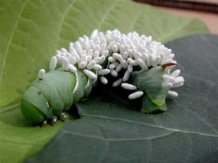
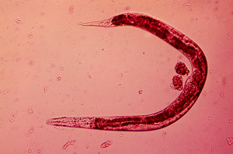
Parasites

Slide 22
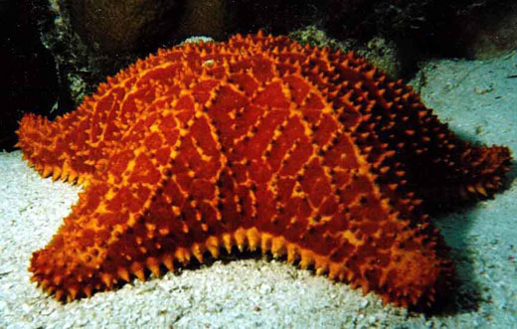
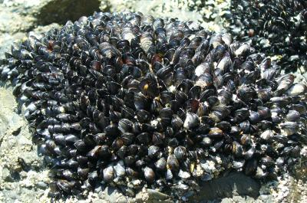
Keystone Species
A keystone species is a species that plays a pivotal role in its community that is far more important than its relative abundance.
Theory pioneered by Robert T. Paine
No sea stars→ too many mussels
Too many mussels→ no spaces for other species

Slide 23
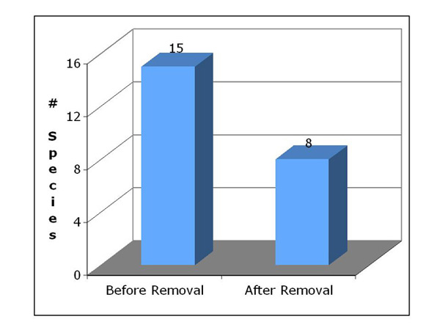

Slide 24
Keystone Species
Predator-mediated competition: organism who reduces abundance of a superior competitor and therefore allows inferior competitors to exist.

Slide 25
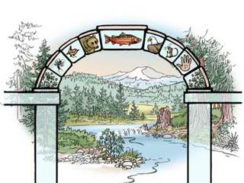
Keystone species
Can be a limiting factor
Affects other species in the ecosystems
Is important in maintaining biological diversity
Affects the available food and other resources in the ecosystem

Slide 26
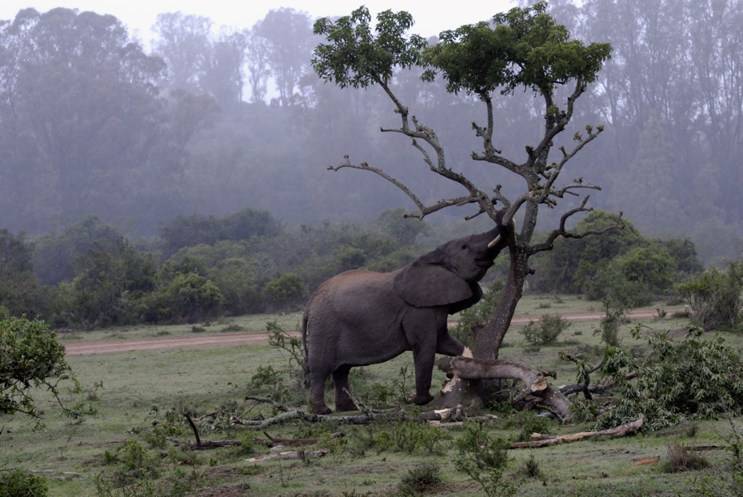
Keystone Species
Elephants pushing over trees and creating forest openings in the grasslands
Bats depositing depositing seed in their guano over deforested areas
Beaver dams changing fast moving streams into a pond or lake

Slide 27
Lab
Label your trays with group initials!
Water each cell with 3 mL of water

Slide 28
Homework
Summarize Rimsha and Amrat’s current event presentations in your current event notebook
Focus on societal, economic and environmental impacts

