Slide 1
Aim: What factors regulate population abundance and distribution?
APES Unit 3 10/26/15

Slide 2
Unit 3: Population and Conservation Biology
Ch. 6 (Population and community ecology) and Ch. 18 (Conservation of biodiversity)
~ 2 Weeks
Essential Questions:
How do human actions affect biodiversity?
What can we do to conserve ecosystems?
Current Event Presenters:
Desire and Monica (Nov. 6th)

Slide 3
Levels of Nature
Individual: survival and reproduction
Unit of natural selection
Population: Group of organisms of the same species in a given area
Unit of evolution
Community: Interactions among different populations
Ecosystem: Interactions of biotic and abiotic components in a particular location.

Slide 4
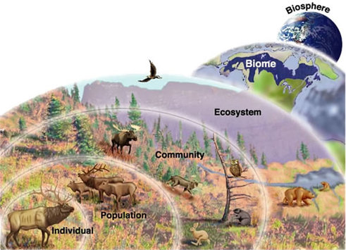

Slide 5
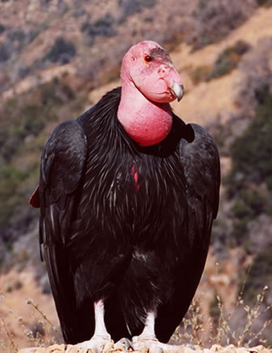
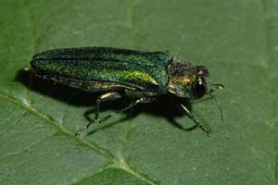
Population Ecology
Study of factors that cause populations to increase or decrease.

Slide 6
Population Characteristics
Factors that affect how populations change over time:
Size
Density
Distribution
Sex ratio
Age structure

Slide 7
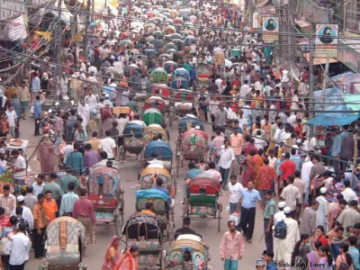
Population Characteristics
Population size (N): Total number of individuals within a defined area at a given time.
Population Density: Number of individuals per unit area at a give time
Greatest population density: Bangladesh
Continent with the larges population density: Asia

Slide 8
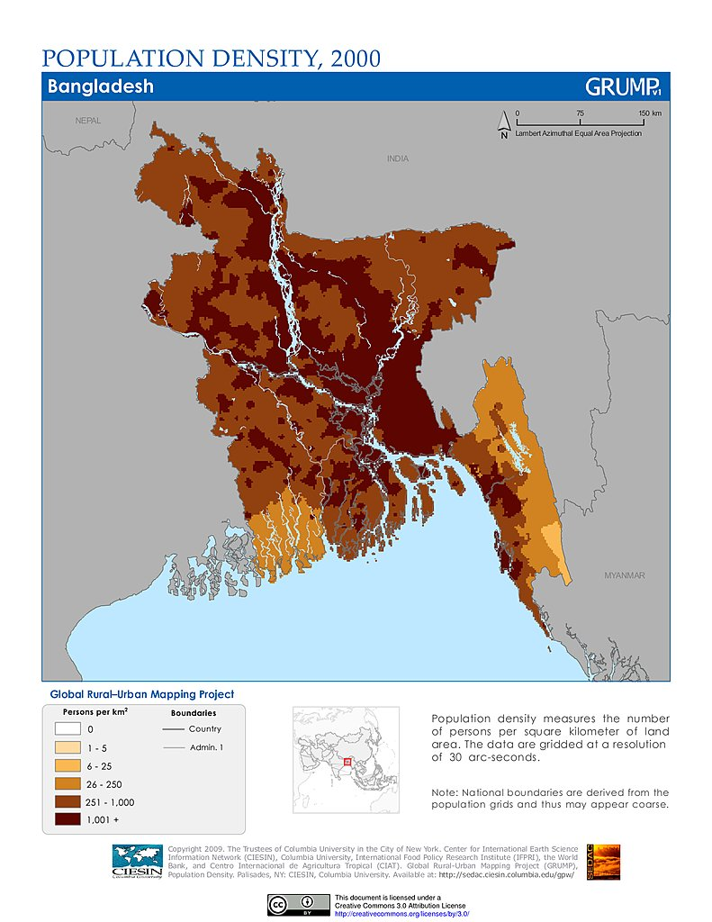

Slide 9
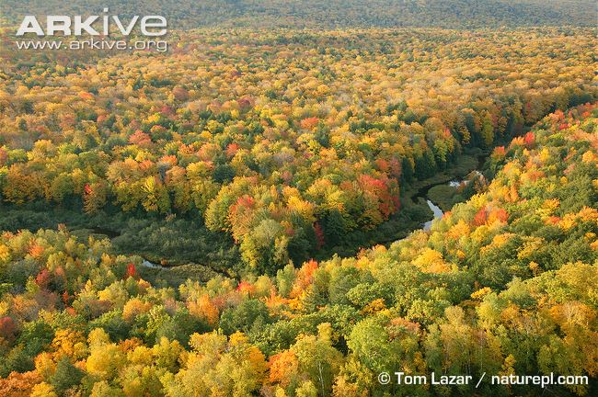
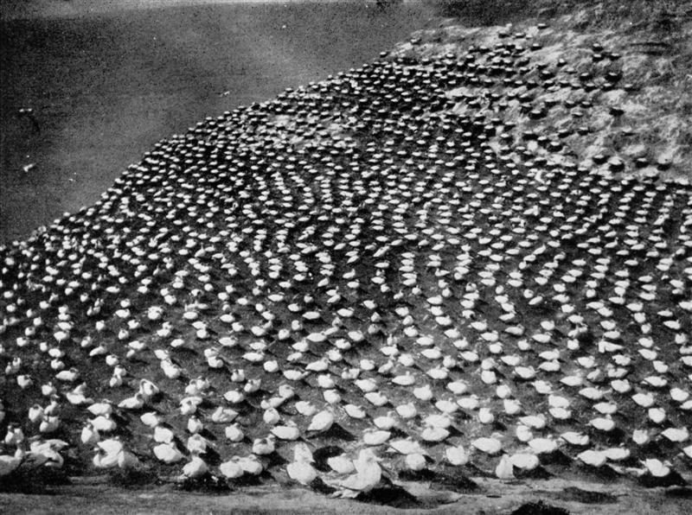
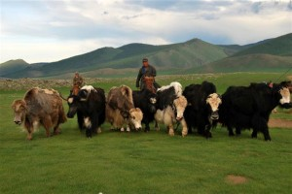
Population Characteristics
Population Distribution: How individuals are distributed with respect to one another
Random distribution: no pattern
Uniform distribution: all individuals maintain a similar distance from one another
Clumped Distribution: Organisms clump together
Protection from predators or better feeding opportunities

Slide 10
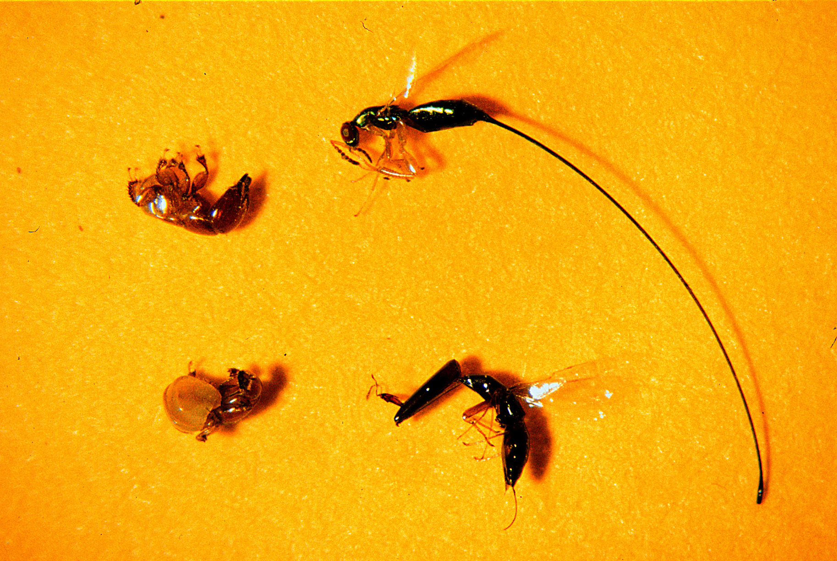
Population Characteristics
Population sex ratio: ratio of males to females
Most species have 50:50 ratios
Number of offspring is dependent upon number of females
Age structure: description of how many individuals fit into each age category

Slide 11
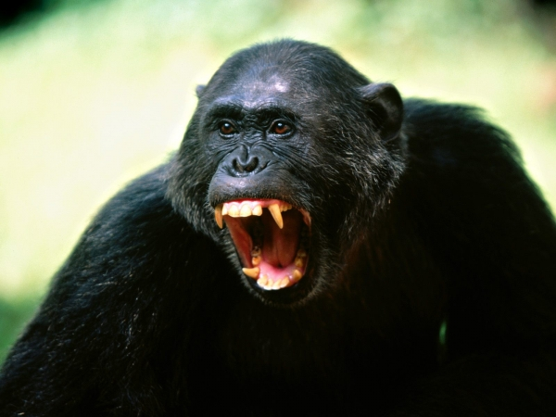
Factors that influence population size
Density dependent factors influence an individual’s probability of survival and reproduction in a manner that depends on the size of the populations
Amount of food
Accumulation of wastes
Increased intraspecies aggression
Infectious disease
Competition
Emigration
Immigration

Slide 12
Limiting resource
Resource that a population needs to survive
Limiting resource decreases→ population decreases
Terrestrial plants population limiting resources:
Water
Nitrogen
Phosphorous
Animal populations:
Food
Water
Nest sites

Slide 13
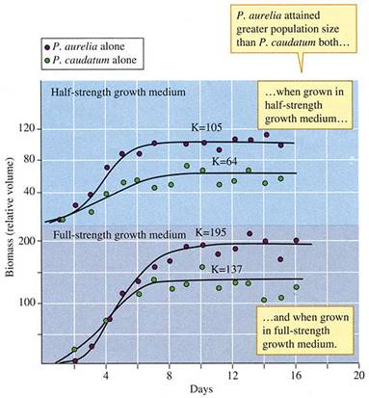
Gause’s Experiment

Slide 14
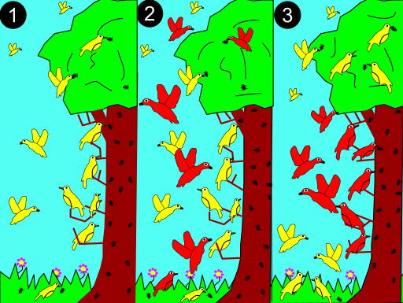
Competitive Exclusion Principle

Slide 15
Biotic potential
The amount that a population would grow if there were unlimited resources in the environment.
Exponential growth
Can be determined from its reproductive age span (how long an individual is capable of reproducing)

Slide 16
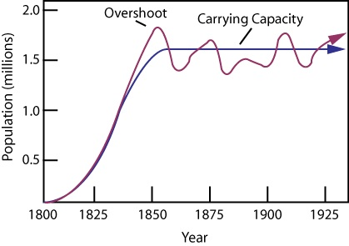
Carrying Capacity (K)
Maximum population size that can sustainably be supported by the available resources in the region
Over time, most populations exhibit a sigmoid (s-shaped) growth curve that levels off at a value K
Determined by:
Competition
Catastrophic events
Immigration
Estimated human carrying capacity: 15 billion

Slide 17
Turn and talk
What do you think will be the limiting resource that will cause humans to reach carrying capacity?

Slide 18
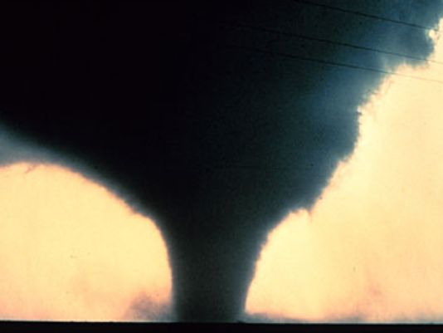
Density-Independent Factors
Have the same effect on an individual’s probability of survival and amount of reproduction at any population size.
Natural disasters
Seasonal cycles
Human activities
Damming rivers
Deforestation
Pollution

Slide 19
Check Point
How does a limiting factor influence whether a population reaches carrying capacity?
What factors regulate the size of a population?
What did Gause discover in his classic experiments?
What is the difference between density independent and density dependent factors that affect population size?

Slide 20
Homework
Read Ch. 6 through page 168 (stop right before succession)

