Slide 1
SWBAT determine the biodiversity of a pond by analyzing macroinvertebrates.
APES Unit 2 10/15/14

Slide 2
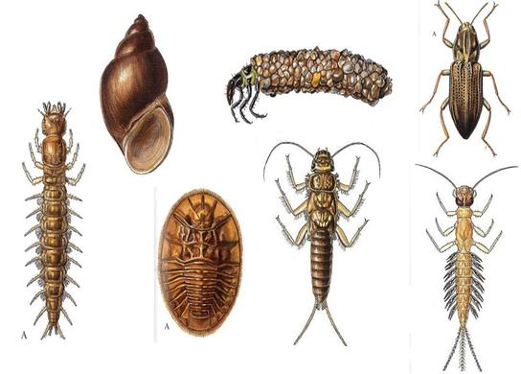
Agenda
Benthic Bugs Lab
Current Event Presentations
Review for the exam

Slide 3
Benthic Bugs Lab
20 seconds to scoop as many macroinvertebrates out of the water as possible.
Percent Composition
EPT/Midge Ratio
Pollution tolerance index
Simpson’s diversity index

Slide 4
Benthic Bugs Lab
Bench person: grab a stream and carry with TWO HANDS
Middle person: grab 3 calculators and a tray
Aisle person: Grab a cup with holes and 1 glove
Lab safety: Don’t get water on the calculators!

Slide 5
Metrics to measure Biodiversity
Shannon’s diversity index
Simpson’s diversity index
Quantifies the biodiversity of a habitat
Measures the probability that two individuals randomly selected from a sample will belong to the different species.
Higher the number→ higher the biodiversity

Slide 6
Lab Clean Up
Throw away all rubber bands
Pour “pond” water into the sink
Stack bins on the countertop

Slide 7
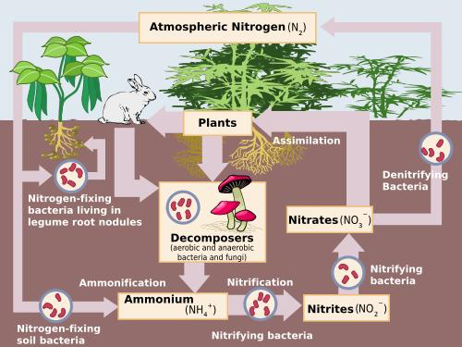
Nitrogen Cycle

Slide 8
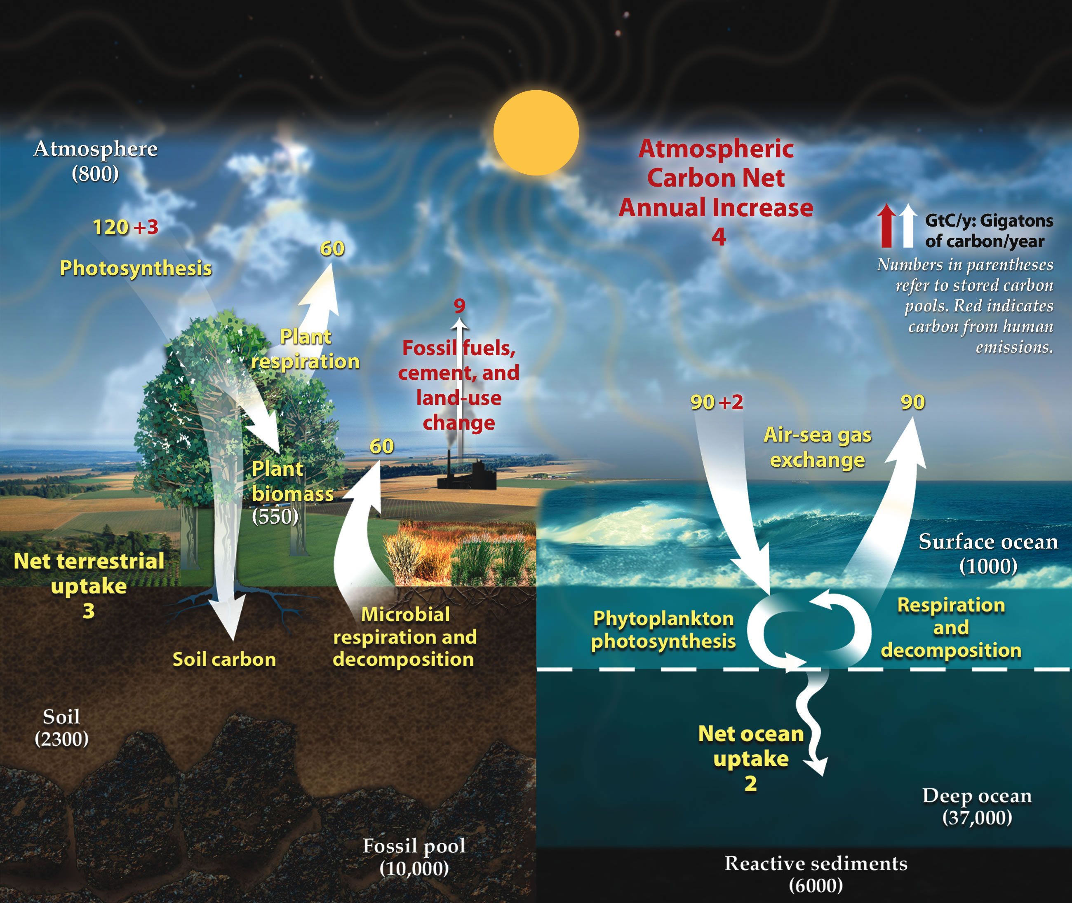
Carbon Cycle
Photosynthesis
Respiration
Important reservoirs:
Old growth forests
Soil
Ocean

Slide 9
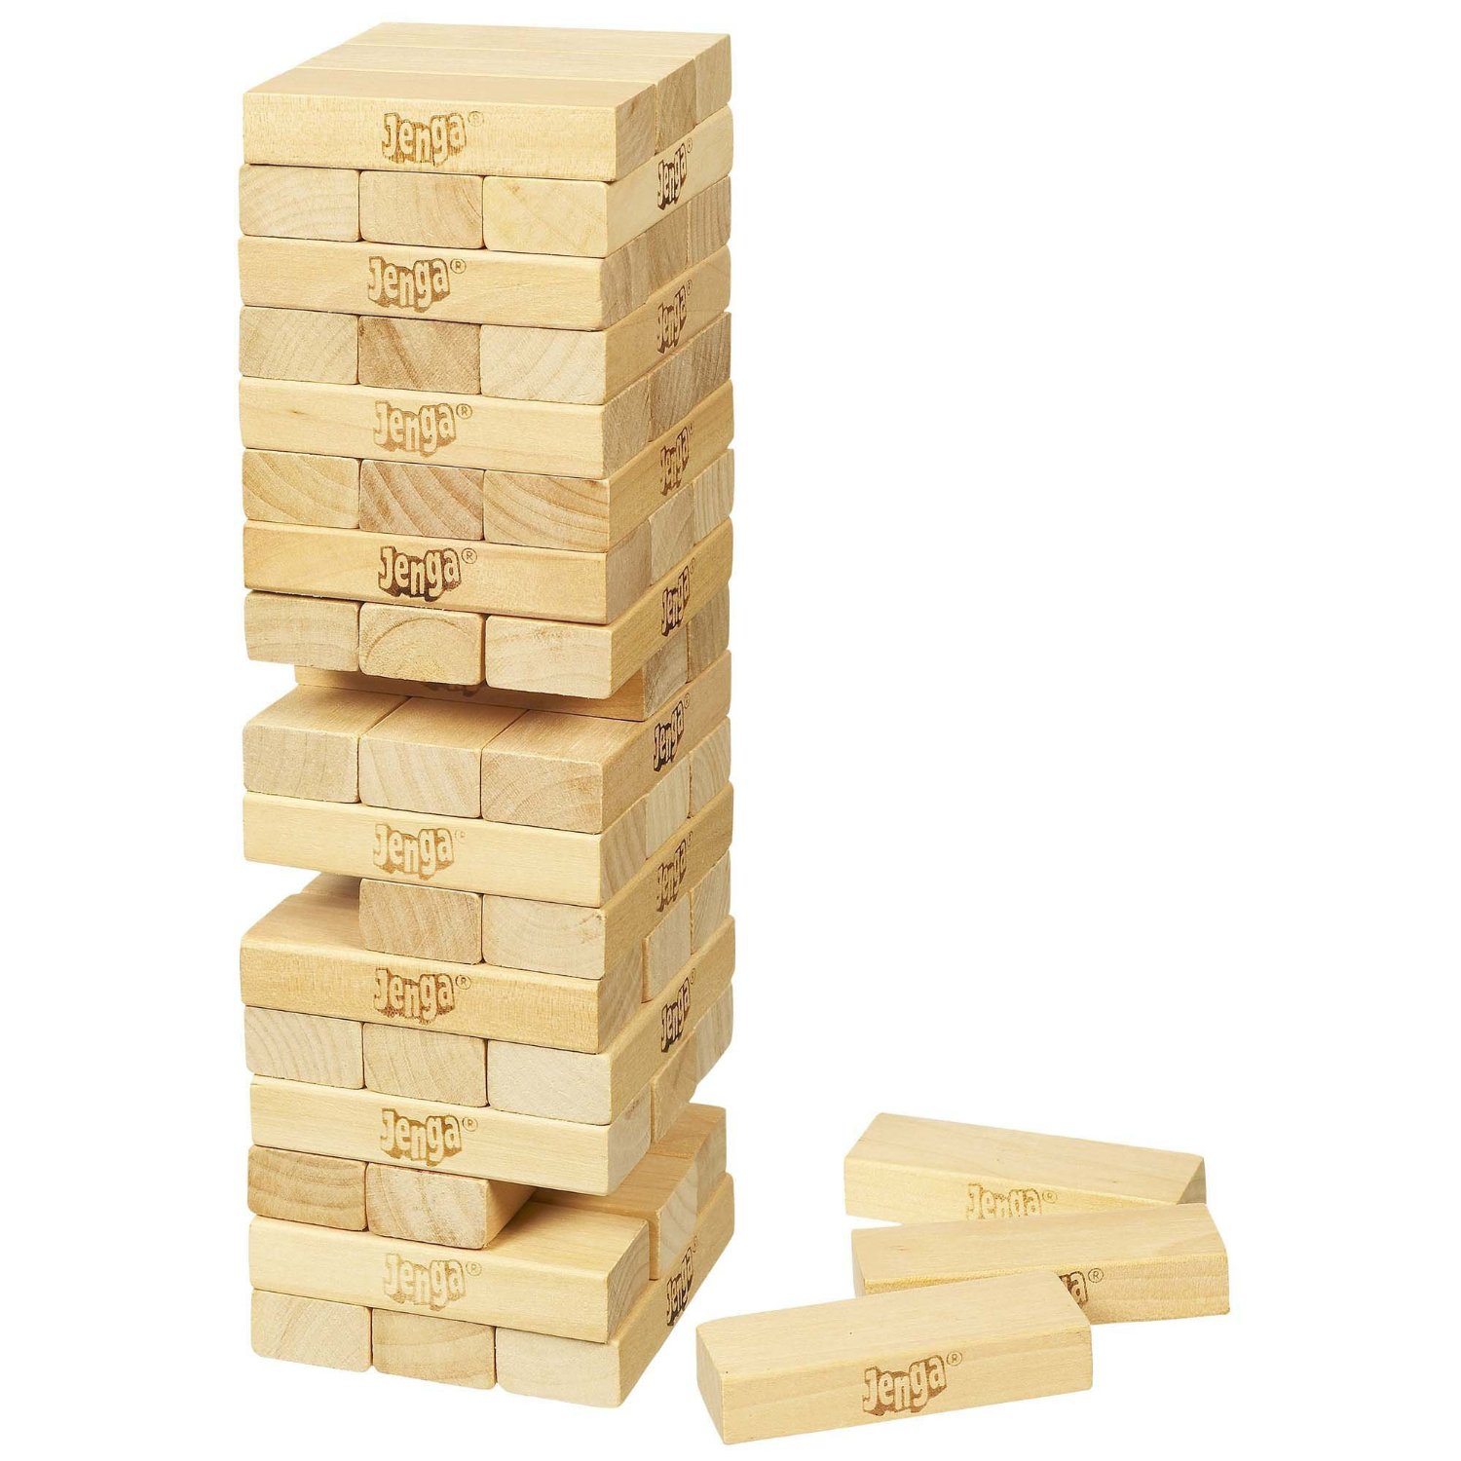
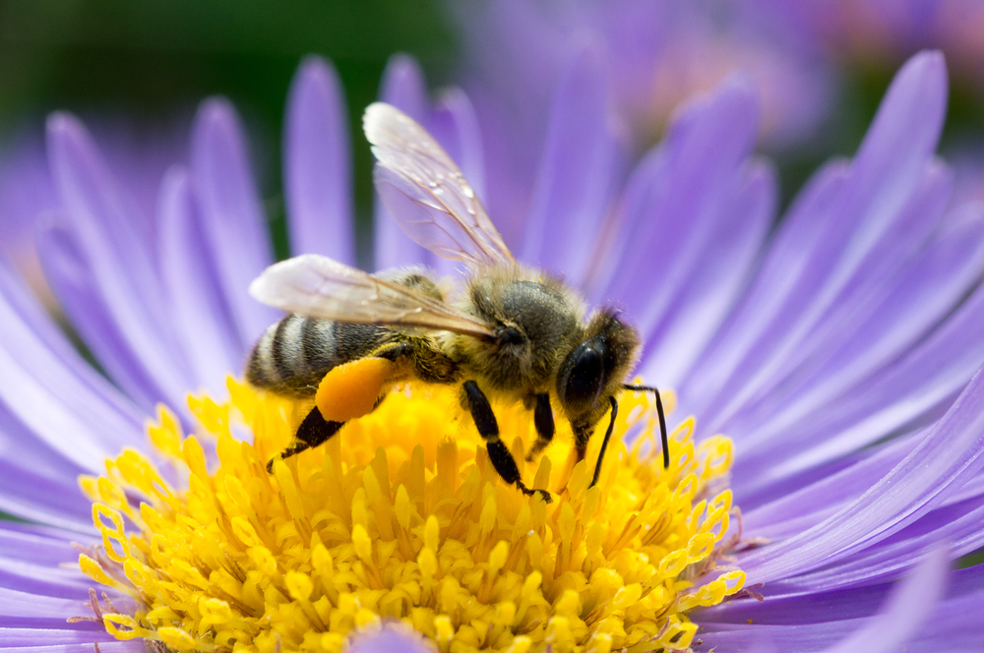
Biodiversity
Characteristics of ecosystem with high biodiversity
How are humans impacting biodiversity?
How can we stop the reduction of biodiversity?
What are ecological benefits from greater biodiversity?

Slide 10
Unit 3 Exam
Ch. 3, 4 and 5
50 MC questions in 45 min.
2 FRQs
Tips:
Look at my slides!
Don’t panic during the FRQ- the answer is probably simpler than you think
Pay attention to the FRQ verbs!

Slide 11
Homework
Finish lab questions
Study for the exam!!
Wear close toed shoes tomorrow!

