Slide 1
Aim: What factors affect the pace of evolution?
APES Unit 2 10/20/15

Slide 2
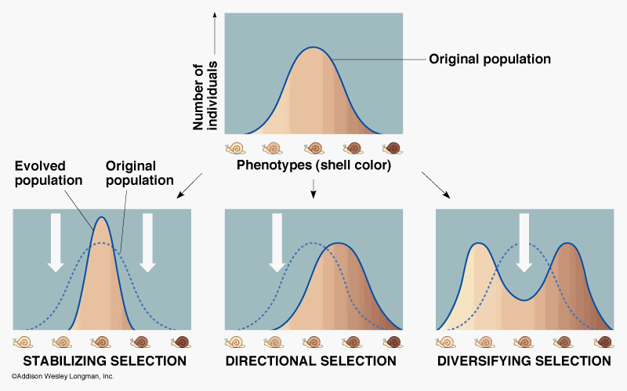
Jellybean Evolution Lab

Slide 3
Vocab:
Speciation: the evolutionary process by which new species arise.
Adaptive radiation: Process in which organisms diversify rapidly into a multitude of new forms

Slide 4
Geographic isolation
A portion of individuals from a larger population may colonize a new area of habitat that is physically separated from that offset of the rest of the population.
Leads to speciation

Slide 5
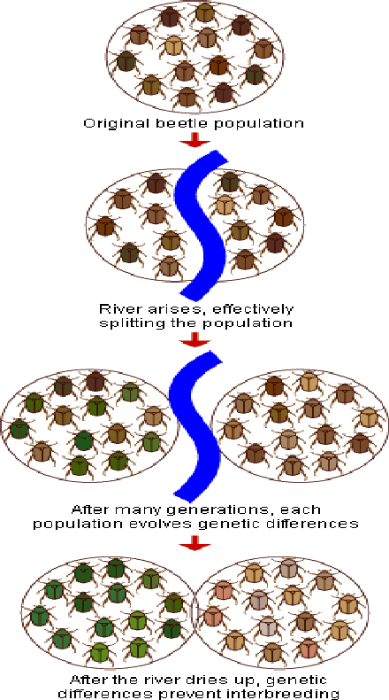
Geographic Isolation

Slide 6
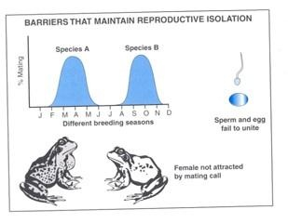
Reproductive Isolation
Populations become so different that they can no longer interbreed.
Leads to speciation

Slide 7
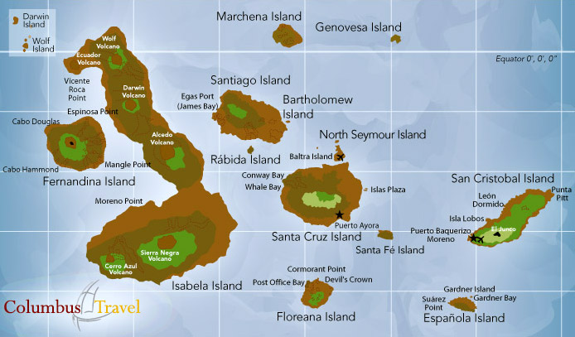
Allopatric speciation
A population that inhabits a particular area is divided into two or more geographically separated groups.
Example: galapagoes finches

Slide 8
Sympatric Speciation
Speciation in the absence of geographic isolation
Result of polyploidy: More than two copies of each chromosome

Slide 9
Pace of evolution
Successful Adaptation:
Rate of environmental change: Lower rate of change → higher chance of adaptability
Genetic Variation: Higher variation→ higher likelihood some individuals will be well suited to the new environment
Population size: Small population→ beneficial mutation spreads quickly
Generation time: Shorter time to reproductive maturity → Evolve faster

Slide 10
Genetic Engineering
Inserting genes from one species into another
GMOs (genetically modified organisms): organisms that have had their genome modified.

Slide 11
Evolution and Niches
Range of tolerance: limits to abiotic conditions organisms can tolerate.
Farther away from ideal → organisms can’t reproduce or survive
Fundamental niche: Ideal conditions for a species to thrive without competition
Realized niche: When a species occupies a smaller niche due to the presence of competition

Slide 12
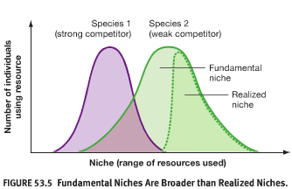
Fundamental niche vs. Realized niche

Slide 13
Gause’s Competitive exclusion principle
No two species can occupy the same niche at the same time
The species that is less fit will will relocate, die out, or occupy a smaller niche.

Slide 14
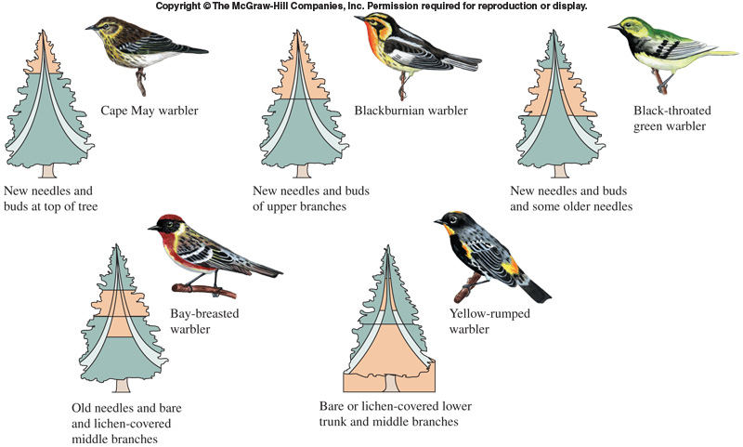
Resource Partitioning
Limits competition by two species using the same scarce resource at different times, in different ways, or in different places

Slide 15
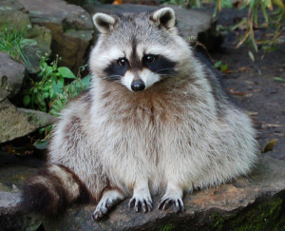
Niches
Distribution: Areas of the world in which a species live.
Niche generalists: Organisms that can live in a variety of habitats or feed on a variety of species
Greater competition for resources but greater ability to adapt to environmental changes

Slide 16
Niches
Niche specialist: Are specialized to live in a particular habitat or feed on a small group of species.
Less competition for resources but less ability to adapt to environmental changes

Slide 17
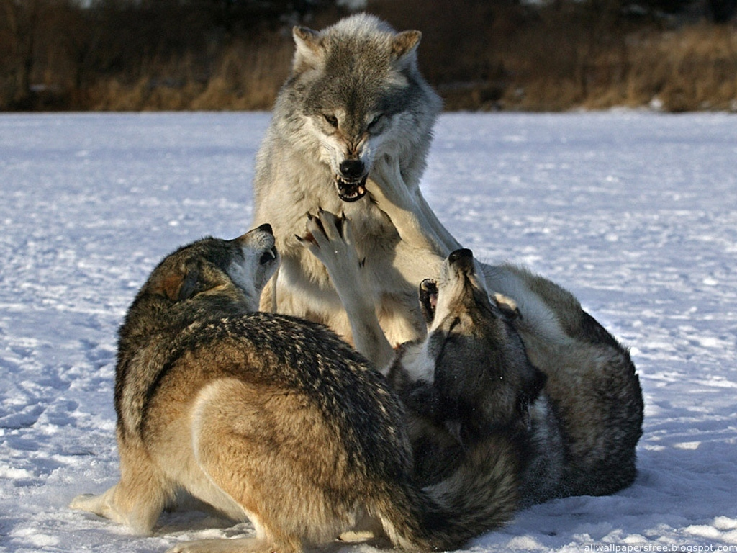
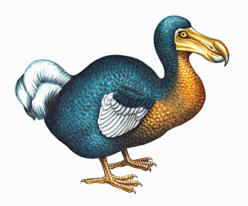
Extinctions
Biological extinction: No individuals of this species left on the planet.
Ex: Dodo birds and passenger pigeons
Ecological extinction: there are so few members of a species that they can no longer perform their ecological function.
Ex: Alligators in Florida Everglades and Wolves in Yellowstone Park

Slide 18
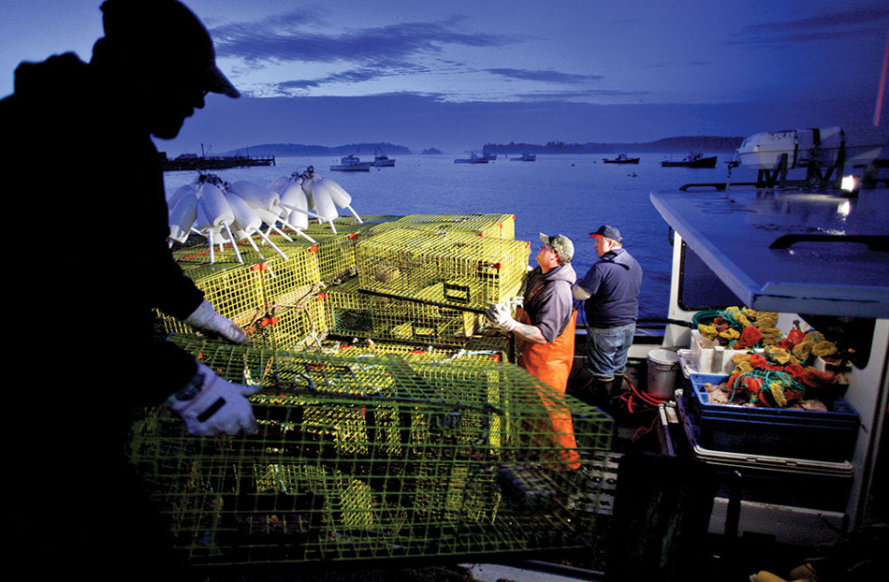
Extinctions
Commercial or economic extinction: Few individuals exist but the effort needed to locate and harvest them is not worth the expense.
Ex: Groundfish population in maritime of Canada

Slide 19
Extinction
Over the next 30 years, about 5 to 10% of all rain forest species are expected to be threatened due to extinction
The background rate of extinction of a species is 1-10 a year
Freshwater species are currently at the greatest risk of extinction in the southwest

Slide 20
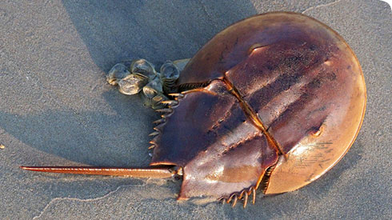
Organisms that survive extinction
High reproduction rate
Not rare
Not commercially valuable
Feed at low trophic levels

Slide 21
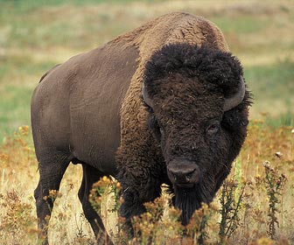
Organisms that are at risk of extinction
Limited geographic range
Naturally small numbers
Endemic to the region (native to the area)

Slide 22
Five Global Mass Extinctions
Pleistocene
Most Recent
Cretaceous
Adaptive radiation occurred which resulted in evolution of homo sapiens
Triassic
Permian
Largest extinction
Devonian

Slide 23
Homework
Homework: Read Benthic Bugs background info and answer questions online

