Slide 1
Aim: What factors drive evolution?
APES Unit 2 10/19/15

Slide 2
Agenda
Lecture
Jelly Bean Lab!

Slide 3
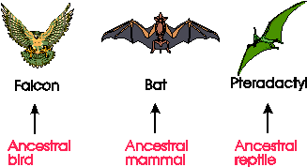
Types of Evolution
Convergent evolution: independent evolution of similar feature in species of different lineages

Slide 4
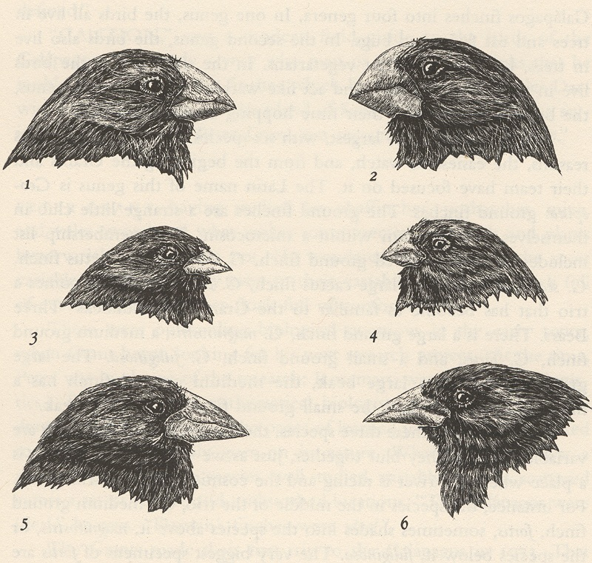
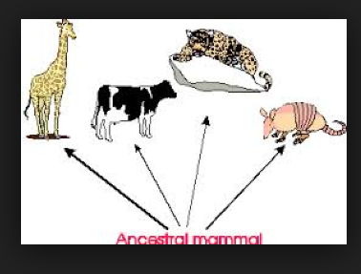
Types of Evolution
Divergent Evolution: Initially similar populations accumulate difference over evolutionary time.
Example: Darwin’s finches

Slide 5
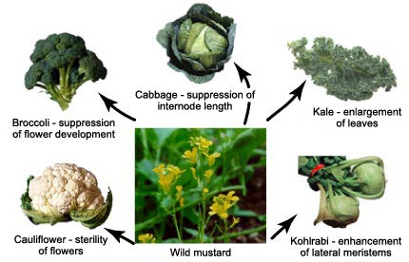
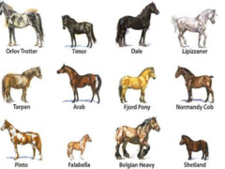
Evolution by Artificial Selection
Artificial selection: when humans determine which organisms breed in order to produce offspring with favorable traits.

Slide 6
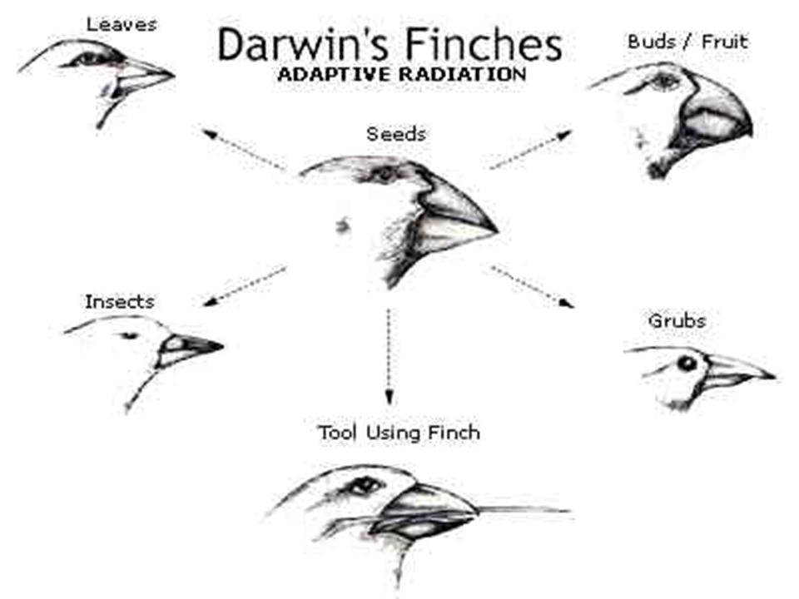
Evolution by Natural Selection
Natural selection: the environment determines which individuals survive.
In order for natural selection to occur, the trait must be heritable

Slide 7
Types of Natural Selection
Stabilizing selection: Genetic diversity decreases and the population mean stabilizes over a particular trait.
Disruptive selection: Extreme values for a trait are favored over intermediate values
Directional selection: Favors individuals only at one end of the spectrum.

Slide 8
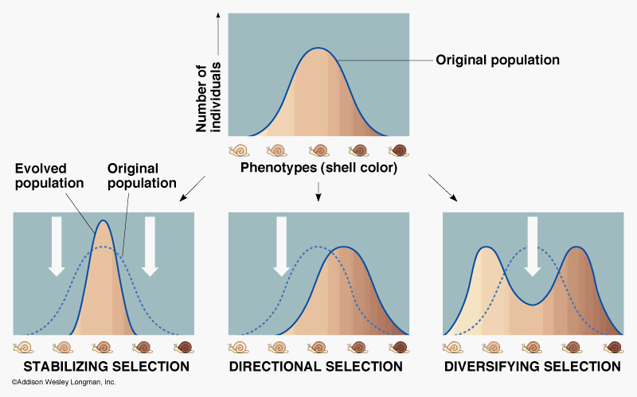

Slide 9
Natural Selection
Natural selection occurs at the level of individuals, not populations
Natural selection occurs over successive generations
Natural selection would not occur unless the environment changes
Natural selection can be stabilizing

Slide 10
Darwin’s key ideas
Individuals produce excess offspring
Not all offspring can survive
Individuals differ in their traits
Differences in traits can be passed on from parents to offspring
Differences in traits are associated with differences in the ability to survive and reproduce.

Slide 11
Evolution by Natural Selection:
Fitness: An individual’s ability to survive and reproduce
Adaptations: Traits that improve an individual’s fitness
Examples of adaptations that help animals acquire energy:
Green, light absorbing leaves in plants
Claws and beak of a hawk

Slide 12
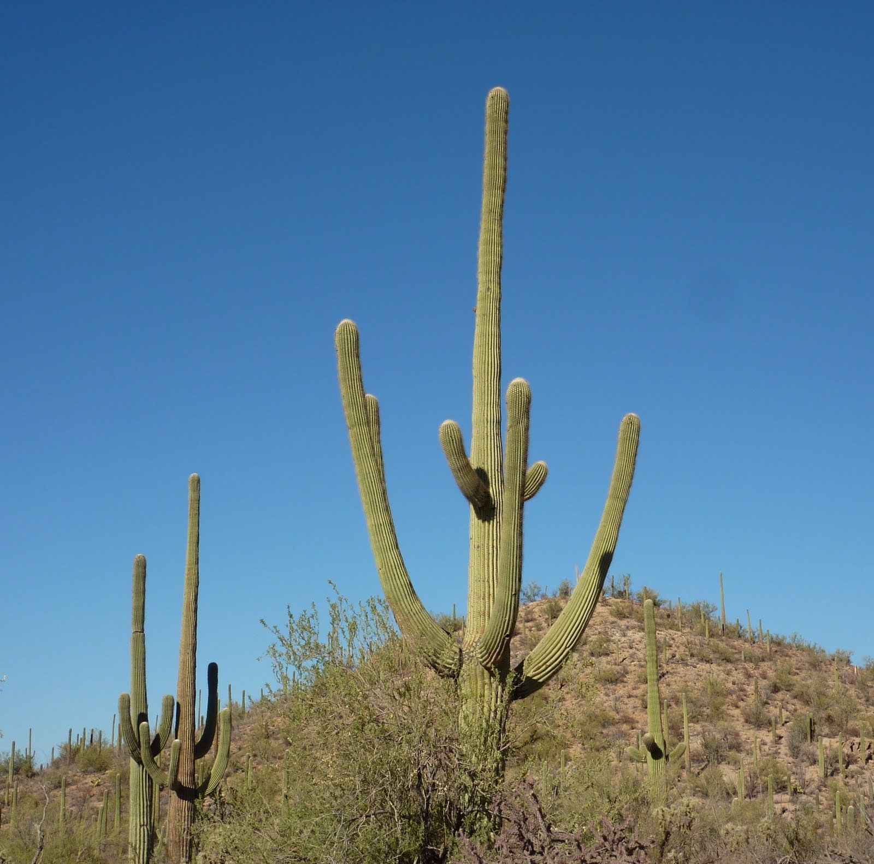
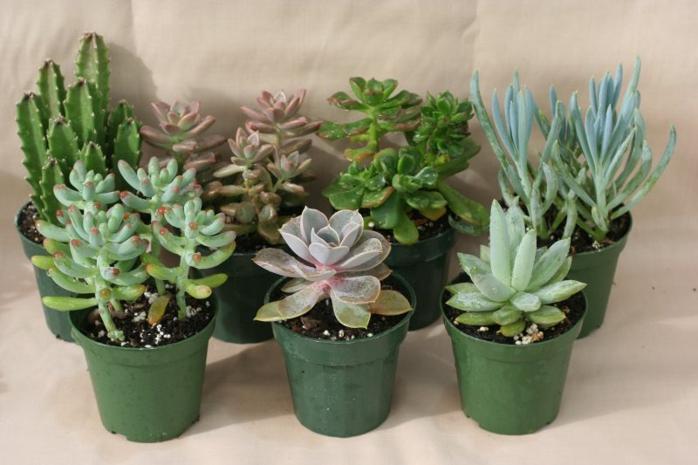
Adaptations and the desert
Succulents store water efficiently
Plants develop deep roots to tap groundwater
Vertical orientation of plants minimizes sunlight exposure

Slide 13
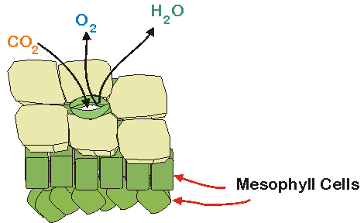
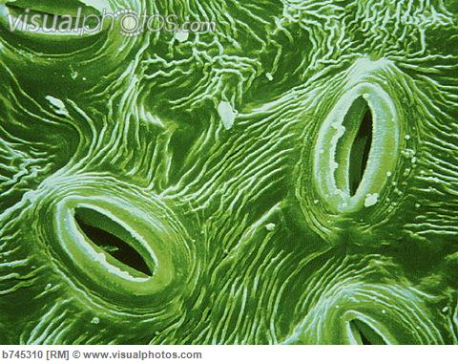
Adaptations and the desert
Stomata open during the night and are closed during the day
Plants secrete toxins into the soil or possess sharp spines as defense mechanisms

Slide 14
Laws and Evolution
Shelford’s Law of Tolerance: The degree to which living organisms are capable of tolerating changes in their environment.
Liebig’s Law of minimum: Living organisms will continue to live, consuming available materials until the supply of these materials is exhausted.

Slide 15
Evolution of random processes
Mutations: random changes in DNA
Larger the population→ more opportunity for mutation
As the number of mutations accumulates→ evolution occurs

Slide 16
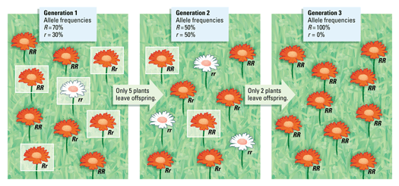
Evolution by random processes
Genetic Drift: change in the genetic composition of a population over time as a result of random chance.
Occurs in small populations

Slide 17
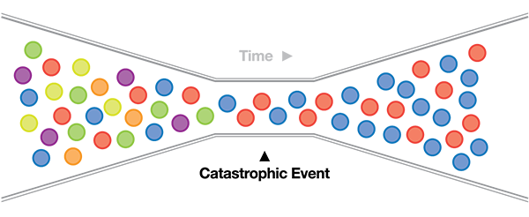
Evolution by random processes
Bottleneck effect: A reduction in the genetic diversity of a population caused by a reduction in its size.
Example: natural disaster wipes out half the population

Slide 18
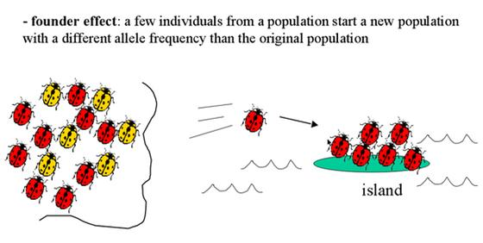
Evolution by random processes
Founder effect: A change in a population descended from a small number of individuals.

Slide 19
Jelly Bean Lab
Group 1 - You may eat any jelly bean you want.
Group 2 - You will eat no jelly beans that are black or resembles a black jelly bean
Group 3 - You will eat first jelly beans that are red or resembles a red jelly beans
Group 4 - You should eat whichever type of Jelly bean is the most abundant.
Group 5 - You may eat any jelly bean you want.

Slide 20
Jelly Bean Lab Notes
Be careful distinguishing between purple and black jelly beans
Count the purple jelly beans as blue jelly beans
Pink jelly beans= red jelly beans

Slide 21
Homework
Finish reading Ch. 5 (including the working toward sustainability section)
Finish answering jelly bean lab questions

