Slide 1
SWBAT evaluate the advantages and disadvantages of ecotourism.
APES Unit 2 10/16/15

Slide 2
Announcements
Unit exam on next Friday!!
Turn in my pencils from yesterday!!
Current event presentations: Rimsha and Amrat on Wed.
Update on fish lab

Slide 3
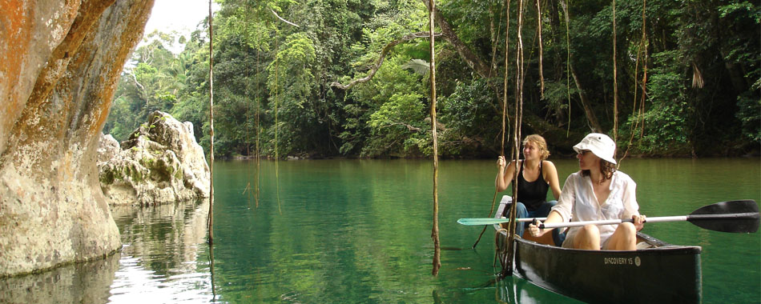
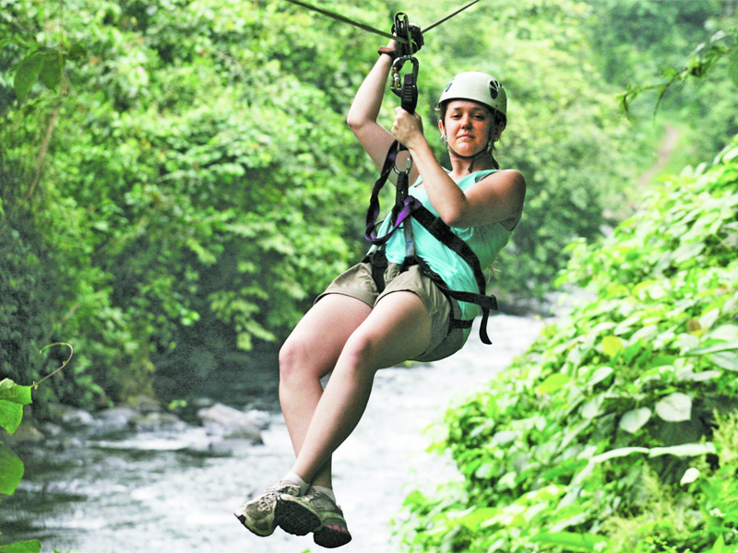
Ecotourism

Slide 4
Pre-Discussion
In what ways is ecotourism beneficial for the environment?
In what ways is ecotourism disadvantage for the environment?

Slide 5
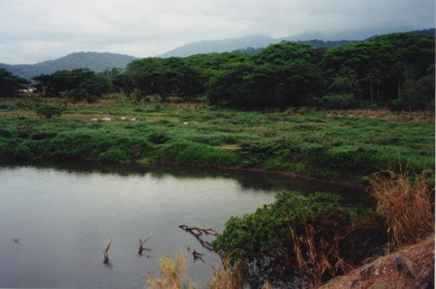
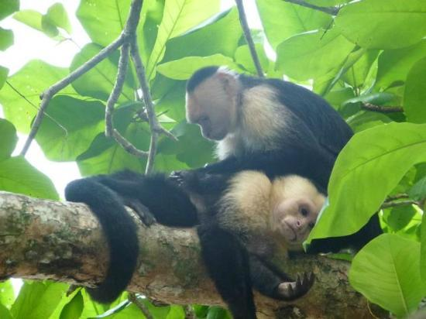
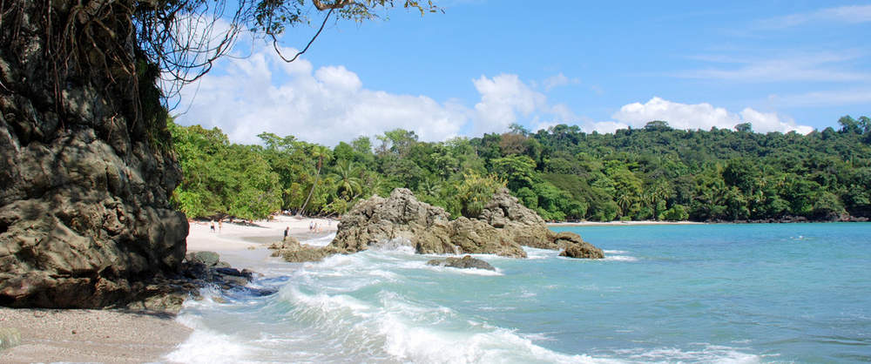
Costa Rica

Slide 6
Discussion Questions
Do you think it is acceptable that Manual has resorted to poaching to make a living? Why or why not?
Do you think the Costa Rican government had the right to set aside land for ecotourism? Why or why not?
How should people whose land is taken from them be compensated?

Slide 7
Homework
Read Ch. 5 Pages 126-130

Slide 8
E.S. Exam
Bubble in the correct version on the scantron!

