Slide 1
SWBAT edit FRQs. How does biodiversity create stable ecosystems?
APES Unit 2 10/15/15

Slide 2
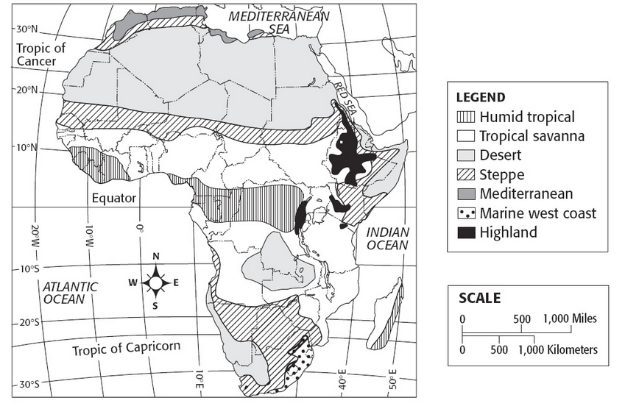

Slide 3
Agenda
Rahila’s Presentation
FRQ Editing
Lecture

Slide 4
APES FRQ
4 questions in 90 minutes (22 minutes per question)
NOT AN ESSAY!!! Each letter should have about three sentences.
1 DBQ, 2 synthesis and evaluation, and 1 quantitative (math!)

Slide 5
FRQ Grading Guideline
10 points total
Grade one letter and roman numeral at a time A(i)
Read the rubric
Give it a point value
Confer with partners at your table

Slide 6
Stop and Think
What did this student do well in his/her responses?

Slide 7
Interpreting Free Response Questions
Key Points:
If the prompt says identify two, only identify two! The reader stops reading after two!
Be specific!
Pay attention to verbs!!

Slide 8
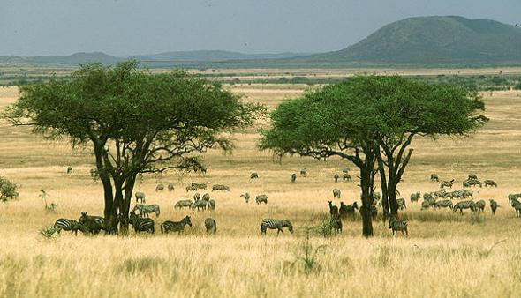
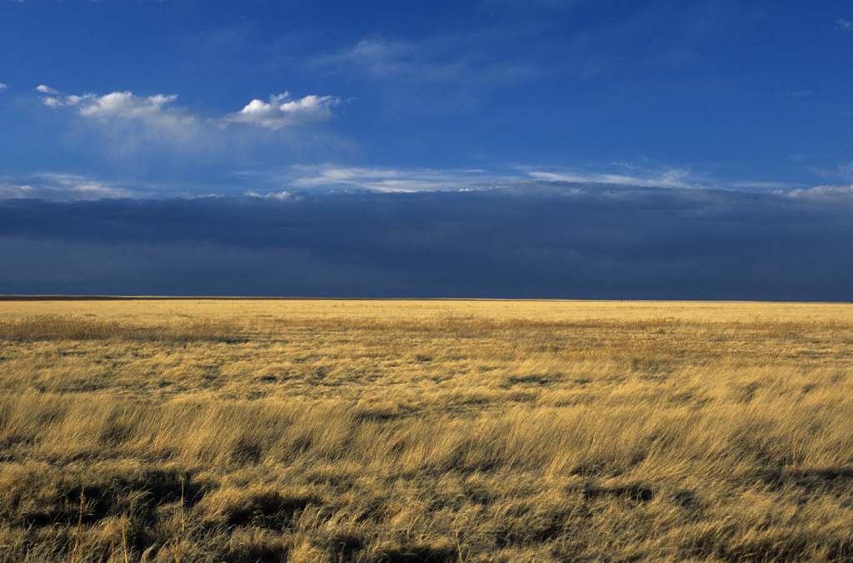
Grassland Vs. Savanna
Grassland is an area dominated by grass or grass-like vegetation
Savanna is a tropical grassland with scattered trees

Slide 9
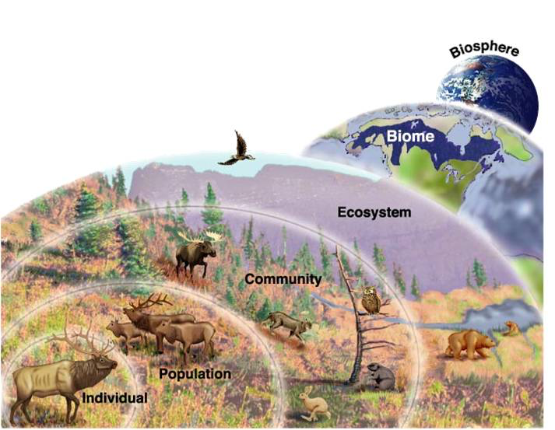
Relationships between species
Species: a group of organisms that are capable of breeding with one another
Population: group of organisms of the same species
Community: When populations of different species occupy the same area
Ecosystem: community of living organisms and their interactions with their environment.

Slide 10
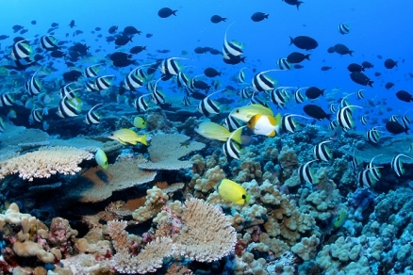
Biodiversity
Species Diversity: The number and variety of organisms found within a specific geographic region or ecosystem.

Slide 11
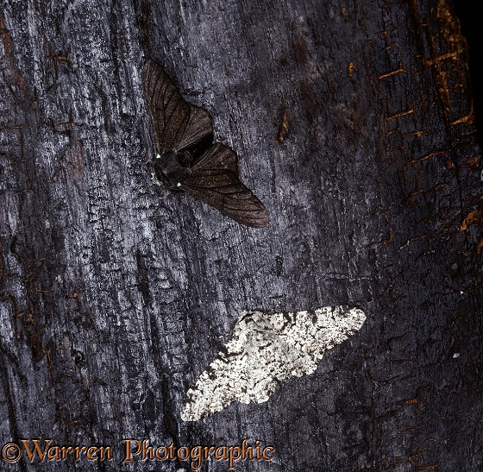
Biodiversity
Genetic Diversity: The range of all genetic traits, expressed and recessive, that make up a gene pool.
Ecosystem Diversity: The range of habitats that can be found in a defined area.

Slide 12
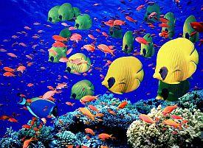
Ecosystems that have high biodiversity
Large number of different species
Large numbers of individuals of different species
Complex food webs
Variety of ecological roles/niches
Abundant resources

Slide 13
Why is biodiversity important?
There is a minimum threshold of species diversity below which ecosystems cannot work
The more diverse an ecosystem is, the less redundancy there is with species occupying the same niches

Slide 14
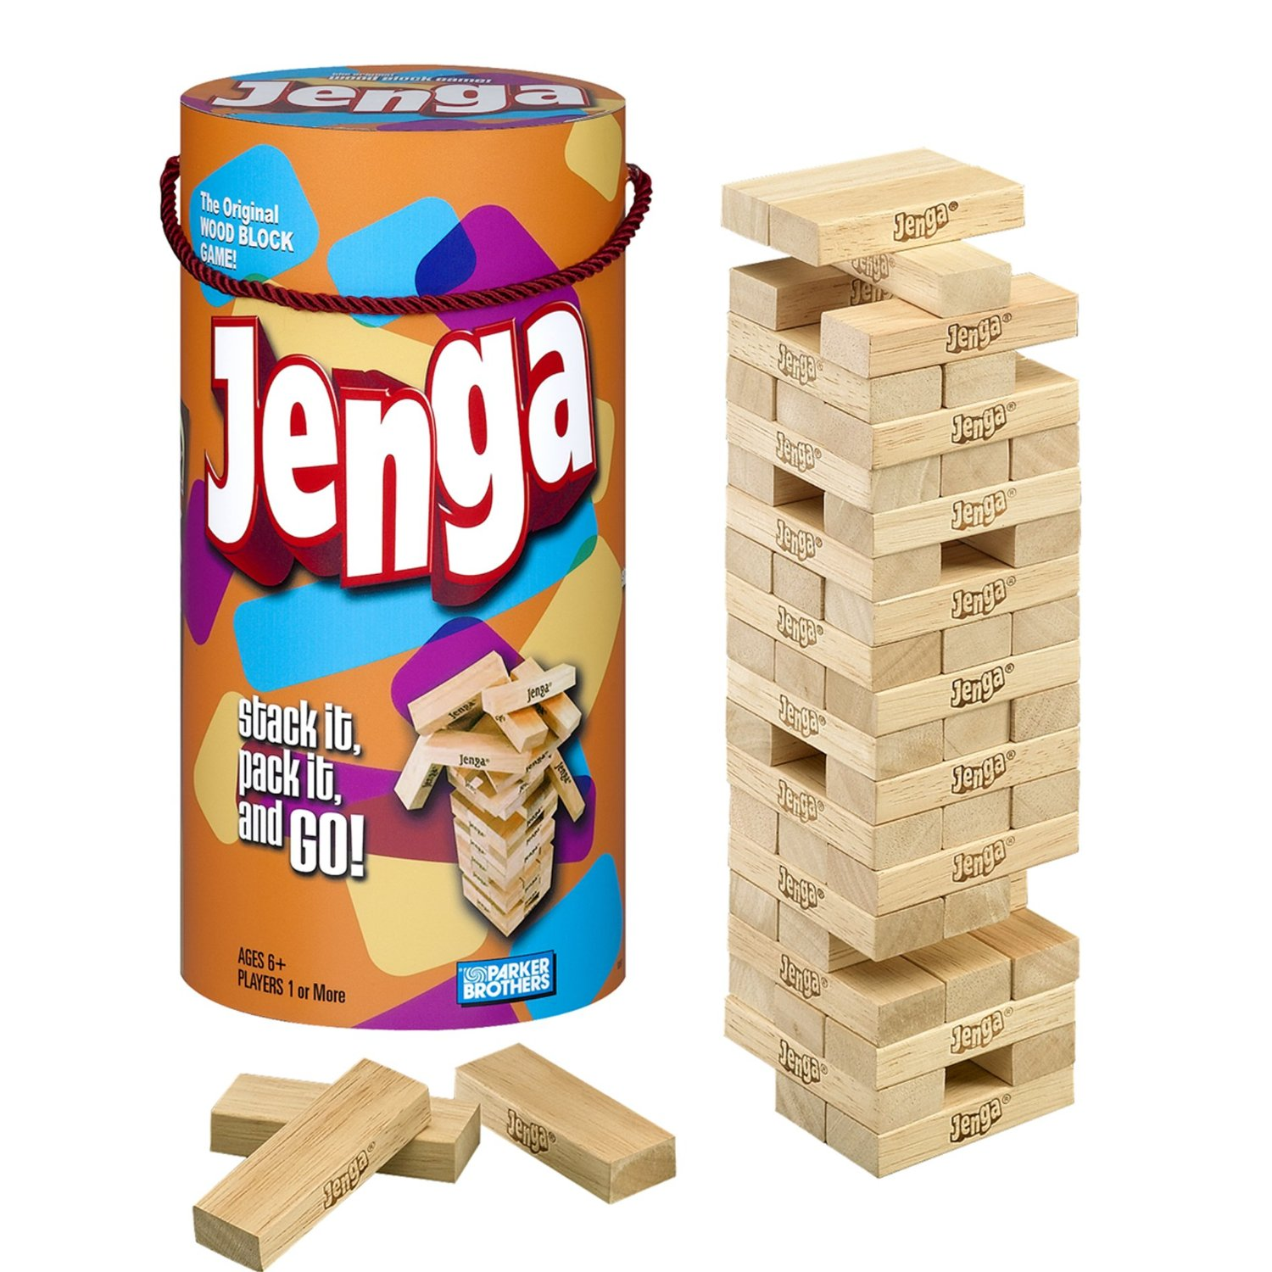
Why is biodiversity important?
The higher biodiversity of the system, the more stable the ecosystem is
Ecosystems with high biodiversity tend to fluctuate less widely than ecosystems with low biodiversity.

Slide 15
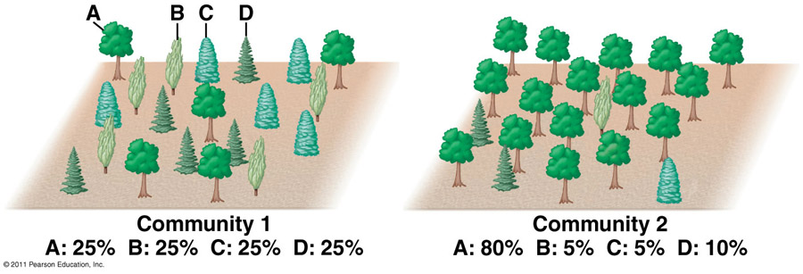
Measuring Biodiversity
Species richness: The number of different species within a given area.
Species evenness: Relative abundance of the different species in an area

Slide 16
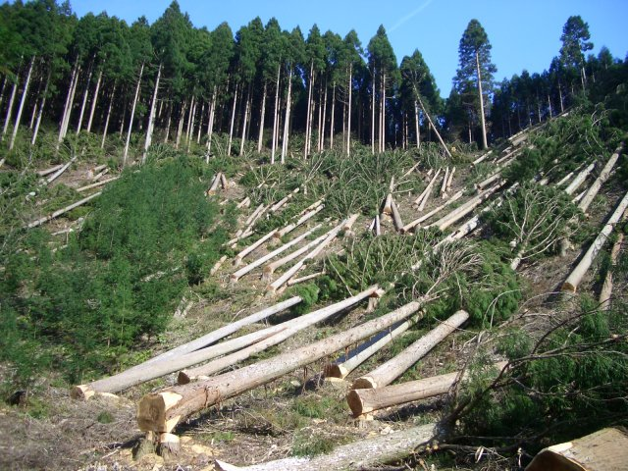
Human Impact on Biodiversity
Clearing land for construction/homes
Deforestation for logging
Effects: reduces habitat for many species
Burning fossil fuels
Effects: death of coral reefs
Increases sea level → loss of coastal habitat
Loss of habitat is the most harmful human impact on biodiversity

Slide 17
Solutions for maintaining biodiversity
Clearing land for construction/homes
Solution: Develop urban boundaries
Solution: Habitat-conservation areas
Deforestation
Solution: Replant trees
Solution: Selective cutting
Burning fossil fuels
Solution: switch to renewable energy
Carbon tax

Slide 18
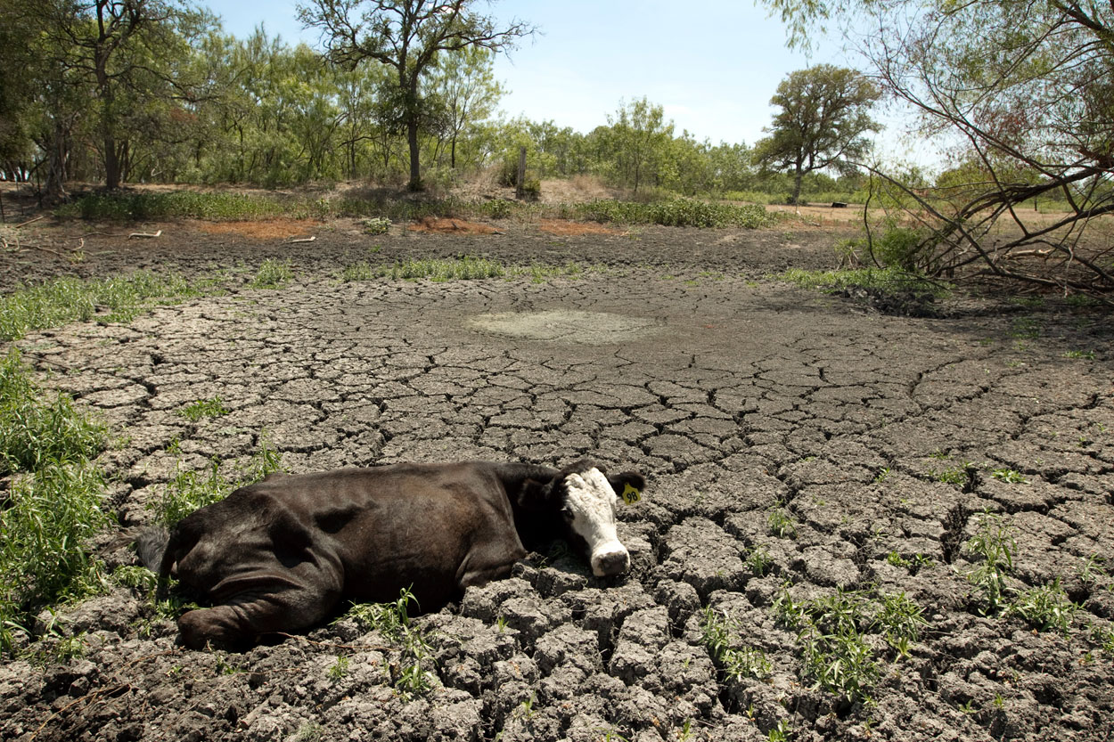
Naturally occurring factors that leads to loss of biodiversity
Widespread wildfires can wipe out small populations
Hurricanes and tsunamis can wipe out coastal/estuary areas
Droughts
Food sources is lost or animals unable to adapt to dry conditions

Slide 19
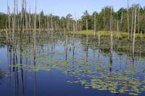
Ecological benefits of greater biodiversity
Pollination!
Water/air filtration by intact ecosystems
Stability of ecosystems
Soil microorganisms contribute to nutrient cycling
More source material for evolution

Slide 20
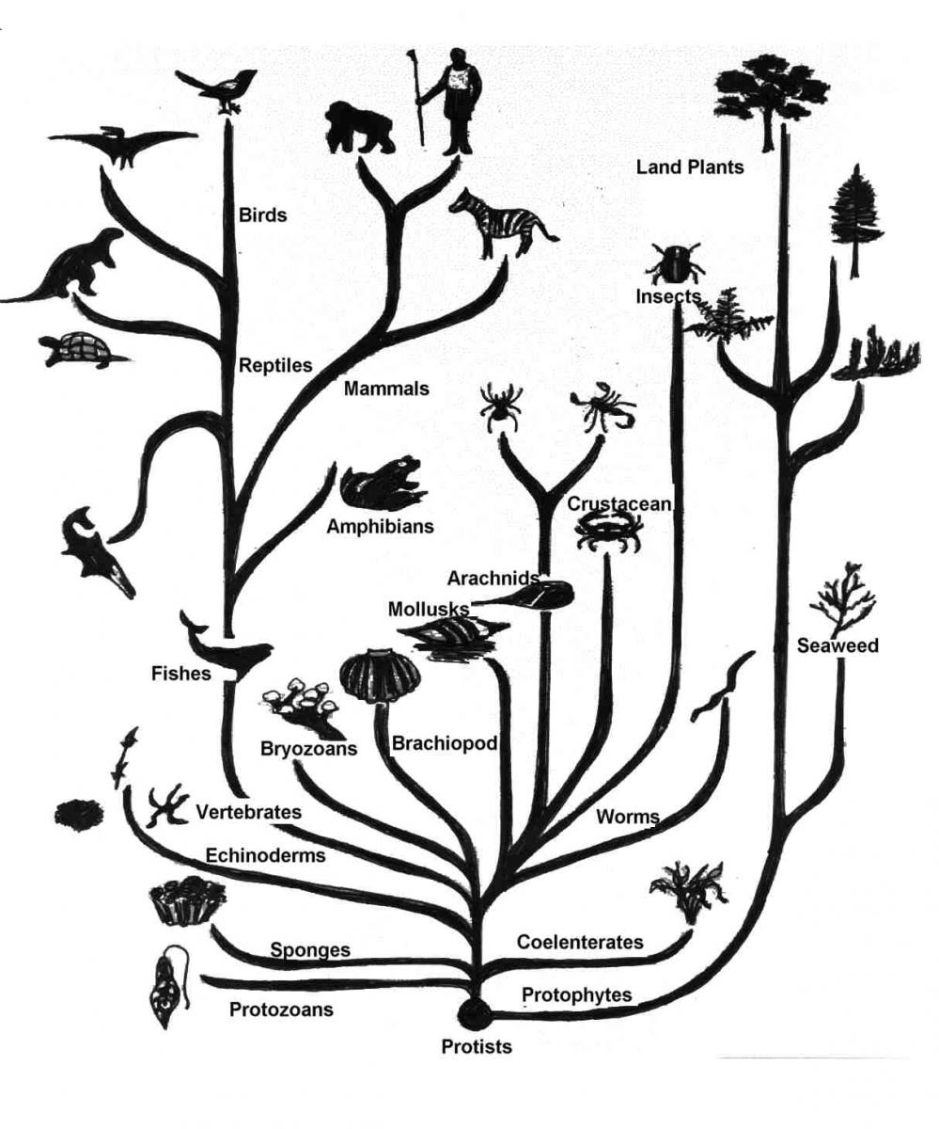
Evolution
Evolution is the change in a population’s genetic composition over time

Slide 21
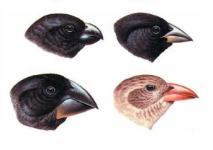
Evolution
Macroevolution: When genetic changes give rise to new species; occur over a long period of time
Microevolution: When a population displays small scale changes over a short period of time
A population is the smallest group that can undergo evolution over a period of time

Slide 22
Creating Genetic Diversity
A gene is the molecular unit of hereditary on a chromosome
Genotype: complete set of genes within an individual
Phenotype is the actual set of traits expressed in an individual

Slide 23
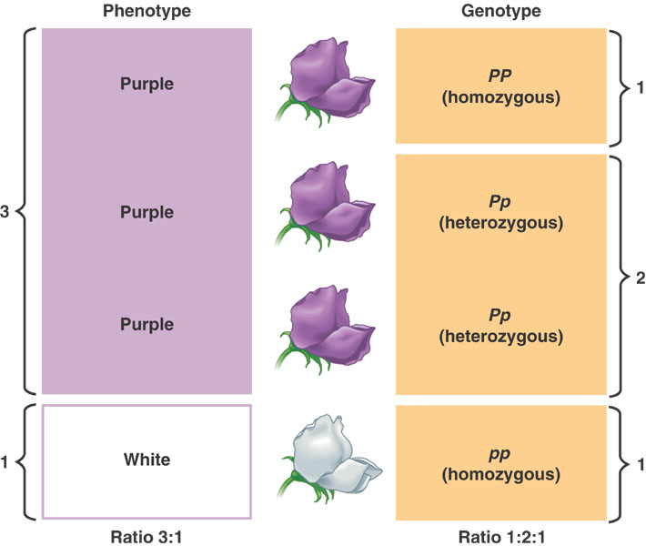

Slide 24
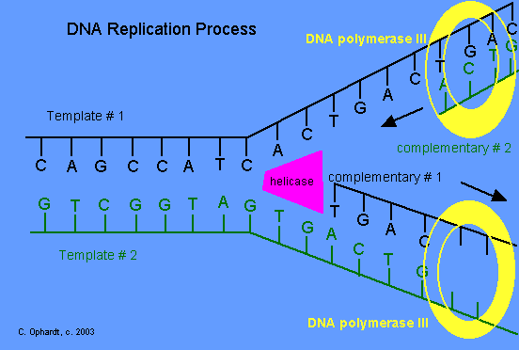
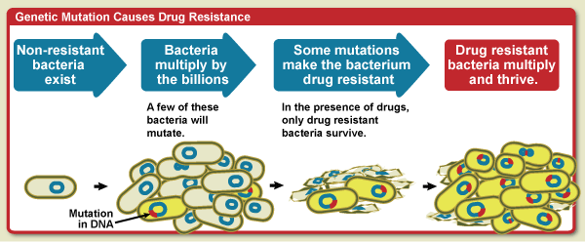
Creating Genetic Diversity
Mutation: random change in DNA
Causes:
mistake in the copying process
UV radiation
Genetic mutations are NOT always harmful!

Slide 25
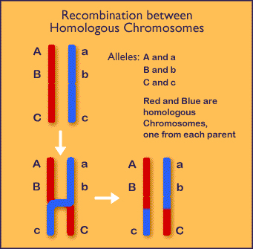
Creating genetic diversity
Recombination: A piece of one chromosome breaks off and attaches to another chromosome during meiosis.

Slide 26
Phylogenies
Used to model evolution
Relatedness based on similarity of traits
More similar traits → more closely related

Slide 27
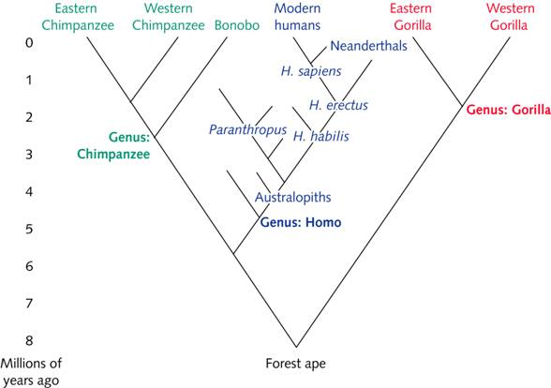
Phylogenies

Slide 28
Homework
Read case study on ecotourism (through pg. 4) and answer questions– it will be posted on website!
Research two negative effects of the impact of humans on biodiversity
Be able to describe three of the services from natural capital in detail
Get permission form signed!!!

