Slide 1
Aim: How do ocean currents and the earth’s orbit affect climate?
APES Unit 2 10/6/15

Slide 2
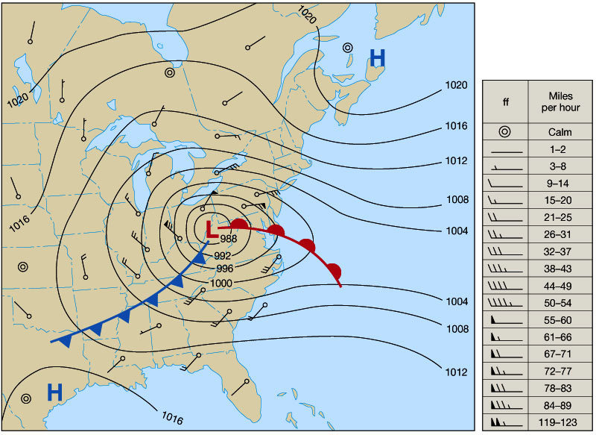
Wind
Wind is air that moves as a result of unequal heating of the earth’s surface
Can move heat, moisture, soil, and pollution around the planet.
The largest factor in wind strength is pressure differences between two regions

Slide 3
Trade Winds
Trade winds:
occur between 30 degrees latitude and the equator
Strong and steady
Speed of 11 to 13 mph
Northern hemisphere: Northeast trade winds
Southern hemisphere: Southeast trade winds

Slide 4
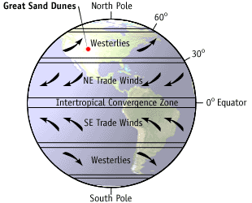
Westerly
Northern hemisphere: travels south and west
Southern hemisphere: travels north and west

Slide 5
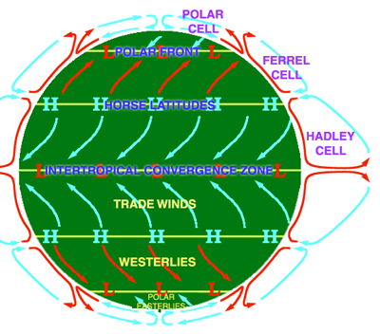
Horse Latitudes
Areas between 30 and 35 degrees latitude, dry air and weak winds

Slide 6
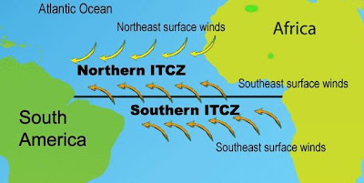
Doldrums = ITCZ
Air is still because it is constantly rising

Slide 7
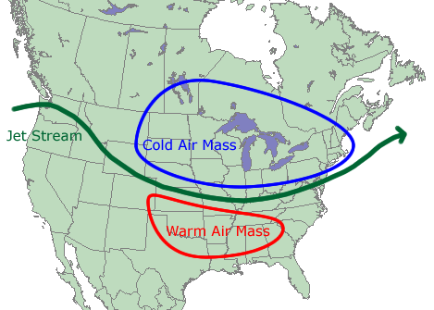
Jet Stream
High speed currents of wind that occur in the upper troposphere
Have a large influence on local weather patterns
Jet Streams in the U.S. primarily travel west to east

Slide 8
Earth’s Tilt
Earth is tiled on it’s axis by 23.5 degrees
Tilt + motion of earth around the sun causes seasons
June 22 Solstice
Northern hemisphere has the longest amount of daylight
Sothern hemisphere has the shortest amount of daylight

Slide 9
Ocean Currents
Surface and deep sea circulation of ocean waters
Movement affected by:
Wind
Differences in temperature
Differences in salinity
Earth’s rotation

Slide 10
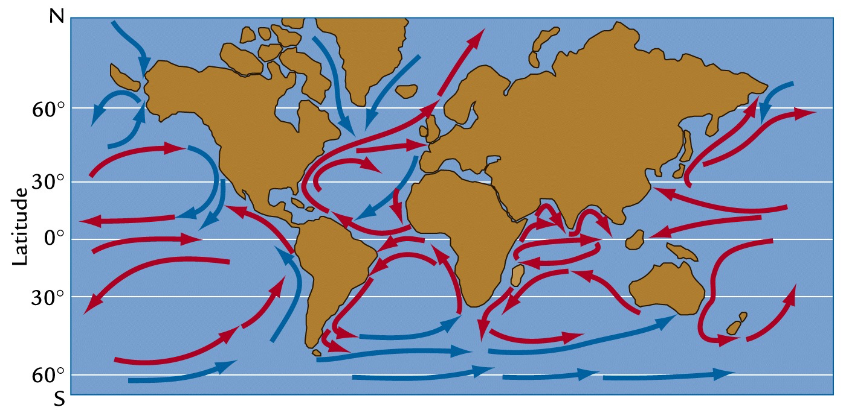
Ocean Currents
Surface ocean currents are driven primarily by wind patterns
The majority of ocean currents are determined by density differences

Slide 11
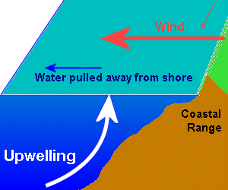
Ocean Currents
Gyres: large-scale patterns of water circulation
Redistribute heat
Upwelling: upward movement of deep water
Brings nutrients
Supports highly productive ecosystems

Slide 12
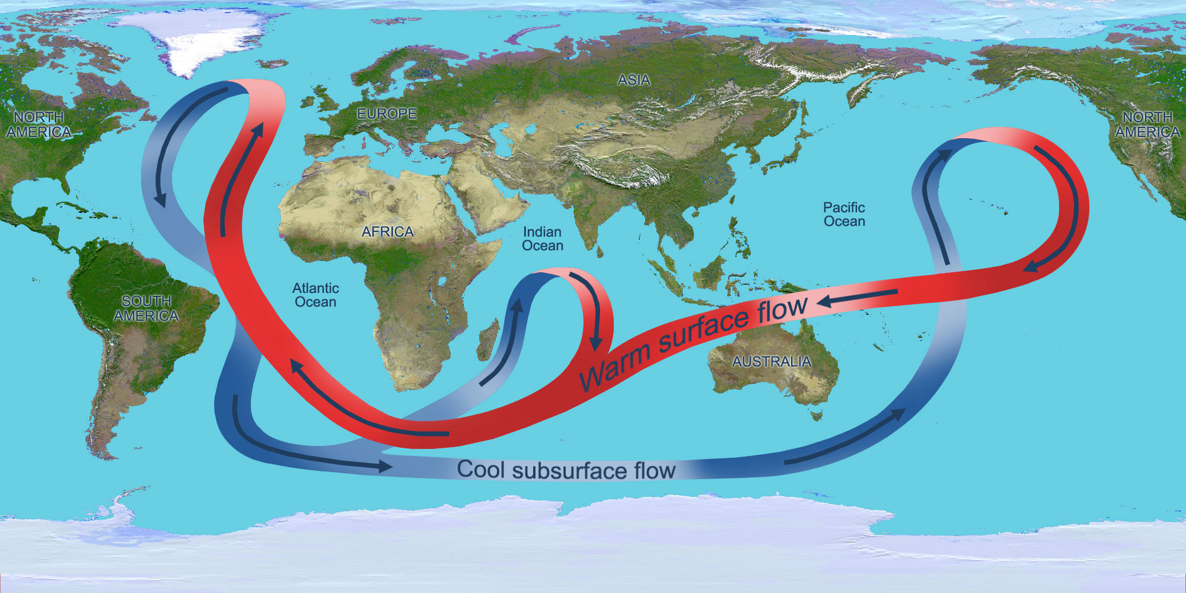
Thermohaline Circulation
Drives mixing of surface and deep water
Moves heat and nutrients across the globe
Equator: warm water rises
High latitudes: cold, salty water sinks
Global subsurface ocean currents complete a single cycle in 1,000 years

Slide 13
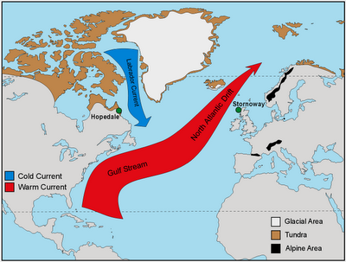
Heat Transport
Ocean currents can affect temperature of nearby land masses
Gulf Stream moderates England’s Climate

Slide 14
How can global warming affect thermohaline circulation?
Glaciers melt→ ocean is less salty
Thermohaline circulation stops
Great Britain becomes COLD!!!

Slide 15
El Nino-Southern Oscillation (ENSO)
Every 3 to 7 years the surface currents in the tropical Pacific Ocean reverse directions.
Normal trade winds and westerlies are weakened
Upwelling slows → warmer water and fewer nutrients
Offshore fish populations decline

Slide 16
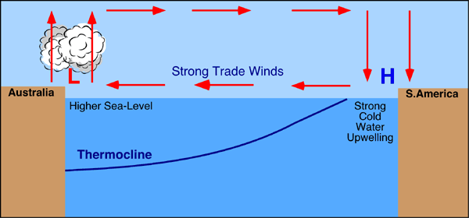
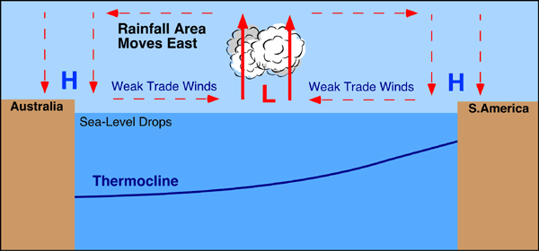
El Nino (ENSO)

Slide 17
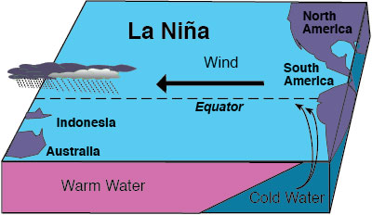
La Nina
Allows upwelling→ surface waters of the ocean surrounding Central and South America are colder than normal.
Brings warm winters to the southeastern U.S.

Slide 18
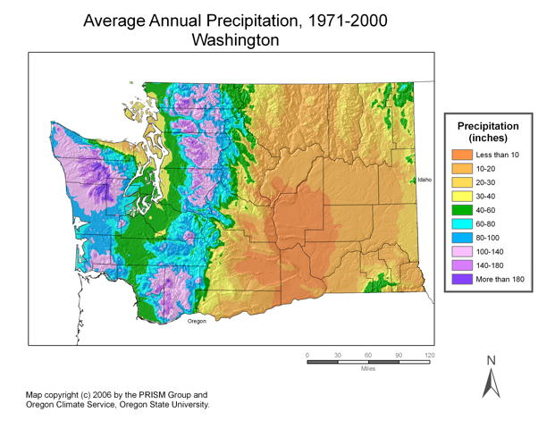
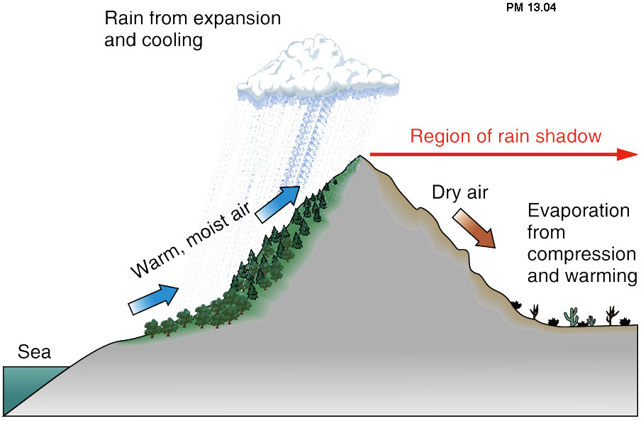
Rain Shadows
Large amounts of rain fall on the windward side (the side facing the wind) of mountains
On the leeward side there are less clouds and less rain

Slide 19
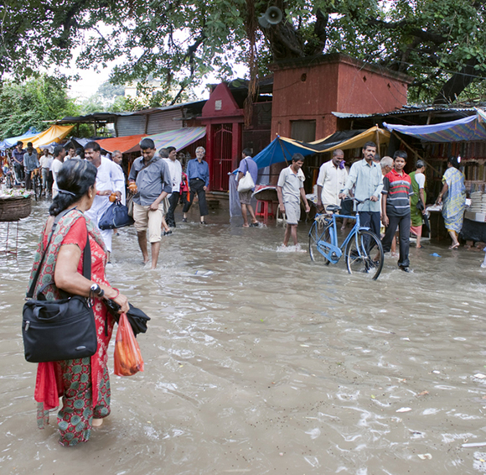
Monsoons
Seasonal wind accompanied by heavy rainfall
Hot air rises→ low pressure system
Low pressure air mass is usually associated with cloudy or stormy weather
Usually occur in coastal areas

Slide 20
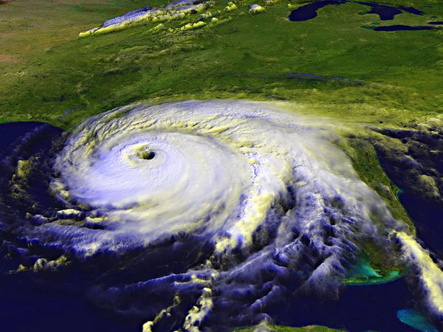
Hurricanes
Intense tropical storms with wind speeds up to 130 km/hr
More energy than a nuclear reaction
Called typhoons or cyclones when they occur in the Pacific Ocean

Slide 21
Homework
Add nitrogen lab data to google doc– please do this ASAP
Answer nitrogen lab questions ( you may need to do online research)

