Slide 1
Aim: How does energy flow in the atmosphere affect weather?
APES Unit 2 10/5/15

Slide 2
Agenda
Lecture
Nitrogen lab
Outdoor Albedo Lab
Videos if time

Slide 3
Climate vs. Weather
Weather is the day to day properties: wind speed, direction, temperature
Climate: Patterns that are constant for many years (30 plus). Most important factors are:
Average temperature
Average precipitation
Regional climates are most affected by latitude and altitude
Meteorologists are scientists who study weather and climate

Slide 4
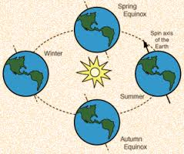
Processes that affect distribution of heat and precipitation
Unequal heating of the earth by the sun
Atmospheric convection currents
Rotation of the earth
Earth’s orbit around the sun on a tilted axis
Ocean Currents

Slide 5
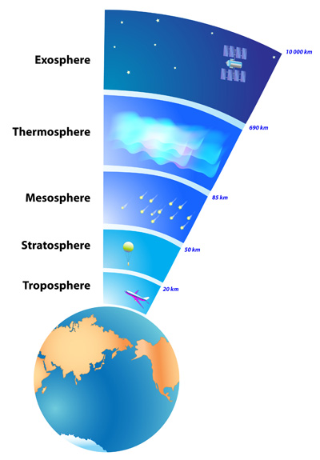
Earth’s Atmosphere

Slide 6
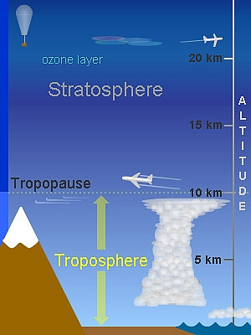
Earth’s Atmosphere
Troposphere: Densest layer; contains weather
Tropopause: Buffer zone between the troposphere and stratosphere
Stratosphere: contains the Ozone layer
Mesosphere: where meteors are destroyed

Slide 7
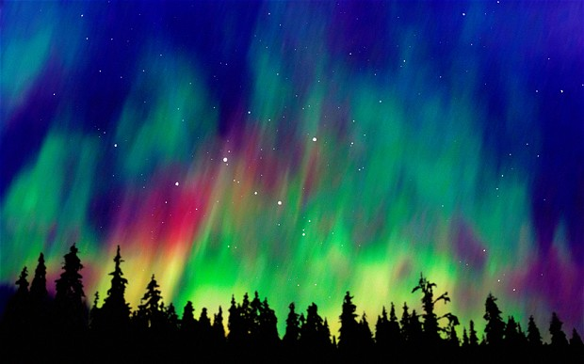
Earth’s Atmosphere
Thermosphere (ionosphere): Air molecules have high velocities; it reflects outgoing radio waves to earth; energetic charged particles are absorbed
Exosphere: uppermost region; fades into a vacuum of space

Slide 8
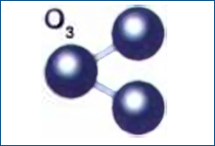
Ozone
Absorbs UV radiation from the sun
Removes both natural and human made gases from the lower atmosphere
Maintains the stratosphere as a stable region of the atmosphere with temperatures increasing with altitude.

Slide 9
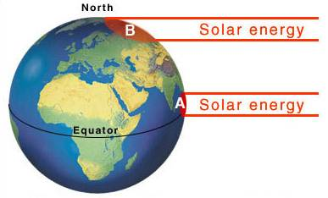
Unequal Heating of the Earth
1. Caused by the angle at which the Sun’s rays strike Earth.
Sun strikes at right angle at the equator= more solar energy

Slide 10
Unequal Heating of the Earth
2. Variation in the amount of surface area over which the Sun’s rays are distributed
Surface area is smaller at the equator → tropical regions receive more solar energy

Slide 11
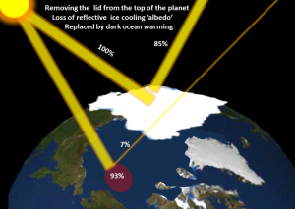
Unequal Heating of the Earth
3. Some areas of earth’s surface reflect more solar energy than others
Albedo: Percentage of incoming sunlight that is reflected from a surface
High albedo: snow
Low albedo: asphalt

Slide 12
Properties of Air
Four properties that determine how air circulates in the atmosphere:
Density
Water Vapor Capacity
Adiabatic heating or cooling
Latent heat release

Slide 13
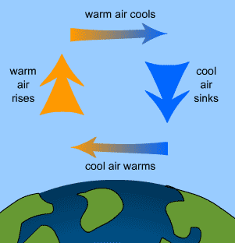
Air Density
More dense air sinks
Less dense air rises
Warm air is less dense → it rises
Cool air is more dense → it sinks

Slide 14
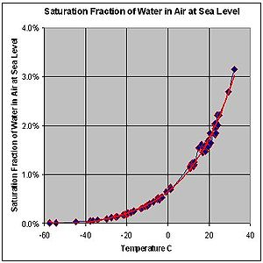
Water Vapor
Warm air has a higher capacity for water vapor than cold air
Saturation point is the maximum amount of water vapor that can be in the air at a given temperature

Slide 15
Air and Pressure
Adiabatic cooling
Air rises → pressure decreases
Lower pressure→ air expands (becomes less dense)
Lower air density→ lower temperature
Adiabatic heating
Air sinks → higher pressure
Higher pressure→ higher density
Higher density --> increase in temperature

Slide 16
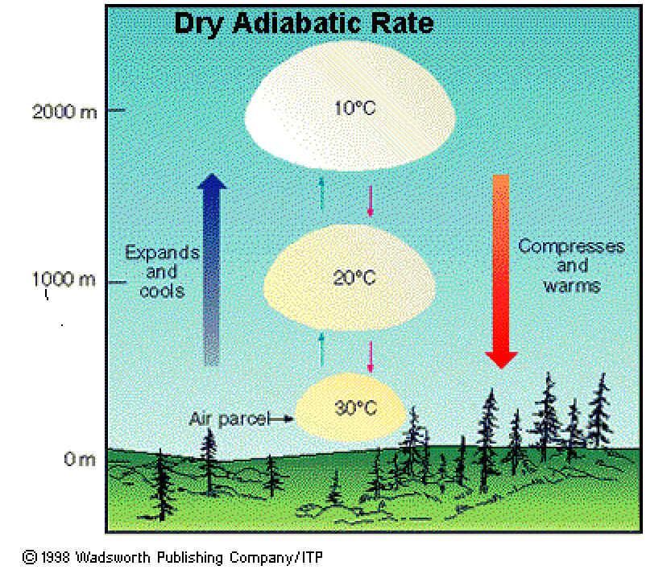
Adiabatic Heating and Cooling

Slide 17
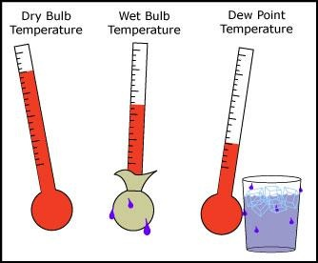
Latent Heat Release
Water vapor condenses to liquid water and releases energy
Water vapor condenses to water→ air becomes warmer → warm air rises
Dew Point: Temperature at which water vapor condenses into liquid water

Slide 18
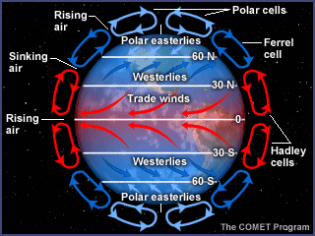
Convection Currents
Global patterns of air movement that are initiated by unequal heating of the earth

Slide 19
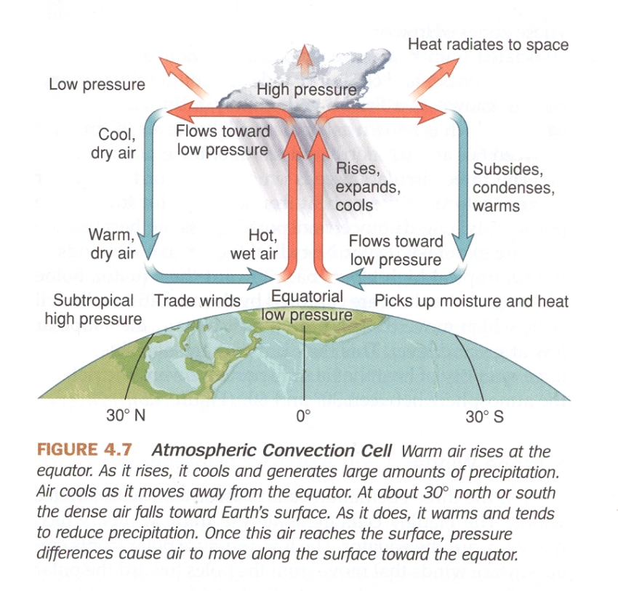
Hadley Cells
Convection current that occurs in the tropics (from the equator to 30° N and S)
H.E.-- Hadley cells at the Equator

Slide 20
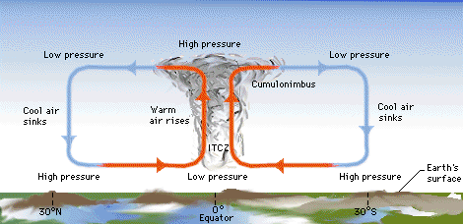
ITCZ
Intertropical Convergence Zone
Where the two Hadley cells meet
Receives the most intense sunlight
Dense clouds and intense thunderstorm activity

Slide 21
Polar Cells
Are that rises at 60° N and S and sinks at the poles (90° N and S)

Slide 22
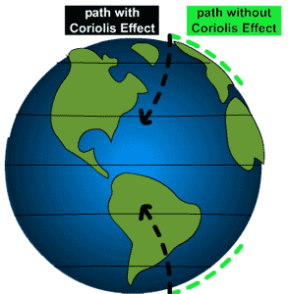
Coriolis effect
Earth’s rotation on its axis influences earth’s climate
Surface at the equator moves faster than the surface at the polar regions
Coriolis Effects is the deflection of an object’s path due to Earth’s rotation

Slide 23
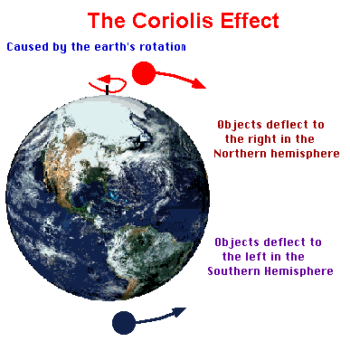
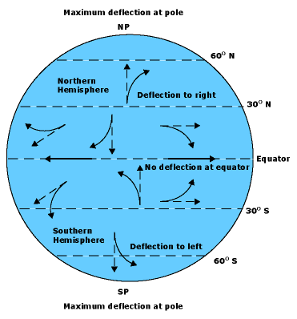
Coriolis Effect
Northern hemisphere: Causes wind to veer to the right
Southern hemisphere: Causes wind to veer to the left

Slide 24
Nitrogen Lab
Take ammonia, nitrate ,nitrite readings

Slide 25
Fertilizer Lab Reports
Glows: Great first lab report!!
Grows:
Make sure you have a data table and graph
Use citations in your percentages summary
In-text citations are your friends!!
Shout outs:
Research: Monica and Wyllana
Discussion: Rimsha, Rahila and Ramlah
Results summary and citations: Mehrangiz

Slide 26
Homework
Read Ch. 4 through page 99
Start working on your presentation!

Slide 27
Outdoor Albedo Lab
Do NOT cross the street
Meet at the front entrance to the school
Partners:
Ramlah and Attia
Wendy and Cynthia
Bukurie and Saliha
Harmanpreet and Uzma
Mehrangiz and Rimsha
Shayna and Hamna
Desire and Rahila
Wyllana and Amrat
Monica , Kaylah and Mahnoor

