Slide 1
Aim: How do ecosystems respond to disturbance and what kind of services do they provide us with?
APES Unit 2 10/2/15

Slide 2
Announcements
Ch. 3 Quiz on Monday!!
12 Multiple choice questions
Agenda:
Mini-lecture
Collect data for lab
Homework/presentations

Slide 3
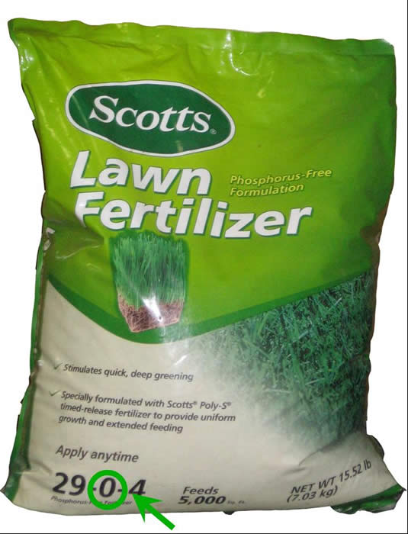
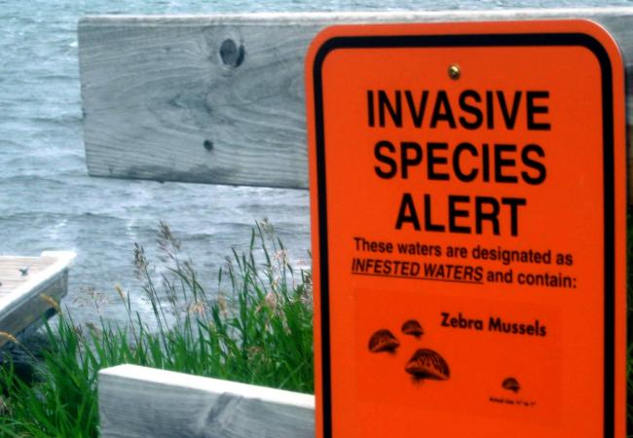
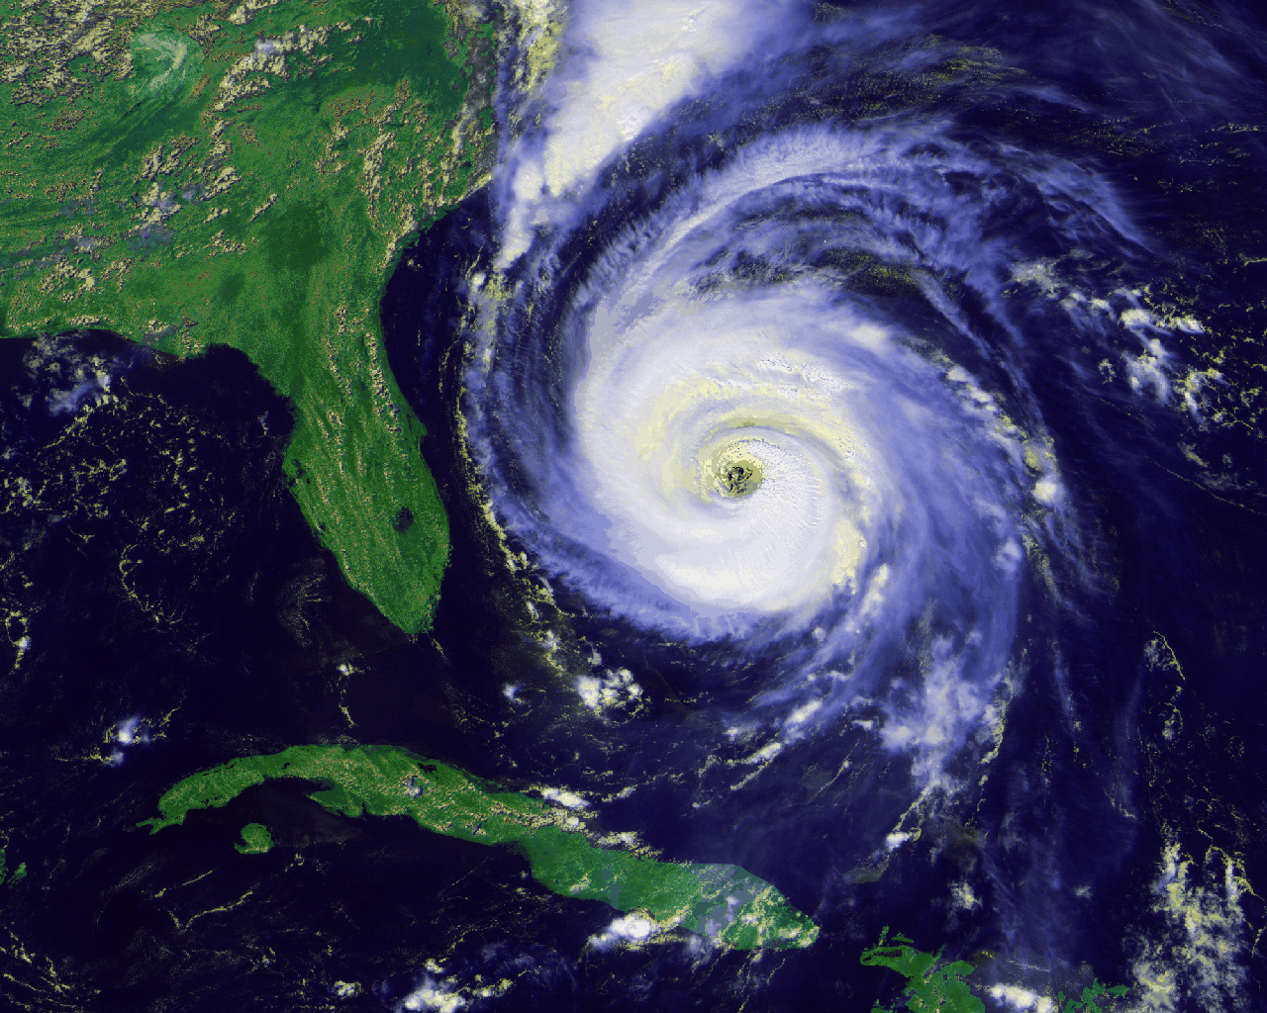
Ecosystem Disturbance
Disturbance: An event caused by physical, chemical, or biological agents that results in a change in population size or community composition.

Slide 4
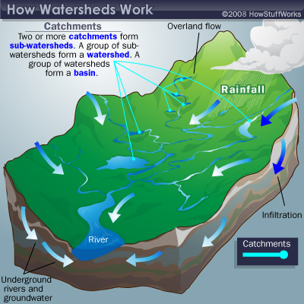
Watershed
A watershed is the area of land drained by a river, stream, lake, or wetland

Slide 5
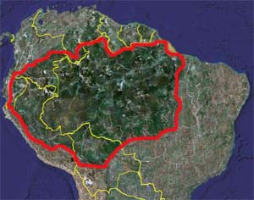
World’s largest watershed
The Amazon Watershed
Flows through 6 countries!

Slide 6
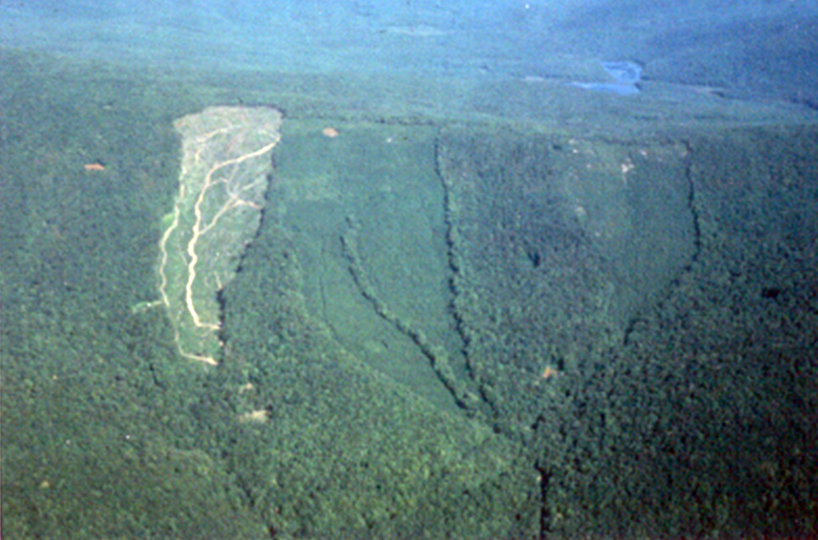
Case Study: Hubbard Brook Watershed
Clear cut watershed
Increase in nitrates in steam
Conclusion: Forests increase the retention of nutrients on land

Slide 7
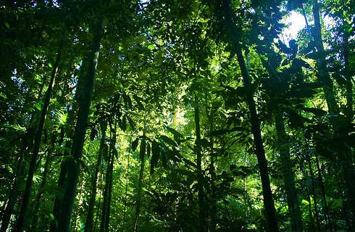
Ecosystem resistance
High resistance ecosystem: disturbance influences populations and communities, but has no effect on the flow of energy or matter.
After a disturbance, the normal function of the ecosystem remains

Slide 8
Ecosystem Resilience
The rate at which an ecosystem returns to its natural state
High resilience: returns to natural state rapidly

Slide 9
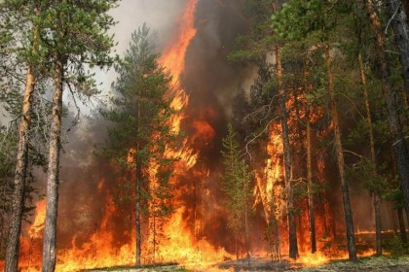
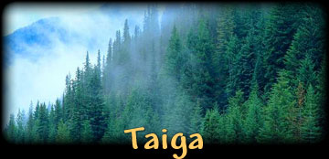
Case Study: Black Spruce Taiga
Low resistance, high resiliency
Burns easily but grows back

Slide 10
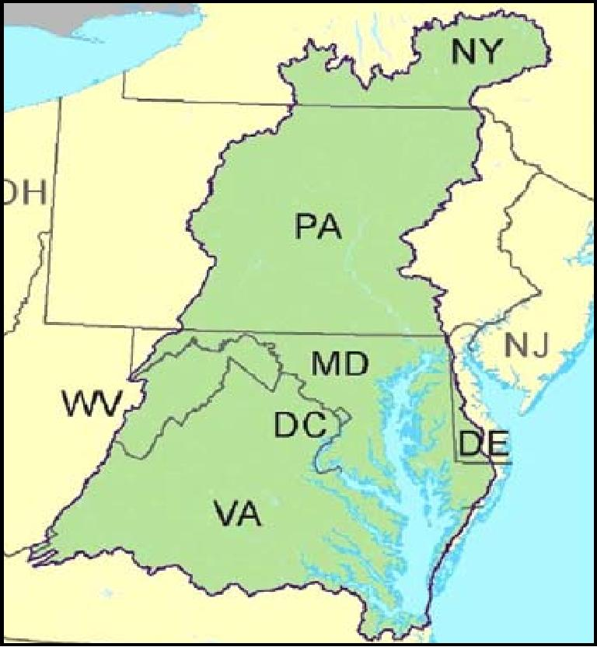
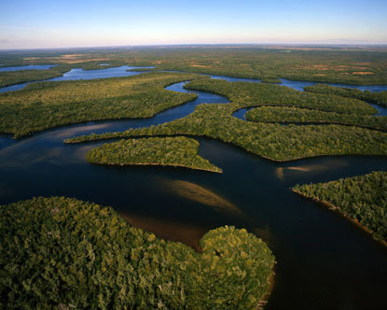
Restoration Ecology
Reversing anthropogenic disturbances to ecosystems
Major Restoration projects in the U.S.:
Florida Everglades
Chesapeake Bay

Slide 11
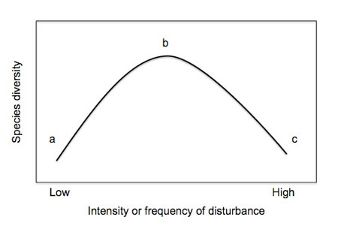
Intermediate Disturbance Hypothesis
Ecosystems experiencing intermediate (moderate) levels of disturbance are more diverse than those with high or low disturbance

Slide 12
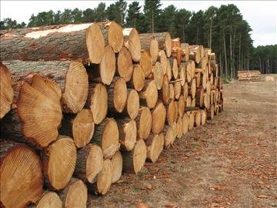
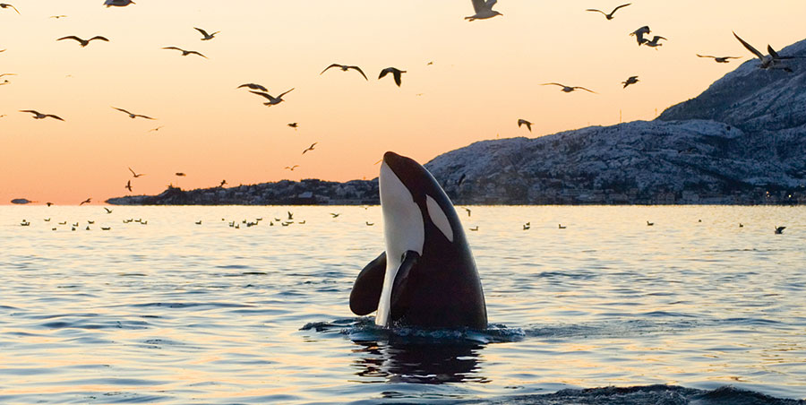
Ecosystem Services
Instrumental Value: How much economic benefit a species has
Intrinsic Value: Has worth that is independent of benefits provided to humans

Slide 13
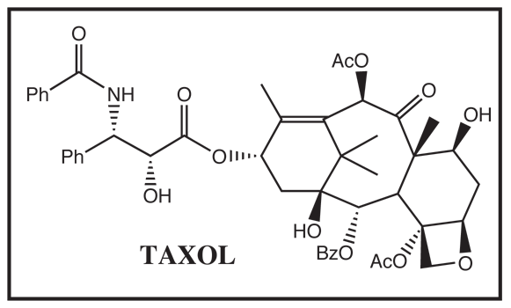
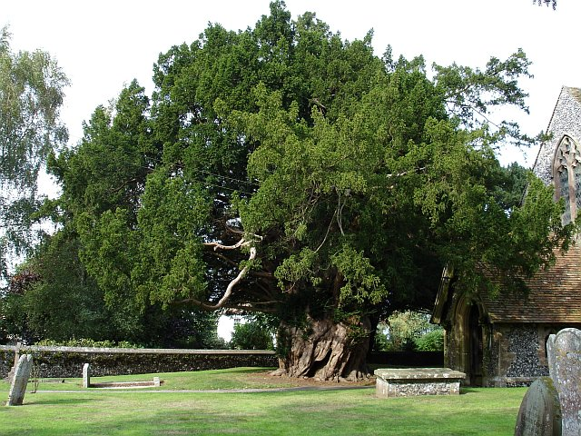
Instrumental Values
Provisions are goods that humans use directly

Slide 14
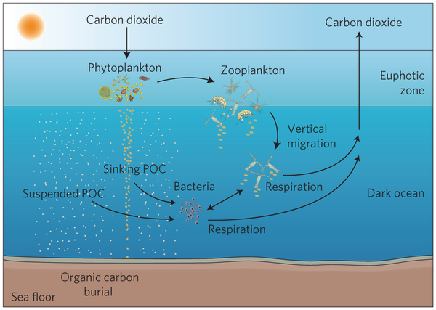
Instrumental Value
Regulating services: ecosystems regulate environmental conditions

Slide 15
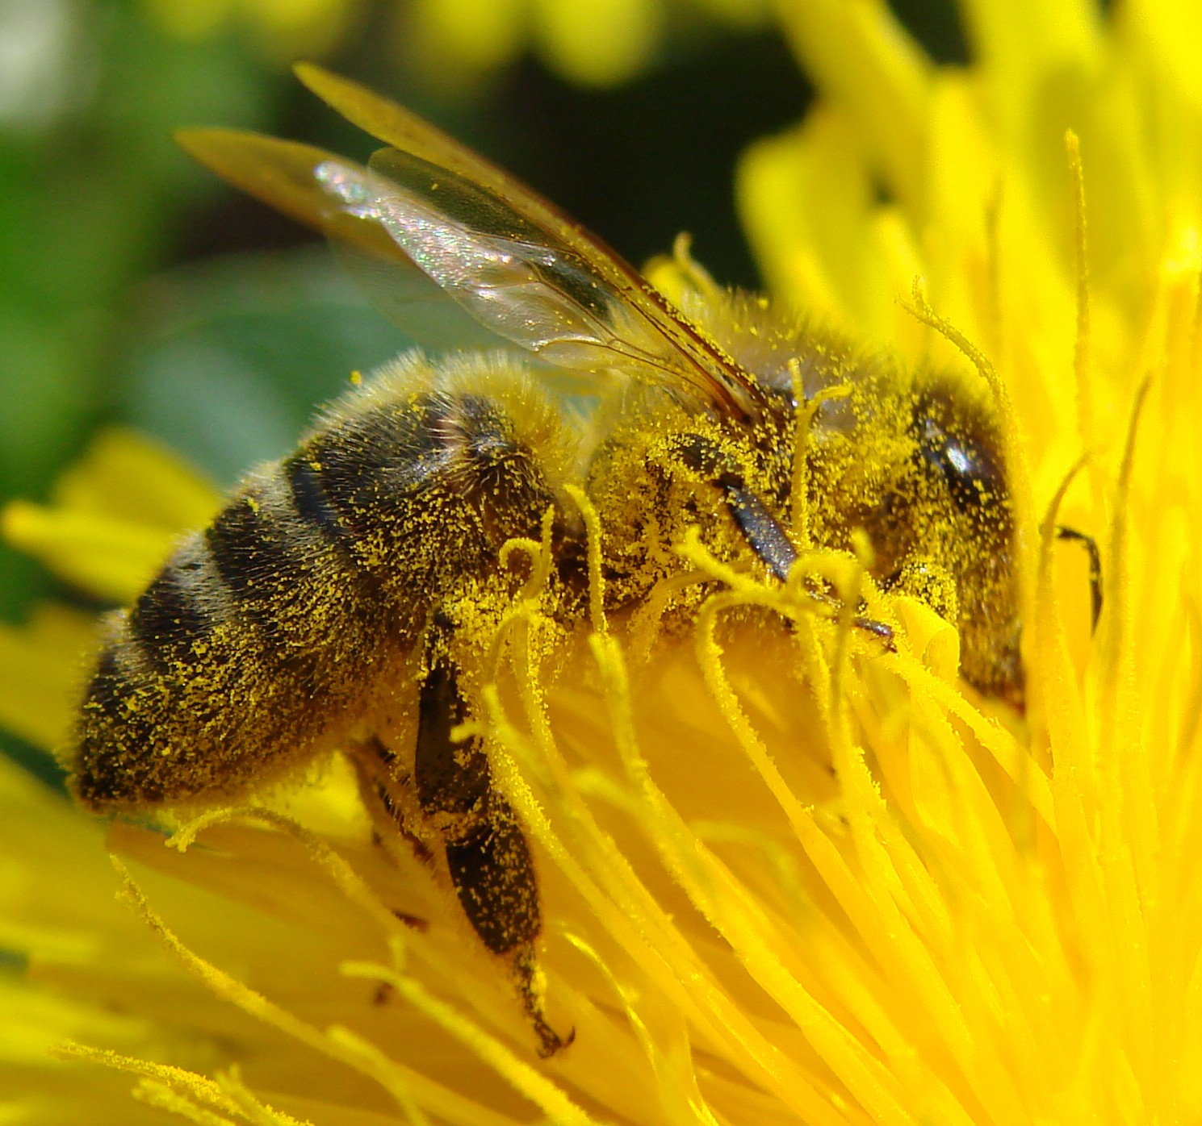
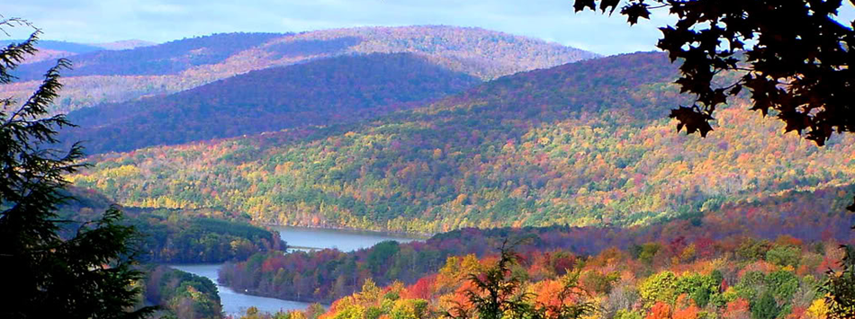
Instrumental Value
Supports systems: provide services that would otherwise be very expensive

Slide 16
Nitrogen cycle lab
Take ammonia, ammonium, nitrate level readings

Slide 17
Land/Aquatic Biome Presentations
Mahnoor: Tundra
Attia: Boreal Forest
Wendy: Temperate Rainforest
Cynthia: Temperate Seasonal Forest
Hamna: Woodland/Shrubland
Bukurie and Desire: Tropical Rainforest
Harmanpreet: Tropical Seasonal Forest/Savanna
Uzma: Subtropical Desert
Mehrangiz: Streams and Rivers
Rimsha: Lakes and Ponds
Monica and Ramlah: Freshwater wetlands
Saliha: Salt marhses
Kaylah: Mangrove Swamps
Rahila: Intertidal Zones
Wyllana and Shayna: Coral Reefs
Amrat: The open ocean

Slide 18
Presentation Day
Thursday (8th): Mahnoor, Attia, Cynthia, Rimsha, Bukurie and Desire, Harmanpreet
Friday (9th): Uzma, Mehrangiz, Hamna, Monica and Ramlah, Saliha, Kaylah, Rahila, Wyllana, Amrat

Slide 19
Homework
Read Ch. 4 through page 94 (read the intro floods, droughts and famine too)

