Slide 1
SWBAT describe how nutrients cycle through the biosphere .
APES Unit 2 10/1/15

Slide 2
Agenda
Lecture
Set up nitrogen cycle lab
Nitrogen cycle video
Pass back exams!!

Slide 3
6 Key Macronutrients
Nitrogen
Phosphorous
Potassium
Calcium
Magnesium
Sulfur

Slide 4
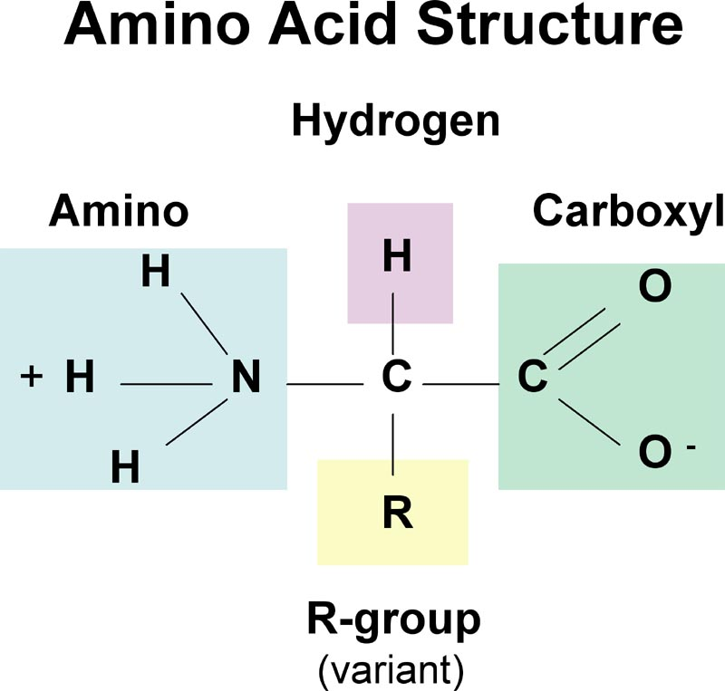
Why care about nitrogen?
Nitrogen can be a limiting nutrient for producers.
Nitrogen is a building block of amino acids

Slide 5
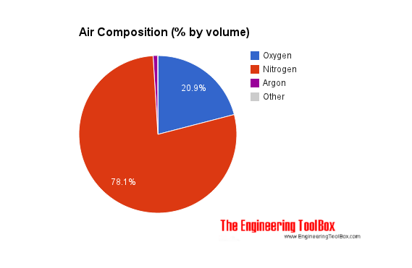
The Nitrogen Cycle
The primary abiotic source of nitrogen is the atmosphere

Slide 6
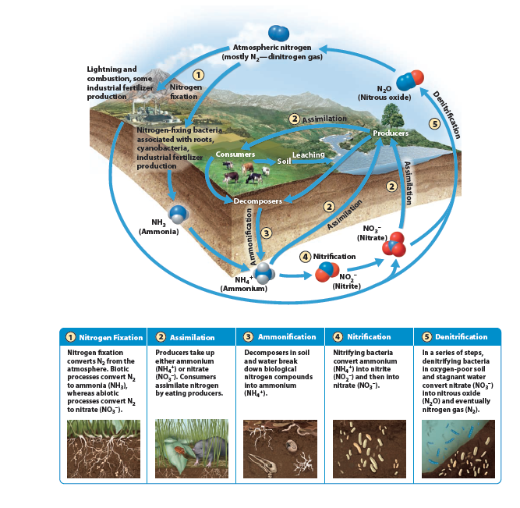

Slide 7
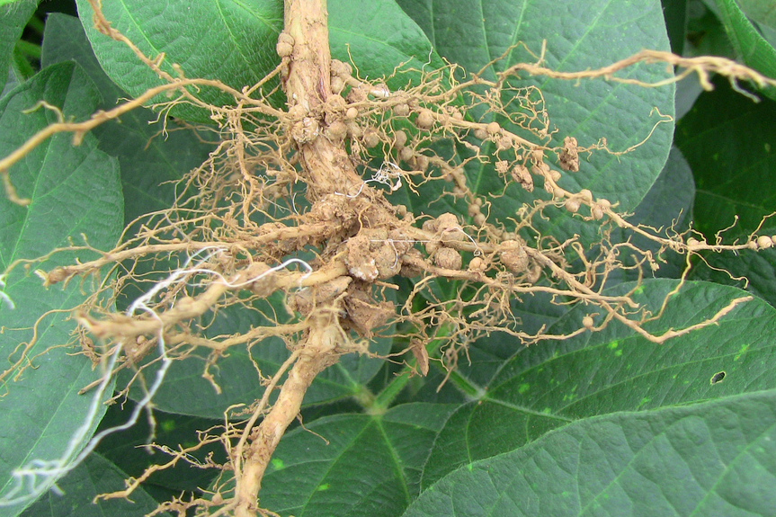
1. Biotic Nitrogen Fixation
Nitrogen gas (N₂) and H₂ is converted into ammonia (NH₃)
Nitrogen fixing organisms: Cyanobacteria and bacteria that live in the roots of legumes (beans, peas)
Bacteria Rhizobium participates in nitrogen fixation

Slide 8
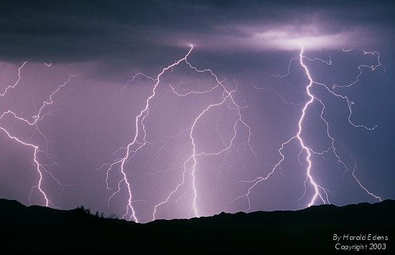
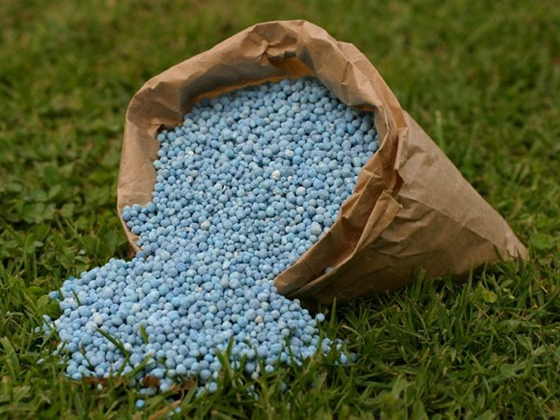
1. Abiotic Nitrogen Fixation
Lightning and combustion convert N₂ into NO₃⁻ (nitrate)
Humans can fix nitrogen through technology that convert N₂ into NO₃⁻ (nitrate) to be used as fertilizer

Slide 9
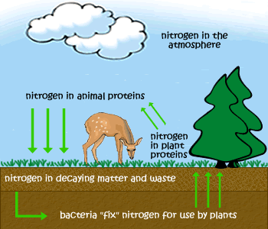
2. Assimilation
Producers obtain fixed nitrogen in the form of ammonium (NH₄⁺), ammonia (NH₃) or nitrate (NO₃⁻) and assimilate it (take it) into their tissues
Consumers assimilate nitrogen by eating producers

Slide 10
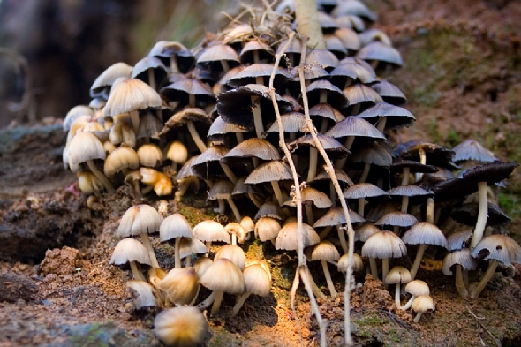
3. Ammonification
Producers and consumers die and decompose
Decomposers (fungi and bacteria) break down biological nitrogen into ammonium (NH₄⁺) or ammonia (NH₃) to be reused by plants.

Slide 11
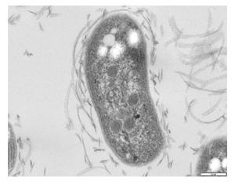
4. Nitrification
Nitrifying bacteria convert ammonium (NH₄⁺) into nitrite (NO₂⁻) and then into nitrate (NO₃⁻)
Nitrobacter (a type of bacteria) can convert nitrite (NO₂⁻) and then into nitrate (NO₃⁻)
Nitrate (NO₃⁻) can be used by producers

Slide 12
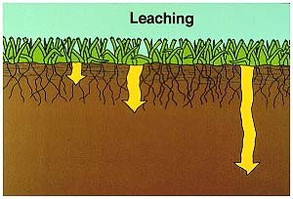
Leaching
Nitrate ions do not bond to soil particles (both are negatively charged).
Nitrate ions move through soil with water (leaching)
Leached nitrates settle in the bottom of oceans, lakes and swamps

Slide 13
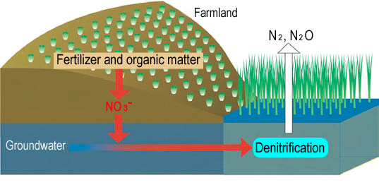
5. Denitrification
Denitrifying bacteria (mostly anaerobic) in oxygen poor soil and stagnant water convert nitrate (NO₃⁻) into nitrous oxide gas (N₂O) and nitrogen gas (N₂)
Nitrous oxide gas (N₂O) and nitrogen gas (N₂) rise to the atmosphere

Slide 14
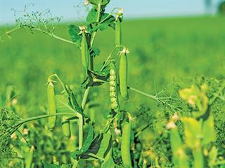
Human impacts on the nitrogen cycle
Inorganic fertilizers applied to soil
Overplanting of nitrogen-rich crops (legumes)
Discharge of municipal sewage waste
Burning of fossil fuels
Coal releases nitrogen oxides

Slide 15
Ms. McDaniel’s tips for mastering the nitrogen cycle
Make flash cards!
Nitrite (NO₂⁻) is light because it has one less oxygen than nitrate (NO₃⁻)
Ammonium (NH₄⁺) has one more letter and one more hydrogen than ammonia (NH₃)
Plants LOVE nitrate

Slide 16
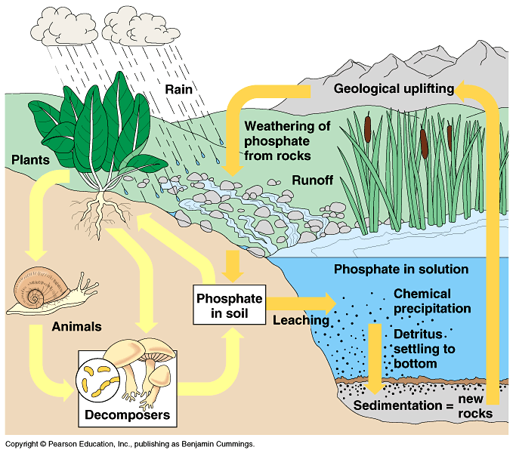
The Phosphorous Cycle
Phosphorous is a major part of DNA, RNA, and ATP
Commonly added to soil as fertilizer

Slide 17
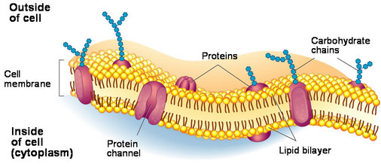
Where is phosphorous found?
Bones
Cell membranes
Shells
Rocks
NOT in the atmosphere (no gas form of phosphorous)

Slide 18
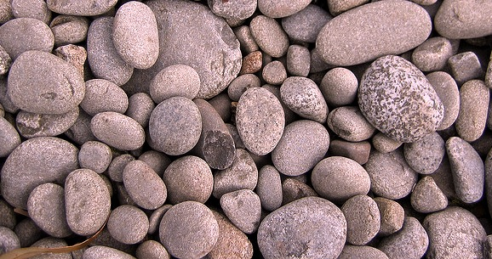
The Phosphorous Cycle
The phosphorous cycle is more local than other biogeochemical cycles
Phosphorous is found in soil, rock and sediments
Considered a sedimentary cycle
Slower than the carbon cycle and has fewer sinks

Slide 19
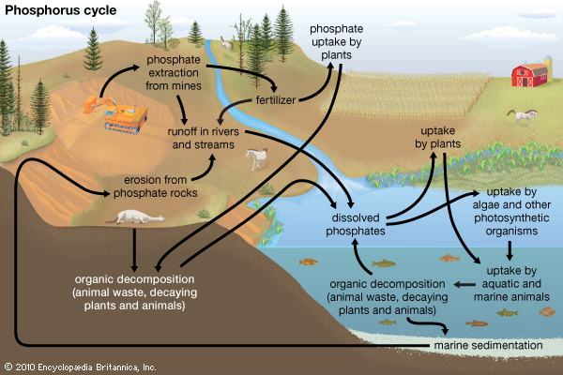
The Phosphorous Cycle

Slide 20
The Phosphorous Cycle
Phosphorous is released from rocks through chemical weathering
Phosphate (PO₄³⁻) is soluble and can be absorbed from the soil by plants
Consumers eat plants
Phosphates (PO₄³⁻) can enter the water table and travel to oceans and be incorporated into rocks on the ocean floor.

Slide 21
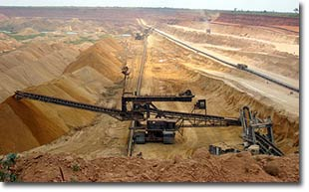
Phosphorous is being added to the environment by
Runoff from feedlots
Slashing and burning in tropical areas
Stream runoff
Mining to produce inorganic fertilizer

Slide 22
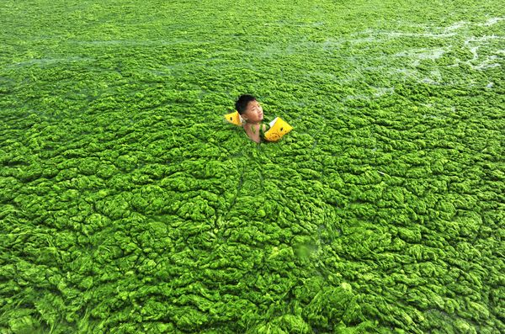
Algal Bloom
Excess phosphorous or nitrogen enters water → rapid growth of algae
Algae eventually die→ increase in decomposition
Uses up oxygen (hypoxic conditions) → death of fish and shellfish

Slide 23
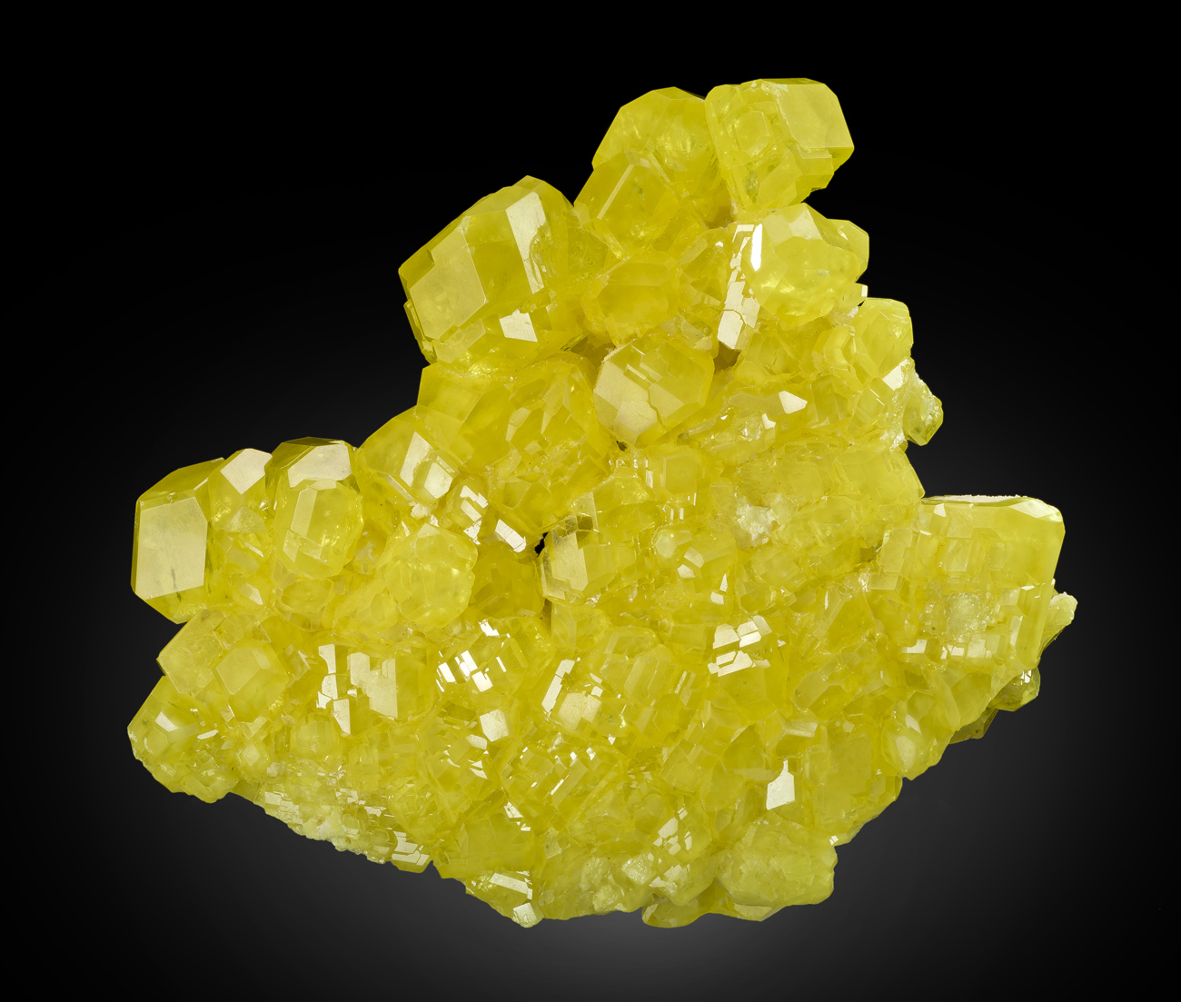
Where is sulfur found?
Sulfur is found in proteins and vitamins
Animals and plants need sulfur!

Slide 24
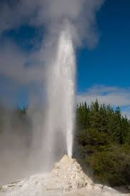
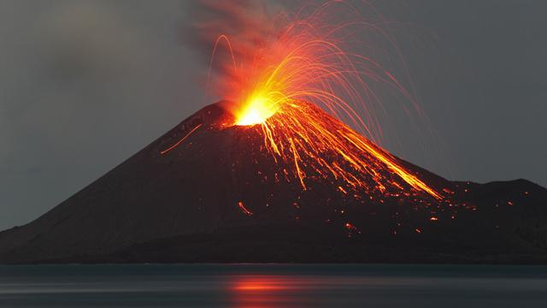
The Sulfur Cycle
Hydrogen sulfide (H₂S) gas enters the sulfur cycle through volcanoes and geysers
The greatest source of sulfur in the environment is volcanic eruptions
Spends most of the biogeochemical cycle in the gaseous phase
Sulfur can be found in ocean sediments

Slide 25
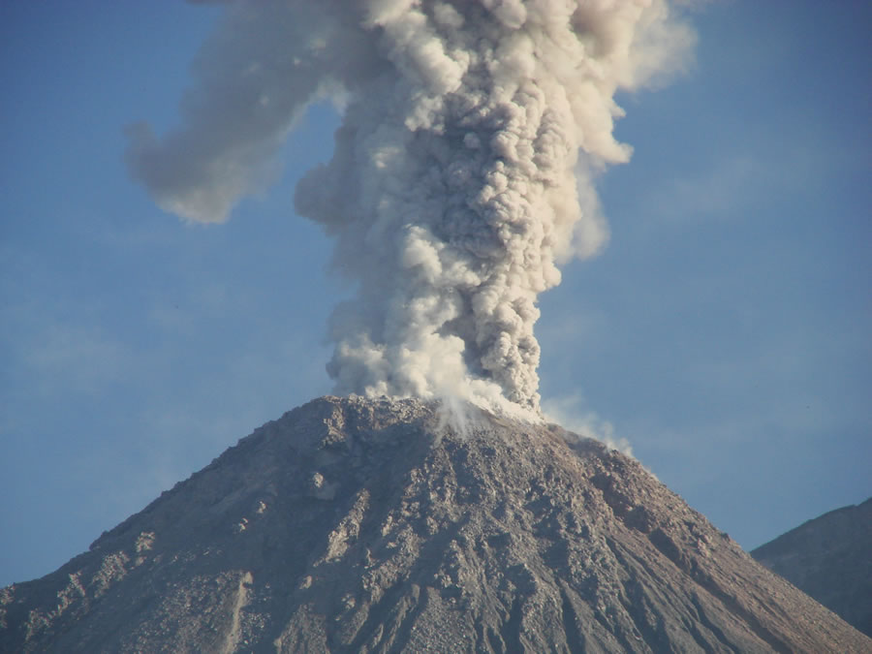
The Sulfur Cycle
Sulfur enters the atmosphere through volcanic eruptions, bacterial functions, and decay of once living organisms
Plants can assimilate sulfate (SO₄²⁻) through water
Animals obtain sulfur by eating plants

Slide 26
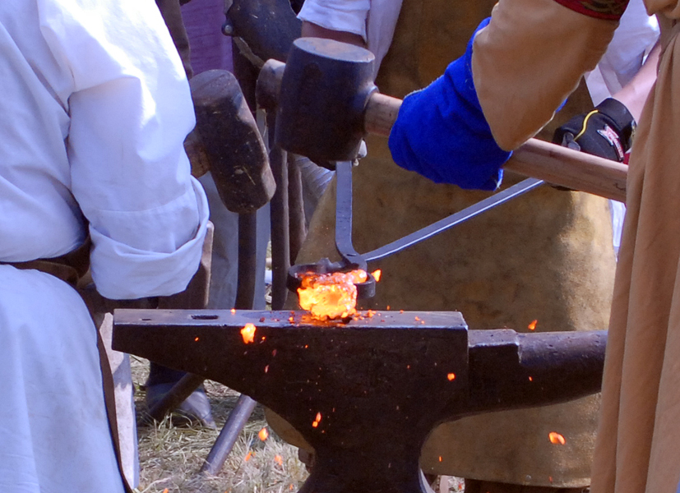
Humans and the Sulfur Cycle
Humans have altered the sulfur cycle by burning coal and oil and smelting ore
Produces SO₂ and H₂S

Slide 27
Calcium, Magnesium and Potassium
Used to regulate cell processes and transmit signals between cells
Derived from rocks decomposed and vegetation
Can dissolve in water

Slide 28
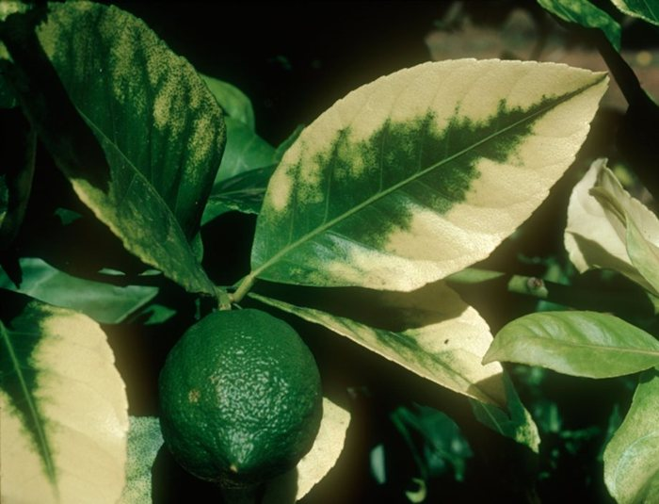
Calcium depletion affects plants and soil
Decreased pH buffering ability of the soil
Depletion of soil nutrients
Decline in decomposer populations
Decreased ability for trees to withstand cold weather

Slide 29
Nitrogen Lab Set Up
Ramlah, Attia, Wendy: plants
Hamna, Bukurie, Kaylah: bacteria
Rimsha, Desire, Saliha: fish
Shayna, Uzma, Amrat: plants
Mahnoor, Cynthia, Rahila: bacteria
Wyllana and Harmanpreet: fish
Monica and Mehrangiz: plants

Slide 30
Data Table
Day 1 | Ammonia | Nitrate | Nitrite
Day 2
Day 3
Day 4
Day 5

Slide 31
Testing Ammonia/Nitrate/Nitrite
Read directions carefully
Thick strips are ammonia
Thin strips are nitrite/nitrate:
Nitrate on top
Nitrite on bottom

Slide 32
Tips for a successful lab
Use the 2nd nob on the faucet for water
Designate roles: Only one person gets water!

Slide 33
Homework
Study chemical cycles (especially nitrogen!!)
Finish Reading Ch. 3

