Slide 1
SWBAT apply knowledge of GPP and NPP to determine the health of a pond.
APES Unit 2 9/29/15

Slide 2
Announcements
Lab Cleanup: Ramlah and Attia
Scientific Notation Quiz on Thursday!!
Any volunteers to come set up fish tomorrow morning???

Slide 3
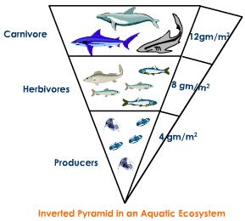
Do Now

Slide 4
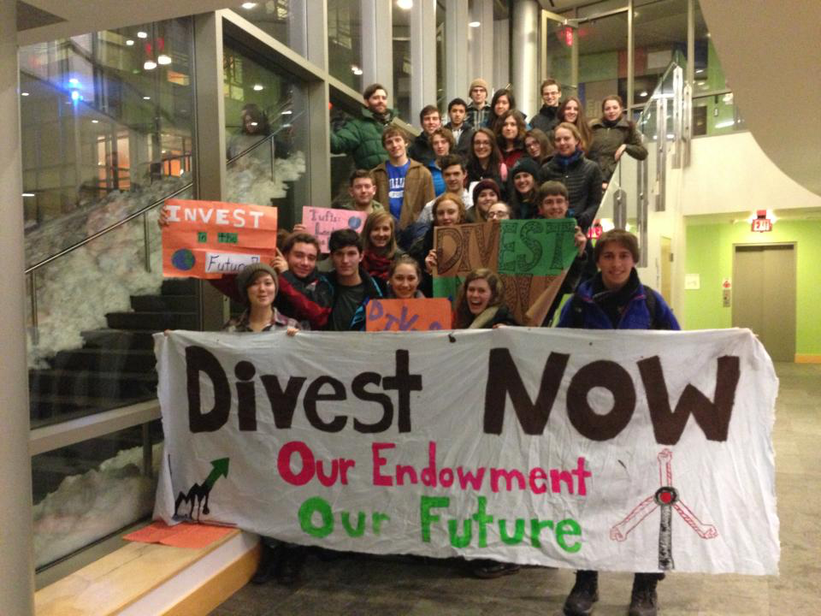
NYT Article
What does it mean to divest fossil fuels?
Does this article give you hope about climate change? Why or why not?

Slide 5
Agenda
Depth profile of a pond
Calculations of GPP and NPP

Slide 6
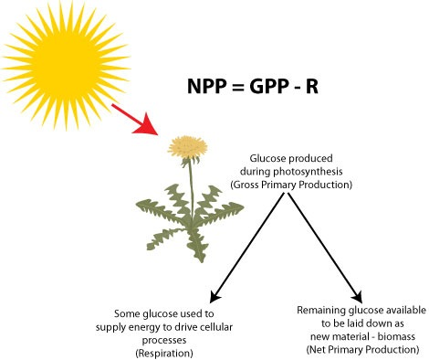
NPP and GPPP

Slide 7
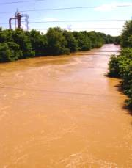
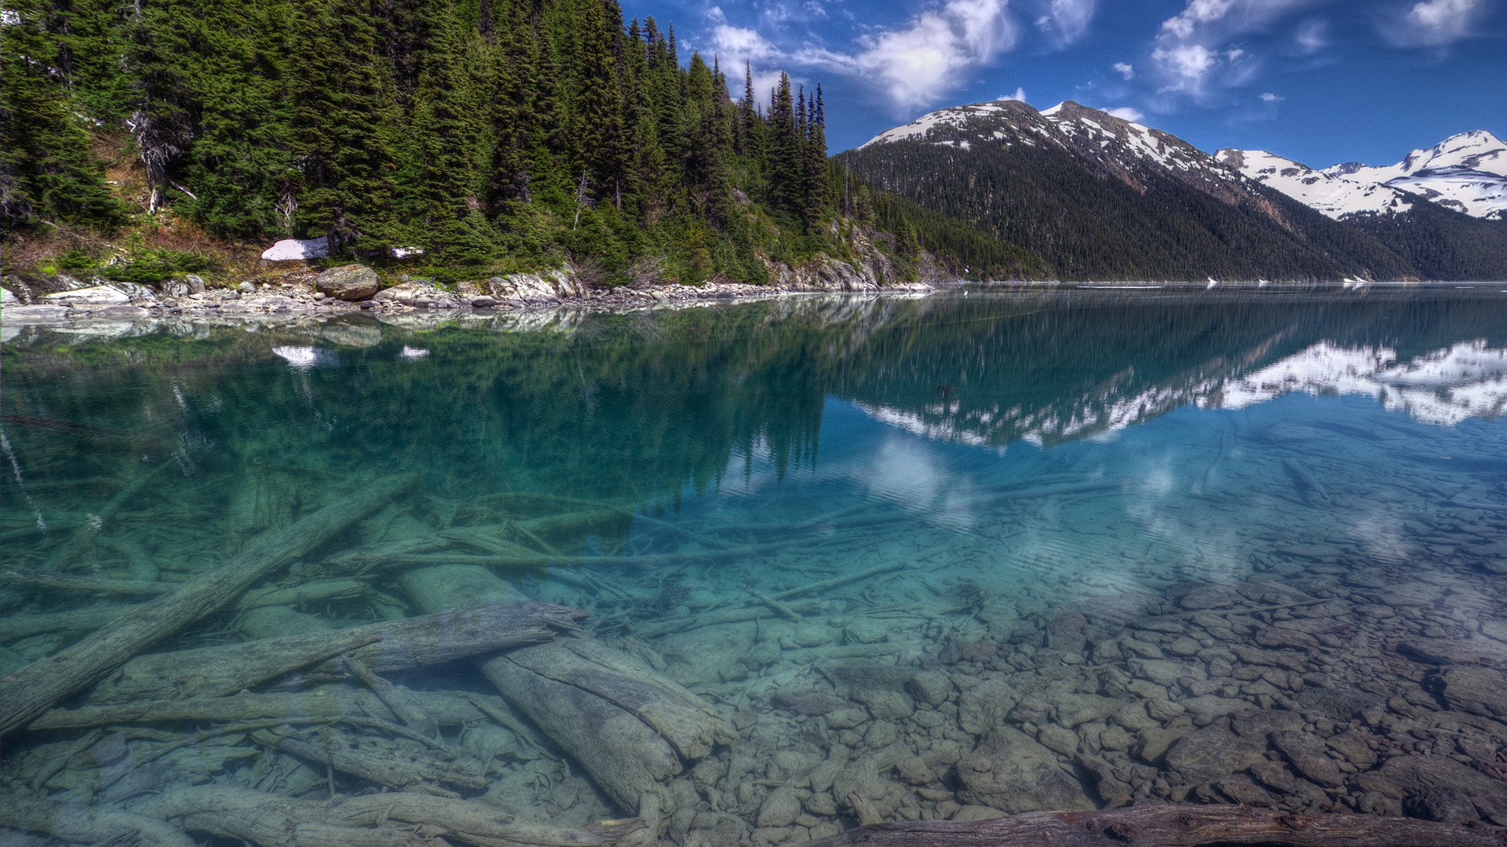
Turbidity
Turbidity is the amount of suspended particles in the water.

Slide 8
Groups!
Group 1: Ramlah, Cynthia, Hamna, Harmanpreet
Group 2: Uzma, Rimsha, Shayna, Saliha, Mahnoor
Group 3: Rahila, Wyllana, Amrat, Monica
Group 4: Attia, Wendy, Bukurie
Group 5: Mehrangiz, Desire, Kaylah

Slide 9
Part 1 Directions:
Complete Unit conversions to the nearest whole number
STOP before graphing!

Slide 10
Check your answers!
Lake | GPP (ml O₂/liter/hr) | GPP (mg C/ m³/day)
Tiger Paw | .15 | 1930
Tiger Paw | .15 | 1930
Tiger Paw | .13 | 1672
Tiger Paw | .10 | 1286
Tiger Paw | .06 | 771
Bulldog | .16 | 2058
Bulldog | .15 | 1930
Bulldog | .14 | 1800
Bulldog | .10 | 1286
Bulldog | .07 | 900
Respiration Loss (both lakes) | .09 | 1158

Slide 11
Compensation Point:
How far light is penetrating into the pond.
Gross Primary Productivity (GPP)= respiration loss
Amount of CO₂ released in respiration = amount of CO₂ used in photosynthesis
Amount of O₂ released in photosynthesis = amount of O₂ used in respiration.

Slide 12
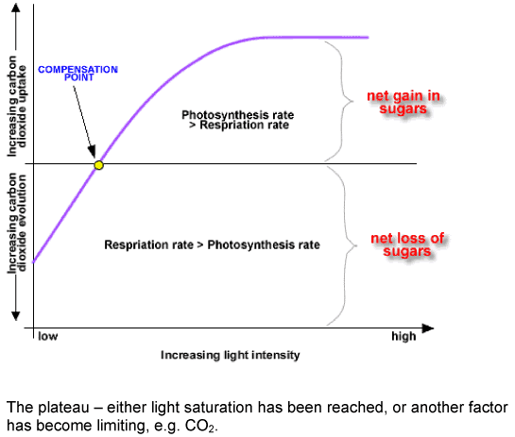

Slide 13
Part 2 Directions:
Calculate the respiration loss
Graph GPP and and depth
Stop before the questions!

Slide 14
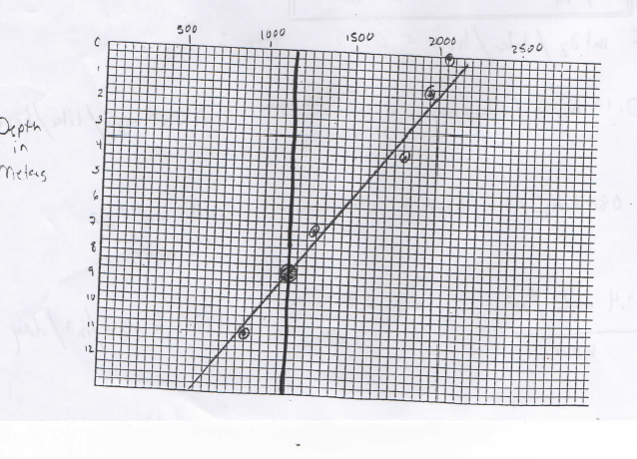
Bull Dog Pond

Slide 15
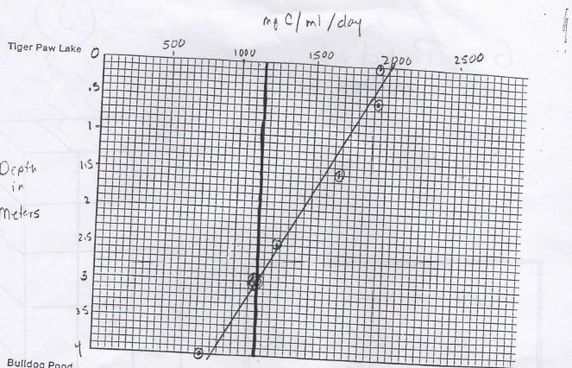
Tiger Paw Lake

Slide 16
Part 3
Answer the questions!

Slide 17
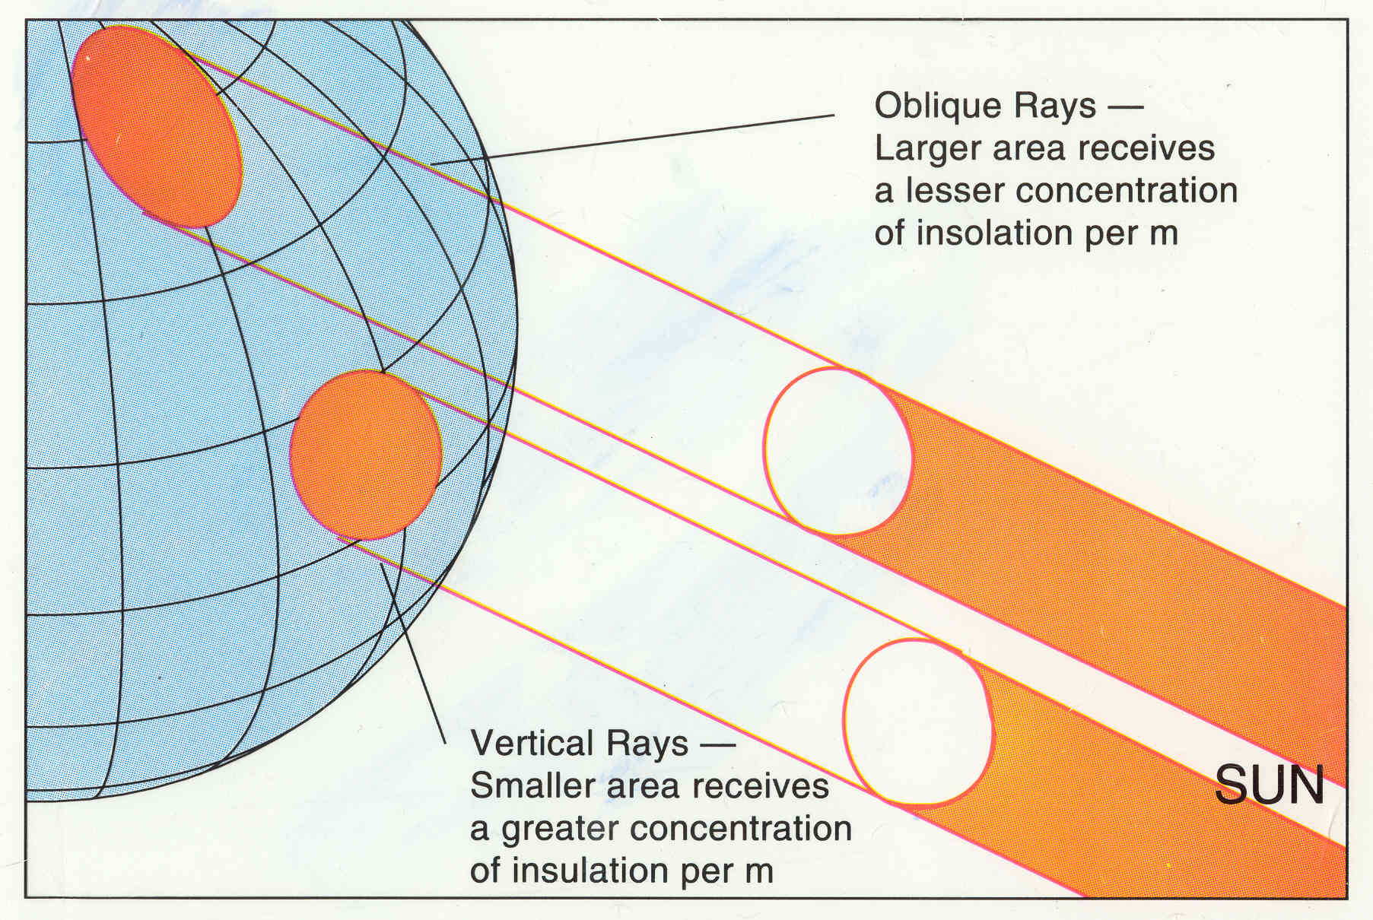
NPP Calculations Vocab
Insolation: Total amount of solar radiation energy received on a given surface’s area during a certain amount of time.

Slide 18
Efficiency

Slide 19
Homework
Read pages 66-69 (stop before the nitrogen cycle)

