Slide 1
SWBAT identify ways to measure sustainability.
APES Unit 6 1/5/16

Slide 2
Agenda
Lecture
Analyzing ecological data (group work!)

Slide 3
Globalization
Interaction and integration among people, governments and companies of different nations.
Positive affects:
New economic opportunities
Expanded access to information
Interactions of many societies
Negative affects:
More pollution and hazardous waste
Rapid spread of emerging diseases
Loss of marine fish stocks

Slide 4
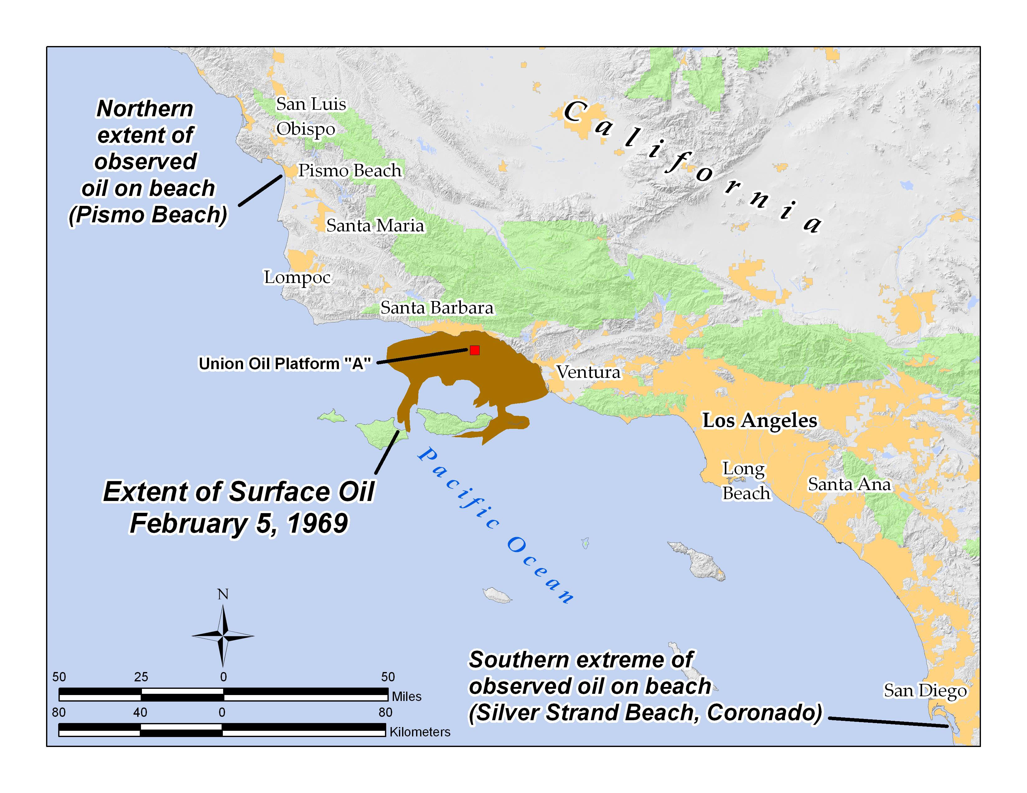
Environmental History
Santa Barbara oil spill in 1969
Public outcry→ First Earth Day in 1970

Slide 5
United States Agencies
Environmental Protection Agency (EPA): Established by Nixon in 1970
Oversees efforts related to the environment:
Science
Research
Assessment
Education
Tools of the EPA
Imposing administrative fines
Requesting that firms provide data
Requesting that firms comply with requirements
Inspecting firms

Slide 6
United States Agencies
Occupational Safety and Health Administration (OSHA)
In charge of the enforcement of of health and safety regulations
Mission: prevent injuries, illnesses and deaths in the workplace
Environmental protection: limit exposure to chemicals and pollutants in the workplace

Slide 7
United States Agencies
Department of Energy (1977)
Goal: advance economic and energy security of the U.S.
Scientific discovery, innovation, and environmental responsibility

Slide 8
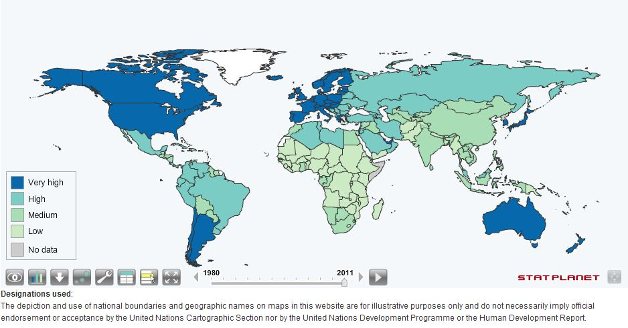
Human Development Index (HDI)
Human Development Index (HDI)
Combines life expectancy, knowledge, and education
Ranks countries as developed, developing or underdeveloped

Slide 9
Human Poverty Index (HPI)
Used to investigate the proportion of a population suffering from deprivation in a country with a high HDI.
Measures:
Longevity: percent of population not expected to live past 40
Knowledge: Adult illiteracy rate
Standard of living: proportion of population without access to clean water

Slide 10
U.S. policies for sustainability
Deterrents and Incentives:
Command and control approach: sets regulations for emissions and controls them with fines or other punishments
Incentive-based approach: constructs financial and other incentives for lowering emissions based on profits and benefits

Slide 11
Stop and Think
Is the uniform policy at UASCJ a incentive-based or deterrent-based policy?

Slide 12
U.S. policies for environmental sustainability
Green tax: Pollution taxes placed on environmentally harmful activities or emissions
Carbon taxes on the use of fossil fuels
Taxes on the extraction of mineral, energy, and forestry products
License fees for fishing and hunting
Taxes on technologies and products that are associated with substantial negative externalities
Garbage disposal taxes
Taxes on effluent, emissions and other hazardous waste

Slide 13
U.S. Policies for Sustainability
Main goals of green taxes:
Generation of revenue to correct past pollution damage and reduce future pollution
Change behavior
Use funds from pollution taxes for restoration
Market permits (cap and trade):
Companies can buy permits that allow them to discharge a certain amount of substances into certain environmental outputs
Incentive for companies to reduce discharge and sell it to another company
Usually proposed for control of CO₂ emissions

Slide 14
Stop and Think
Do you believe an incentive or deterrent based policy would be more effective for protecting the environment? Why?

Slide 15
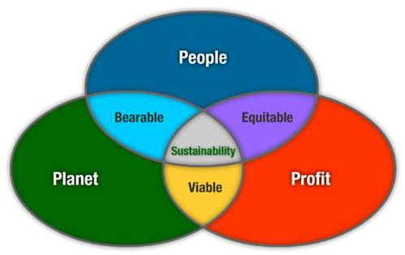
U.S. Policies for Sustainability
The Triple Bottom Line
States that we need to take into account economic, environmental and social factors
“Leave the world better than you found it”

Slide 16
Poverty and Inequity
One-sixth of the population lives in unsanitary conditions and earns les than $1 a day
In many countries, more modernized economy → disparities between rich and poor have increased
Millennium Development Goals
Eradicate extreme poverty and hunger
Achieve universal primary education
Promote gender equality and empower women
Reduce child mortality
Improve maternal health
Combat HIV/AIDS
Ensure environmental sustainability
Develop a global partnership for development

Slide 17
Economics and the Environment
Using economics to make choices for the environment is morally neutral
Example: Toxic chemical X in stream
Economics perspective: how much does it cost to clean it up?
Moral perspective: Are people harmed by chemical X?

Slide 18
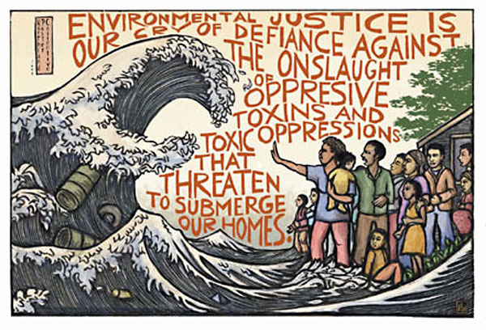
Environmental Justice
Inequitable distribution of pollution and environmental degradation
Minority and poor populations are exposed to more pollutants
“Dumping in Dixie”: Minority and lower socioeconomic groups were usually the recipients of pollution
Minority populations were present first

Slide 19
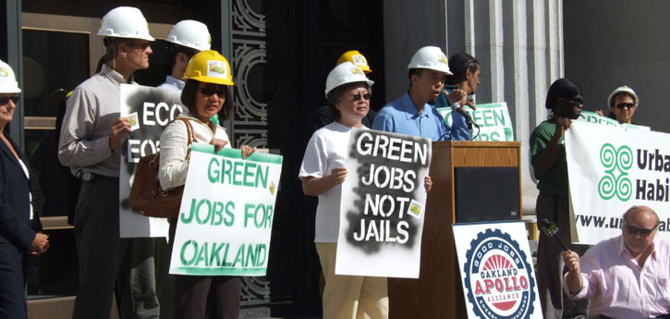
Individual and Community Action
“If the people lead, the leaders will follow”
Van Jones and Green for All
Create green jobs and improve living conditions

Slide 20
Discussion
What are the major world agencies that are concerned with the environment? Describe their functions.
What is the human development index? How is it used?
How are deterrents and incentive used in environmental policy? Give an example of each.

Slide 21
Group work!
Group 1: Ramlah, Attia, Wendy
Group 2: Cynthia, Hamna, Mahnoor,
Group 3: Bukurie, Harmanpreet, Uzma
Group 4: Mehrangiz, Shayna, Rimsha
Group 5: Saliha, Desire, Rahila
Group 6: Amrat, Wyllana, Monica, Kaylah
Ask 2 before me!!

Slide 22
Ecological Data
In graph 2 skip part C
For Chart 5 Part D, assume the total population of mice is 1,000
For question 2 on the second page it should be per 1,000

Slide 23
Homework
Research an example of environmental justice and summarize it in your current events journal
Thursday is the last day to turn in any work for this unit!!

