Slide 1
Aim: How does economic health affect natural capital?
APES Unit 6 1/4/16

Slide 2
Agenda
Mini-Lecture
Pass back lab reports
Reminder:
Current event presentations on Wed.
Unit Exam on Thursday (Ch. 7 and Ch. 20)

Slide 3
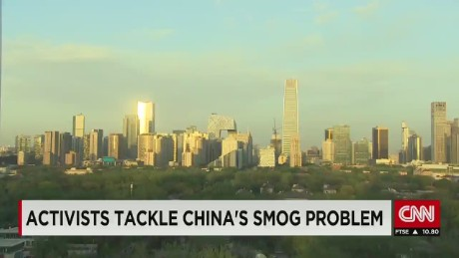
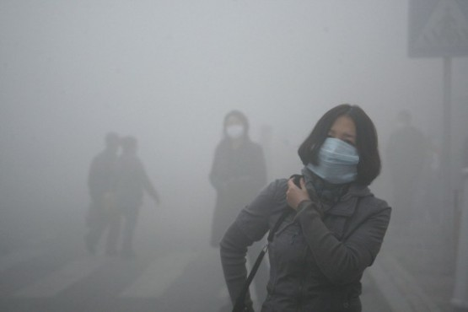
Marginal Costs
The additional cost of producing one additional unit of goods
Environmental example: pollution

Slide 4
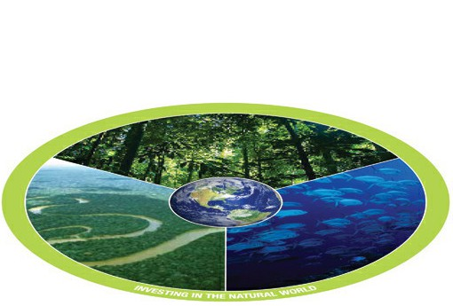
Capital
Natural capital: air, water and minerals
Human capital: human knowledge and abilities
Manufactured capital: goods and services that humans produce
Natural capital is essential for economic systems

Slide 5
Economics and the Environment
Market failure: When the economic system does not appropriately account for all costs
Environmental economics: cost/benefit analysis of policies that regulate environmental degradation
Ecological economics:
Economy is a component of natural and human systems
goal is to preserve natural capital

Slide 6
Economics and the Environment
Valuation: assign monetary value to intangible benefits and natural capital
Global ecosystem services: $30 trillion per year
Internalize externalities: Make people pay for the negative effect that a product has on the environment
Ex: a tax on cars for the cost of air pollution

Slide 7
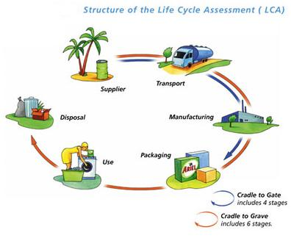
Sustainable Economic Systems
Current system: Cradle to grave
Responsibility to dispose of product lies with the consumer→ no incentive for manufacturer to make it easy to reuse or recycle

Slide 8
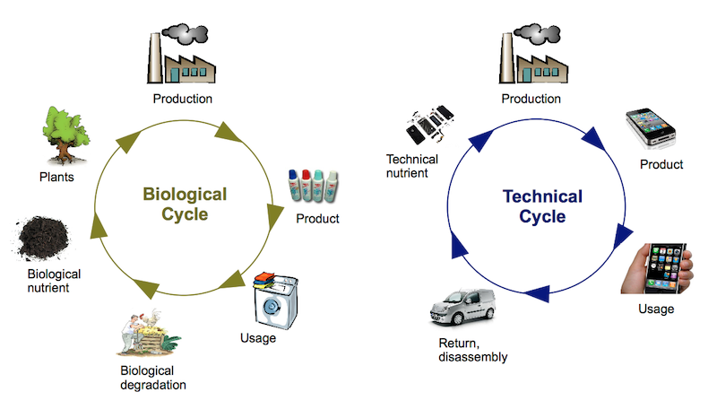
Sustainable Economic Systems
Sustainable system: cradle to cradle
As a product reaches the end of its life it can be reused to make a new product

Slide 9
Environmental Worldviews
How you think the world works
How you view your role in it
What you believe to be the proper environmental behavior
Anthropocentric (human-centered): Nature has value to provide for our needs
Stewardship: careful management and care of the earth and its resources
It is our responsibility to protect the natural world

Slide 10
Environmental Worldviews
Biocentric (life-centered): humans are one of many species on Earth, all of which have equal value
Ecosystems with humans have instrumental value
Ecocentric (Earth-centered): places equal value on all living organisms and the ecosystems in which they live in
Value nature free of any associations with humans

Slide 11
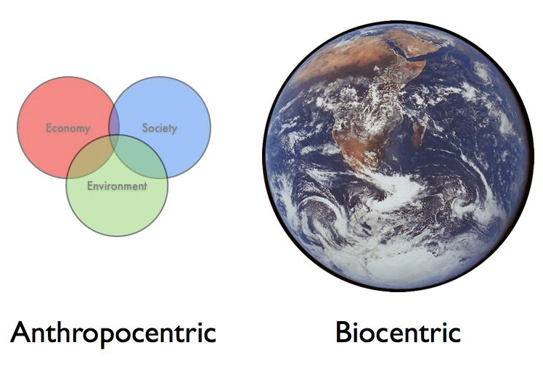
Turn and talk
Which environmental worldview do you think most aligns to your worldview? Why?

Slide 12
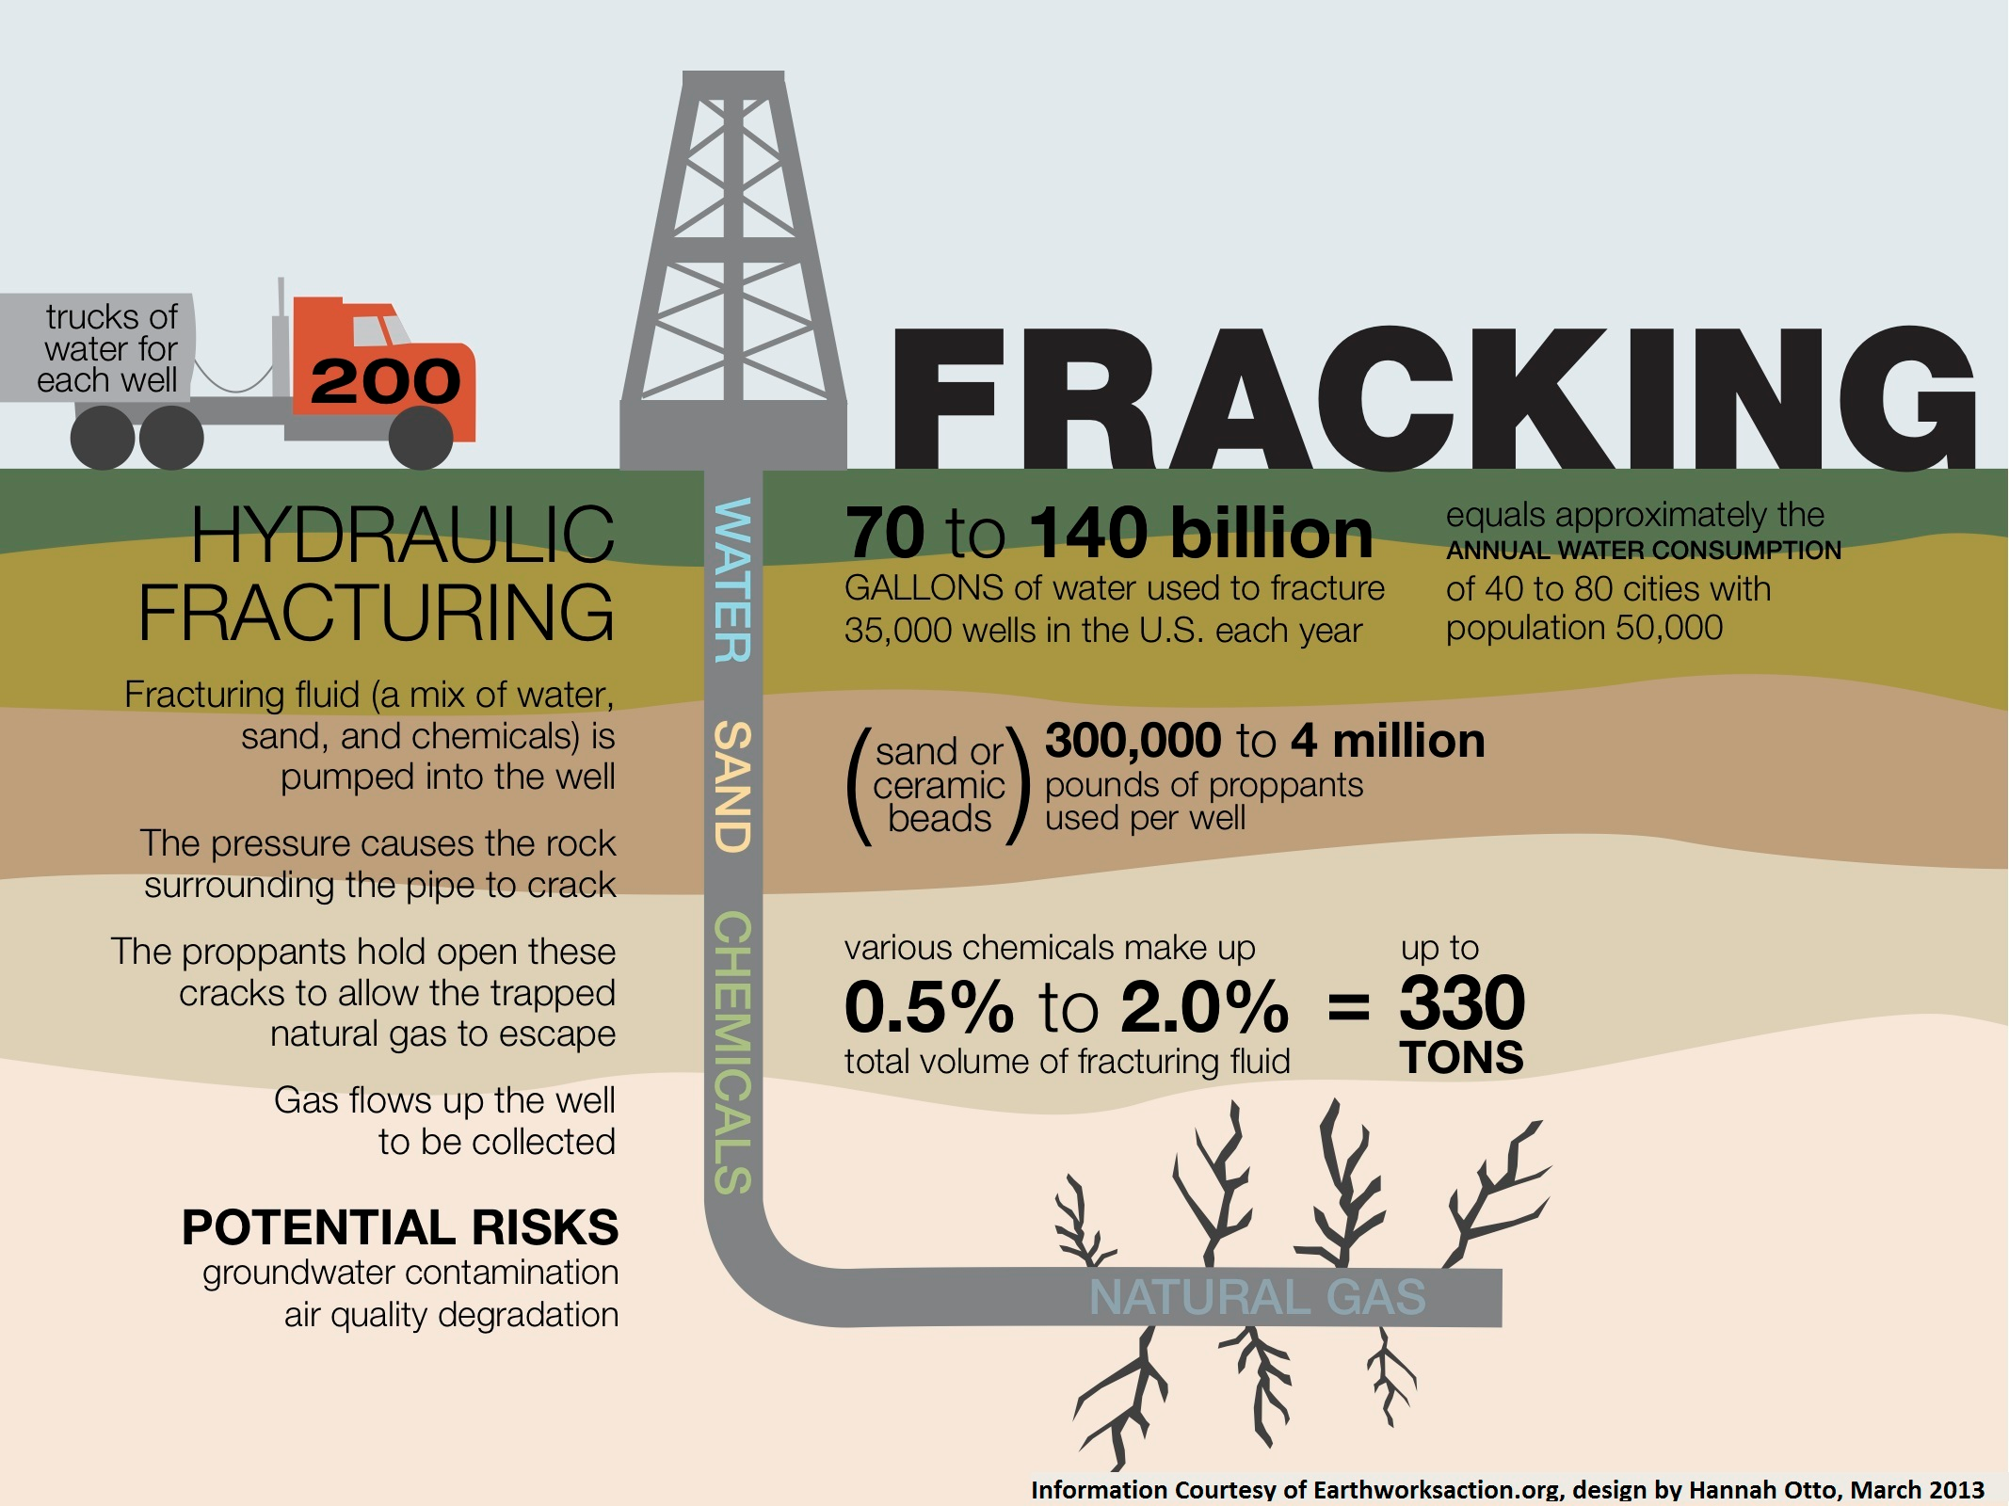
Precautionary Principle
When the results of an action are uncertain, it is better to choose an alternative known to be harmless
Critics state that economic progress will be hindered
Example: Montreal Protocol (1987) to eliminate the use of CFCs

Slide 13
World Agencies
United Nations (UN): Founded after WWII, promotes dialogue among countries
The United Nations Environment Program (UNEP)
Gather environmental information
Conduct research
Assess environmental problems
Important treaties: CITES and Montreal Protocol

Slide 14
World Agencies
World Bank and International Monetary Fund (IMF): Aims to provide technical and financial assistance to developing countries
Educate government officials
Create infrastructure
Develop financial systems
Combat corruption
Criticism: Little consideration of environmental impacts

Slide 15
World Agencies
World Health Organization (WHO): Improves human health by monitoring and assessing health trends
Promotes development
Fosters health security to defend against outbreaks of emerging diseases
Strengthens healthcare systems
Coordinates and synthesizes health research
Enhances partnerships with other organizations

Slide 16
World Agencies
United Nations Development Program (UNDP): Help people obtain a better life through development
Addresses:
Poverty reduction
Crisis prevention
Environment and energy issues
Preventing spread of HIV/AIDS

Slide 17
Discussion
How might an environmental worldview influence environmental policy or regulations?
How does the precautionary principle relate to scientific uncertainty?
What are the major world agencies that are concerned with the environment?

Slide 18
Chemical Weathering Lab Report Feedback
Characteristics of strong lab reports:
Used calculations for results (difference between final and initial mass and percent change)
Performed outside research for discussion to explain results

Slide 19
Homework
Finish Reading Chapter 20
Read working towards sustainability: “Reuse a Sneaker”

