Slide 1
SWBAT explain the Environmental Problems of 1st and 3rd world countries.
APES Unit 6 12/23/15

Slide 2
Turn and Talk
Share out microlending research Hw

Slide 3
Agenda
Finish Economics Lecture
IPAT country analysis
Documentary

Slide 4
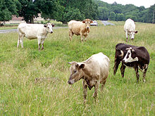
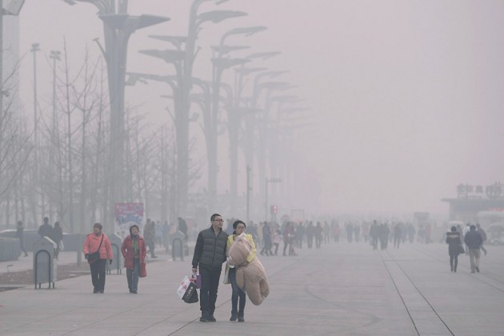
Externalities
The costs or impact of a good or impact of a good or service not included in the economic price of that good or service.
Tragedy of the commons

Slide 5
Genuine Progress Indicator (GPI)
Includes:
Personal consumption
Levels of higher education
Resource depletion
Pollution
Health of a population

Slide 6
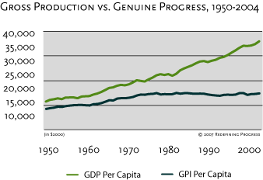
GPI

Slide 7
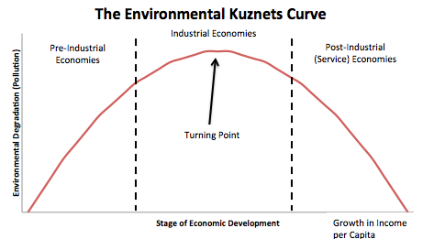
The Kuznets Curve
Per capita income increases→ environmental degradation increases and then decreases

Slide 8
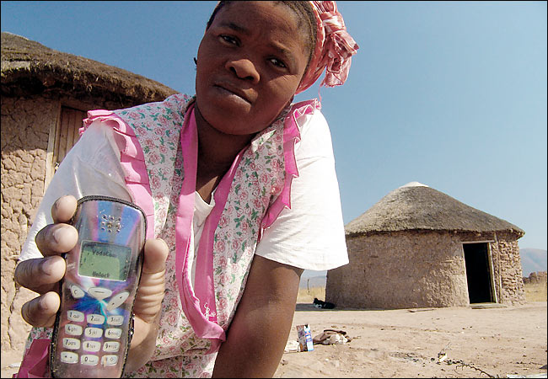
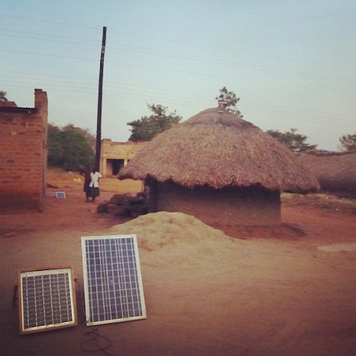
The Kuznets Curves
Technology transfer: when less developed countries adopt technological innovations developed in wealthy countries
Leapfrogging: new technology develops and makes old technology obsolete

Slide 9
Microlending (Microfinance)
Loaning small amounts of money to people who intend to start a small business in less developed countries.
http://www.kiva.org/

Slide 10
Break Homework
U.N. Report
Read Ch. 20 through page 561
Donorschoose Thank you Letter (watch for email!)

